Slide 1

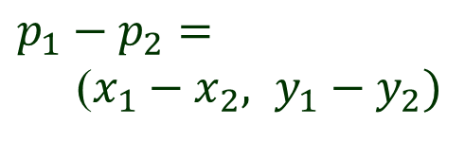
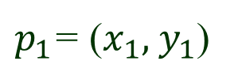
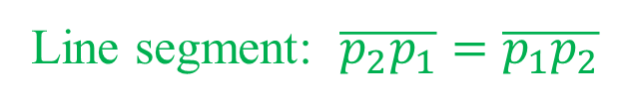
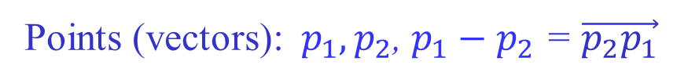

Line Segments & Vectors
y
$p_{1}$= ($x_{1}, { y}_{1}$)
$p_{1}−p_{2}$ $=$
($x_{1}−x_{2}, y_{1}−y_{2})$
$$p_{2}= (x_{2} , y_{2})$$
$$O = (0, 0)$$
x
Points (vectors):${ p}_{1}, p_{2}$, $p_{1}−p_{2}$ = $\vec{p_{2}p_{1}}$
Line segment: $\overline{p_{2}p_{1}}=\overline{p_{1}p_{2}}$

Slide 2
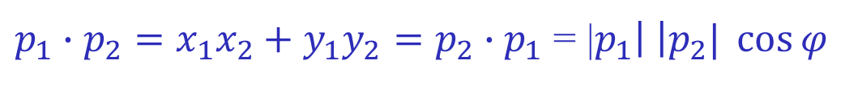






Dot (Inner) Product
$$y$$
$$p_{2}$$
$$φ$$
$$p_{1}$$
$(0, 0)$
$$x$$
$p_{1}∙p_{2}=x_{1}x_{2}+y_{1}y_{2}=p_{2}∙p_{1}$ = |$p_{1}\left| \right|p_{2}| \cos{φ}$

Slide 3
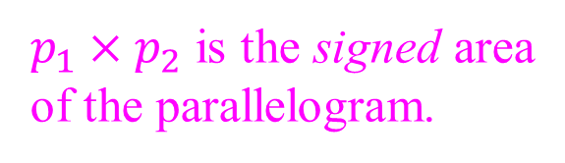




Cross (Vector) Product
$$y$$
$$p_{1}+p_{2}$$
$$p_{2}$$
$p_{1}×p_{2}$ is the signed area
of the parallelogram.
$$φ$$
$$p_{1}$$
$$(0, 0)$$
$$x$$
$p_{1}×p_{2}=x_{1}y_{2}−x_{2}y_{1}=−p_{2}×p_{1}=$|$p_{1}\left| \right|p_{2}| \sin{φ}$
$p_{1}$ and $p_{2}$ are collinear with the origin iff $p_{1}×p_{2}=$ $0$.

Slide 4












Turning of Consecutive Segments
Segments $\overline{p_{0}p_{1}}$ and $\overline{p_{1}p_{2}}$. Move from $p_{0}$ to $p_{1}$ then to $p_{2}$.
$$p_{2}$$
$$p_{2}$$
$$p_{1}$$
$$p_{2}$$
$$p_{1}$$
$$p_{1}$$
$$p_{0}$$
$$p_{0}$$
$$p_{0}$$
Counterclockwise Clockwise Turn of 0 or $π$
$$\vec{p_{0}p_{1}}×\vec{p_{1}p_{2}}>0$$
$\vec{p_{0}p_{1}}×\vec{p_{1}p_{2}}$ $< 0$
$$\vec{p_{0}p_{1}}×\vec{p_{1}p_{2}}= 0$$

Slide 5





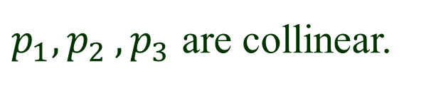




Case of Collinearity
$$\vec{p_{0}p_{1}}×\vec{p_{1}p_{2}}= 0$$
$p_{1}{, p}_{2}{, p}_{3}$ are collinear.
$$p_{2}$$
$$p_{1}$$
$$p_{1}$$
$$p_{2}$$
$$p_{0}$$
$$p_{0}$$
No change of direction Direction reversal
$$\vec{p_{0}p_{1}}∙\vec{p_{1}p_{2}}>0$$
$\vec{p_{0}p_{1}}∙\vec{p_{1}p_{2}}$ $< 0$

Slide 6
Intersection of Two Lines
Rewrite the above equations in terms of
dot products:
p
Hence is perpendicular to both and .
must be parallel to their cross product!

Slide 7
Homogeneous Coordinates
Represent every point as
homogeneous coordinates of
Intersection is parallel to the cross product vector:
homogeneous coordinates of intersection
Normalize the z-coordinate of the cross product to 1.
Hence the intersection point:

Slide 8
Intersection Example
Find the intersect point of the lines:
Take the cross product of the two coefficient vectors:
Intersection point:

Slide 9
Two Parallel Lines
point at infinity
Two parallel lines “intersect” at infinity.

Slide 10
Line through Two Points
Scaling yields the same line!
Ex. The line through (3, 1) and (-4, 5) has coefficients (i.e., homogeneous coordinates)
and equation

Slide 11
Advantages of Homogeneous Coordinates
Scaling independent:
all represent the same point
Uniform handling of all cases (horizontal, perpendicular,
parallel lines, etc.)
No need to solve equations – just take a cross product.
For more, see http://web.cs.iastate.edu/~cs577/handouts/homogeneous-coords.pdf

Slide 12

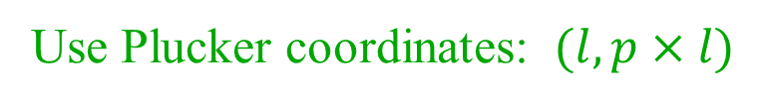


Lines in the Space
Use Plucker coordinates: $(l, p×l)$
$$l$$
$$p$$
Compute the distance between two lines.
Find their common perpendicular.
Find intersections with their common
perpendicular.
$$O$$
(When the lines intersect, the two
intersections coincide.)
For more, see http://web.cs.iastate.edu/~cs577/handouts/plucker-coordinates.pdf

