Slide 1

Network Security Analysis
UNSW_NB15 Dataset Findings: Understanding Cyber Threats in Modern Networks
Presented By: Christopher Mbuthia

Slide 2

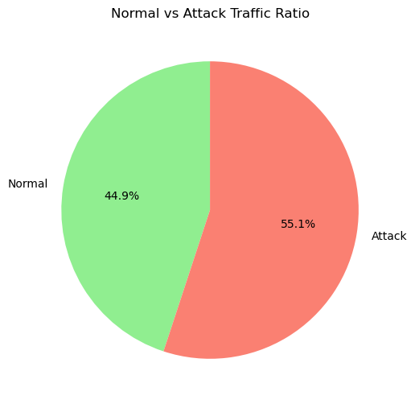
The Big Picture: Traffic Distribution
Key Finding
Normal Traffic
More than half of all network traffic analyzed was malicious, highlighting constant threats.
44.9%
Attack Traffic
55.1%

Slide 3
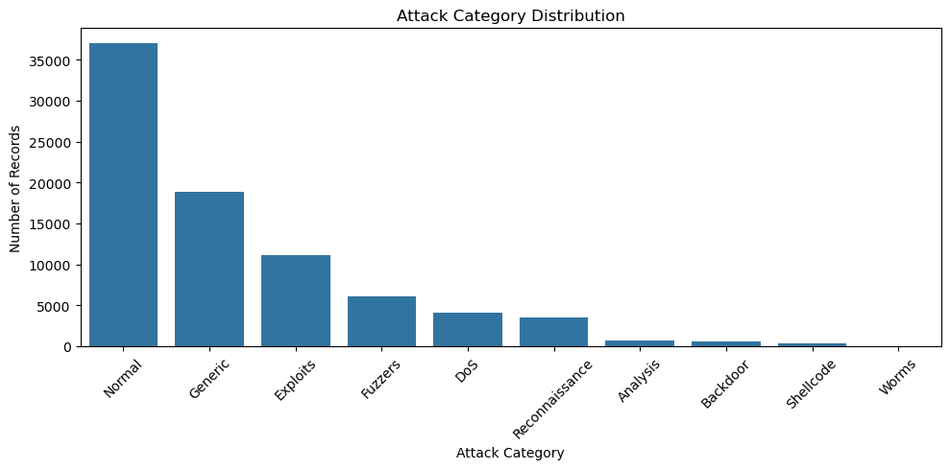
Attack Category Distribution
Breaking Down the Threat Landscape
Generic Attacks
Exploits
Fuzzers
~19,000 records: General-purpose attack techniques.
~11,000 records: Taking advantage of vulnerabilities.
~6,000 records: Automated testing for weaknesses.
DoS Attacks
Reconnaissance
~4,000 records: Overwhelming system resources.
~3,500 records: Information gathering activities.

Slide 4

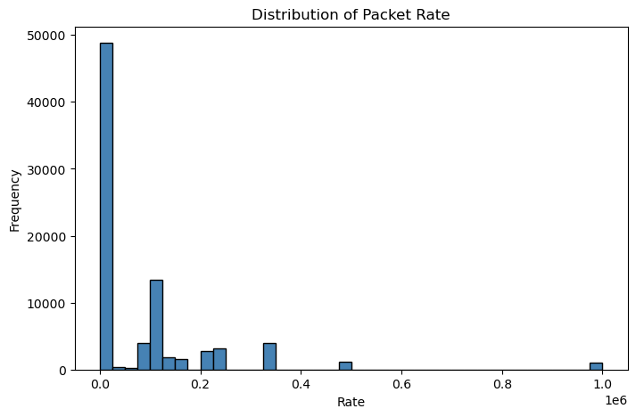
Network Traffic Patterns
Understanding Packet Rate Distribution
Key Observations:
Most network traffic operates at very low packet rates, clustering near zero.
49K
13K
Very Low Rates
Low Rates (0.1)
5K
1K
Medium Rates
High Rates (1M+)

Slide 5
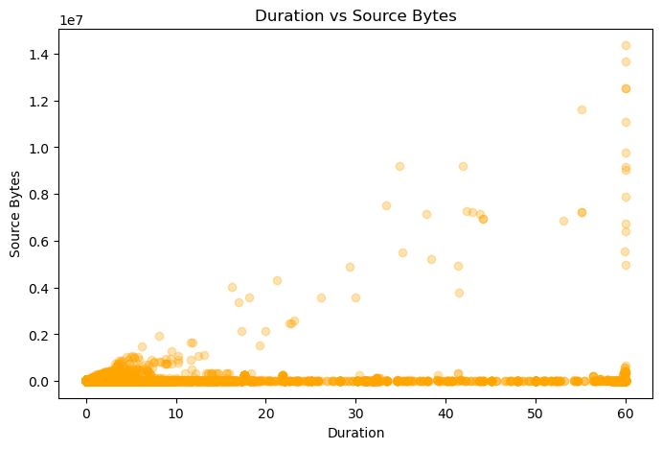
Connection Characteristics
Duration vs Data Volume Analysis
Short Connections
Long Connections (Suspicious)
Most connections are brief, with low data transfer.
Duration: 40-60+ seconds, high data volume.
Typical of normal browsing and reconnaissance attacks.
Potential data exfiltration or ongoing attacks.

Slide 6
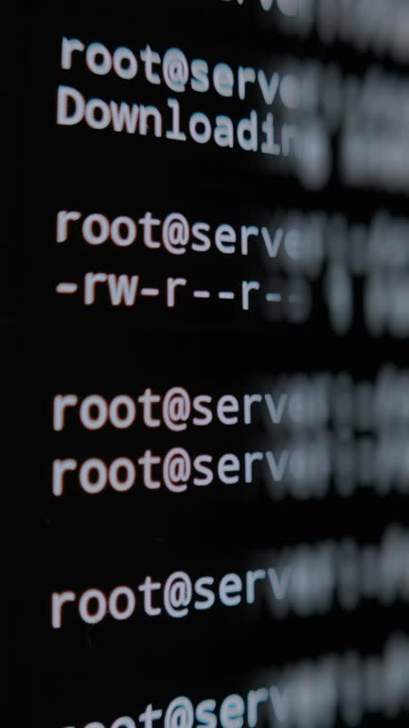
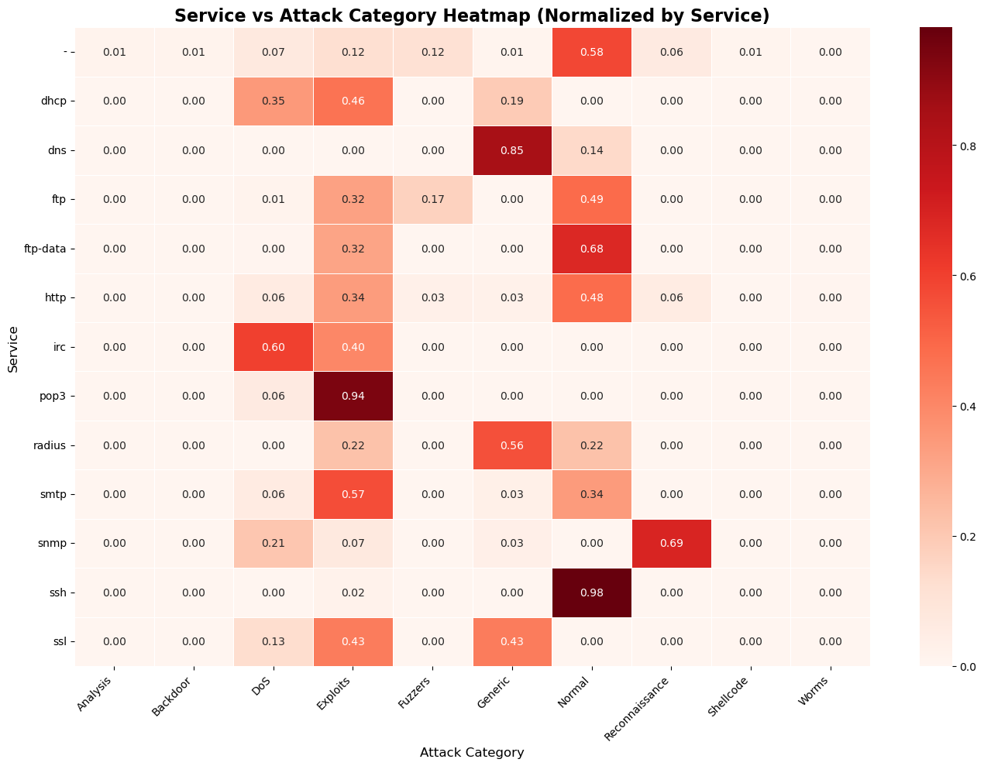
Service-Specific Threats
Which Services Are Most Targeted?
1
SSH
98% "Normal" classification, heavily targeted but well-defended.
2
POP3 (Email)
94% Exploits, primary target for exploitation.
3
DNS
85% Generic attacks, high rates of general attacks.

Slide 7
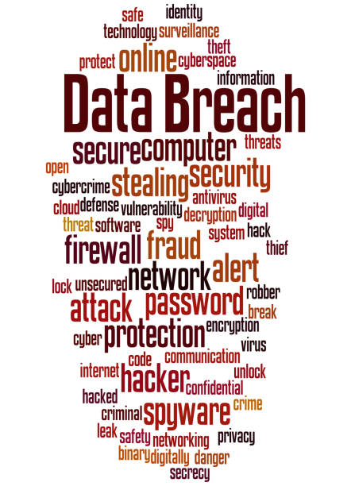
Service-Specific Threats (Continued)
SNMP
1
69% Reconnaissance, probed for network information.
IRC
2
60% DoS attacks, chat services disrupted.
FTP/HTTP
3
Mixed patterns, indicating varied attack vectors.

Slide 8
Key Takeaways
Critical Insights from the Analysis
1
Attack Traffic Dominates
2
Diverse Attack Landscape
55% malicious traffic means robust security is non-negotiable.
Organizations face multiple threat vectors simultaneously.
3
Service-Specific Vulnerabilities
4
Pattern Recognition is Key
Security must be tailored to different services.
Unusual connection patterns indicate malicious activity.
Bottom Line
Cybersecurity requires constant vigilance, multi-layered defenses, and proactive monitoring.

Slide 9






Recommendations
Actionable Steps to Protect Your Network
Implement Multi-Layered Security
Deploy firewalls, IDS/IPS, and endpoint protection across all segments.
Monitor Traffic Continuously
Set automated alerts for unusual packet rates and data transfer.
Harden Critical Services
Enhance authentication for SSH, email, DNS, and web services.
Conduct Regular Training
Educate staff on evolving threats and security best practices.
Perform Continuous Assessments
Analyze traffic and conduct penetration testing to identify vulnerabilities.

Slide 10


Thank You
Cybersecurity is not optional—it's essential. Understanding attack patterns helps us build better defenses.

