Slide 1
Student Portal
System Analysis and Design
Architecture · Data flows · ERDs · UML use cases and sequences
Code-informed presentation pack | 20 October 2026
Selected views · confirm environment and integration readiness before presenting

Slide 2
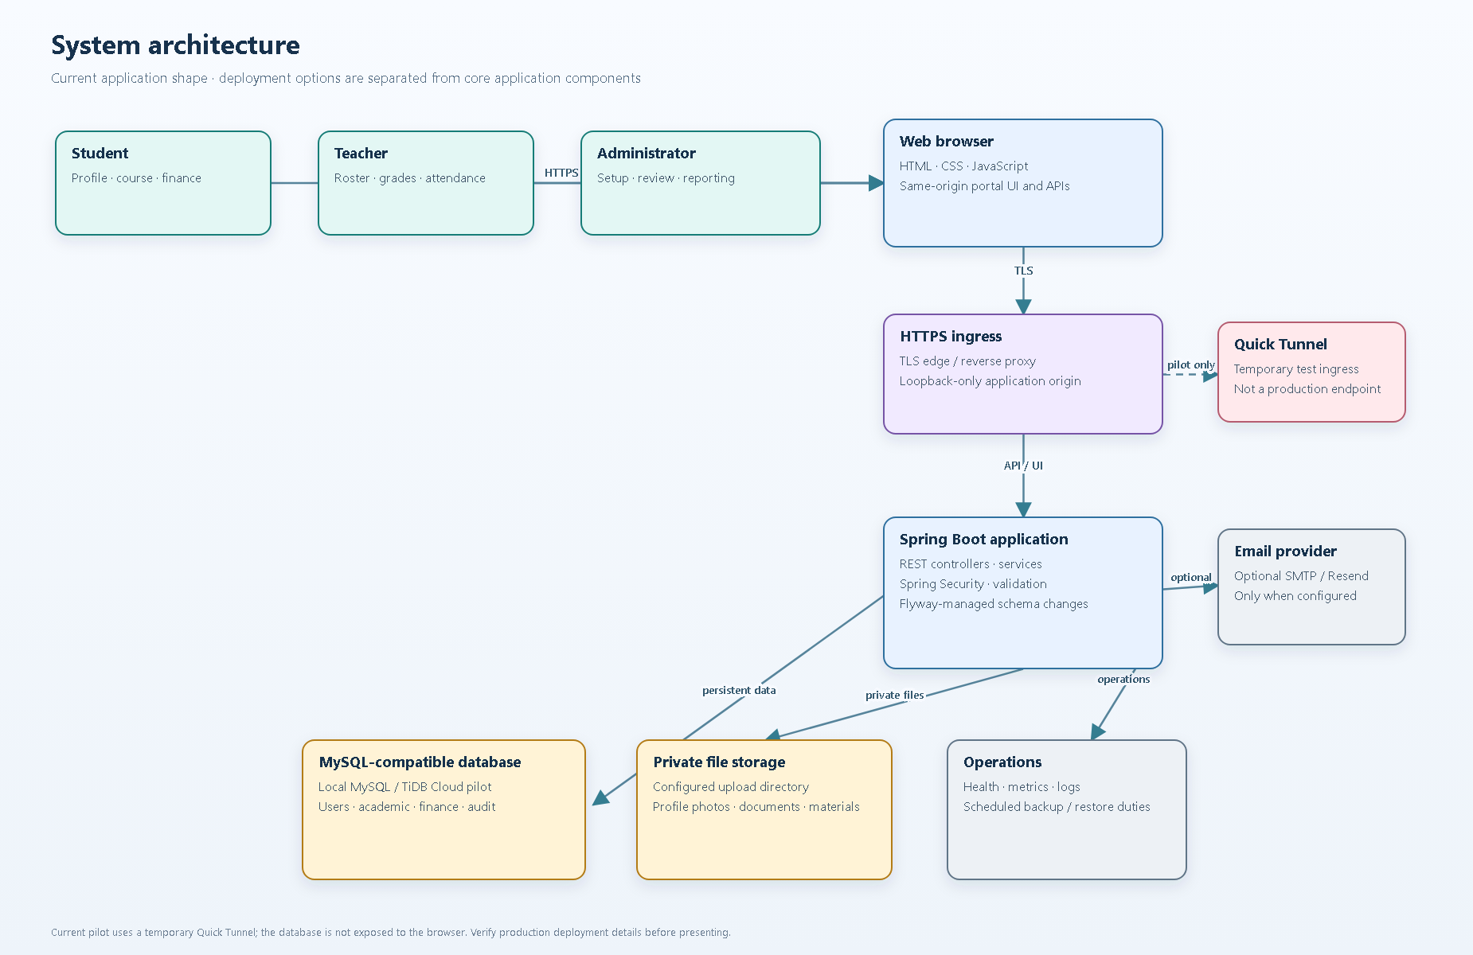

Slide 3
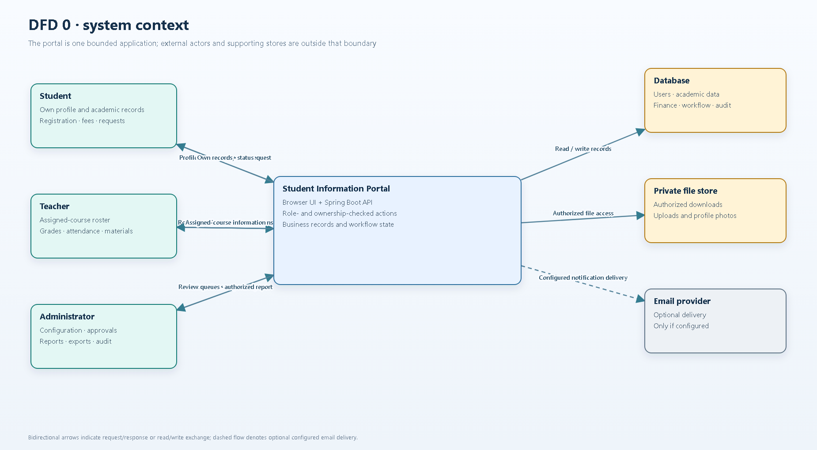

Slide 4
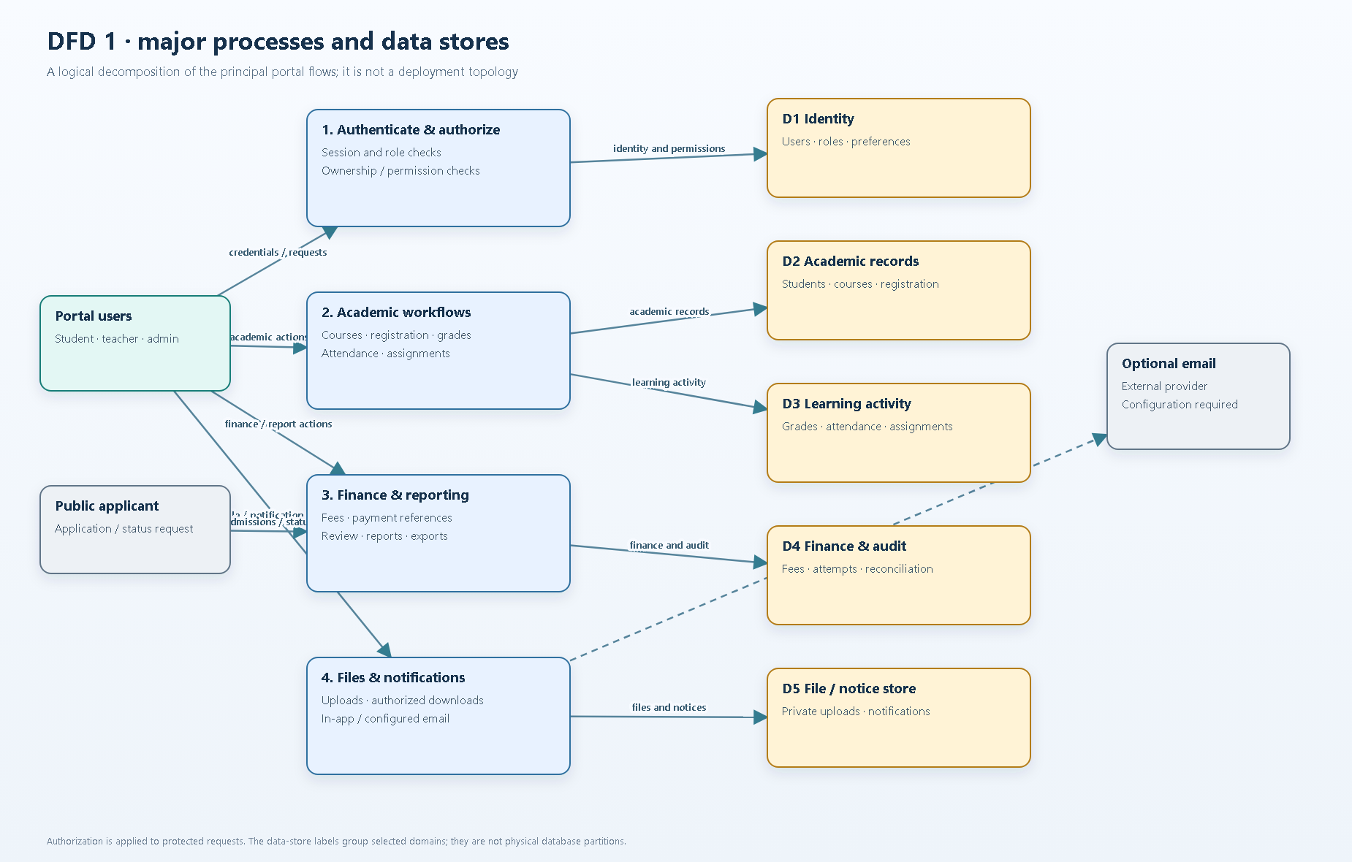

Slide 5
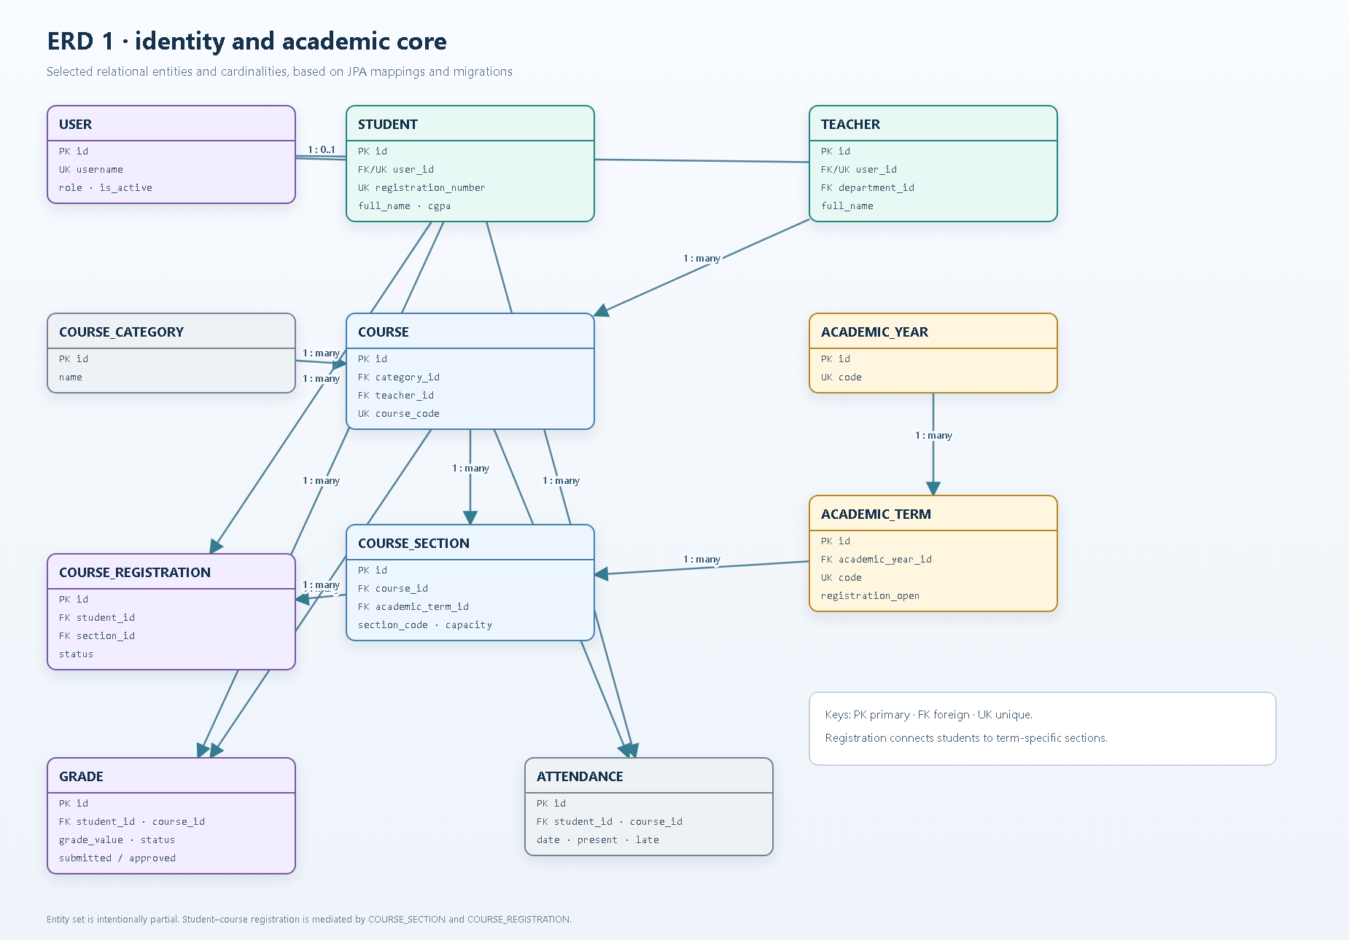

Slide 6
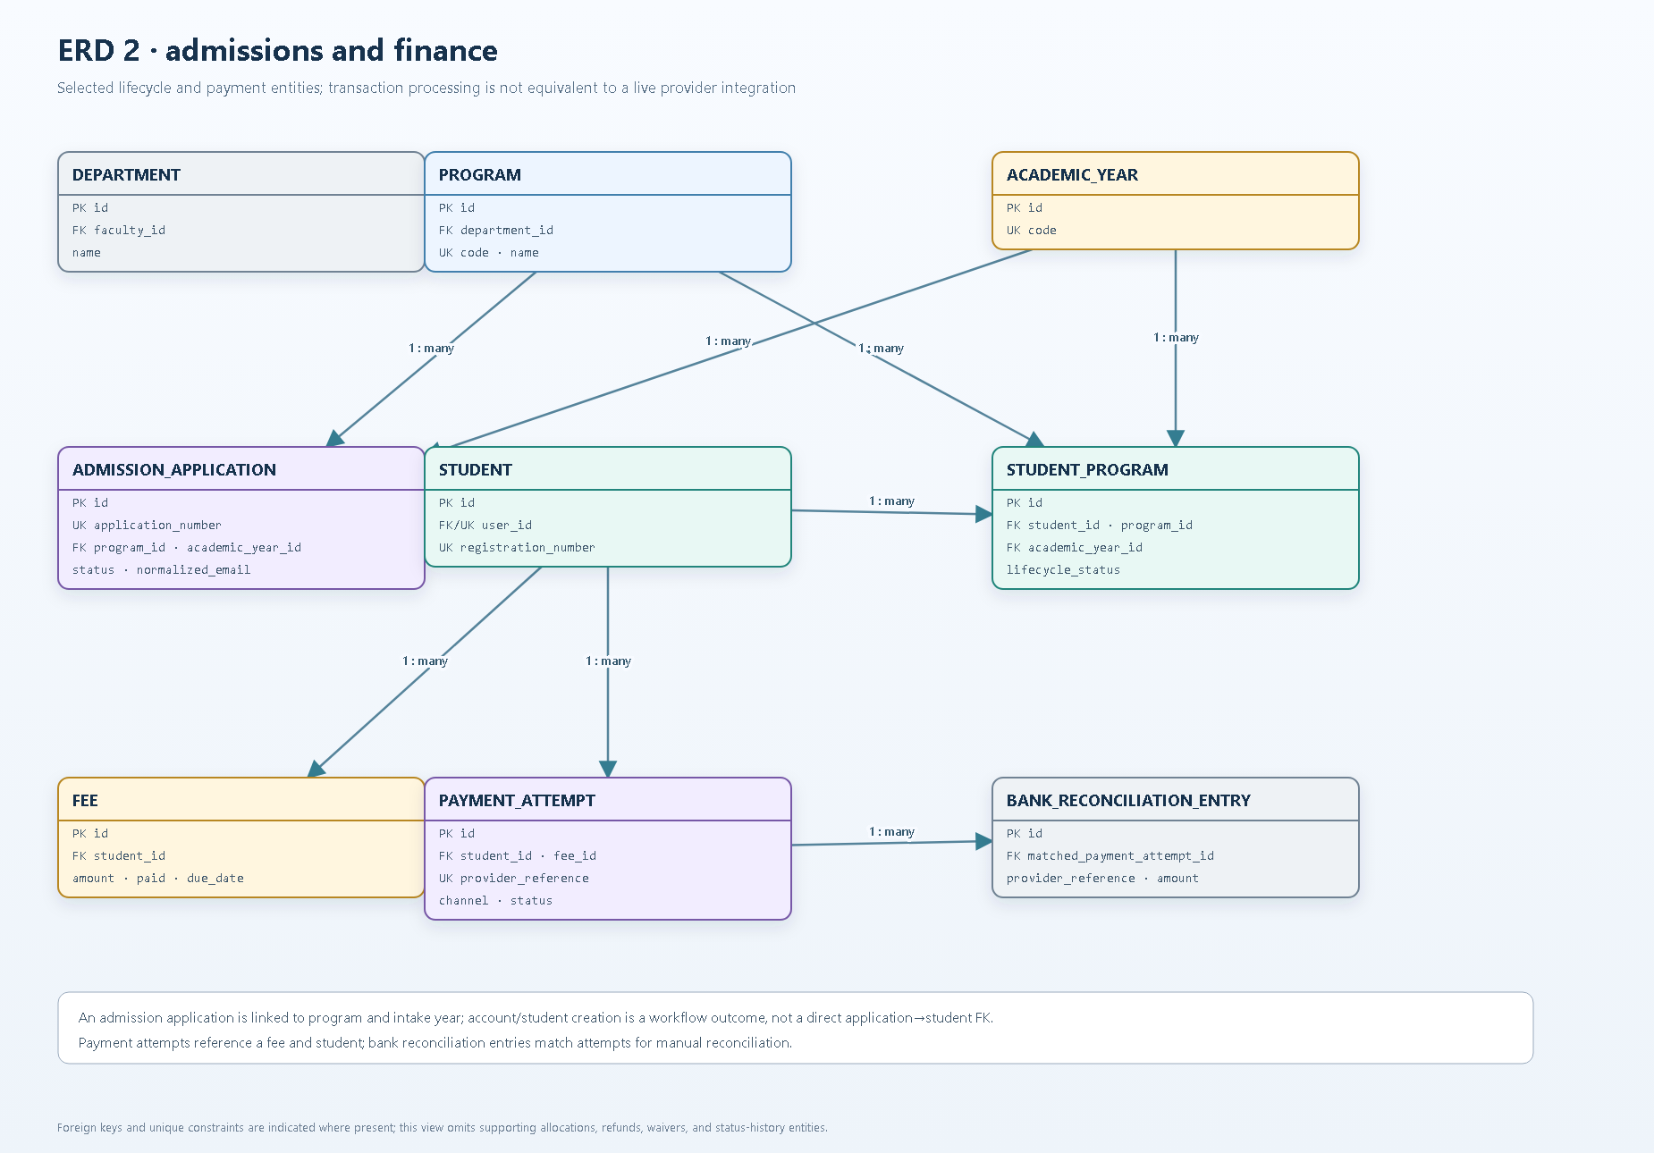

Slide 7
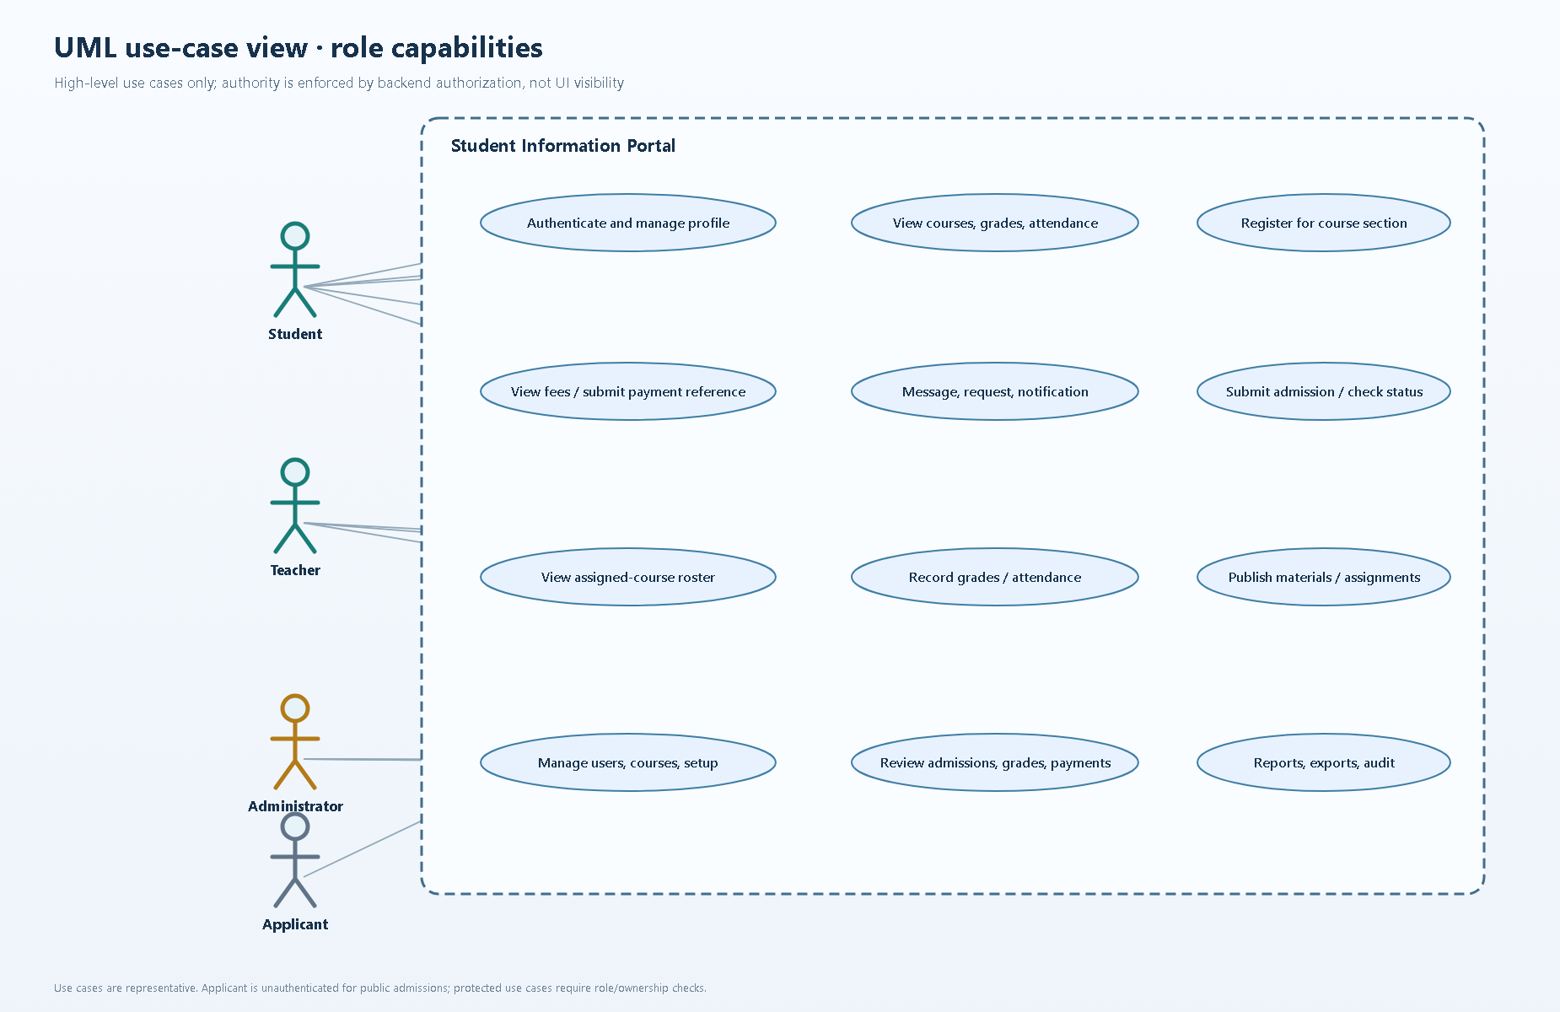

Slide 8
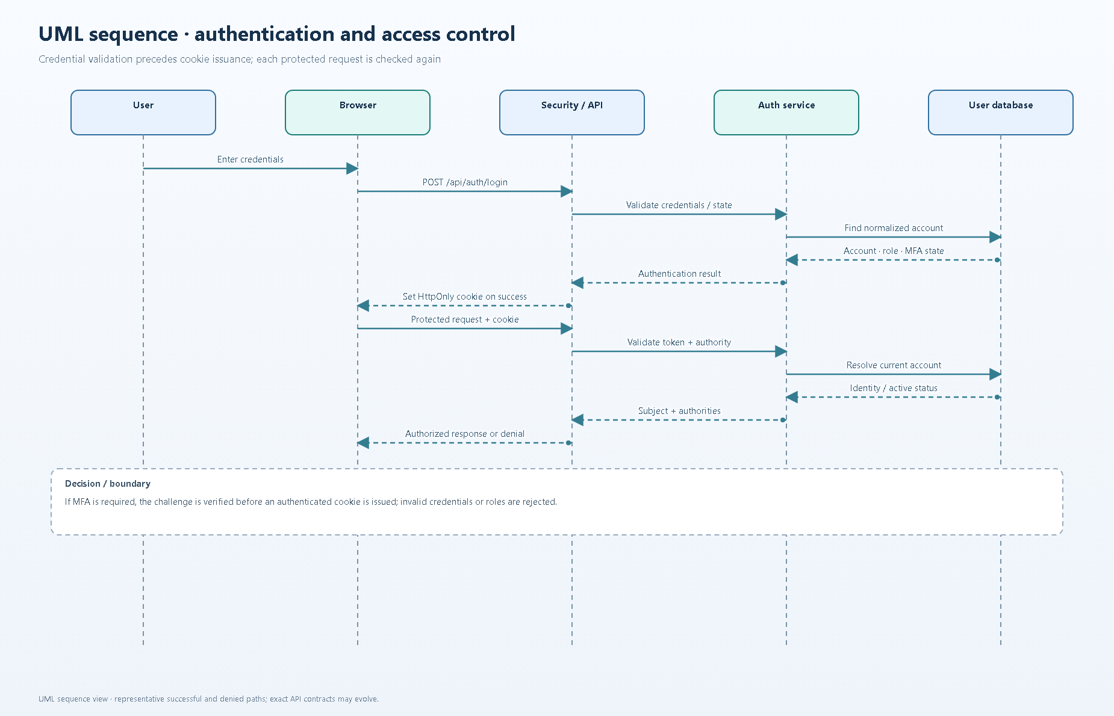

Slide 9
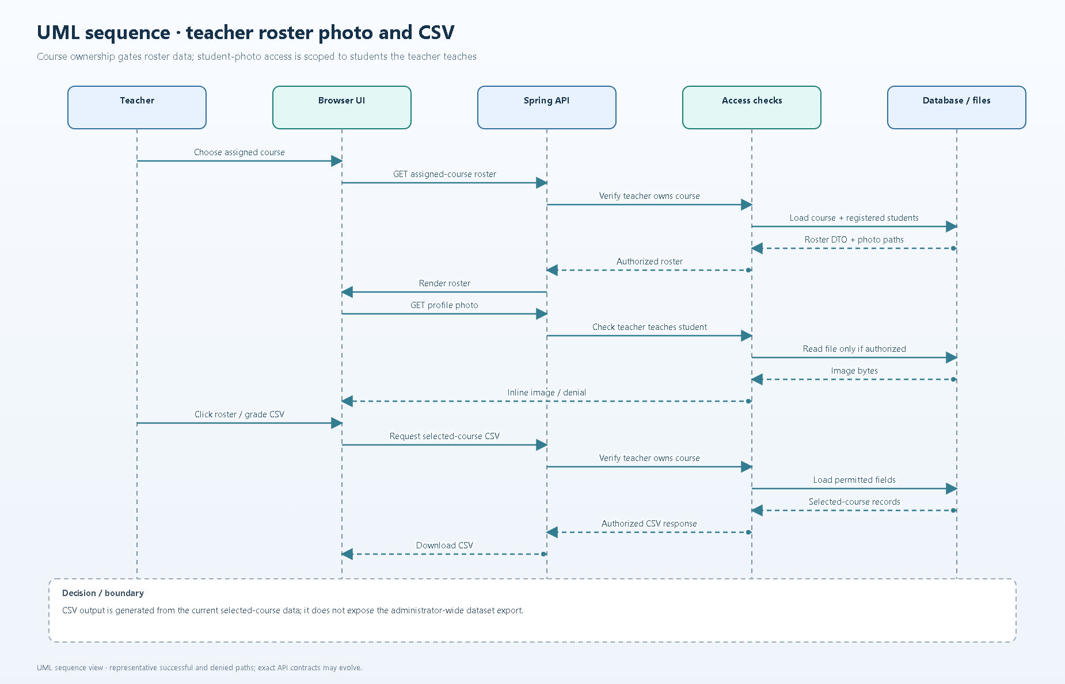

Slide 10
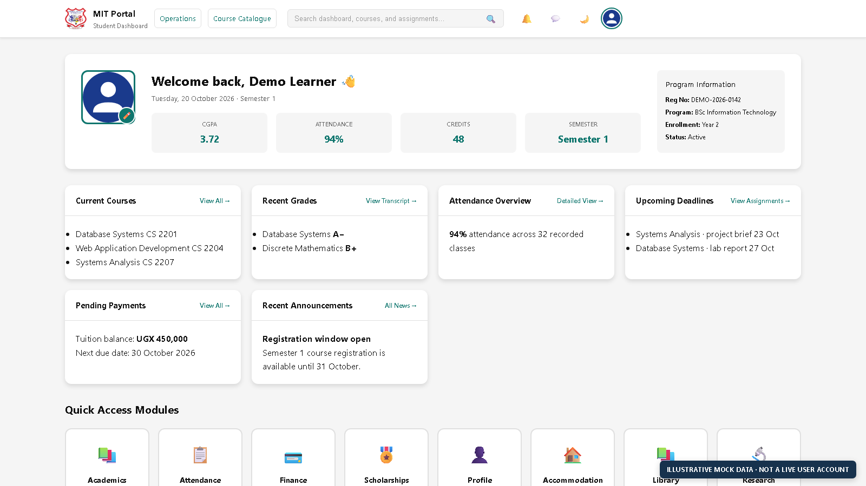
Student Dashboard · Illustrative Mock Data

Slide 11
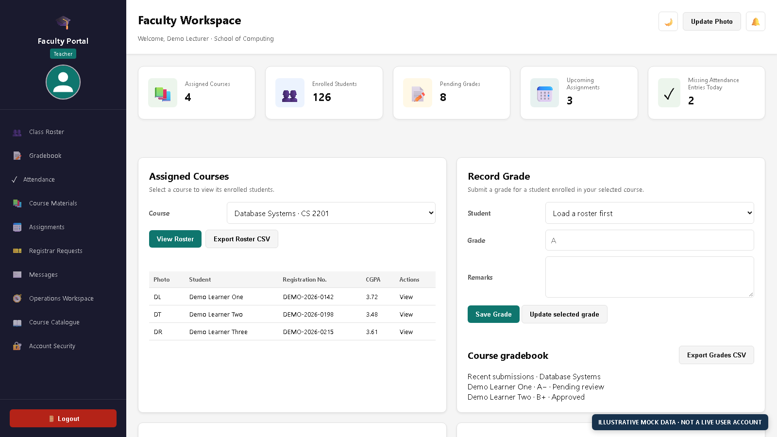
Teacher Dashboard · Illustrative Mock Data

Slide 12
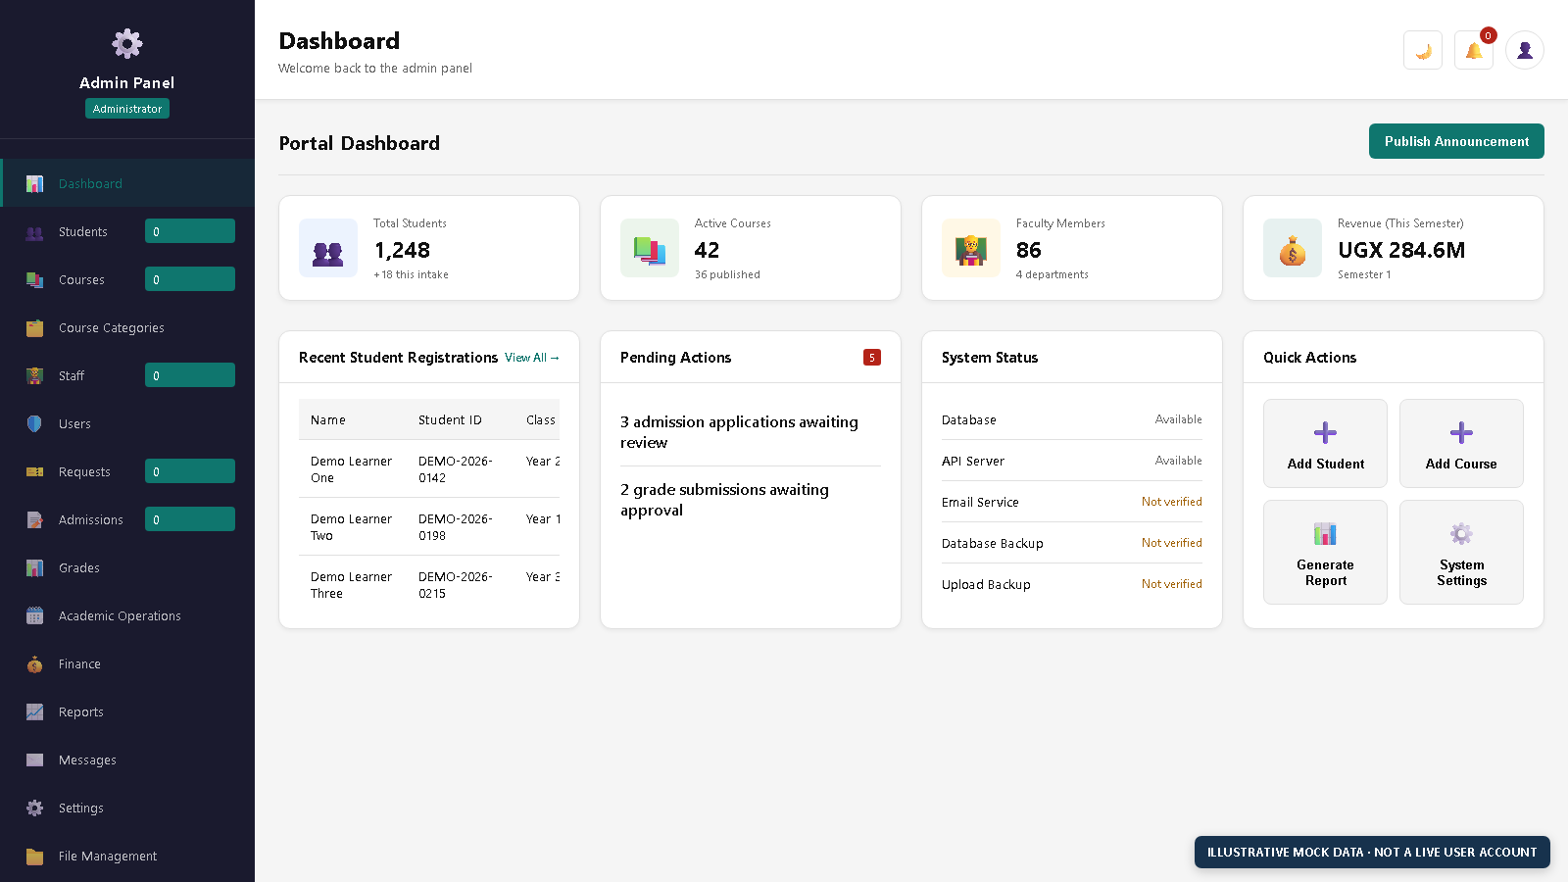
Administrator Dashboard · Illustrative Mock Data

Slide 13
Design decisions, limitations, and next steps
• Authorization is enforced by the backend; UI visibility is not the security boundary.
• Quick Tunnel is temporary testing ingress, not a permanent service address.
• Provider integrations and operational controls must be qualified against the current readiness checklist.
• Live health checks do not replace authenticated role-by-role acceptance testing.
• Present synthetic data only; do not include credentials, database dumps, or real personal records.
• These diagrams are bounded views, not an exhaustive catalog of every portal domain.

