Slide 1
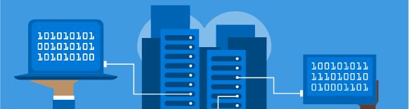
#jaxcloud @jaxcloudug #gab2017 April 22, 2017
Managing Your Azure Environment

Slide 2



Sponsors

Slide 3

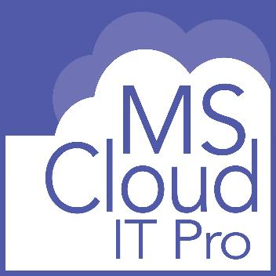

psconfig.com
msclouditpro.com
Scott Hoag
scott@psconfig.com
@ciphertxt

Slide 4
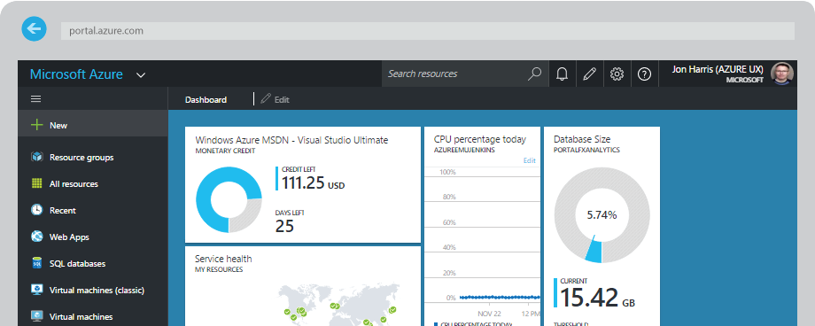
Azure Portal

Slide 5
Key Capabilities
Comprehensive Marketpalce
Browse thousands of items from Microsoft and other vendors that can be purchased and/or provisioned
Scalable Experience
Easy to find the resources you care about and perform various management operations
Consistent Management
Manage Azure’s wide variety of services through a consistent way of exposing settings, actions, and much more
Personal Experience
Create a customized start screen that shows you the information you want to see when you log in
Notes:
The Microsoft Azure portal is a central place where you can provision and manage your Azure resources. This tutorial will familiarize you with the portal and show you how to use some of these key capabilities:
A comprehensive marketplace that lets you browse through thousands of items from Microsoft and other vendors that can be purchased and/or provisioned.
A unified and scalable browse experience that makes it easy to find the resources you care about and perform various management operations.
Consistent management pages (or blades) that let you manage Azure’s wide variety of services through a consistent way of exposing settings, actions, billing information, health monitoring and usage data, and much more.
A personal experience that lets you create a customized start screen that shows the information that you want to see whenever you log in. You can also customize any of the management blades that contain tiles.

Slide 6
Demo Create a VM in the Portal

Slide 7
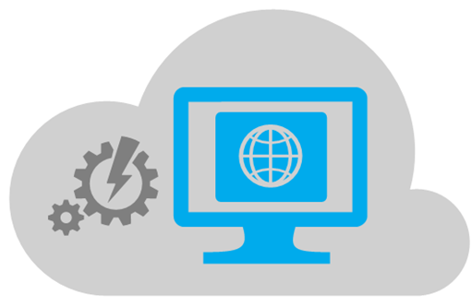
Azure PowerShell
Azure PowerShell provides a set of cmdlets that use the Azure Resource Manager model for managing your Azure resources.
Notes:
https://docs.microsoft.com/en-us/powershell/azure/install-azurerm-ps?view=azurermps-3.8.0
Get-Module AzureRM -list | Select-Object Name,Version,Path
Update-Module -Name AzureRM –Force
Install-Module -Name AzureRM -RequiredVersion 3.7.0
Install-Module -Name AzureRM -RequiredVersion 1.2.9
Import-Module AzureRM -RequiredVersion 1.2.9

Slide 8
Installation & Updates
PS C:\> # Install the Azure Resource Manager modules from the PowerShell Gallery
PS C:\> Install-Module AzureRM
PS C:\> Update-Module AzureRM –Force
Installing package 'AzureRM'
Installing dependent package 'AzureRM.AnalysisServices'
[ooooo ]
PS C:\> Import-Module AzureRM

Slide 9
Versioning
PS C:\> Get-Module AzureRM -list | Select-Object Name,Version,Path
Name Version Path
---- ------- ----
AzureRM 3.8.0 C:\Program Files\WindowsPowerShell\Modules\AzureRM\3.8.0\AzureRM.psd1
AzureRM 1.6.0 C:\Program Files\WindowsPowerShell\Modules\AzureRM\1.6.0\AzureRM.psd1
AzureRM 1.3.0 C:\Program Files\WindowsPowerShell\Modules\AzureRM\1.3.0\AzureRM.psd1
PS C:\> Install-Module -Name AzureRM -RequiredVersion 3.7.0
PS C:\> Install-Module -Name AzureRM -RequiredVersion 1.2.9
PS C:\> Import-Module AzureRM -RequiredVersion 1.2.9

Slide 10
Interacting
PS C:\> Login-AzureRMAccount
PS C:\> # Get subscriptions
PS C:\> Get-AzureRmSubscription
PS C:\> # Select subscription
PS C:\> Select-AzureRmSubscription -SubscriptionName [SubName]
# Get Resource Groups
PS C:\> Get-AzureRmResourceGroup
# Find resources
PS C:\> Find-AzureRmResource -ResourceGroupName [RGName]

Slide 11
Interacting (Con’t)
PS C:\> $loc = 'eastus2' #first set a location
PS C:\> # Check all the publishers
PS C:\> Get-AzureRmVMImagePublisher -Location $loc
PublisherName Location Id
------------- -------- --
Microsoft eastus2 /Subscriptions/f97da7d2-1dd0-42cd-93bc-57fb30549d66/Pr...
microsoft-ads eastus2 /Subscriptions/f97da7d2-1dd0-42cd-93bc-57fb30549d66/Pr...
Microsoft.Azure.Applications eastus2 /Subscriptions/f97da7d2-1dd0-42cd-93bc-57fb30549d66/Pr...
Microsoft.Azure.Backup.Test eastus2 /Subscriptions/f97da7d2-1dd0-42cd-93bc-57fb30549d66/Pr...
Microsoft.Azure.Compute.Security eastus2 /Subscriptions/f97da7d2-1dd0-42cd-93bc-57fb30549d66/Pr...
Microsoft.Azure.Diagnostics eastus2 /Subscriptions/f97da7d2-1dd0-42cd-93bc-57fb30549d66/Pr...
Microsoft.Azure.Extensions eastus2 /Subscriptions/f97da7d2-1dd0-42cd-93bc-57fb30549d66/Pr...

Slide 12
Interacting (Con’t)
PS C:\> # Get the publisher offers
PS C:\> Get-AzureRmVMImageOffer -Location $loc -PublisherName "MicrosoftWindowsServer“
Offer PublisherName Location Id
----- ------------- -------- --
Windows-HUB MicrosoftWindowsServer eastus2 /Subscriptions/f97da7d2-1dd0-42cd-93bc-57fb30549d66/Providers/Micr...
WindowsServer MicrosoftWindowsServer eastus2 /Subscriptions/f97da7d2-1dd0-42cd-93bc-57fb30549d66/Providers/Micr...
WindowsServer-HUB MicrosoftWindowsServer eastus2 /Subscriptions/f97da7d2-1dd0-42cd-93bc-57fb30549d66/Providers/Micr...

Slide 13
Interacting (Con’t)
PS C:\> # view the SKUS for an offer
PS C:\> Get-AzureRmVMImageSku -Location $loc -PublisherName "MicrosoftWindowsServer" -Offer "WindowsServer“
Skus Offer PublisherName Location Id
---- ----- ------------- -------- --
2008-R2-SP1 WindowsServer MicrosoftWindowsServer eastus2 /Subscriptions/f97da7d2-1dd0-42cd-93bc...
2008-R2-SP1-BYOL WindowsServer MicrosoftWindowsServer eastus2 /Subscriptions/f97da7d2-1dd0-42cd-93bc...
2012-Datacenter WindowsServer MicrosoftWindowsServer eastus2 /Subscriptions/f97da7d2-1dd0-42cd-93bc...
2012-Datacenter-BYOL WindowsServer MicrosoftWindowsServer eastus2 /Subscriptions/f97da7d2-1dd0-42cd-93bc...
2012-R2-Datacenter WindowsServer MicrosoftWindowsServer eastus2 /Subscriptions/f97da7d2-1dd0-42cd-93bc...
2012-R2-Datacenter-BYOL WindowsServer MicrosoftWindowsServer eastus2 /Subscriptions/f97da7d2-1dd0-42cd-93bc...
2016-Datacenter WindowsServer MicrosoftWindowsServer eastus2 /Subscriptions/f97da7d2-1dd0-42cd-93bc...
2016-Datacenter-Server-Core WindowsServer MicrosoftWindowsServer eastus2 /Subscriptions/f97da7d2-1dd0-42cd-93bc...
2016-Datacenter-with-Containers WindowsServer MicrosoftWindowsServer eastus2 /Subscriptions/f97da7d2-1dd0-42cd-93bc...
2016-Nano-Server WindowsServer MicrosoftWindowsServer eastus2 /Subscriptions/f97da7d2-1dd0-42cd-93bc...

Slide 14
Interacting (Con’t)
PS C:\> # pick an image
PS C:\> Get-AzureRmVMImage -Location $loc -PublisherName "MicrosoftWindowsServer" -Offer "WindowsServer" -Skus "2012-R2-Datacenter"
Version FilterExpression Skus Offer PublisherName Location Id
------- ---------------- ---- ----- ------------- -------- --
4.0.20160617 2012-R2-Datacenter WindowsServer MicrosoftWindowsServer eastus2 /Subscriptions/f97d...
4.0.20160721 2012-R2-Datacenter WindowsServer MicrosoftWindowsServer eastus2 /Subscriptions/f97d...
4.0.20160812 2012-R2-Datacenter WindowsServer MicrosoftWindowsServer eastus2 /Subscriptions/f97d...
4.0.20160915 2012-R2-Datacenter WindowsServer MicrosoftWindowsServer eastus2 /Subscriptions/f97d...
4.0.20161012 2012-R2-Datacenter WindowsServer MicrosoftWindowsServer eastus2 /Subscriptions/f97d...
4.0.20161109 2012-R2-Datacenter WindowsServer MicrosoftWindowsServer eastus2 /Subscriptions/f97d...
4.0.20161214 2012-R2-Datacenter WindowsServer MicrosoftWindowsServer eastus2 /Subscriptions/f97d...
4.0.20170111 2012-R2-Datacenter WindowsServer MicrosoftWindowsServer eastus2 /Subscriptions/f97d...
4.127.20170406 2012-R2-Datacenter WindowsServer MicrosoftWindowsServer eastus2 /Subscriptions/f97d...

Slide 15
Demo Create a VM with PowerShell

Slide 16
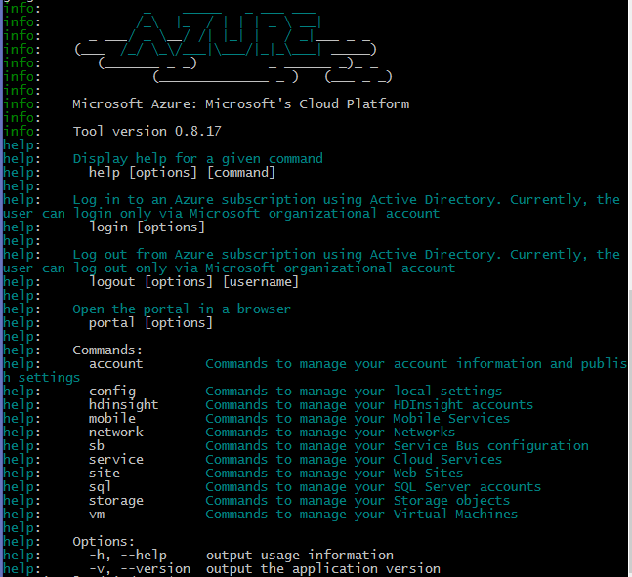
Azure CLI
The Azure CLI 2.0 is Azure's command line experience for managing Azure resources. It can be used on macOS, Linux, and Windows.
Azure CLI 2.0 is optimized for managing and administering Azure resources from the command line, and for building automation scripts that work against the Azure Resource Manager.
Notes:
https://docs.microsoft.com/en-us/cli/azure/get-started-with-azure-cli

Slide 17
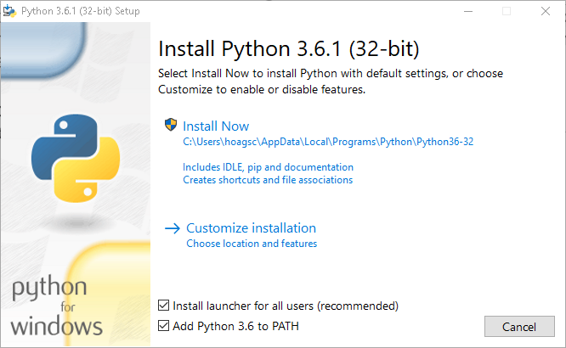
Windows Installation
Visit the Python site and download Python for Windows.
Be sure to install the Pip component when you install Python. After the install completes, add Python to your PATH environment variable (the installer will prompt you).

Slide 18
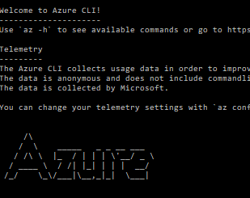
Windows Installation (Con’t)
C:\> REM Check the version
C:\> python –version
Python 3.6.1
C:\> pip install –user azure-cli
* The CLI az.bat may be installed in %USERPROFILE%\AppData\Roaming\Python\Scripts or %USERPROFILE%\AppData\Roaming\Python\PythonXY\Scripts where XY is your Python version (for example, %USERPROFILE%\AppData\Roaming\Python\Python27\Scripts). Add the folder that contains az.bat to your path.
C:\> az

Slide 19
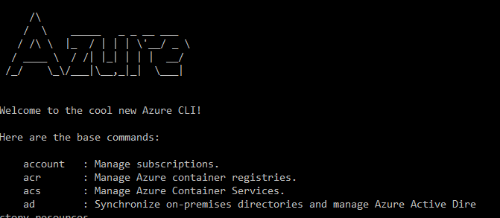
Linux / OS X Installation
user@machine:~$ curl -L https://aka.ms/InstallAzureCli | bash
user@machine:~$ exec –l $SHELL
user@machine:~$ az

Slide 20
Interacting
C:\> az login
C:\> REM Get subscriptions
C:\> az account list
C:\> az account list –output table
C:\> REM Select subscription
C:\> az account set –subscription [SubName]
C:\> REM Get Resource Groups
C:\> az group list

Slide 21
Interacting (Con’t)
C:\> REM Find resources
C:\> az vm list –output table
Name ResourceGroup Location
-------------- --------------- ----------
ATLSPUGCLIENT1 ATLSPUG0417 eastus2
ATLSPUGDC1 ATLSPUG0417 eastus2
C:\> az vm list --query [*].[name,resourceGroup] --out table
Column1 Column2
-------------- -----------
ATLSPUGCLIENT1 ATLSPUG0417
ATLSPUGDC1 ATLSPUG0417
C:\> az vm list --query "[].{RGName:resourceGroup, VMName:name}" --out table
Notes:
https://docs.microsoft.com/en-us/cli/azure/query-azure-cli

Slide 22
Demo Create a VM with the CLI

Slide 23

You learned how to browse to the portal You got oriented with the portal UI and learned how to create and browse resources You learned about the structure or management blades and how you can consistently manage different types of resources You learned how to create resources with PowerShell You learned how to create resources with the CLI You learned how to create resources with a template

Slide 24

questions

Slide 25

#jaxcloud @jaxcloudug
http://jaxug.cloud https://jaxcloudug.azurewebsites.net

