Slide 1

应 用 随 机 过 程
均匀泊松过程
授课教师：赵毅
哈尔滨工业大学（深圳）理学院

Slide 2



Chapter 2 Outline of Poisson Process
Poisson Process Definition
Properties of Poisson Process
Nonhomogeneous Poisson Process
Compound Poisson Process
Filtered Poisson Process
Poisson Process is the starting and breakthrough points to understand Stochastic Processes
Notes:
总结Poisson process

Slide 3
Course Objective
What is Poisson Process
  Acquire the four typical properties of Poisson Process
  Decide the adequacy of using it to approximate actual arrival behaviors
How to obtain the analytical equation of Poisson Process
  Understand mathematical thought from intuitively literal describing to rigorously theoretical deduction
  Grasp the probability generating function and Laplace transform for random variables

Slide 4
2.1 Poisson Process Definition
Consider a counting process N={N(t), t>0}, where N(t) denotes the number of arrivals in the interval (0, t]
Definition
A counting process N={N(t), t>0} is a Poisson Process with rate λ>0, if it possesses the following properties:
N(0)=0,
It satisfies the stationary and independent increment properties,
P{N(h)=1}=λh+o(h),
P(N(h)≥2}=o(h).
Notes:
Little-oh function

Slide 5
目录
泊松过程的定义
泊松过程的性质
非均匀泊松过程
复合泊松过程
过滤型泊松过程
泊松过程是理解随机过程的起点和突破点

Slide 6
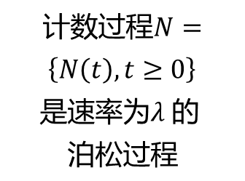



泊松过程的定义
1
$$N\left(0\right)=0$$
2
平稳增加，独立增加
计数过程$N=\left\{N\left(t\right),t≥0\right\}$
是速率为$λ 的 泊松过程$
泊松过程
3
$$P\left\{N\left(h\right)=1\right\}=λh+ο(h)$$
4
$$P\left\{N\left(h\right)≥2\right\}=ο(h)$$

Slide 7
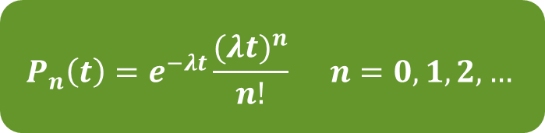
泊松过程的概率公式
对于一个速率为$λ$的泊松过程，在$(0,t]时间$内发生$n$次事件的概率：
$$P_{n}\left(t\right)=e^{−λt}\frac{{(λt)}^{n}}{n!} n=0,1,2,…$$

Slide 8





泊松过程的概率推导
考虑$初始情况，在t$时刻内发生0次事件的概率
令$P_{n}\left(t\right)=P\{N\left(t\right)=n\}$
$$P_{0}\left(t+h\right)=P\left\{N\left(t+h\right)=0\right\}=P\{N\left(t\right)=0,N\left(t+h\right)−N\left(t\right)=0\}$$
独立增加
$$=P\left\{N\left(t\right)=0\right\}P\{N\left(t+h\right)−N\left(t\right)=0\}$$
平稳增加
$$=P_{0}\left(t\right)P\{N\left(h\right)=0\}$$
$$P\left\{N\left(h\right)=1\right\}=λh+ο(h)$$
$$=P_{0}\left(t\right)[1−λh+ο(h)]$$
延时符

Slide 9

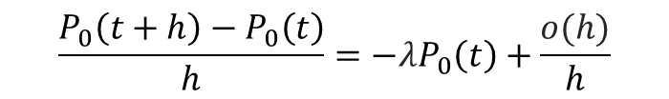



泊松过程的概率推导
考虑初始$情况，在t$时刻内发生0次事件的概率
$$P_{0}\left(t+h\right)=P_{0}\left(t\right)[1−λh+ο(h)]$$
等式两边减去$P_{0}\left(t\right)$，再除以$h$
$$\frac{P_{0}\left(t+h\right)−P_{0}\left(t\right)}{h}=−λP_{0}\left(t\right)+\frac{ο(h)}{h}$$
$$求极限$$
$$P_{0}^{′}\left(t\right)=−λP_{0}\left(t\right)⋯⋯⋯(1)$$
延时符

Slide 10

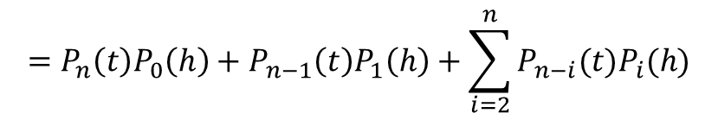
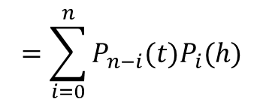

泊松过程的概率推导
考虑$一般情况，在t$时刻内发生$n(n≥1)$次事件的概率
$$P_{n}\left(t+h\right)=P\left\{N\left(t+h\right)=n\right\}$$
独立增加，平稳增加
$$=\sum_{i=0}^{n}{P_{n−i}(t)P_{i}(h)}$$
全概率公式
$$=P_{n}\left(t\right)P_{0}\left(h\right)+P_{n−1}\left(t\right)P_{1}\left(h\right)+\sum_{i=2}^{n}{P_{n−i}(t)P_{i}(h)}$$
$$P\left\{N\left(h\right)=1\right\}=λh+ο(h)$$
$$=P_{n}\left(t\right)\left[1−λh+ο\left(h\right)\right]+P_{n−1}\left(t\right)[λh+ο\left(h\right)]+ο(h)$$
$$=\left(1−λh\right)P_{n}\left(t\right)+λhP_{n−1}\left(t\right)+ο\left(h\right)$$
延时符

Slide 11

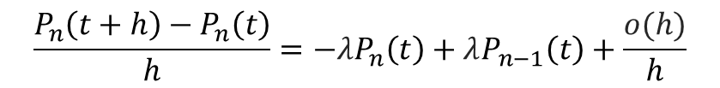

泊松过程的概率推导
考虑一般$情况，在t$时刻内发生$n(n≥1)$次事件的概率
$$P_{n}\left(t+h\right)=\left(1−λh\right)P_{n}\left(t\right)+λhP_{n−1}\left(t\right)+ο\left(h\right)$$
等式两边减去$P_{0}\left(t\right)$，再除以$h$
$$\frac{P_{n}\left(t+h\right)−P_{n}\left(t\right)}{h}=−λP_{n}\left(t\right)+λP_{n−1}\left(t\right)+\frac{ο(h)}{h}$$
$求$极限
$$P_{n}^{′}\left(t\right)=−λP_{n}\left(t\right)+λP_{n−1}\left(t\right)⋯⋯⋯(2)$$
定义：当$n<0$时 $P_{n}\left(t\right)=0$，则公式(2)包含公式(1)
延时符

Slide 12
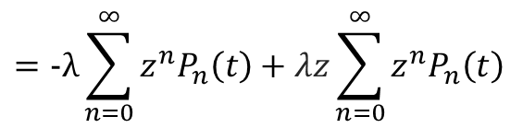

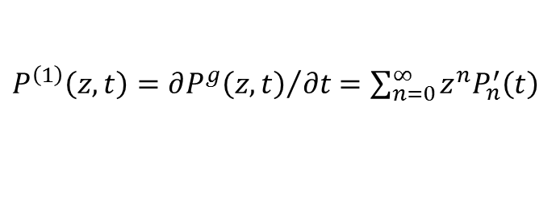
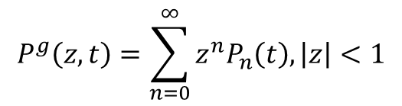
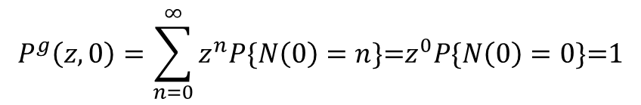
泊松过程的概率推导
定义随机变量$N(t)$的概率生成函数为
$$P^{g}\left(z,t\right)=\sum_{n=0}^{∞}{z^{n}P_{n}\left(t\right),\left|z\right|<1}$$
对$t$求导
$P^{\left(1\right)}\left(z,t\right)={∂P^{g}\left(z,t\right)}/{∂t}$ $=\sum_{n=0}^{∞}{z^{n}P_{n}^{′}\left(t\right)}$
代入公式(2)
$$=−λ\sum_{n=0}^{∞}{z^{n}P_{n}\left(t\right)+λz\sum_{n=0}^{∞}{z^{n}P_{n}\left(t\right) }}$$
$$=−λP^{g}\left(z,t\right)+λzP^{g}\left(x,t\right)=λ(z−1)P^{g}\left(z,t\right)⋯⋯(3)$$
概率生成函数边界条件
$$P^{g}\left(z,0\right)=\sum_{n=0}^{∞}{z^{n}P\{N\left(0\right)=n\}\text{=}z^{0}P\{N\left(0\right)=0\}\text{=}\text{1}}$$
延时符

Slide 13


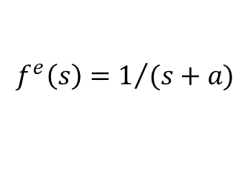

泊松过程的概率推导
为方便起见，作如下定义
$$f\left(t\right)=P^{g}\left(z,t\right)，f^{′}\left(t\right)=P^{\left(1\right)}\left(z,t\right)，a=λ(z−1)$$
代入式(3)
$$f^{′}\left(t\right)=af\left(t\right)且f\left(0\right)=1$$
Laplace变换
$$f^{e}\left(s\right)=1/{(s+a)}$$
Laplace逆变换
$$f\left(t\right)=e^{at}=e^{λ\left(z−1\right)t}, t≥0$$
$$P^{g}\left(z,t\right)=e^{at}=e^{λ\left(z−1\right)t},t≥0$$
延时符

Slide 14
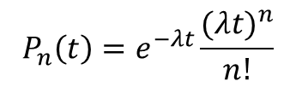
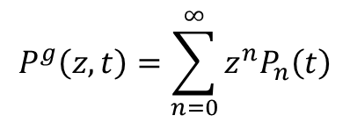
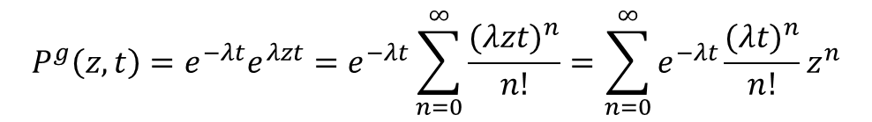
泊松过程的概率推导
因此，可得出
$$P^{g}\left(z,t\right)=e^{−λt}e^{λzt}=e^{−λt}\sum_{n=0}^{∞}{\frac{{(λzt)}^{n}}{n!}=\sum_{n=0}^{∞}{e^{−λt}\frac{{(λt)}^{n}}{n!}z^{n}}}$$
$$P^{g}\left(z,t\right)=\sum_{n=0}^{∞}{z^{n}P_{n}\left(t\right)}$$
$$P_{n}\left(t\right)=e^{−λt}\frac{{(λt)}^{n}}{n!}$$
延时符

Slide 15


课堂思考
给定参数为$λ$的泊松过程，请问
(1)相邻事件之间的间隔时间服从什么分布？
(2)第$n$次事件的到达时刻服从什么分布？
延时符

Slide 16
谢
谢
听
课
授课教师
赵毅

