Slide 1

应 用 随 机 过 程
非均匀泊松过程应用
授课教师：赵毅
哈尔滨工业大学（深圳）理学院

Slide 2



知识回顾
01
$$N\left(0\right)=0$$
02
非均匀泊松过程的性质
满足独立增加特性
03
$$P\left\{N\left(t+h\right)−N(t)=1\right\}=λ(t)h+ο(h)$$
04
$$P\left\{N\left(t+h\right)−N(t)≥2\right\}=ο(h)$$

Slide 3
The Multiserver Queue
Consider a service system with s identical servers. The arrivals to the system follow a nonhomogeneous Poisson process with intensity function λ(t). The service time of each server follows an exponential distribution with parameter μ.
We define such system as a M(t)/M/s queue
Prerequisite: to address the time epoch S for the first service completion to occur, we need to review the Competing Exponential Random Variables.

Slide 4
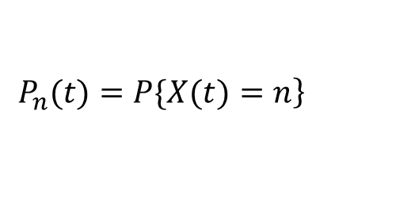



Modeling for the Multiserver Queue
Let $X(t)$denote the number of customers in the system at time t and assume $X\left(0\right)=0$.
Define .
$$\left.P_{n}(t)=P\{X(t)=n\right\}$$
How to calculate ?
$$\left.P_{n}(t\right)$$
Thought: to take an analogy to the derivation of Equation 2.1.1 for the Poisson process
We derive differential-difference equations characterizing .
$$\left\{P_{n}(t)\right\}$$

Slide 5
First Service Completion
k ($k≤s$, s is the number of identical servers) servers are busy at the same time
Service times are mutually independent and independent of the arrival process.
When k servers are busy simultaneously at any epoch, the time S for the first service completion to occur follows an exponential distribution with parameter kμ
S ~ exp(kμ)

Slide 6



知识回顾
对于每一个随机$变量{，X}_{i}\sim exp⁡(μ_{i})$，且相互独立
竞争型
指数分布
$$X=min⁡\{X_{1},⋯,X_{n}\}$$
$X$服从参数为$μ_{1}+⋯+μ_{n}$的指数分布
$$X\sim exp{(μ}_{1}+⋯+μ_{n})$$

Slide 7



多服务排队系统
1
系统有$s$个独立的服务器
$${M\left(t\right)}/M/s$$
排队系统
2
系统到达过程服从泊松过程，参数为$λ\left(t\right)$
定义
3
系统的服务时间服从参数为$μ$的指数分布

Slide 8


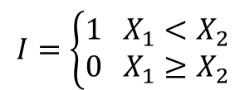
排队系统建模
定义$X(t)$为时刻$t$在系统中的顾客的人数，假设$X\left(0\right)=0$
定义 $P_{n}\left(t\right)=P\left\{X\left(t\right)=n\right\}$
类比于均匀的泊松过程的推导过程
解题思路
找到关于$P_{n}\left(t\right)$的微分形式
通过$P_{n}\left(t\right)$的微分形式，求解$P_{n}\left(t\right)$

Slide 9
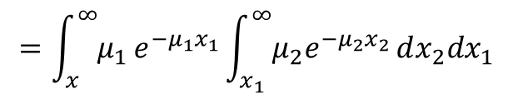


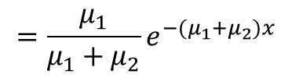
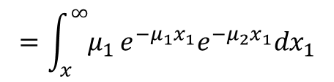
排队系统建模
排队系统有如下等式关系
$$\left.X\left(t+h\right)=X\left(t\right)+N(t,t+h)−S(t,t+h\right)$$
到达的人数
$$N(t,t+h)$$
完成服务人数
$$S(t,t+h)$$
$t$时刻在系统中
服务的人数$X(t)$
$t+h$时刻在系统中
服务的人数$X(t+h)$

Slide 10

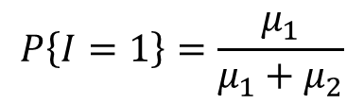


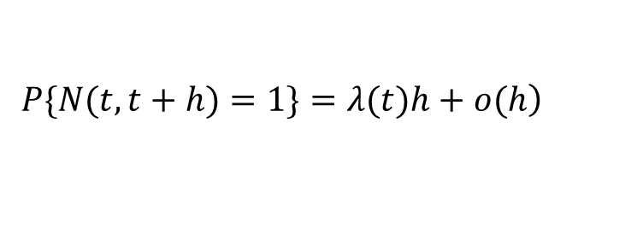
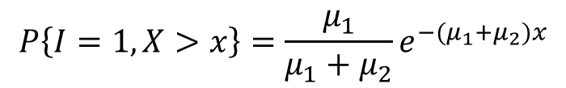

系统到达离开过程概率
定义$N(t,t+h)$为在时间$(t,t+h]$内到达的人数
$$\left.N(t,t+h)=N(t+h)−N(t\right)$$
非均匀泊松过程性质
$$\left.P\{N(t,t+h)=1\}=λ(t)h+o(h\right)$$
$$\left.P\{N(t,t+h)=0\}=1−λ(t)h+o(h\right)$$
$t时刻$有$k$个服务器在工作，$S(t, t+h|k)$为$(t, t+h]$内完成服务的人数
$$\left.P\{S(t,t+h|k)=1\}=kμh+o(h\right)$$
$$P\left\{S\left(t,t+h|k\right)=0\right\}=1−kμh+o\left(h\right)$$

Slide 11


系统中竞争性指数分布
要对系统人数建模，首先要知道第一个完成服务服从什么分布
$k(k≤s,s$是服务器的个数$)$个服务器同时在工作
且服务时间是相互独立的且独立于到达过程
$$竞争型指数分布$$
当$k$个服务器同时工作，那么第一个完成服务的服务时长$S$服从参数为$kμ$的指数分布
$$S\sim exp⁡(kμ)$$

Slide 12




系统人数的概率分布建模
考虑第一种情况$n=0$时
$$P0(t+h)=P\{X(t+h)=0\}=\sum_{k=0}^{∞}{\left.P\{X(t)=k,X(t+h)=0\right\}}$$
全概率公式
$$=\sum_{k=0}^{∞}{\left.P\{X(t+h)=0|X(t)=k\right\}P\{X\left(t\right)=k\}}$$
讨论根据$X(t)$的不同的值列举可能出现的情况
$$X(t)$$ | $$N(t,t+h)$$ | $$S(t,t+h|k)$$ | $$X(t+h)$$ | $$P\{X(t)=k,X(t+h)=0\}$$
0 | 1 | - | 1
0 | 0 | - | 0 | $$P_{0}[1−λ\left(t\right)h+o(h)]$$
1 | 0 | 1 | 0 | $$P_{1}\left(t\right)\left[1−λ\left(t\right)h+o\left(h\right)\right][μh+o(h)]$$
1 | 0 | 0 | 1

Slide 13
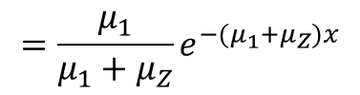




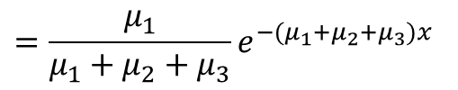
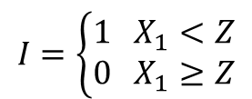

系统人数的概率分布建模
根据上表可以得出
$$\left.P_{0}(t+h)=P_{0} (t)[1−λ\left(t\right)h+o\left(h\right)]+P_{1} \left(t\right)[1−λ\left(t\right)h+o\left(h\right)][μh+o\left(h\right)\right]$$
$$P_{0}\left(t+h\right)=P_{0}(t)\left[1−λ\left(t\right)h\right]+P_{1}\left(t\right)μh+o(h)$$
两边减去$P_{0}(t)$
$$P_{0}\left(t+h\right)−P_{0}(t)={−P}_{0}(t) λ\left(t\right)h+P_{1}\left(t\right)μh+o(h)$$
两边除以$h$
$${{[P}_{0}\left(t+h\right)−P_{0}(t)]}/h={−λ\left(t\right)P}_{0}(t) +μP_{1}\left(t\right)+{o(h)}/h$$
取极限$h→0$
$${P_{0}}^{′}\left(t\right)={−λ\left(t\right)P}_{0}\left(t\right)+{μP}_{1}\left(t\right) ⋯(1)$$

Slide 14




系统人数的概率分布建模
考虑第二种情况$1≤n<s$时
$$P_{n}\left(t+h\right)=P\left\{X\left(t+h\right)=n\right\}=\sum_{k=0}^{∞}{P\{X\left(t\right)=k,X\left(t+h\right)=n\}}$$
全概率公式
$$=\sum_{k=0}^{∞}{\left.P\{X(t+h)=n|X(t)=k\right\}P\{X\left(t\right)=k\}}$$
讨论根据$X(t)$的不同的值列举可能出现的情况

Slide 15
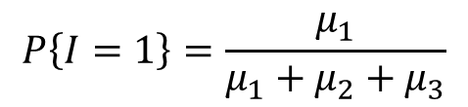
系统人数的概率分布建模
$$X(t)$$ | $$N(t,t+h)$$ | $$S(t,t+h|k)$$ | $$X(t+h)$$ | $$P\{X(t)=k,X(t+h)=0\}$$
n-1 | 1 | 1 | n-1
n-1 | 1 | 0 | n | $$P_{n−1}\left(t\right)[λ\left(t\right)h+o(h)][1−\left(n−1\right)μh+o(h)]$$
n-1 | 0 | 1 | n-2
n-1 | 0 | 0 | n-2
n | 1 | 1 | n | $$P_{n}\left(t\right)[λ\left(t\right)h+o(h)][nμh+o(h)]\text{=}\text{o}\text{(}\text{h}\text{)}$$
n | 1 | 0 | n+1
n | 0 | 1 | n-1
n | 0 | 0 | n | $$P_{n}\left(t\right)[1−λ\left(t\right)h+o(h)][1−nμh+o(h)]$$
n+1 | 1 | 1 | n+1
n+1 | 1 | 0 | n+2
n+1 | 0 | 1 | n | $$P_{n+1}\left(t\right)[1−λ\left(t\right)h+o(h)][(n+1)μh+o(h)]$$
n+1 | 0 | 0 | n+1

Slide 16
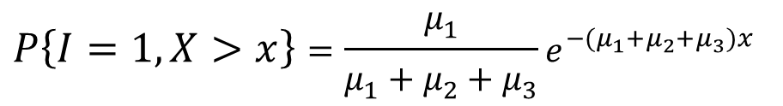
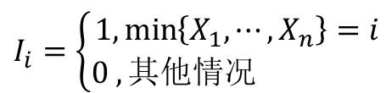
系统人数的概率分布建模
根据上表可以得出
$$P_{n}\left(t+h\right)=P_{n−1}\left(t\right)\left[λ\left(t\right)h+ο\left(t\right)\right]+P_{n}\left(t\right)\left[1−λ\left(t\right)h−nμh+ο\left(t\right)\right]$$
$+P_{n+1}\left(t\right)\left[(n+1)μh+ο\left(t\right)\right]$+$ο\left(t\right)$
分为两种情况讨论
$${P_{n}}^{′}\left(t\right)={λ\left(t\right)P}_{n−1}\left(t\right)+{(n+1)μP}_{n+1}\left(t\right)−\left(λ\left(t\right)+nμ\right)P_{n}\left(t\right) 1≤n<s ⋯(2)$$
$${P_{n}}^{′}\left(t\right)={λ\left(t\right)P}_{n−1}\left(t\right)+{sμP}_{n+1}\left(t\right)−\left(λ\left(t\right)+sμ\right)P_{n}\left(t\right) n>s ⋯(3)$$
$${P_{0}}^{′}\left(t\right)={−λ\left(t\right)P}_{0}\left(t\right)+{μP}_{1}\left(t\right) ⋯(1)$$

Slide 17
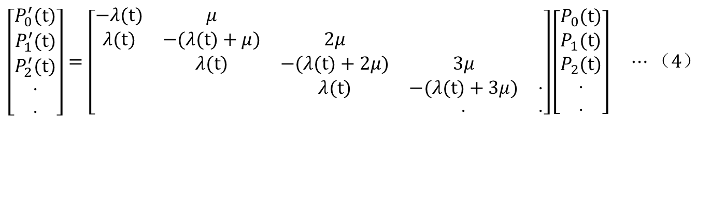

系统人数的概率分布建模
系统内人数用微分方程$\left(1\right)−(3)$描述，写成矩阵形式
(设$s=3)$
$$\left[\begin{matrix}P_{0}^{′}(t{)} \\ P_{1}^{′}(t{)} \\ P_{2}^{′}(t{)} \\ ⋅ \\ ⋅\end{matrix}\right]=\left[\begin{matrix}−λ(t{)} & μ & & & \\ λ(t{)} & −(λ(t{)}+μ) & 2μ & & \\ & λ(t{)} & −(λ(t{)}+2μ) & 3μ & \\ & & λ(t{)} & −(λ(t{)}+3μ) & ⋅ \\ & & & ⋅ & ⋅\end{matrix}\right]\left[\begin{matrix}P_{0}(t{)} \\ P_{1}(t{)} \\ P_{2}(t{)} \\ ⋅ \\ ⋅\end{matrix}\right] ⋯（4）$$
$$P^{′}\left(t\right) = Q\left(t\right) P\left(t\right)$$

Slide 18
Question Time
Consider the computer system for processing the service enquiry. The arrival process follows Poisson process with the intensity function λ(t). Assume that the system has three waiting spaces and the exponential service time distribution with a rate μ. An arriving person seeing all waiting spaces occupied will leave and have no influence on the system.
Question: to obtain the probability that an arrival will be lost.

Slide 19
Question Time
Consider a cafeteria in our university that serves lunch at noon. The cafeteria is self-service. Arrivals to the cafeteria can be modeled by Poisson process with parameter λ. Each customer’s sojourn time follows a distribution function G. Once a customer finishes food selection, he joins a single waiting line leading to three cashiers. The service times at each cashier follows an exponential distribution with a rate μ.
Question: how to model the stochastic process in the cafeteria.

Slide 20
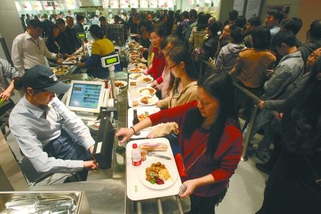



思考问题
自助餐厅就餐服务系统
到达餐厅的顾客服从参数为$λ$的泊松过程
1
每个顾客选餐逗留时间服从$分布函数为G$的分布
2
顾客选好食物进入有三个收银员的收费柜台排队
3
4
每个收银员的服务时间服从参数为$μ$的指数分布

Slide 21
谢
谢
听
课
授课教师
赵毅

