Slide 1


File Systems: GFS vs. HDFS
Seminar: Internet-scale Distributed Systems
Ciprian Lucaci
Daniel Straub

Slide 2
Distributed File Systems - Motivation
The problem
The solution
Big Data
Drive speed: 500 MB/s (SSD)
1 PB of data
1 super computer
138 hours loading time
100 machines
2.8 hours loading time
Scalable
Fault-tolerant
Low cost
Distributed computation
Distributed storage
Moving computation is faster than moving data!
HDFS & GFS

Slide 3


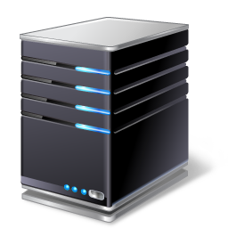

HDFS - Architecture
Client
Namenode
Secondary node
Rack 1
Rack 2
Rack 3
DN1
DN1
B2
…
B2
…
Rack n
B1
B3
Bn
B1
B3
Bn
Datanodes

Slide 4
HDFS - Workflow

Slide 5
HDFS - Purpose

Slide 6
GFS - Architecture

Slide 7
GFS - Workflow

Slide 8
GFS - Purpose

Slide 9
HDFS vs. GFS
Similarities
Differences

Slide 10
Usage examples
HDFS
GFS

Slide 11
Conclusion

Slide 12
References
HDFS
s
GFS
s

