Slide 1

HDFS Vs. GFS
Yuval Carmel
Tel-Aviv University
"Advanced Topics in Storage Systems" - Spring 2013

Slide 2
Outline
About & Keywords
Motivation & Purpose
Assumptions
Architecture overview & Comparison
Measurements
How does it fit in?
The Future

Slide 3
Outline
About & Keywords
Motivation & Purpose
Assumptions
Architecture overview & Comparison
Measurements
How does it fit in?
The Future

Slide 4
About
The Google File System - Sanjay Ghemawat, Howard Gobioff, and Shun-Tak Leung, {authors}@Google.com, SOSP’03
The Hadoop Distributed File System - Konstantin Shvachko, Hairong Kuang, Sanjay Radia, Robert Chansler, Sunnyvale, California USA, {authors}@Yahoo-Inc.com, IEEE2010

Slide 5
Keywords
GFS
HDFS
Apache Hadoop – A framework for running applications on large clusters of commodity hardware, implements the MapReduce computational paradigm, and using HDFS as it’s compute nodes.
MapReduce – A programming model for processing large data sets with parallel distributed algorithm.

Slide 6
Outline
About & Keywords
Motivation & Purpose
Assumptions
Architecture overview & Comparison
Measurements
How does it fit in?
The Future

Slide 7
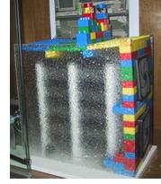
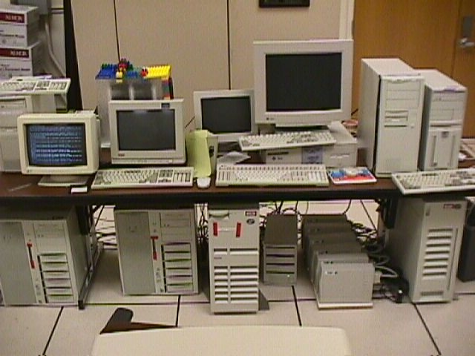
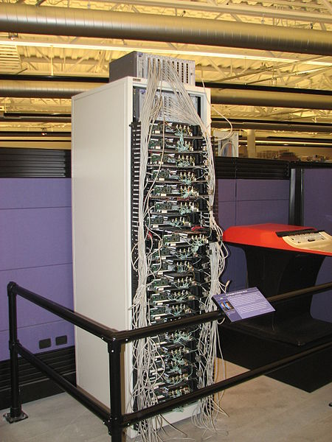
Motivation (Google disk farm)
Early days (at Stanford)
~1998

Slide 8
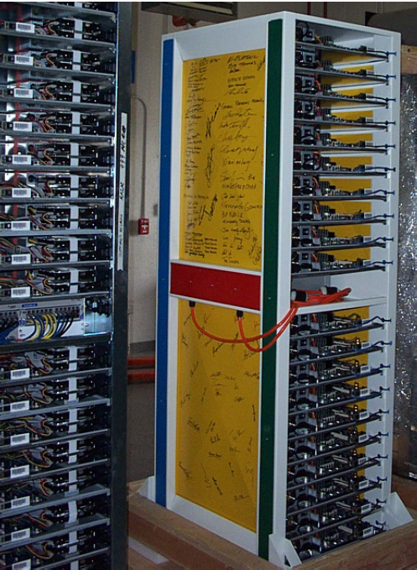
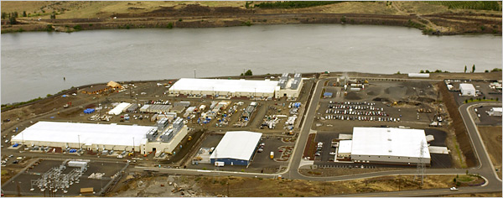
Motivation
Today…

Slide 9
Purpose
GFS – Implemented especially for meeting the rapidly growing demands of Google’s data processing needs.
HDFS – Implemented for the purpose of running Hadoop’s MapReduce applications. Created as an open-source framework for the usage of different clients with different needs.

Slide 10
Outline
About & Keywords
Motivation
Assumptions
Architecture overview & Comparison
Measurements
How does it fit in?
The Future

Slide 11
Assumptions
Many inexpensive commodity hardware that often fail.
Millions of files, multi-GB files are common
Two types of reads
Large streaming reads
Small random reads (usually batched together)
Once written, files are seldom modified
Random writes are supported but do not have to be efficient.
Concurrent writes
High sustained bandwidth is more important than low latency

Slide 12
Outline
About & Keywords
Motivation
Assumptions
Architecture overview & Comparison
Measurements
How does it fit in?
The Future

Slide 13
Architecture Overview
File Structure - GFS
Divided into 64 MB chunks
Chunk identified by 64-bit handle
Chunks replicated
(default 3 replicas)
Chunks divided into 64KB blocks
Each block has a 32-bit checksum
File Structure – HDFS
Divided into 128MB blocks
NameNode holds block replica as 2 files
One for the data
One for checksum & generation stamp.
chunk
file
…
blocks

Slide 14
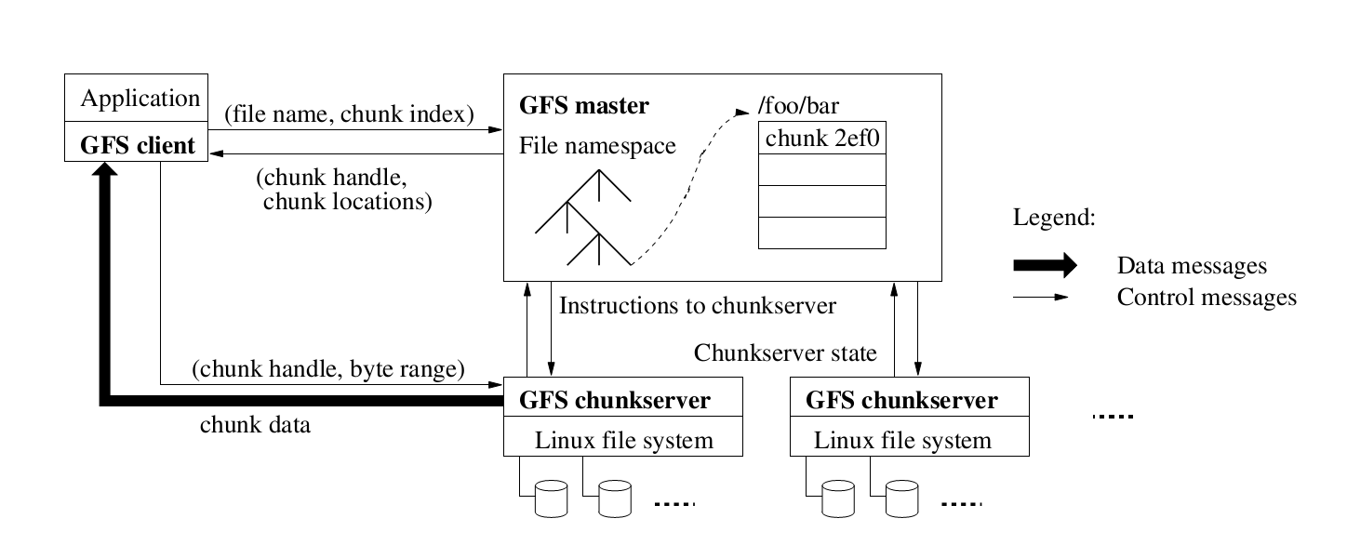
Architecture Overview - GFS

Slide 15
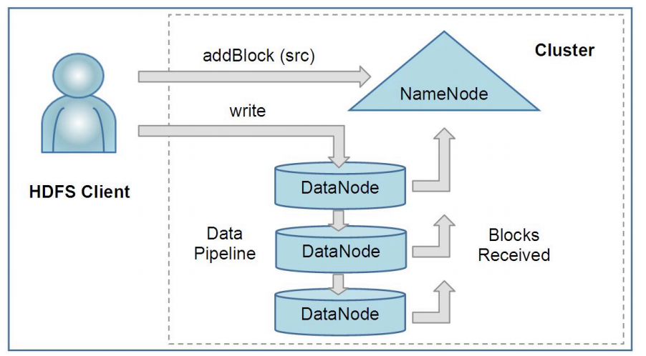
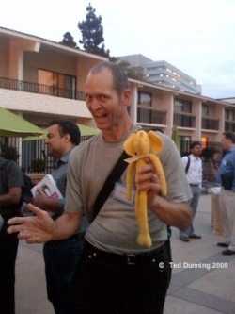
Architecture Overview - HDFS

Slide 16
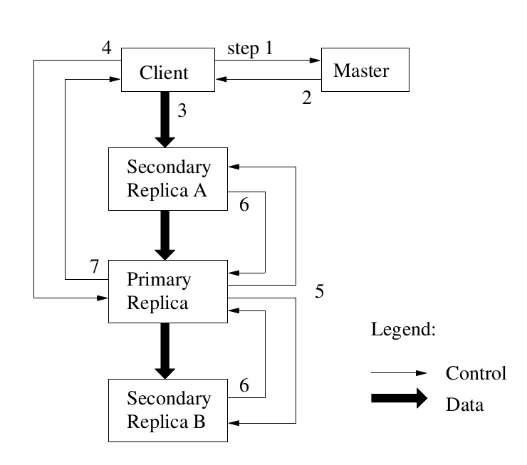
Architecture Comparison
Data Flow (I/O operations) – GFS
Leases at primary (60 sec. default)
Client read -
Sends request to master
Caches list of replicas
locations for a limited time.
Client Write –
1-2: client obtains replica
locations and identity of primary replica
3: client pushes data to replicas
(stored in LRU buffer by chunk servers holding replicas)
4: client issues update request to primary
5: primary forwards/performs write request
6: primary receives replies from replica
7: primary replies to client

Slide 17
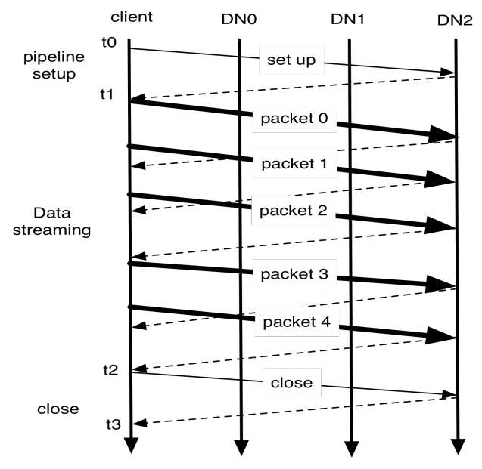
Architecture Comparison
Data Flow (I/O operations) – HDFS
No Leases (client decides where to write)
Exposes the file’s block’s locations (enabling applications like MapReduce to schedule tasks).
Client read & write –
Similar to GFS.
Mutation order is handled
with a client constructed
pipeline.

Slide 18
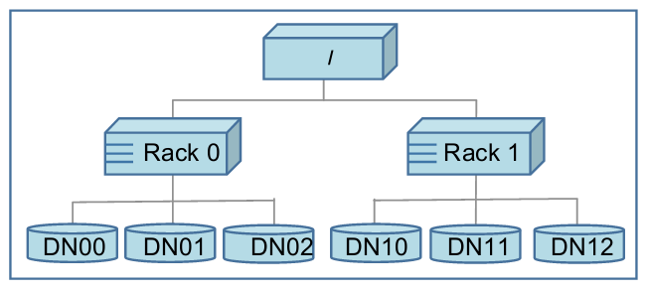
Architecture Comparison
Replica management – GFS & HDFS
Placement policy
Minimizing write cost.
Reliability & Availability – Different racks
No more than one replica on one node, and no more than two replica’s in the same rack (HDFS).
Network bandwidth utilization – First block same as writer.

Slide 19
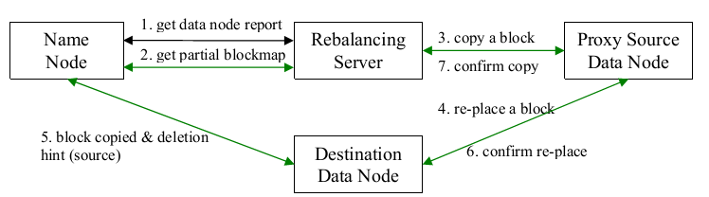
Architecture Comparison
Data balancing – GFS
Placing new replicas on chunkservers with below average disk space utilization
Master rebalances replicas periodically
Data balancing (The Balancer) – HDFS
Avoiding disk space utilization on write (prevents bottle-neck situation on a small subset of DataNodes).
Runs as an application in the cluster (by the cluster admin).
Optimizes inter-rack communication.

Slide 20
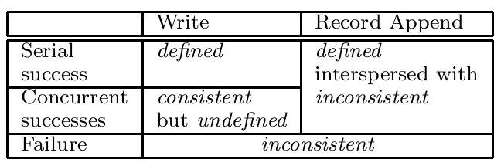
Architecture Comparison
GFS’s consistency model
Write
Large or cross-chunk writes are divided buy client into individual writes.
Record Append
GFS’s recommendation (preferred over write).
Client specifies only the data (no offset).
GFS chooses the offset and returns to client.
No locks and client synchronization is needed.
Atomically, at-least-once semantics.
Client retries faild operations.
Defined in regions of successful appends, but may have undefined intervening regions.
Application Safeguard
Insert checksums in records
headers to detect fragments.
Insert sequence numbers to
detect duplications.
primary
primary
primary
replica
replica
replica
defined
consistent
inconsistent

Slide 21
Outline
About & Keywords
Motivation & Purpose
Assumptions
Architecture overview & Comparison
Measurements
How does it fit in?
The Future

Slide 22
Measurements
GFS micro benchmark
Configuration
one master, two master replicas, 16 chunkservers, and 16 clients. All the machines are configured with dual 1.4 GHz PIII processors, 2 GB of memory, two 80 GB 5400 rpm disks, and a 100 Mbps full-duplex Ethernet connection to an HP 2524 switch. All 19 GFS server machines are connected to one switch, and all 16 client machines to the other. The two switches are connected with a 1 Gbps link.
Reads
N clients read simultaneously from the file system. Each
client reads a randomly selected 4 MB region from a 320 GB
file set. This is repeated 256 times so that each client ends
up reading 1 GB of data.
Writes
N clients write simultaneously to N distinct files
Record append
N clients append simultaneously to a single file

Slide 23
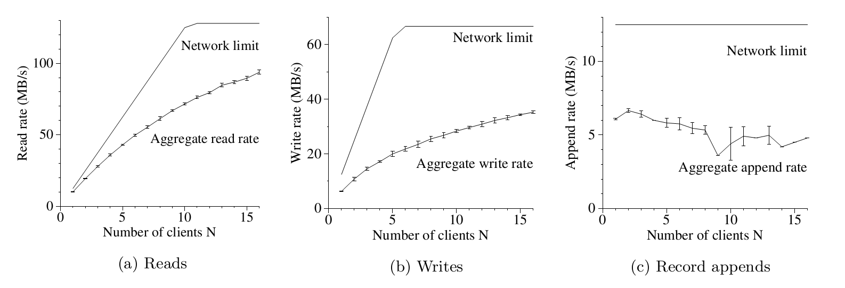
Measurements
Total network limit (Read) = 125 MB/s (Switch’s connection)
Network limit per client (Read) = 12.5 MB/s
Total network limit (Write) = 67 MB/s (Each byte is written to three different chunkservers, total chunkservers is 16)
Record append limit = 12.5 MB/s (appending to the same chunk)

Slide 24
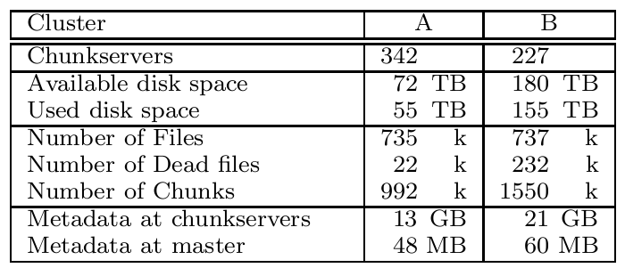
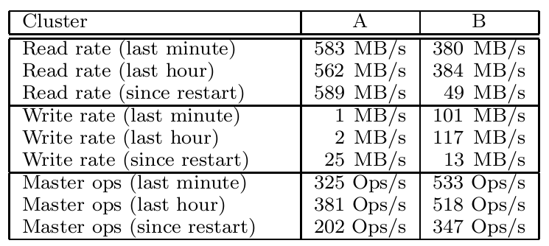
Measurements
Real world clusters (at Google)
*Does not show chunck fetch latency in master (30 to 60 sec)

Slide 25
Measurements
HDFS DFSIO benchmark
3500 Nodes.
Uses the MapReduce framework.
Read & Write rates
DFSIO Read: 66 MB/s per node.
DFSIO Write: 40 MB/s per node.
Busy cluster read: 1.02 MB/s per node.
Busy cluster write: 1.09 MB/s per node.

Slide 26
Outline
About & Keywords
Motivation & Purpose
Assumptions
Architecture overview & Comparison
Measurements
How does it fit in?
The Future

Slide 27
How does it fit in?
Sawzall / Pig / Hive
MapReduce / Hadoop
BigTable / HBase
GFS / HDFS

Slide 28
Outline
About & Keywords
Assumptions & Purpose
Architecture overview & Comparison
Measurements
How does it fit in?
The Future

Slide 29
The Future (Google’s Present)
Build for “real-time” low latency operations instead of big batch operations.
Smaller chuncks (1MB)
Constant update
Eliminated “single point of failure” in GFS (The master)
Caffeine
BigTable
Colossus

Slide 30
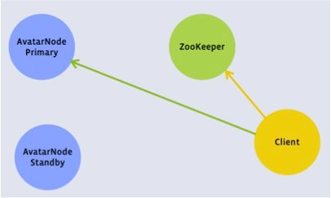
The Future - HDFS
Real secondary (“hot” backup) NameNode – Facebook’s AvatarNode
(Already in production).
Low latency MapReduce.
Inter cluster cooperation.

Slide 31
References
Hadoop & HDFS User Guide
http://archive.cloudera.com/cdh/3/hadoop/hdfs_user_guide.html
Google file system at Virginia Tech (CS 5204 – Operating Systems)
Hadoop tutorial: Intro to HDFS
http://www.youtube.com/watch?v=ziqx2hJY8Hg
Under the Hood: Hadoop Distributed Filesystem reliability with Namenode and Avatarnode. by Andrew Ryan for Facebook Engineering.
Thank you.

