Slide 1
File Systems: GFS vs. HDFS
Seminar: Internet-scale Distributed Systems
Ciprian Lucaci
Daniel Straub

Slide 2
Distributed File Systems - Motivation

Slide 3
HDFS - Architecture

Slide 4
HDFS - Workflow

Slide 5
HDFS - Purpose

Slide 6
GFS - Purpose
Designed for environment where
Component failures are the norm
Files are huge (100MB and more)
Files usually do not change (written once)
If they change, changes are appended
Files are mostly read sequentially
High data throughput is important

Slide 7

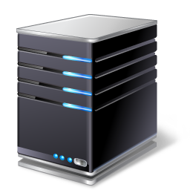

GFS - Architecture
Chunkserver
Chunk a
Chunk d
Chunk k
…
Master
File1: chunk a, chunk c, chunk d, …
File2: chunk b, chunk x
…
Client
Control flow
Data flow

Slide 8
GFS - Workflow
Read
File name and chunk index
Chunk handle and location
Chunk handle and byte range
Data
4
3
1
2

Slide 9
HDFS vs. GFS
Similarities
Differences

Slide 10
Usage examples
HDFS
GFS

Slide 11
Conclusion

Slide 12
References
HDFS
s
GFS
s

