Slide 1
File Systems: GFS vs. HDFS
Seminar: Internet-scale Distributed Systems
Ciprian Lucaci
Daniel Straub

Slide 2
Distributed File Systems - Motivation

Slide 3
HDFS - Architecture

Slide 4
HDFS - Workflow

Slide 5
HDFS - Purpose

Slide 6
GFS - Purpose
Large files (100MB and more)
Commodity hardware (failures are the norm)
(Concurrently) appending files
Files are mostly read sequentially
High data throughput
Small files
Modifying (not appending) writes
Small random reads
High latency

Slide 7

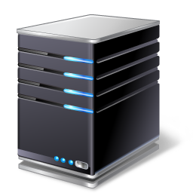

GFS - Architecture
Chunkserver 1
Chunk a
Chunk d
Chunk k
…
Chunk: 64MB of data
Chunkserver 2
Chunk b
Chunk d
Chunk e
…
Master
File1: chunk a, chunk c, chunk d, …
File2: chunk b, chunk x
…
Client
Control flow
Data flow

Slide 8
GFS - Workflow
CS 1
Chunk a
Chunk d
Chunk k
…
CS 2
Chunk b
Chunk d
Chunk e
…
Master
File1: chunk a, chunk c, chunk d, …
File2: chunk b, chunk x
…
Read
File: File1, chunk index: 3
Chunk d, location: CS 1, CS 2
Chunk d, byte range: 1-1000
Data: byte 1-1000
4
3
1
2

Slide 9
HDFS vs. GFS
Similarities
Differences

Slide 10
Usage examples
HDFS
GFS

Slide 11
Conclusion

Slide 12
References
HDFS
s
GFS
s

