Slide 1
Event Based Systems Routing in Publish/Subscribe I
Dr. Emanuel Onica
Faculty of Computer Science, Alexandru Ioan Cuza University of Iaşi

Slide 2
Contents
Basic routing framework
Necessary routing guarantees
Routing techniques (in Part II)

Slide 3
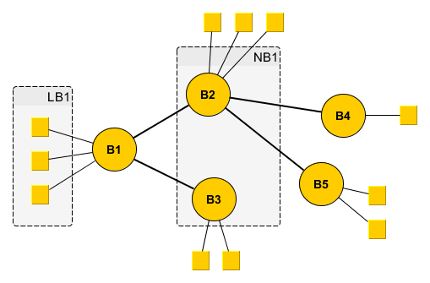
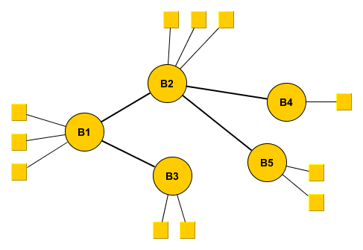
Basic routing framework
Model:
B1 – Bn : acyclically connected brokers
LBi : The local clients of broker Bi
NBi : The neighbor brokers of broker Bi

Slide 4
Basic routing framework
Assumptions (for now):
Static topology:
no client joins/leaves/movements between broker local groups
no broker joins/leaves/changes of links
Every broker uses a synchronization primitive (e.g., a conditional mutex or semaphore) to ensure atomicity of concurrent calls when handling received messages
Messages are received and processed individually (not batched) in the order sent, are not lost, and their delay is finite
Brokers don’t fail (... for now)

Slide 5
Basic routing framework (based on Muhl et al. – 2006)
ContentBasedRouting_main() {
init(TB,sync);
forall(C in LB) init(QC);
while(true) {
wait_for_messages();
synchronized(sync){
m=fair_get_message();
handle_message(m);
}
}
}
TB – the routing table of broker B; array of pairs (F,D) where F is a subscription (filter) and D a destination in LB or NB
QC – a notification delivery queue for a client C
wait_for_messages() – waits until some messages are received (multiple messages can be received from different sources)
fair_get_message() – a balanced selector that extracts one message from one of the possible sources

Slide 6
Basic routing framework
handle_message(Message m) {
if (m==”forward(n)”) {
handle_notification(source(m),n);
}
if (m==”admin(S,U)”) {
(FS,FU)=administer(source(m),S,U); handle_admin_message(source(m),FS,FU);
}
}
n – notification for a client
S – set of subscriptions
U – set of unsubscriptions
administer() – method specific for a routing algorithm managing the local routing table; returns the sets of subscriptions (FS) and unsubscriptions (FU) that must be delivered to other brokers

Slide 7
Basic routing framework
handle_notification(Node D, Notification n) {
matching_nodes = destinations(match(FB,n));
forall(Bi in ((matching_nodes-{D}) ∩ NB)) {
send(Bi,”forward(n)”);
}
forall(C in (matching_nodes ∩ LB)) {
notify(C,n);
}
}
notify(Client C, Notification n){
QC = append(QC,n);
}
FB – the set of subscriptions (filters) stored at broker B
match(FB,n) – matching function returning ids of matching neighbor brokers and clients
notify() – the function handling client notification; can be extended to actually empty the queue and send at appropriate times

Slide 8
Basic routing framework
handle_admin_message(Node D, Set FS, Set FU) {
forall(H in NB-{D}){
S = {F|(F,H) in FS};
U = {F|(F,H) in FU};
if (S!=Φ || U!=Φ) {
send(H,”admin(S,U)”);
}
}
}

Slide 9
Basic routing framework
synchronized pub(Client C, Notification n){
handle_notification(C,n);
}
synchronized sub(Client C, Subscription F){
(FS,FU)=administer(C,{F},Φ);
handle_admin_message(C,FS,FU);
}
synchronized unsub(Client C, Unsubscription F){
(FS,FU)=administer(C,Φ,{F});
handle_admin_message(C,FS,FU);
}

Slide 10

Basic routing framework
Some notations:
$$T_{B}^{|D}=\left\{F | ∃\left(F,D\right)∈T_{B}\right\}$$
$$T_{B}^{\backslash D}=\left\{F | ∃\left(F,E\right)∈T_{B}∧E≠D\right\}$$
$$N\left(T_{B}^{|D}\right)=\{n|match\left(n,T_{B}^{|D}\right)=true\}$$
$$F_{B}(n)=\left\{D | D∈NB∪LB∧n∈N\left(T_{B}^{|D}\right)\right\}$$

Slide 11
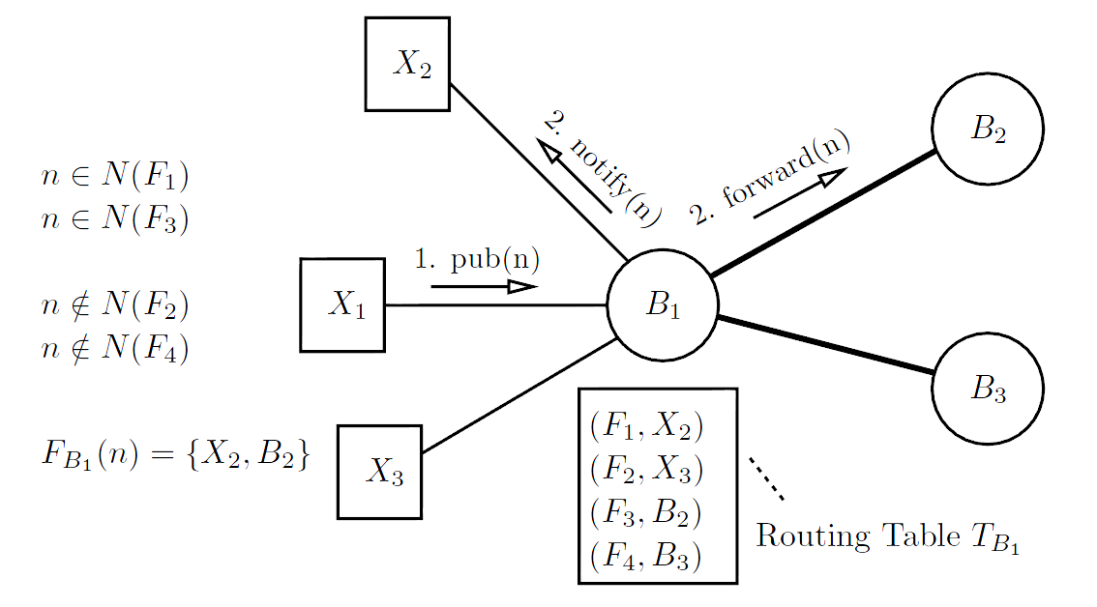
Basic routing framework
Figure source: Distributed Event-Based Systems (Muhl et al. 2006)

Slide 12
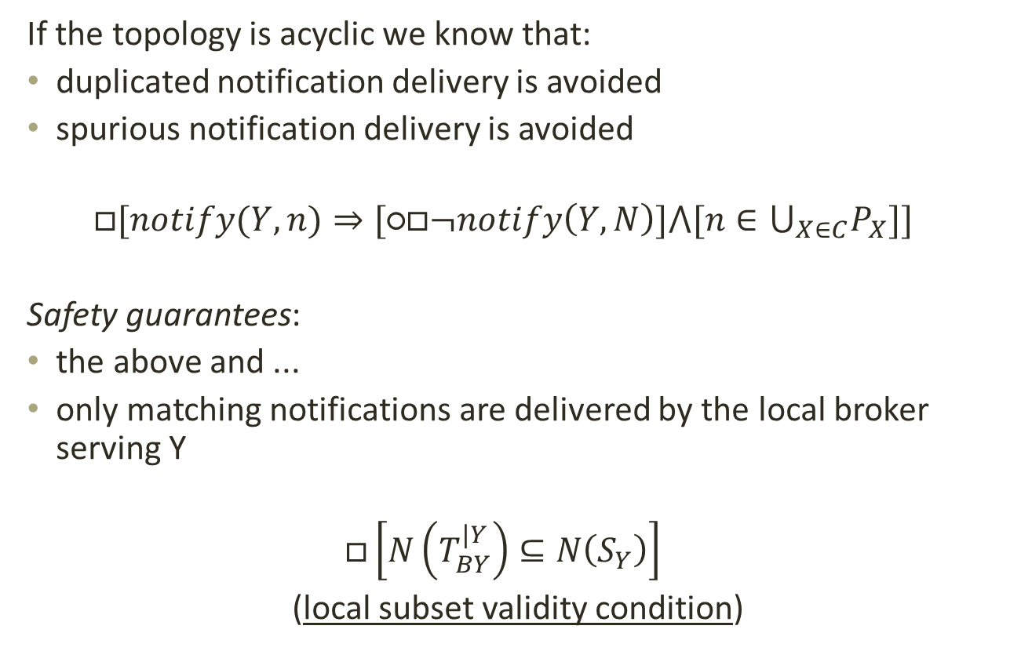
Necessary routing guarantees
If the topology is acyclic we know that:
duplicated notification delivery is avoided
spurious notification delivery is avoided
$$□[notify(Y,n)⇒[\text{○}□¬notify\left(Y,N\right)]⋀[n∈⋃_{X∈C}P_{X}]]$$
Safety guarantees:
the above and ...
only matching notifications are delivered by the local broker serving Y
$$□\left[N\left(T_{BY}^{|Y}\right)⊆N\left(S_{Y}\right)\right]$$
(local subset validity condition)

Slide 13
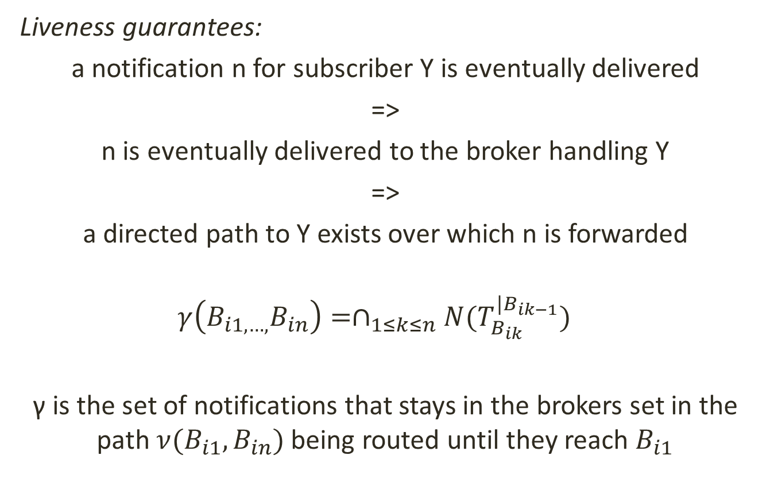
Necessary routing guarantees
Liveness guarantees:
a notification n for subscriber Y is eventually delivered
=>
n is eventually delivered to the broker handling Y
=>
a directed path to Y exists over which n is forwarded
$$γ\left(B_{i1,…,}B_{in}\right)=∩_{1≤k≤n}N(T_{B_{ik}}^{|B_{ik−1}})$$
γ is the set of notifications that stays in the brokers set in the path $ν(B_{i1},B_{in})$ being routed until they reach $B_{i1}$

Slide 14
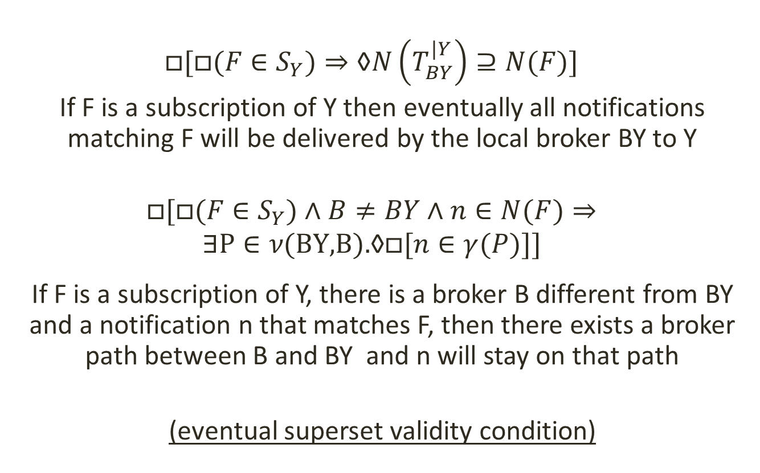
Necessary routing guarantees
$$□[□(F∈S_{Y})⇒\text{◊}N\left(T_{BY}^{|Y}\right)⊇N(F)]$$
If F is a subscription of Y then eventually all notifications matching F will be delivered by the local broker BY to Y
$$□[□(F∈S_{Y})∧B≠BY∧n∈N(F)⇒$$
$$∃\text{P}∈ν\text{(}\text{BY}\text{,}\text{B}\text{).}\text{◊}□[n∈γ(P)]]$$
If F is a subscription of Y, there is a broker B different from BY and a notification n that matches F, then there exists a broker path between B and BY and n will stay on that path
(eventual superset validity condition)

Slide 15
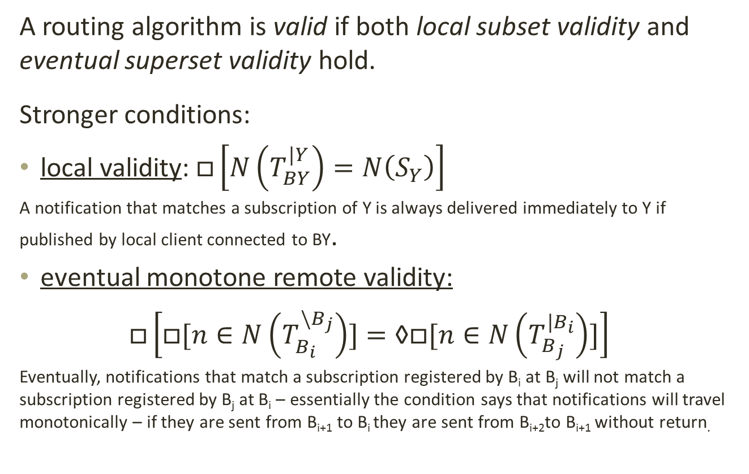
Necessary routing guarantees
A routing algorithm is valid if both local subset validity and eventual superset validity hold.
Stronger conditions:
local validity: $□\left[N\left(T_{BY}^{|Y}\right)=N\left(S_{Y}\right)\right]$
A notification that matches a subscription of Y is always delivered immediately to Y if published by local client connected to BY.
eventual monotone remote validity:
$$□\left[□[n∈N\left(T_{B_{i}}^{\backslash B_{j}}\right)]=\text{◊}□[n∈N\left(T_{B_{j}}^{|B_{i}}\right)]\right]$$
Eventually, notifications that match a subscription registered by B_{i} at B_{j} will not match a subscription registered by B_{j} at B_{i} – essentially the condition says that notifications will travel monotonically – if they are sent from B_{i+1} to B_{i} they are sent from B_{i+2}to B_{i+1} without return.

Slide 16
Necessary routing guarantees
Basic rule for a valid routing algorithm: safety and liveness
At what do we look when designing a routing algoritm?
what provides safety and liveness
or/and
what prevents safety and liveness
Probably the most important (if not single) aspect to focus on: how the active subcriptions set changes dynamically at the brokers side

Slide 17
Necessary routing guarantees
handle_message(Message m) {
if (m==”forward(n)”) {
handle_notification(source(m),n);
}
if (m==”admin(S,U)”) {
(FS,FU)=administer(source(m),S,U); handle_admin_message(source(m),FS,FU);
}
}
administer() – method specific for a routing algorithm managing the local routing table; returns the sets of subscriptions (FS) and unsubscriptions (FU) that must be delivered to other brokers
progress guarantee: administer should return after a finite time (a broker cannot block forever when processing a message)

Slide 18

Necessary routing guarantees
What happens if we have multiple admin messages coming from everywhere and overlapping each other in terms of affected routing table entries?
Let’s stop a bit, think on it, and make the life easier (or see that it actually is) ...

Slide 19
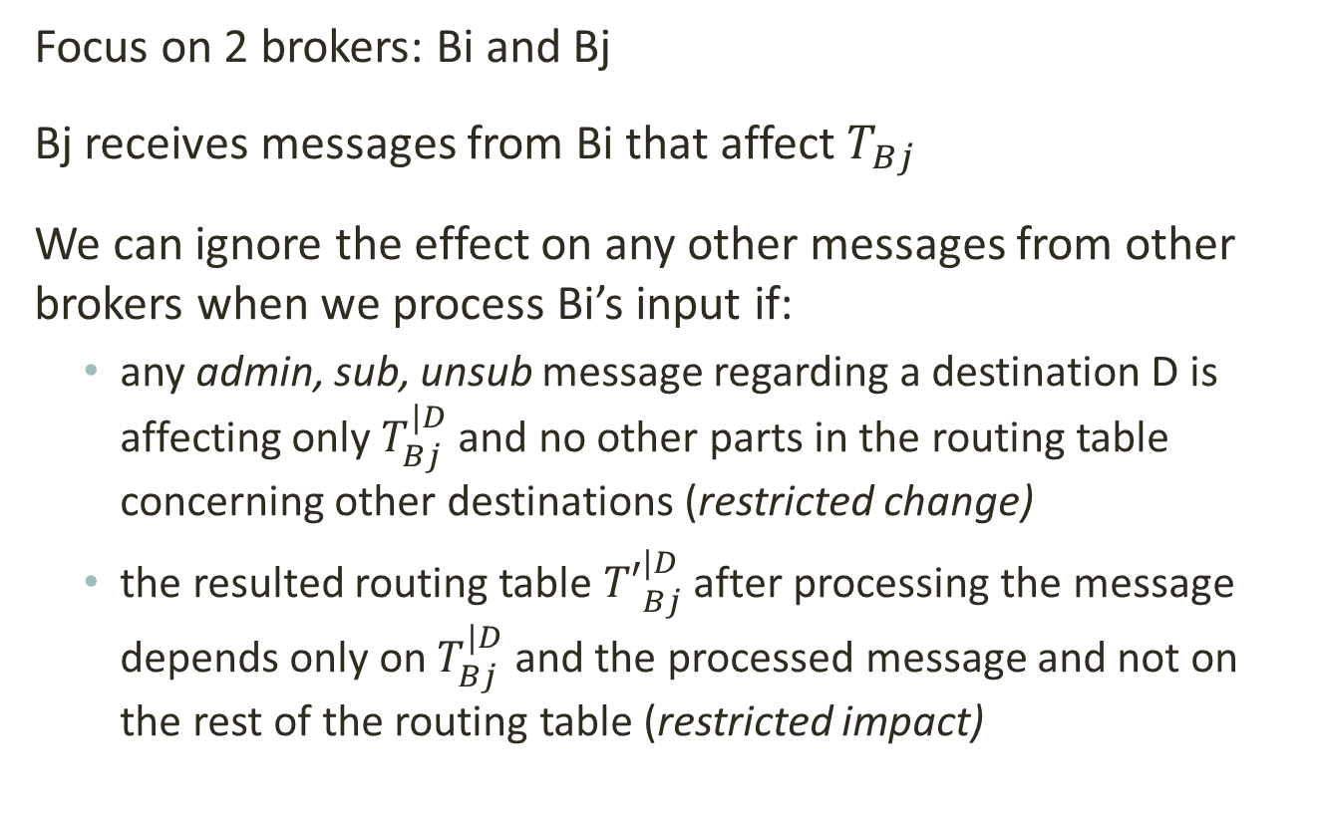
Necessary routing guarantees
Focus on 2 brokers: Bi and Bj
Bj receives messages from Bi that affect${ T}_{Bj}$
We can ignore the effect on any other messages from other brokers when we process Bi’s input if:
any admin, sub, unsub message regarding a destination D is affecting only $T_{Bj}^{|D}$ and no other parts in the routing table concerning other destinations (restricted change)
the resulted routing table ${T′}_{Bj}^{|D}$ after processing the message depends only on $T_{Bj}^{|D}$ and the processed message and not on the rest of the routing table (restricted impact)

Slide 20
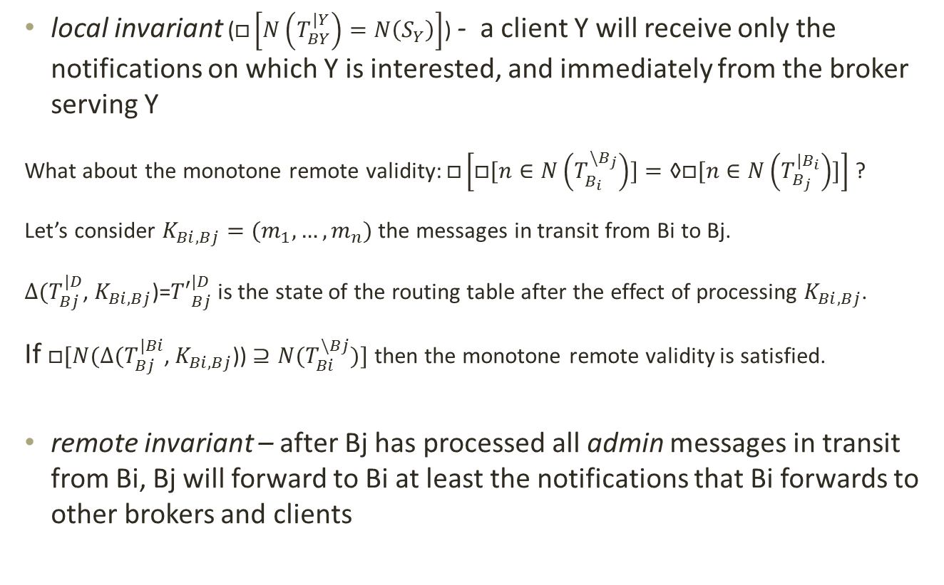
Necessary routing guarantees
local invariant ($□\left[N\left(T_{BY}^{|Y}\right)=N\left(S_{Y}\right)\right]$) - a client Y will receive only the notifications on which Y is interested, and immediately from the broker serving Y
What about the monotone remote validity: $□\left[□[n∈N\left(T_{B_{i}}^{\backslash B_{j}}\right)]=\text{◊}□[n∈N\left(T_{B_{j}}^{|B_{i}}\right)]\right]$ ?
Let’s consider $K_{Bi,Bj}=(m_{1},…,m_{n})$ the messages in transit from Bi to Bj.
$∆(T_{Bj}^{|D}$, $K_{Bi,Bj}$)=${T′}_{Bj}^{|D}$ is the state of the routing table after the effect of processing $K_{Bi,Bj}$.
If $□[N(∆(T_{Bj}^{|Bi}$, $K_{Bi,Bj}$)) $⊇{N(T}_{Bi}^{\backslash Bj})]$ then the monotone remote validity is satisfied.
remote invariant – after Bj has processed all admin messages in transit from Bi, Bj will forward to Bi at least the notifications that Bi forwards to other brokers and clients

Slide 21
Necessary routing guarantees
Guarantees recap:
Progress
Restricted change
Restricted impact
Local invarant
Remote invariant
All these make a routing algorithm valid
(Note that not necessarily a valid routing algorithm does make all these are true!)

Slide 22
Basic routing techniques - Flooding
init() {
T_{B} = {(FT,Bi) | Bi ∈ NB and
FT(n)=true for any notification n}
}
administer(source(m),S,U)
begin {
T_{B} = T_{B} ∪ {(F,source(m))|F ∈ S};
T_{B} = T_{B} \ {(F,source(m))|F ∈ U};
return (φ,φ);
}

Slide 23
Basic routing techniques - Flooding
In the initial setting the broker B has a routing table including an universal match filter FT that is registered to deliver notifications to any neighbour broker in NB.
The broker B than simply processes subscribe and unsubscribe requests by adding and removing filters registered exclusively with end clients destination.
No admin messages are exchanged with subscriptions and unsubscriptions to be delivered to other brokers.
A notification gets everywhere, being flooded in the broker network.

