Slide 1
Event Based Systems Routing in Publish/Subscribe II
Dr. Emanuel Onica
Faculty of Computer Science, Alexandru Ioan Cuza University of Iaşi

Slide 2
Contents
Simple Routing
Identity Routing
Coverage Routing
Topology Changes
Cyclic Topologies
Routing with Advertisements
Hierarchical Routing
Content-Based pub/sub examples (Gryphon, Padres)

Slide 3
To prove or not to prove ...
Starting note:
We will not discuss proving that each routing algorithm is valid according to the necessary guarantees presented before ...
... but you can think on this ;) ...
... and the algorithms we will present are definitely valid.

Slide 4
Recap
handle_message(Message m) {
if (m==”forward(n)”) {
handle_notification(source(m),n);
}
if (m==”admin(S,U)”) {
(FS,FU)=administer(source(m),S,U); handle_admin_message(source(m),FS,FU);
}
}
handle_admin_message(Node D, Set FS, Set FU) {
forall(H in NB-{D}){
S = {F|(F,H) in FS};
U = {F|(F,H) in FU};
if (S!=Φ || U!=Φ) {
send(H,”admin(S,U)”);
}
}
}

Slide 5
Recap
synchronized sub(Client C, Subscription F){
(FS,FU)=administer(C,{F},Φ);
handle_admin_message(C,FS,FU);
}
synchronized unsub(Client C, Unsubscription F){
(FS,FU)=administer(C,Φ,{F});
handle_admin_message(C,FS,FU);
}

Slide 6
Simple Routing
init() {
T_{B} = φ;
}
administer(source(m),S,U)
begin {
T_{B} = T_{B} ∪ {(F,source(m))|F ∈ S};
T_{B} = T_{B} - {(F,source(m))|F ∈ U};
M_{S} = {(F,H)|H ∈ NB-{source(m)} and F ∈ S};
M_{U} = {(F,H)|H ∈ NB-{source(m)} and F ∈ U};
return (M_{S},M_{U});
}

Slide 7
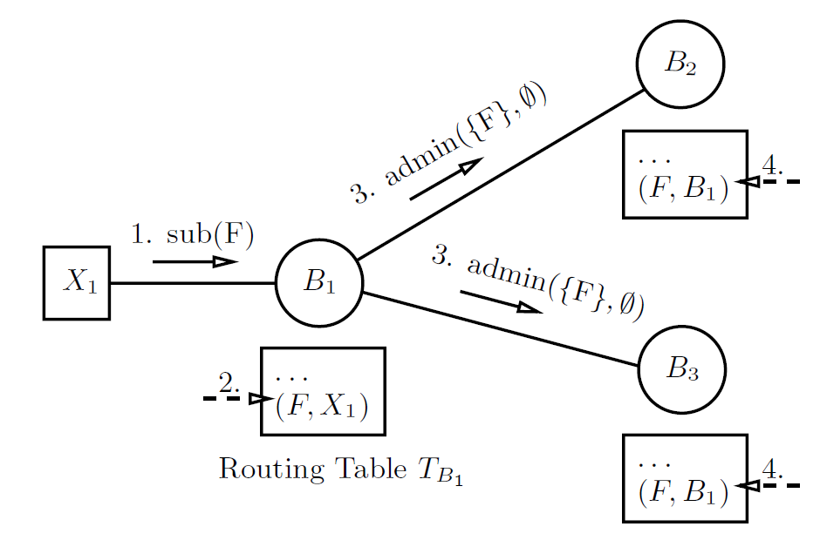
Simple Routing
We can observe that when a client registers a new subscription or unsubscription F, only messages that are routed between brokers are admin({F},φ) or respectively admin(φ,{F}).
Figure source: Distributed Event-Based Systems (Muhl et al. 2006)

Slide 8
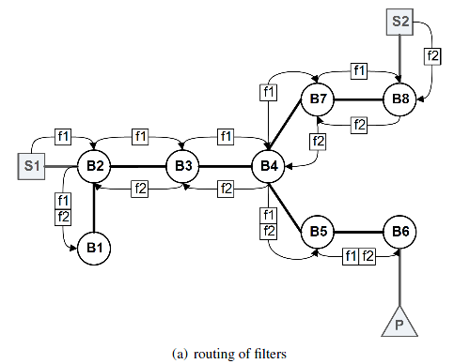
Simple Routing
Figure source: XSiena – The Content-Based Publish/Subscribe System (Z. Jerzak, 2009)

Slide 9
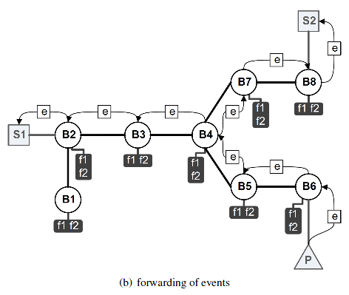
Simple Routing
Figure source: XSiena – The Content-Based Publish/Subscribe System (Z. Jerzak, 2009)

Slide 10
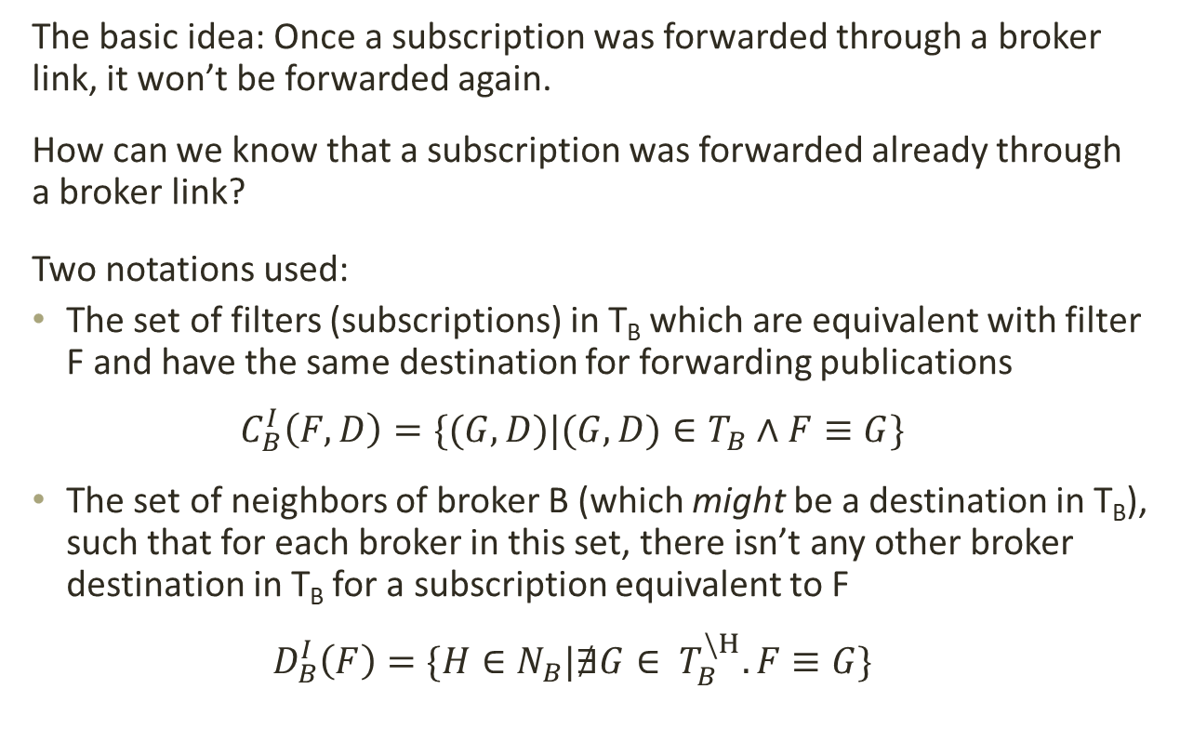
Identity Routing
The basic idea: Once a subscription was forwarded through a broker link, it won’t be forwarded again.
How can we know that a subscription was forwarded already through a broker link?
Two notations used:
The set of filters (subscriptions) in T_{B} which are equivalent with filter F and have the same destination for forwarding publications
$$C_{B}^{I}\left(F,D\right)=\{(G,D)|(G,D)∈T_{B}∧F≡G\}$$
The set of neighbors of broker B (which might be a destination in T_{B}), such that for each broker in this set, there isn’t any other broker destination in T_{B} for a subscription equivalent to F
$$D_{B}^{I}\left(F\right)=\{H∈N_{B}|∄G∈ T_{B}^{\backslash H}. F≡G\}$$

Slide 11
Identity Routing (according Muhl et al. 2006 ... do you think it works?)
administer(source(m),S,U)
begin {
M_{S} = φ;
M_{U} = φ;
forall (F in S ∪ U) do {
if (source(m) ∈ NB) {
T_{B} = T_{B}-C_{B}^{I}(F,source(m));
}
else {
T_{B} = T_{B}-{(F,source(m))};
}
A={(F,H)|H ∈ D_{B}^{I}(F)-{source(m)}};
if (F ∈ U) {
M_{U} = M_{U} ∪ A;
}
else {
M_{S} = M_{S} ∪ A;
T_{B} = T_{B} ∪ {(F,source(m))};
}
}
return (M_{S},M_{U});
}

Slide 12
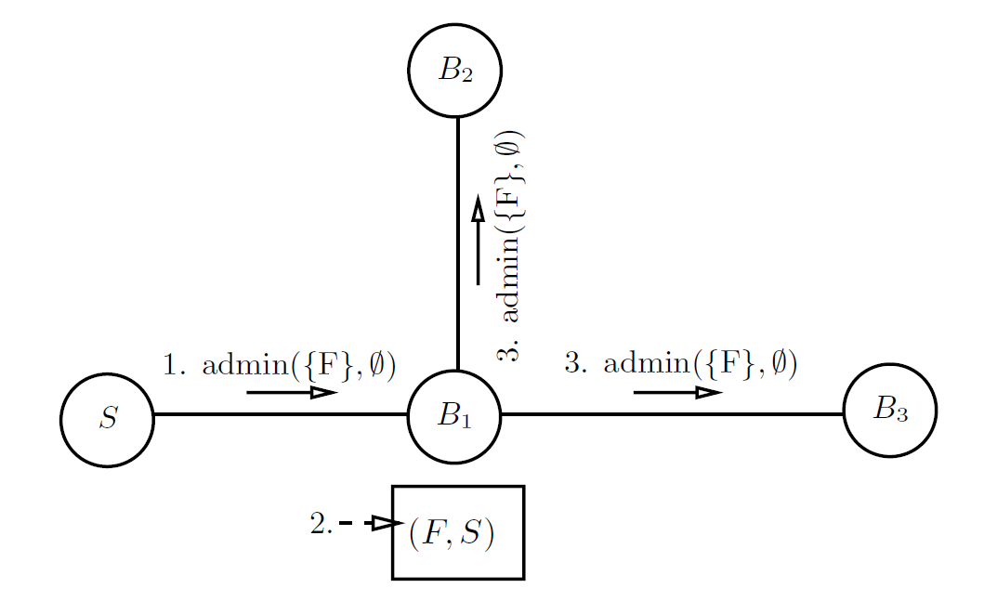
Identity Routing
Figure source: Distributed Event-Based Systems (Muhl et al. 2006)

Slide 13
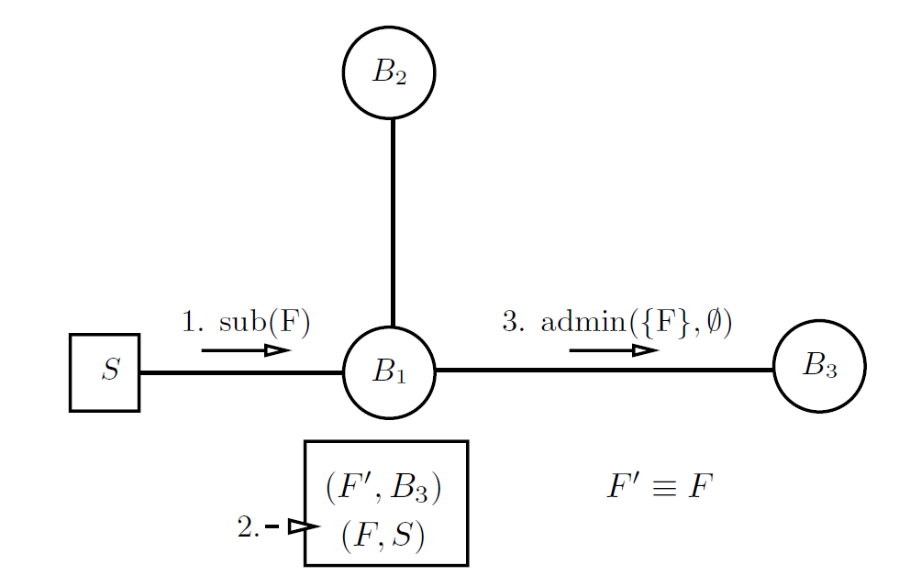
Identity Routing
Why ? ... seems counterintuitive ...
Figure source: Distributed Event-Based Systems (Muhl et al. 2006)

Slide 14
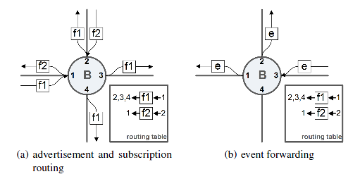
Identity Routing
A broker sees a filter for the 2nd time (f1=f2): Once a filter is forwarded first time on a link, we know the only link on which was not forwarded is the one from which it arrived the first time.
A broker sees a filter for the 3rd time: ? ...
Figure source: XSiena – The Content-Based Publish/Subscribe System (Z. Jerzak, 2009)

Slide 15
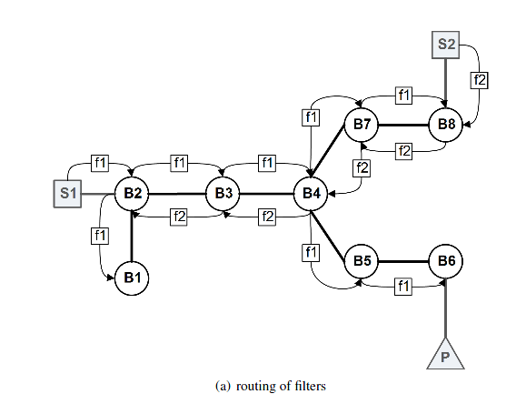
Identity Routing
Figure source: XSiena – The Content-Based Publish/Subscribe System (Z. Jerzak, 2009)

Slide 16
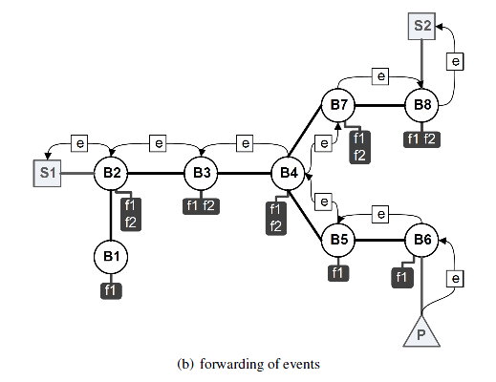
Identity Routing
Figure source: XSiena – The Content-Based Publish/Subscribe System (Z. Jerzak, 2009)

Slide 17
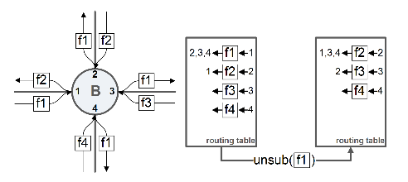
Identity Routing
What happens with the unsubscriptions? (these were handled similarly with subscriptions in the pseudocode before ...)
1) The unsubscription effect is to remove an existing filter.
2) Some registered filters prevented forwarding of other filters.
So ... We have to re-forward some filters we didn’t forward (f1=f2=f3=f4):

Slide 18
Coverage Routing
Exactly the same principle and technique as identity routing:
If a filter (subscription) F was forwarded over a link already there is no need to forward other filter G over that link, if F covers G.
Why?
All publications matching G will match F, so G does not influence the behavior of brokers where F was already forwarded.
Same problem for unsubcriptions:
Removing filters from routing tables creates gaps in the reasoning above when previous other filters were not forwarded ... so these have to be tracked and resent.

Slide 19
Topology Changes
In a real case environment, the brokers topology changes:
brokers can be removed from topology
brokers can be added to topology
The effect of topology changes on the routing tables of neighbor brokers are directly related to the routing algorithm in use.
Let’s recap ...

Slide 20
Simple Routing
Figure source: Distributed Event-Based Systems (Muhl et al. 2006)
Broker removal (e.g., B1): the filter entries having as source the removed broker area must be removed on the neighbors (e.g., (F,B1) on B2, B3).
Broker addition (e.g., B4 is connected to B3): the filter entries on the neighbors of the added broker are forwarded to the other broker (e.g., B4 will receive (F, B1)).
Similar reasoning for the other routing algorithms.

Slide 21
Cyclic Topologies
Cyclic topologies should be generally avoided in pub/sub:
links redundancy – usually bad
typically can be reduced to acyclic by applying spanning trees algorithms
If a cyclic topology is unavoidable: the main concern – prevent notification duplicates:
brokers store IDs of processed notifications
notifications received more than once are ignored
How many IDs can a broker store? ...
use a notification timestamps vector for messages received from clients or neighbors
keep brokers time relatively synchronized
stored IDs are removed after a while if they’re not seen again

Slide 22
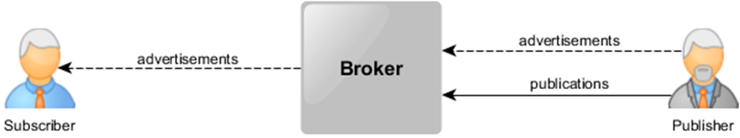
Routing with Advertisements
What’s an advertisement ? (recap):
Essentially, it’s a type of meta-subscription announcing what publications will follow (e.g., containing some particular field or having a particular structure – example: symbol=„Google” and any other field).
Main idea: Filters routing could be optimized by forwarding only towards the publisher direction that emits matching advertisements (e.g., if a filter includes symbol=„Google” will be routed just towards the advertiser who said that will publish Google related info)

Slide 23
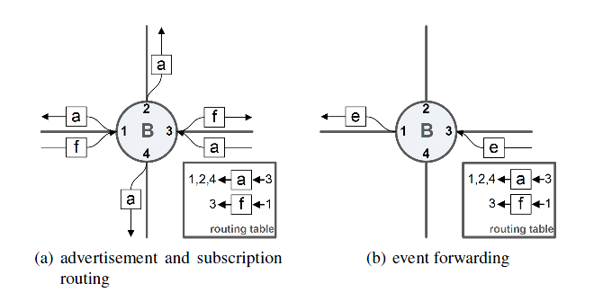
Routing with Advertisements
The advertisements will be also stored in the routing table:
Figure source: XSiena – The Content-Based Publish/Subscribe System (Z. Jerzak, 2009)
Filter forwarding is done in a similar manner to the identity or coverage routing, but based on the validity of the intersection relation between the advertisement and the filter.

Slide 24
Routing with Advertisements
Intersection relation:
A filter F intersects an advertisement A if there is at least one publication that matches both F and A.
Examples:
F={(x>5)} ∩ A={(x>5)}
True
F={(x>5)} ∩ A={(x<7)}
True
F={(x>5)} ∩ A={(y>6)}
False
F={(x>5)} ∩ A={(x>4);(y>6)}
True
F={(x>5);(y>7)} ∩ A={(x>5)}
True

Slide 25
Hierarchical Routing
Brokers are organized as a tree hierarchy, with a root node.
Publications are always forwarded towards this root node, being disseminated by the brokers on-path in their subtrees.
Subscriptions and unsubscriptions are always forwarded towards the root node, based on the other rules of the routing algorithm.
Typically, a non-hierarchical routing algorithm (e.g., coverage, identity) can be adapted to a hierarchical form by organizing the broker overlay as a tree.

Slide 26
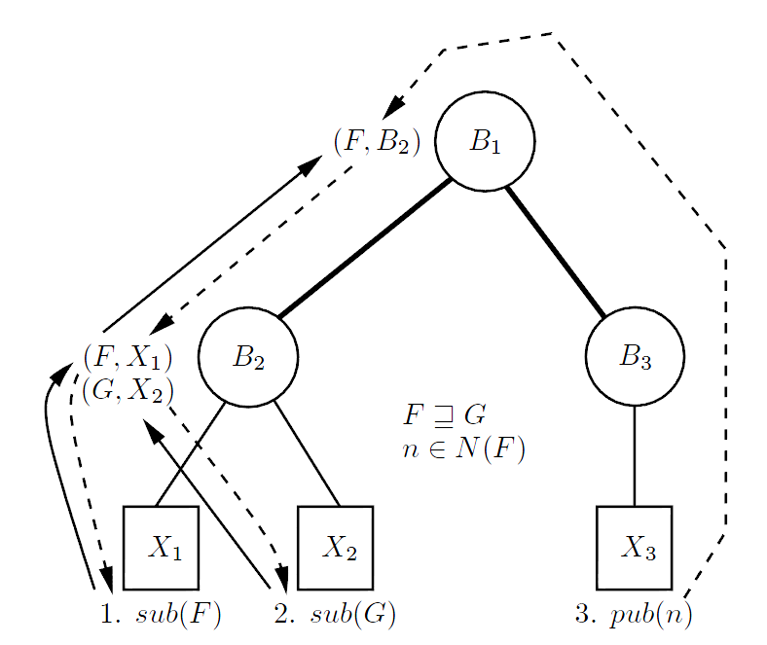
Hierarchical Routing
Hierarchical coverage routing:
Figure source: Distributed Event-Based Systems (Muhl et al. 2006)
Advantages ? ... Disadvantages ? ...

Slide 27
Gryphon – general description
Message brokering platform initially developed at IBM Research in 1998
Various advances (storage, congestion control, subscription propagation, etc) until 2004
Event stream dissemination described via an information flow graph
Specifies the selective delivery of events
Specifies the transformation of events
Specifies generation of derived events as function of states derived from event histories

Slide 28
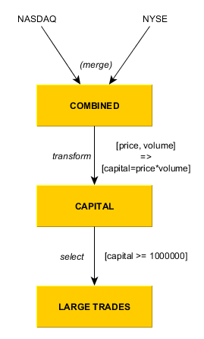
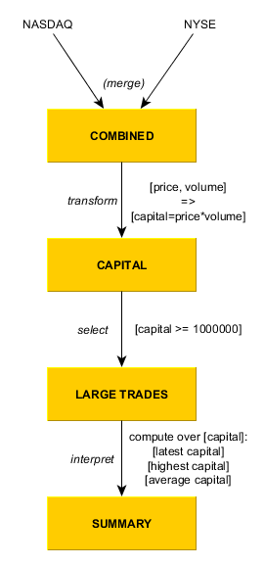
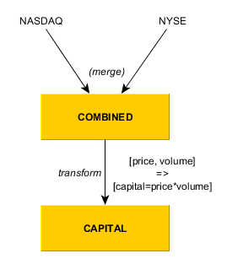
Gryphon – information flow graph
Graph nodes - information spaces:
Event histories (monotonically growing collections of events – e.g., [price, volume])
Event interpretations (interpretations of sequences of events – e.g., [latest, highest])
Arcs:
merge – combines multiple histories into one
transform – applies a specific function to each event in the source to obtain each destination event
select – selects a history of events from the source based on a criteria
interpret – incrementally computes a function over incoming events

Slide 29
Padres – general description
Project started at University of Toronto in 2003 (many increments and additions since then)
Brokers network working based on the pub/sub/advertise model
ORT - Overlay Routing Tables – on each broker:
SRT – Subscription Routing Tables – built based on advertisements stored on broker (contain [adv, lasthop] entries over which overlapping subscriptions are routed)
PRT – Publication Routing Tables – built based on subscriptions (contain [sub, lasthop] entries)

Slide 30
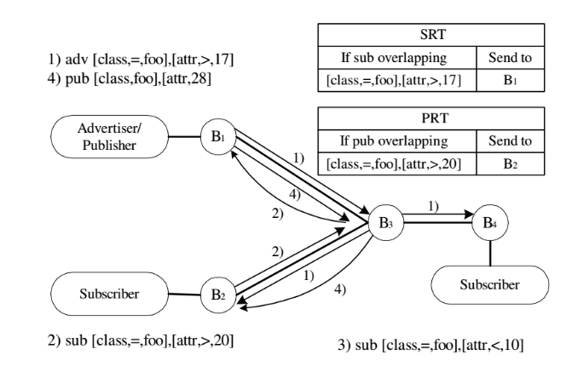
Padres – broker architecture
Figure source: The PADRES Distributed Publish/Subscribe System (Fidler et al. 2005)

Slide 31
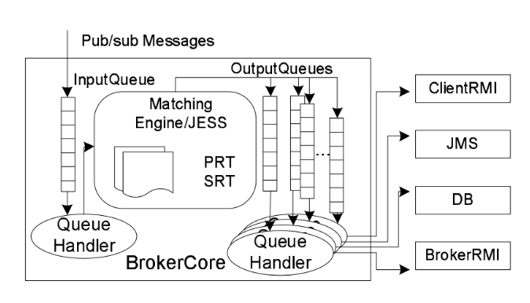
Padres – broker internals
Figure source: The PADRES Distributed Publish/Subscribe System (Fidler et al. 2005)

Slide 32
Padres – other characteristics
Composite subscriptions:
sequence aggregation
repetition
field references (joins)
Historic data access:
time predicates added to subscriptions
brokers can store publication databases
brokers forward old publications matching within subscription time window (including past time)

