Slide 1
Git
Ivan Cipriani

Slide 2
Agenda
What it is Git
Git Overview
Git content-addressable database
Atomic Commit
Branch
Merge/Rebase
Revert/Reset
Reflog/Stask/Cherry-Pick

Slide 3

https://git-scm.com/
Notes:
Documentation free book

Slide 4
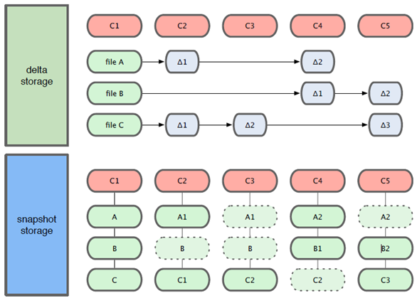
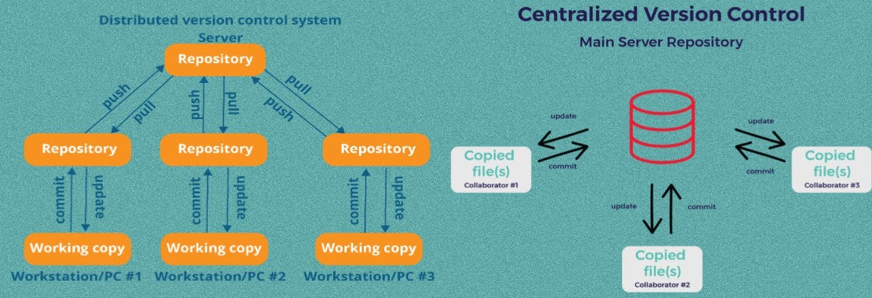
What it is Git
Git is a content tracker
Distributed version control system optimized for local operation
Snapshot of changes not deltas
Git is definitive
Bolster not linear development
Notes:
Git is not only for software developer but also for data science, grahic editor, writers etc.. You can use for your football teams to keep an history of static e...
Local repository allow to work also disconnected from internet
Git is definit command are explicit
Thinking GIT
Git content-addressable database under the hood
To with branching you can work in parallelto your main branch

Slide 5
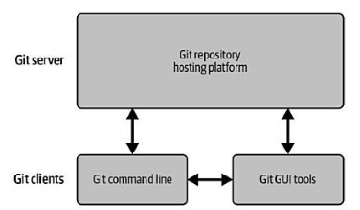
What it is Git
Notes:
Git server is not need but make easier to collaborate.
Git GUI use command line but can call them in a different way or combine some together so they suggest to start with command line and then move to gui

Slide 6
DEMO
Creation of a repository
Intro to Git extension
Notes:
Create a repo in github (server) --> name git ignore visualstudio readme file repository template
Show reflog and history of commit and how to keep dialog open to see the command that the gui run
The non-bare repository is the one developers use - it has a working copy checked out, i.e. the code is directly available.
In case of a bare repository all that's there is the contents of the .git folder. This is great for pushing/pulling to/from the repository but for obvious reasons not suitable to view the code directly or work on the code.
So, when you want to develop stuff you want a non-bare repository. When you want to push to another machine create a bare one there and push to it from your non-bare one. If you use e.g. GitHub you won't create that bare repository manually - you create it on the website (which usually creates a bare one internally and sets up access control) and then setup it as a remote locally (the address of the repository is displayed so you just need to copy&paste it).
This command manages the information recorded in the reflogs.
Reference logs, or "reflogs", record when the tips of branches and other references were updated in the local repository. Reflogs are useful in various Git commands, to specify the old value of a reference. For example, HEAD@{2} means "where HEAD used to be two moves ago", master@{one.week.ago} means "where master used to point to one week ago in this local repository", and so on. See gitrevisions[7] for more details.
The command takes various subcommands, and different options depending on the subcommand:

Slide 7
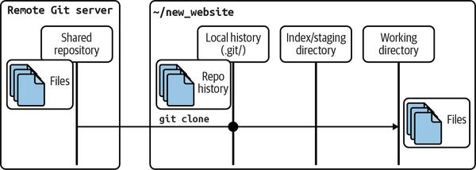
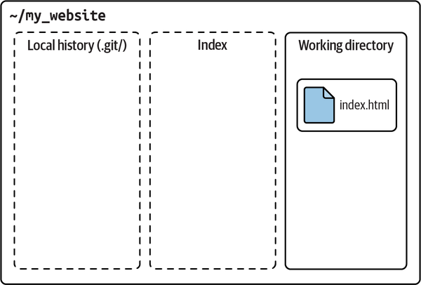
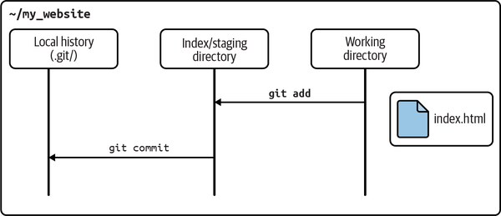
Git Overview
Git hidden folder (local repository)
Local history (commits)
Index (stage)
Working directory
Notes:
Working directory where you alter your files
Local history --> repo history
Shared repository git clone
Working directory is "clean" empty in the image above if equal to the remote one

Slide 8
Git Overview
Index (Stage)
Separation between incremental steps and the commit of those change
Useful also in merge operation allowing multiple version of the same file to be manage inspected and manipulated
It is private to your repository
It is transitory information
It is like a cache
Ramdom modification
1. git add
Ramdom modification
2. New changes
Other modification
Notes:
This concept it will be important later in another slide
Key distinguish feature pf git
Does not create a tree for your objets creted but update git/index
Do not care of the name of the file only of the content
Rappresnt a tree object candidate to be a commit
List of pathnames with persmission and reference to objects in the .git/objects folder (file or other tree)
Git commit check the index to see what to commit

Slide 9
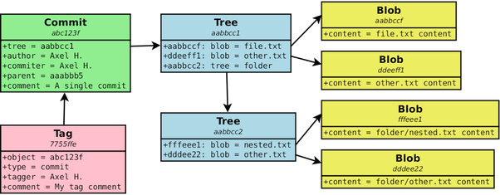
GIT Content-addressable database
Objects are stored in key-value pairs
Git store the whole content of the file not the difference
The key is an SHA1 hash value
Git use the whole content of the object to generate this key (but not file name)
The same content always the same key (True function)
Collision of sha1 is almost impossible
The path and name of the files are saved in the tree objects
Notes:
So two files with the same content are identical and treated like on object (same hash always)
Commit is not identical to other commit in the world because they have date and name of the author… still possible but…
If you hired a trillion of people to produce a trillion new unique blobs per second per a trillion years only 10 elevate to 43 and you have about 10 elvetae 48 with 160 bits
It is a collosion only if two different content create the same hash

Slide 10
Git repository
Four type of objects in the Object store
Blobs
Each version of a file is represented as a blob (opaque) and does not contain any metadata included the name
Trees
A tree object represents one level of directory information. It records blob identifiers, pathname and bit of metadata in one directory. It can also refer another tree so to create complex structure
Commits
A commit object holds metadata for each change introduce into the repository. Each commit point to a tree object that capture the state (snapshot) of the repository at that time
Tags
A tag object assigns a human readable name to a specific object mainly commits
Immutable
Notes:
It contain all the information to retieve the whole history and revision
Here object store
Make easy to clone
Contains data file log message author information dates ans all the information need to recreate the project state at a given moment in time
Zlib to package files
Like in angular for redux
Commit rappresent a snapshot of all the files but only the one modifies or added are stored in a separated object and reuse the other blob

Slide 11
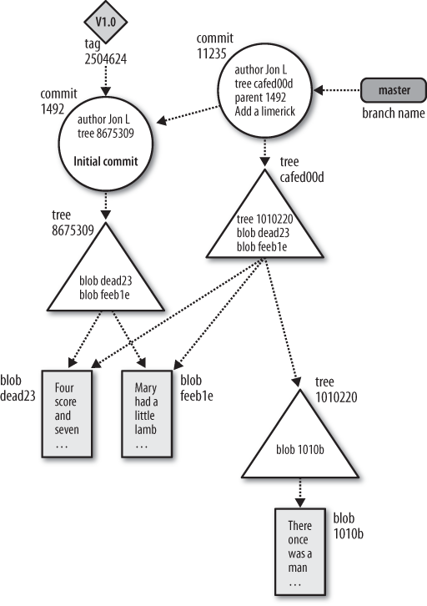
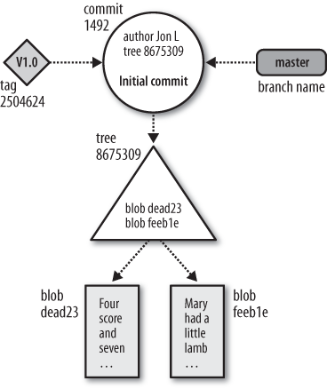
Visualizing git Object store
Time
Notes:
It contain all the information to retrieve the whole history and revision
Here object store
Make easy to clone
Contains data file log message author information dates ans all the information need to recreate the project state at a given moment in time
Branch is not an object in git
This is DAG for the commit
DRY →

Slide 12
DEMO
Working directory
Index
Local repository
Intro to HEAD
Optional demo on trees and objects and commits
Notes:
Create a project in the repo (working directory change) show nothig is created in the local repo or in index and create a commit
Go to HEAD --> name of the branch go to refs heads click on the name of the branch see the hash and copy
Go to powershell open the commit with cat-file --> then the tree see the tree and the object tree is another folder in this case
Stage 2 files --> git ls-files –stage cat-file one object that you change see that has the difference respect that in your local
Optionall see how two tree point to the same object if they have the same content
Why commit is not possible to have same hash (author or tiem is deiffernt
Do not create an object from the tree you can see only file and path of the file
The index is a binary file (generally kept in .git/index) containing a sorted list of path names, each with permissions and the SHA1 of a blob object; git ls-files can show you the contents of the index:
$ git ls-files --stage 100644 63c918c667fa005ff12ad89437f2fdc80926e21c 0 .gitignore 100644 5529b198e8d14decbe4ad99db3f7fb632de0439d 0 .mailmap 100644 6ff87c4664981e4397625791c8ea3bbb5f2279a3 0 COPYING 100644 a37b2152bd26be2c2289e1f57a292534a51a93c7 0 Documentation/.gitignore 100644 fbefe9a45b00a54b58d94d06eca48b03d40a50e0 0 Documentation/Makefile ... 100644 2511aef8d89ab52be5ec6a5e46236b4b6bcd07ea 0 xdiff/xtypes.h 100644 2ade97b2574a9f77e7ae4002a4e07a6a38e46d07 0 xdiff/xutils.c 100644 d5de8292e05e7c36c4b68857c1cf9855e3d2f70a 0 xdiff/xutils.h
Note that in older documentation you may see the index called the "current directory cache" or just the "cache". It has three important properties:
The index contains all the information necessary to generate a single (uniquely determined) tree object.
For example, running git commit generates this tree object from the index, stores it in the object database, and uses it as the tree object associated with the new commit.
The index enables fast comparisons between the tree object it defines and the working tree.
It does this by storing some additional data for each entry (such as the last modified time). This data is not displayed above, and is not stored in the created tree object, but it can be used to determine quickly which files in the working directory differ from what was stored in the index, and thus save git from having to read all of the data from such files to look for changes.
It can efficiently represent information about merge conflicts between different tree objects, allowing each pathname to be associated with sufficient information about the trees involved that you can create a three-way merge between them.
During a merge, the index can store multiple versions of a single file (called "stages"). The third column in the git ls-files output above is the stage number, and will take on values other than 0 for files with merge conflicts.
The index is thus a sort of temporary staging area, which is filled with a tree which you are in the process of working on.
Hash is true function

Slide 13

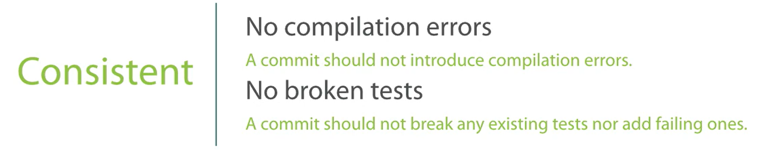
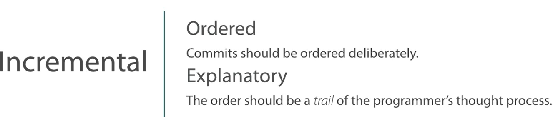
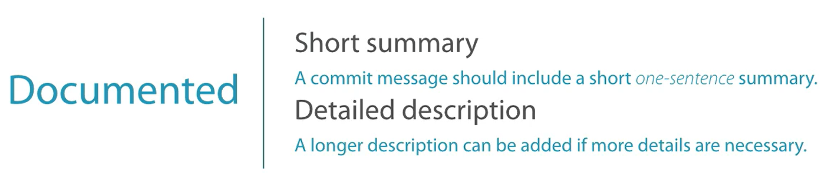
Atomic commit
Notes:
Do not remove something in one commit and add that in a second commit difficult to see bot atomic
Realistic hystoric every commit is retained and nothing is changed
fine grained
didactic only best work
Pay attention to clean history if you are not alone of work on that branch
Use always Push with lease so that if there are new change in the remote repo you will be notify

Slide 14
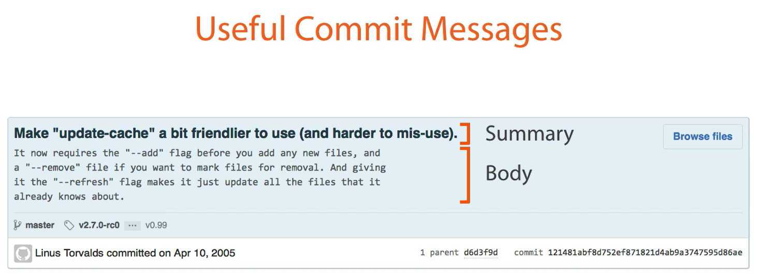
Atomic commit
Does Self-Documenting Code Actually Exist?
Probably not but we have to aim to that

Slide 15
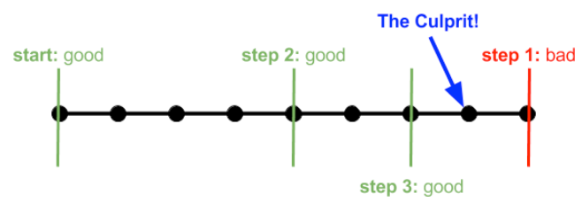
Atomic commit
Git Bisect
A toll included with Git that enables you to specify a start and end commit and either manually or automatically determine the point of failure with that range of commits
Notes:
Bynary search algorithm
You can use a script or sayd god badi
Do thing different from command line

Slide 16
DEMO
Amend commit
Commit template
Stash
Bisect
Optionall Refs and Symrefs
Optionall Tracked/Untracked
Notes:
Bisect need to check-out the commit and then you can mark good bad or skip you are in detach mode

Slide 17
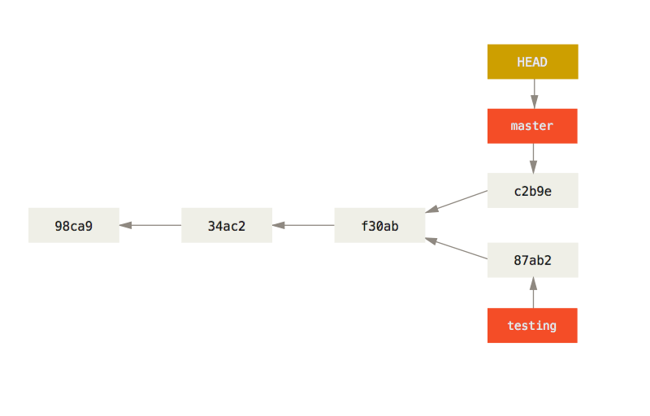
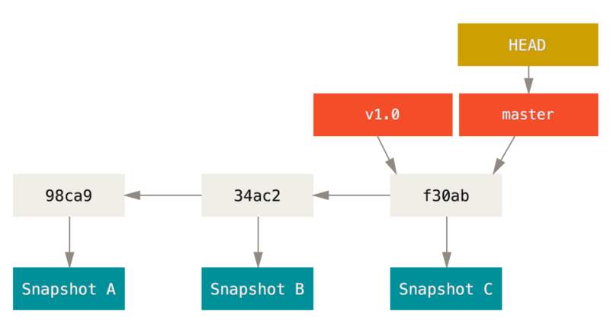
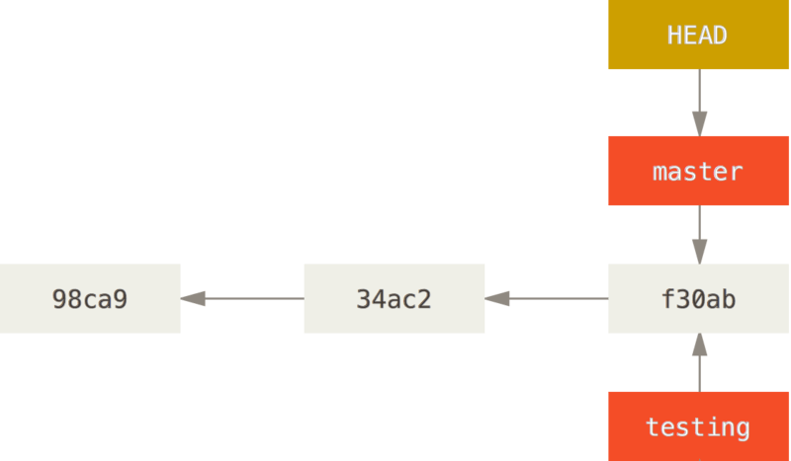
Branch
Branch is just a pointer to a commit
Active branch is the one in the working directory
Stash or merge when you change branch with not a clean working directory
Detach head (Garbage collect if not reachable)
Detach Head Garbage collect in the future
Notes:
Just a pointer to a specific comit lightwigh not expensive
Active branch is the one in the working directory
Branch versus tag they are static head and so branch name is moving with the commits in the branch
Checkout when something modiied in working directory Not loosing data use stash
Otherwise you can merge --> three way merging 1) current branch 2)working directory 3) target branch
Detach head (check out a commit not in the last place, start a git biset
Garbage collect not reachable otherwise need git reflog
In Git, a ref is a human readable name that references a Git commit ID. A ref is essentially a pointer to a commit. Examples of refs are Git branch names such as master and dev. Another example of refs are Git tags such as v0.1 or v0.2. You can think of each of these as a variable name that points to a commit ID. The commit ID that a ref points to is dynamic so it can change over time.
In Git, a head is a ref that points to the tip (latest commit) of a branch. You can view your repository’s heads in the path .git/refs/heads/. In this path you will find one file for each branch, and the content in each file will be the commit ID of the tip (most recent commit) of that branch.
Git refs and Git heads are simply pointers to commits, in the form of text files where the file name represents the name of the ref/head and the content is the commit ID that the ref points to.
HEAD is a special ref that points to the commit you are currently working on
In lowercase, "head" is a general term that means any commit that represents a branch tip. In uppercase, "HEAD" is a specific Git ref that always points to the commit currently checked out in the working directory.
This places Git into a detached HEAD state, which means that HEAD is not currently pointing to a branch head (branch tip). In this state, you can view and edit any files in your working directory, exactly as they were in that commit.

Slide 18
DEMO
Riproduce detach mode

Slide 19
Merge

Slide 20
Rebase

Slide 21
DEMO
Ref

Slide 22
Revert and Reset

Slide 23
Reflog – Stash – Cherry pick

Slide 24
Reflog – Stash – Cherry pick

Slide 25
Other important topic not in the presentation
Hook
Submodules
Patch
GitHub connection in git extension
.gitignore
Git maintance
Large file
Notes:
So subtrees

Slide 26
Thank you!
Ivan Cipriani

