Slide 1
Git and Git Extension

Slide 2
Agenda
Problem
Solution: Use a Version Control System (VCS)
The levels of Git
Branches
Merge
Demo Git extension

Slide 3
Problem
Tracking your code revision history
Unable to undo errors and roll back to earlier code versions
Sharing your codebase with a collaborator
Merging collaborator’s code to your code

Slide 4
Solution: Use a Version Control System (VCS)
a way to manage files and directories
a way to track and manage file changes so that you can recall specific versions later
a way to share a codebase to a collaborator without any trouble
a way to merge your collaborators code to your codebase without having conflicts

Slide 5
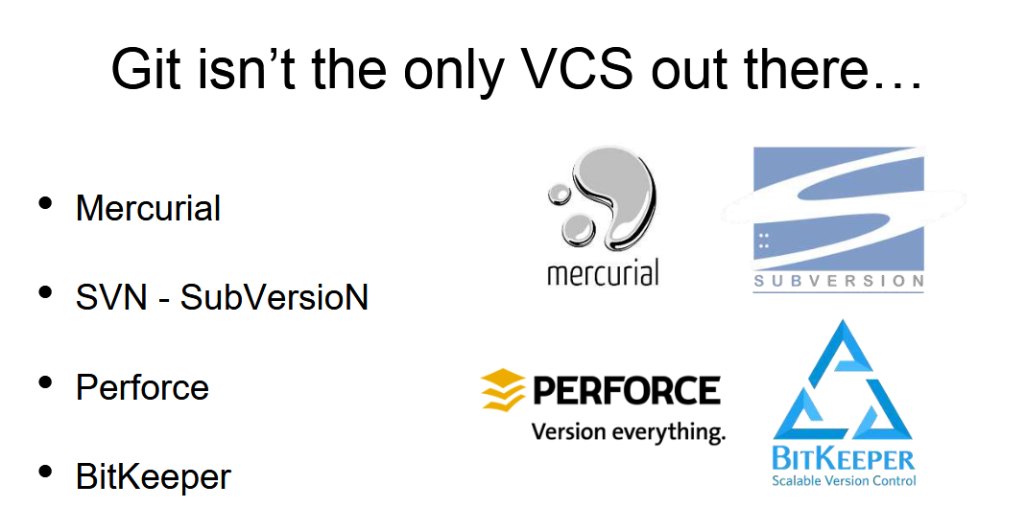

Slide 6
History of Git
• Created by Linus Torvalds in 2005
• Described by Linus as “the stupid content tracker”
• Originally created for the development of Linux kernel
• It’s written in C, Shell, Perl, Tcl, and Python
• Currently maintained by Junio Hamano since 2005

Slide 7
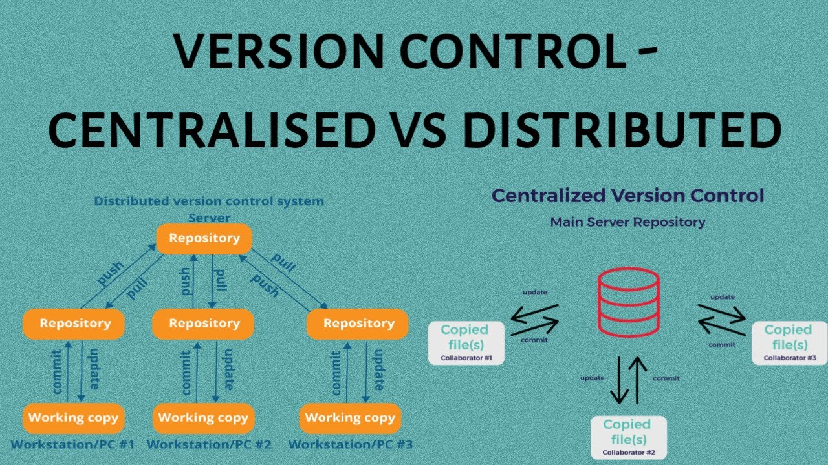
Notes:
Disconnetd development TFS example

Slide 8
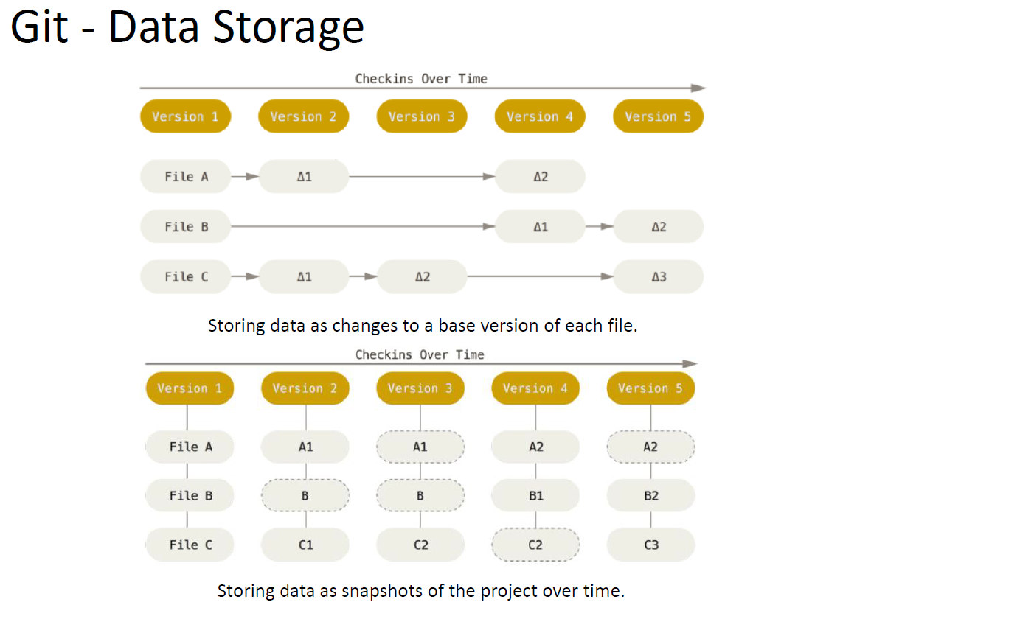
Notes:
Optimization:
Compressed package file for part that do not change
If file is not changed only a link
Snapshot stored a capture of the whole tree nor need of recostruction

Slide 9
Repository design
One repository for solution or smaller
Exclude binary file or large one it is not optimized for that (use other solution or extension of Git)
Exclude files generate from source code (.gitattributes file .gitignore)
Shared code used submodules but difficult to keep in sync

Slide 10
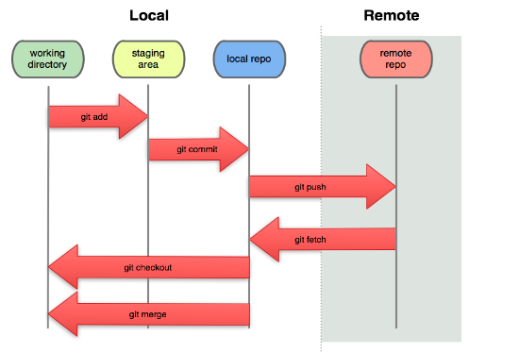
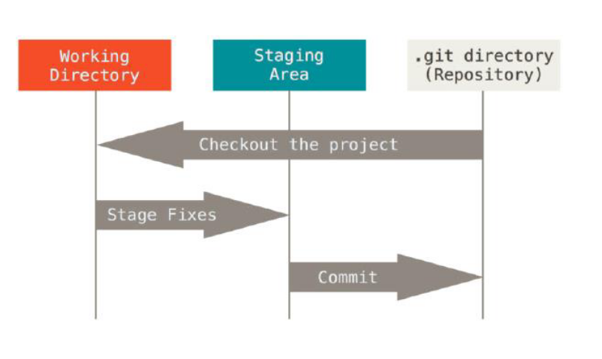
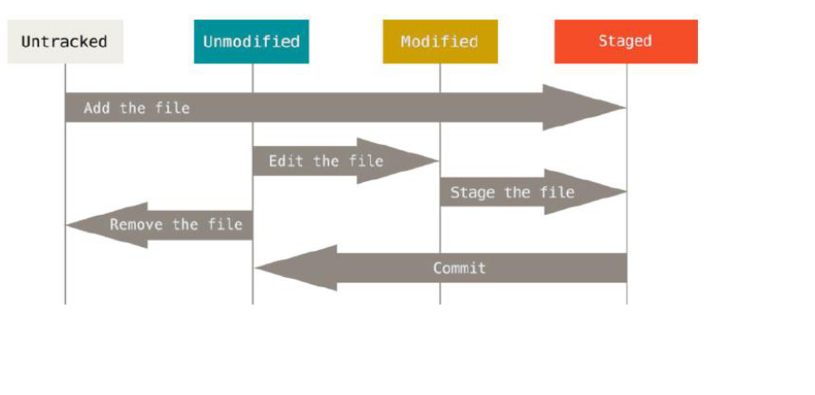
The levels of Git
git clone
git commit --amend
git pull (a fetch followed by a merge)
Notes:
Stage area promoted changes to collect for a commit
Repair scenario (amend commit
Merge conflict stage file that merged clean
Remote repository is not mean for fix conflict you fix that locally
To have a file tracking you need to stage
Git pull is a fetch followed by a merge

Slide 11
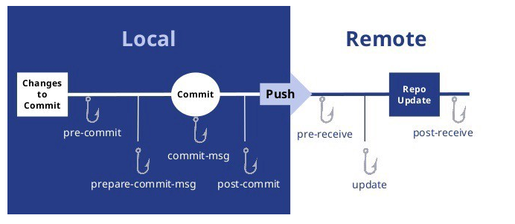
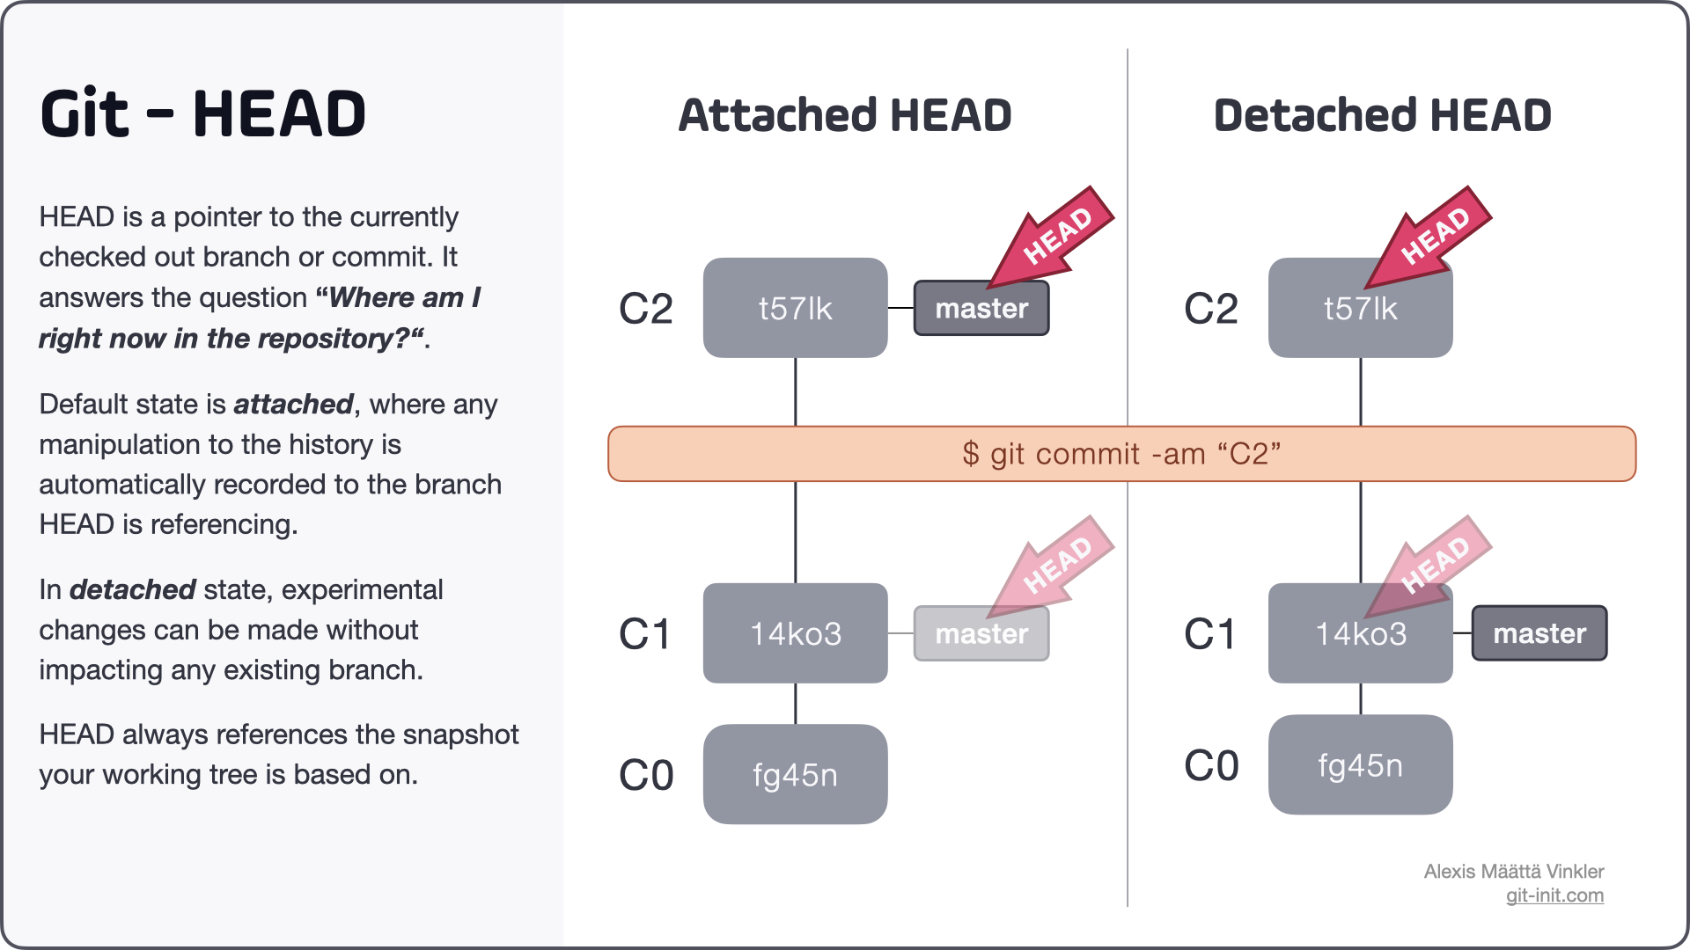
Notes:
Git head a pointer or a physical file (last commit in your current branch)

Slide 12
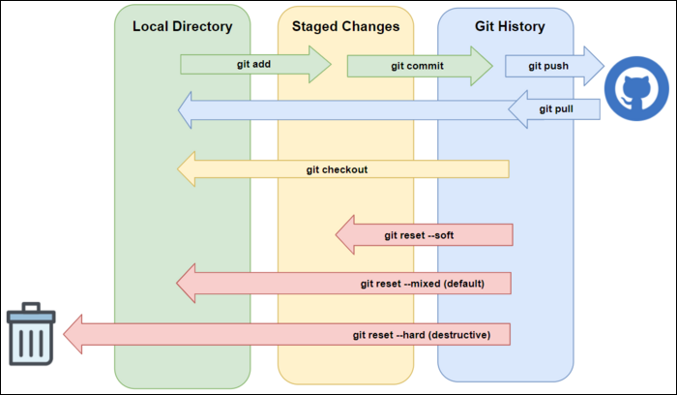
Git reset
For change already push on remote environment, Use git revert
Better to use only on local change
Notes:
Get back to a previous stage for remote change you need to force push because you change history is dangerous
Git revert do not change history but add only a new commit

Slide 13
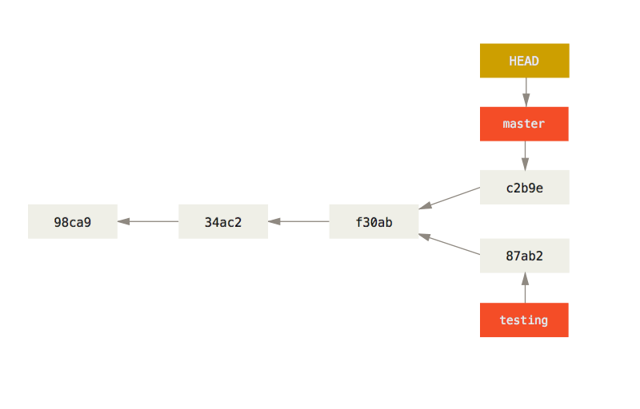
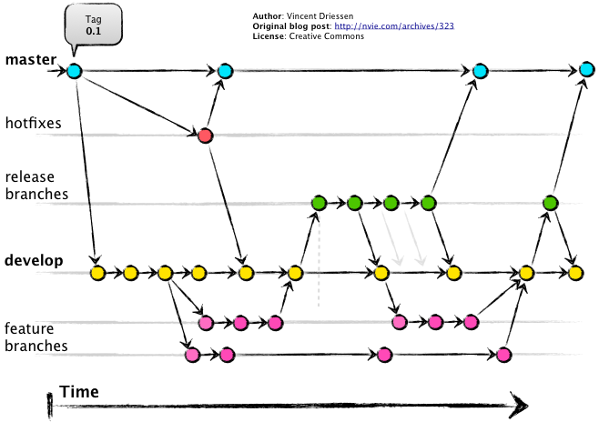
Branches

Slide 14
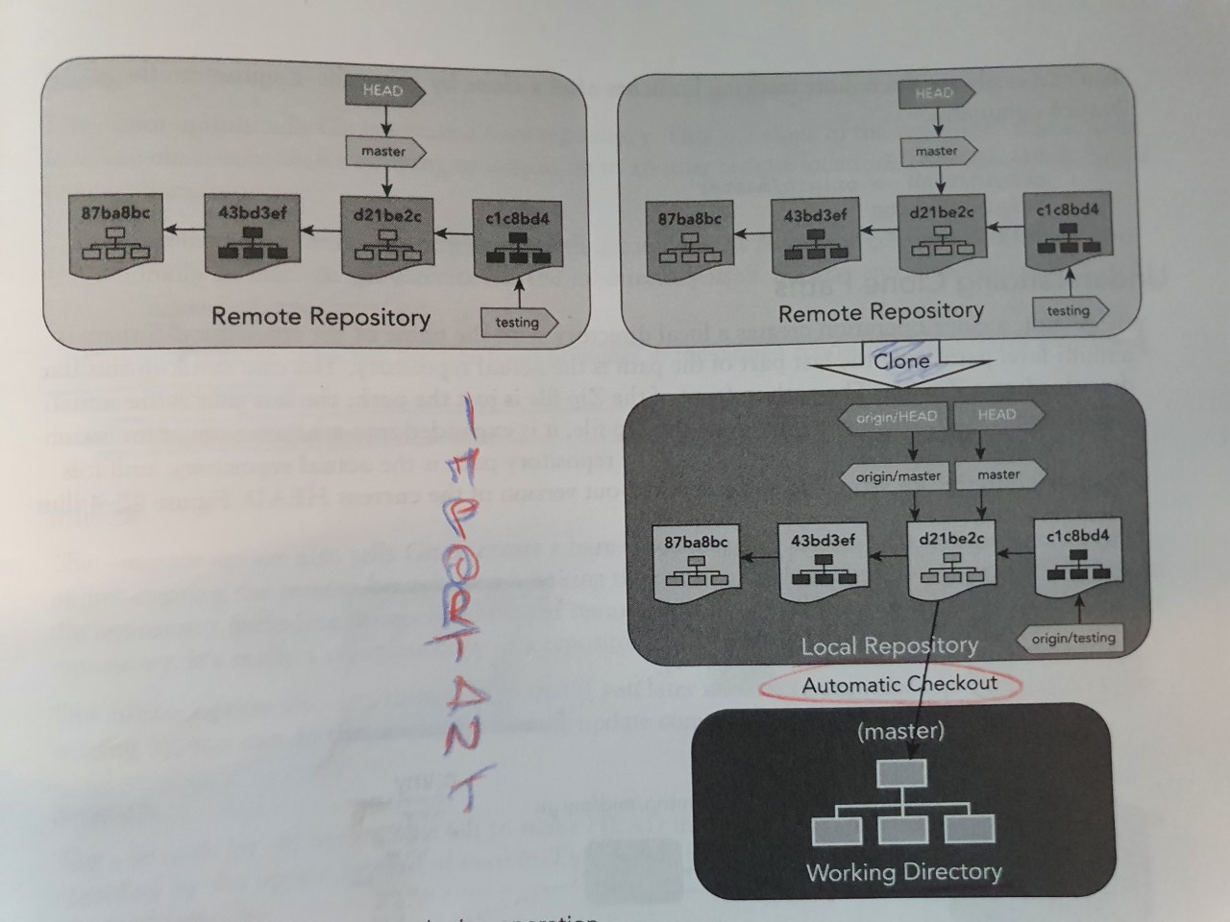
Clone

Slide 15
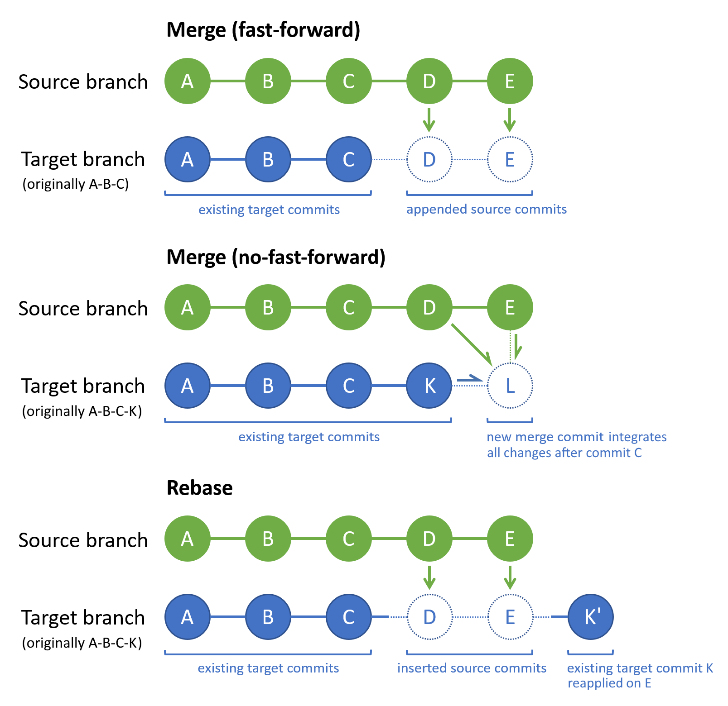
Tree-way merge
Change history
Force push is need
Notes:
On rebase you have to solve conflict on each commit so you can use interactive commit to squash ect..

Slide 16
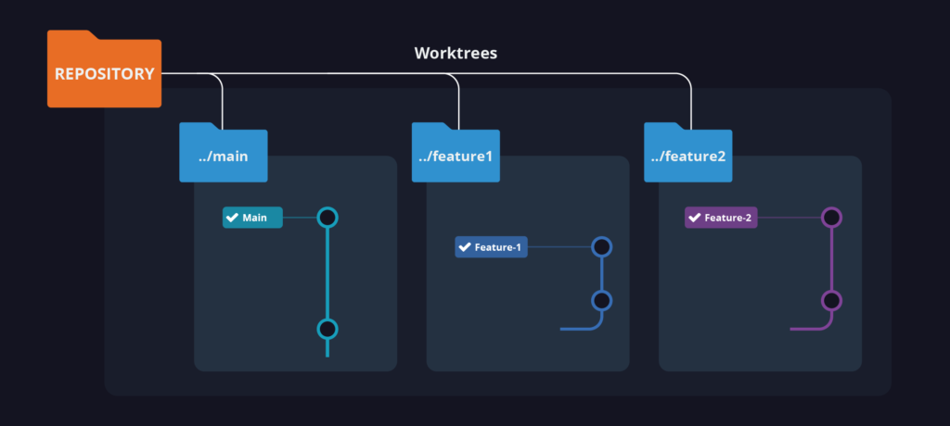
Worktrees

Slide 17
Git extension
Demo
Not demo
Git blame
Git diff
Git history
Git amend commit
Git descritption
Interactive rebase
Git stash
Git renaming a branch
Git cherry picking
Git conflict
Git reflog
Git grep
Git clean
Pull request
Git worktree functionality
Git renaming a branch
Git forkflow
Git ignore file
Git tags
Notes:
Git tag to commit

Slide 18
Thank You

Slide 19
