Slide 1

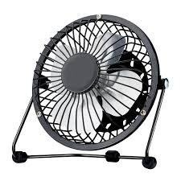
Smart Fan
By Samolă Ciprian

Slide 2


Slide 3
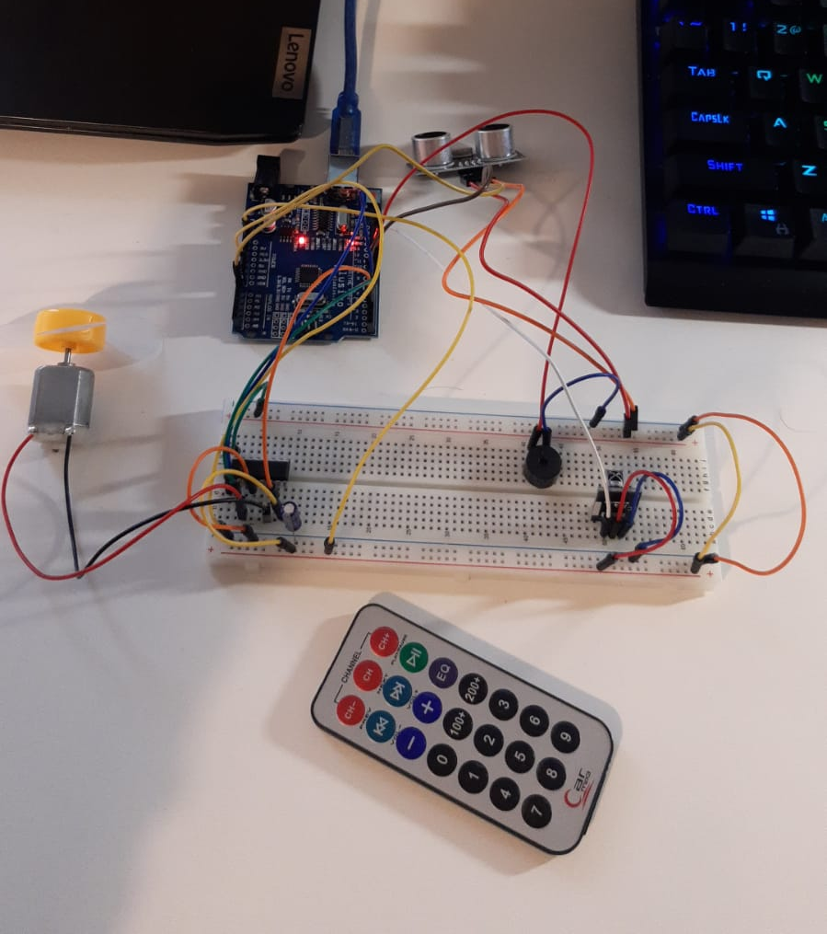
I’m joking… This is my fan

Slide 4
Functionalities
Three speed levels
Controlled by a remote
Stops when someone may be harmed

Slide 5
Componemts

Slide 6
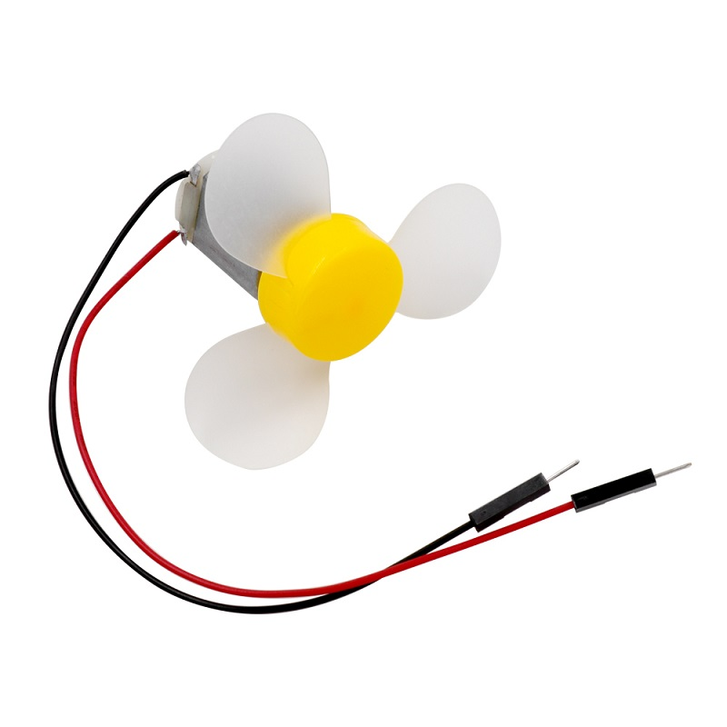
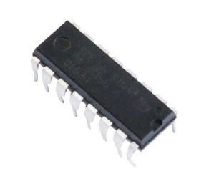
L293D
Used for controlling the motor (change speed, direction)
It is unsafe to connect the motor directly to development board
3-6v DC motor with fan blade

Slide 7
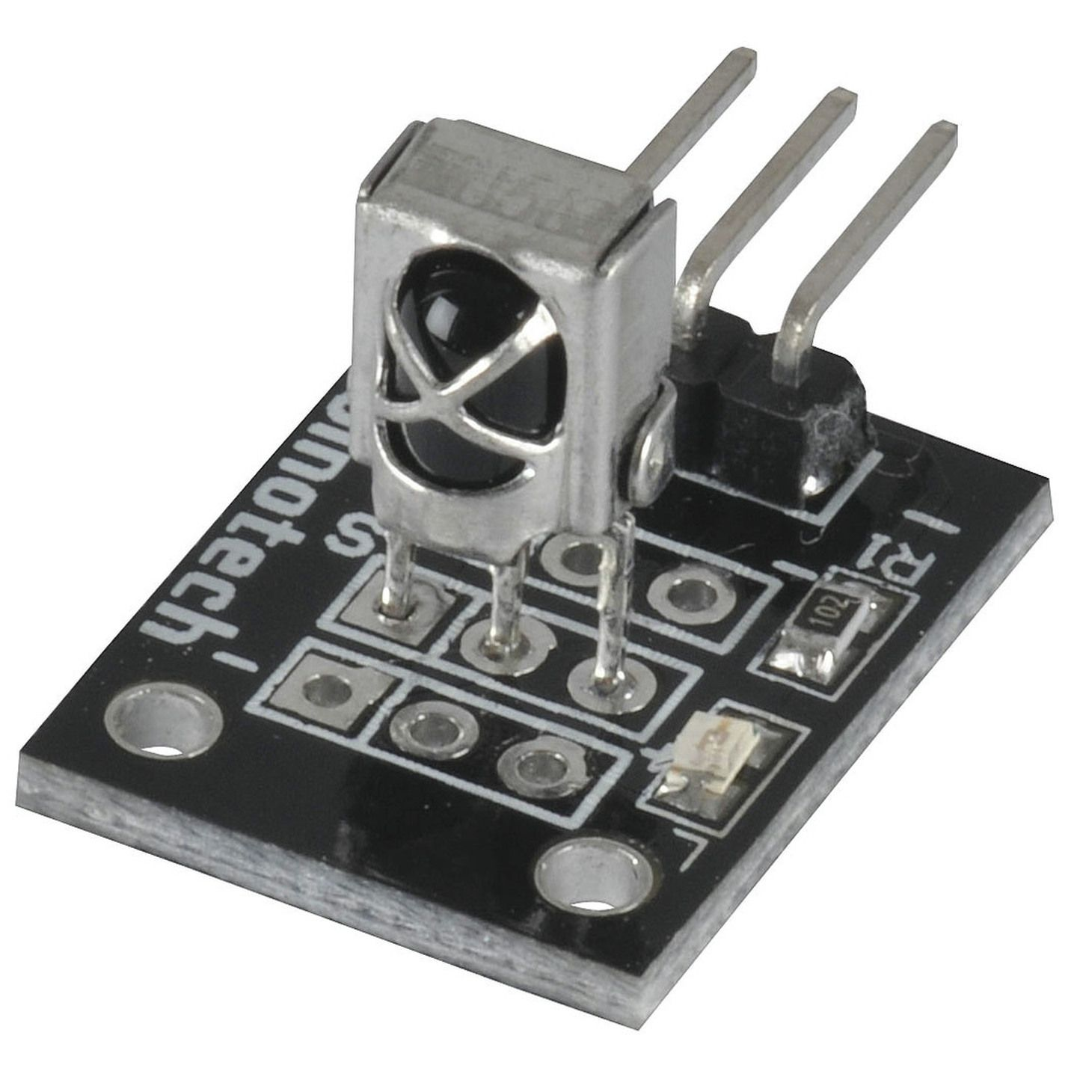
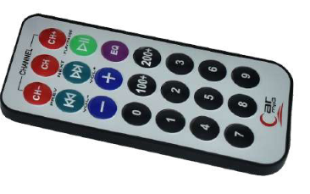
IR Receiver
- Detects IR light only at specific frequency (38 kHz)
Remote

Slide 8
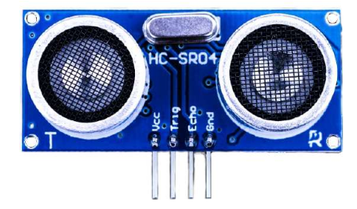
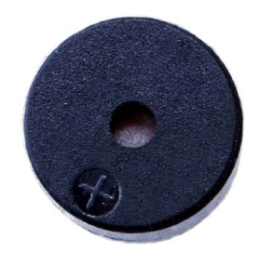
Buzzer
Vibrates at some specific frequency => creates a sound
actuator
Ultrasonic Sensor
Can measure 2 -> 400 cm
Precision: 3mm
Sends 40kHz signals, detect whether there is a signal back

Slide 9
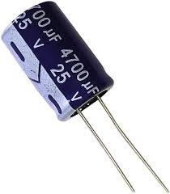
One problem…
The solution
The DC motor adds noise in the circuit. When it is ON, the IR Receiver doesn’t get signals anymore…
I added a capacitor to filter out the noise

Slide 10
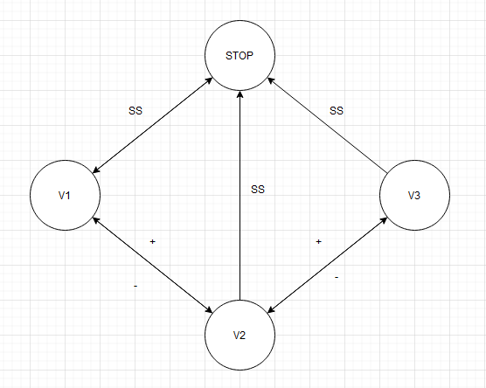
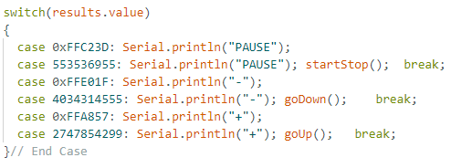
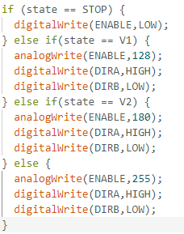
The code
State diagram (sort of)

Slide 11
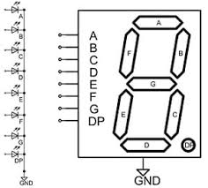
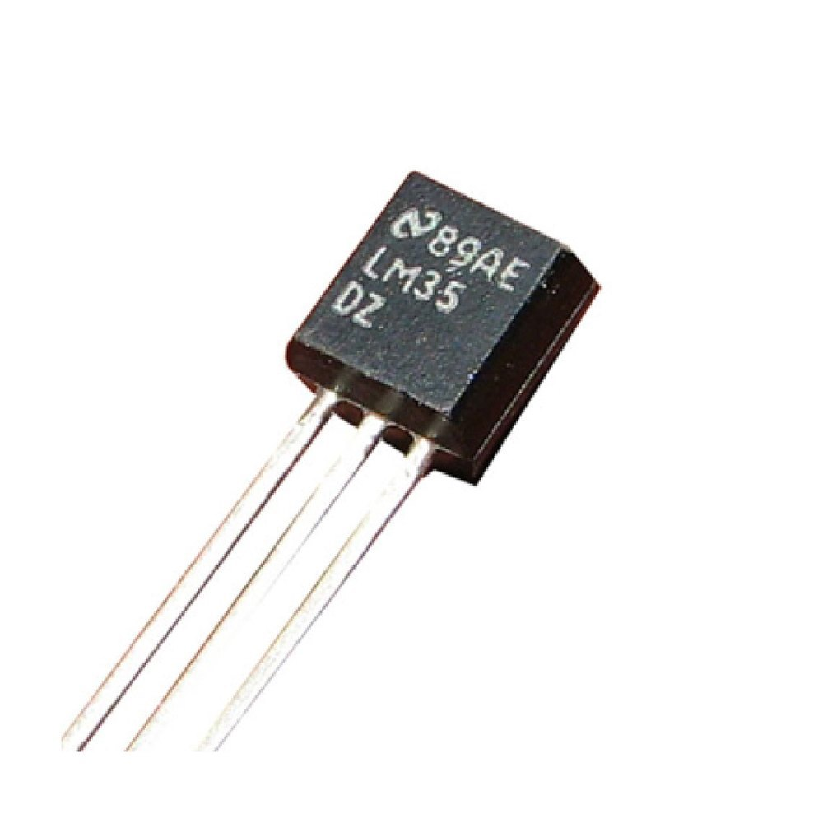
Further improvements
7 segment display that displays the speed level
An integrated temperature sensor
Phone control

Slide 12
Thank you for your kindly attention

