Slide 1
International Academic Communication
What is Communication?

Slide 2
What is communication
“A symbolic process whereby reality is produced, maintained, repaired, and transformed” – James Carey
“A language is not just words. It’s a culture, a tradition, a unification of a community, a whole history that creates what a community is. It’s all embodied in a language.” – Noam Chomsky
“The first problem of communication is getting people’s attention.” – Chip Heath

Slide 3
What is communication
Process of sending and receiving messages
Speech
Writing
Charts/images
Body language (behaviours, signs, signals)
Defining reality and sharing it with others

Slide 4
Formal Communication
Professional communication
Bigger or more specific and technical vocabulary
Specific communication protocol (certain rules you must follow)
Takes more time and preparation – no room for mistakes
Often uses writing (even for presentations)
Considered reliable – sometimes with legal backing

Slide 5
Tips for formal communication
Have a purpose (what are you trying to say and why is it important)
Use a well-defined structure (beginning, middle, end)
Keep your tone friendly
Remember to thank your audience

Slide 6
Informal Communication
More freedom – no structure or protocol
Less reliable and accurate – no consequences
Mostly oral
More user-friendly – you can communicate in ways that most people will understand

Slide 7
Oral Communication
Not set in stone – you can change your words and expressions last minute
Prone to mistakes
The more you practice, the more aware you become of your expressions
Engages the audience more

Slide 8
General tips for Speaking
In face-to-face communication, use eye contact
Practice with a mirror
Make sure this is something that you would be interested in yourself
Engage your audience
Be a good listener

Slide 9

Remember:
You don’t have to speak or write to communicate – you are communicating every minute right now!

Slide 10
IMRD Framework

Slide 11
Research Papers & Scientific Journals
So back to the subject of research….
Who is the audience of a research paper?
What is the purpose? What are we trying to do?

Slide 12
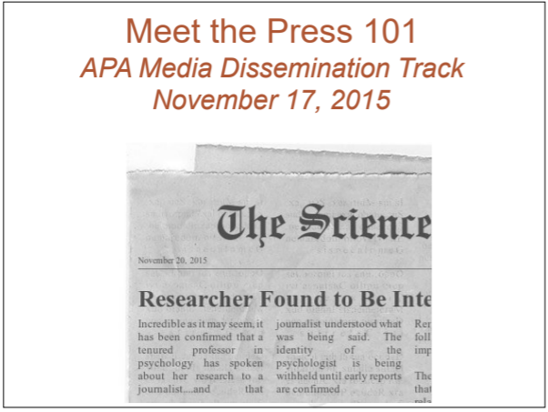
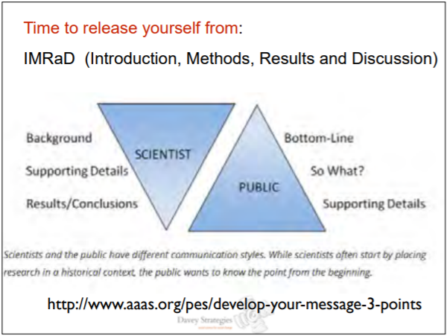
Specific Purpose and Specific Audience
https://www.apa.org/pi/about/public-messages.pdf

Slide 13
Research Papers & Scientific Journals
The scientific method is about testing and replication
Theory comes from observation, and is tested through repeated experimentation
Observation
Hypothesis
Testing
Theory

Slide 14
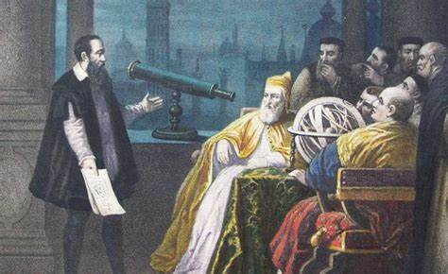
Research Papers & Scientific Journals
Academic studies, research papers, and scientific journal articles are a key part of the scientific method
Papers and articles are instructions that other researchers can use to replicate the studies, either proving or disproving the hypothesis
They can also be used to help others design their own research projects to build on the research
And of course, this is the main way that new discoveries are shared with the world

Slide 15
Different Kinds of Research
Empirical
Based on things you can observe or measure
If A happens → B happens
Lab experiments repeated over and over
Theoretical
How likely will A happen?
Related to ideas
Look at existing data and make a theory about the patterns (no experiment)

Slide 16
Difference Kinds of Research
Quantitative Research | Qualitative Research
Predominant in science, medicine, and engineering but can be found in any field Usually consists of numerical data and measurements, and can include statistical analysis Seen as more objective | Common in arts and social science Involves gathering and interpreting non-numerical data, such as interviews, surveys, or observation Seen as more subjective
Do you hurt? Y/N
How does pain make you feel?

Slide 17
What do we need?
We know our purpose and audience: to share the findings of our completed research with other researchers, to allow them to either confirm our hypothesis by repeating the experiment, or to use our research to help their own
What kind of content do you think should we include?

Slide 18
The IMRD Framework
The norm, and most common structure, for original research papers. The template contains 4 main sections:
Introduction
Methods
Results
Discussion
Introduction
Methods
Results
Sometimes also called IMRaD
Discussion

Slide 19
IMRD Framework
Introduction – why is your research important
Methods – how did you do it
Results – what did you find
Discussion – what does it mean
The IMRD framework is often used in most scientific and research areas

Slide 20
IMRD framework
Experiments
Questionnaires and surveys
Interviews
Observations
Secondary research (books, journals, magazines, etc.)

Slide 21
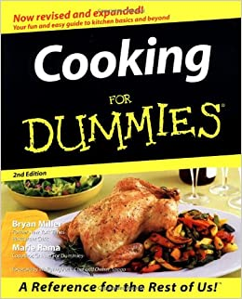

It’s like a cookbook for science!

Slide 22

Introduction
Research problem
Literature review – what did other people find? (previous research)
Gaps in research
Hypothesis – what results do you think you will get
Summary of research
Enough information given to the readers – they don’t have to do extra reading to understand your topic
Do not hide facts

Slide 23
Introduction
Just like all writing, a research paper should start with an introduction answering the question why:
Why is this a valid field of research?
Why was this particular research undertaken?
Why was this paper written?
Why should you be reading this paper?
Why should this research be continued or replicated?
The introduction should also give an overview of the subject, to bring the reader up to speed on what will be discussion, including defining any key terms and covering any relevant existing research.

Slide 24

Methods
How did you do your research?
Describe the steps so someone else can follow it and do the same research
This is different for every field, but try to be as detailed as possible (don’t include irrelevant information)
Who/what is in the research?
What did you do?
What did you look for?
If your methods are used by many others, you can just use a reference

Slide 25
Methods
This is the “recipe” for the research design, and should answer the question How:
How did the author conduct their study?
How did the author decide what variables were relevant?
How did the author collect and analyze their data?
How could I conduct this same study?

Slide 26

Results
Data – what did you find?
Charts
Graphs
Tables
Quotes
Build up to a conclusion, but don’t give any analyses yet

Slide 27
Results
This is where the data can be found, both raw and processed, and should answer the question What:
What raw data did we collect?
What data did we get from analyzing the raw data according to our methodology?
What did we find?
Often the full raw data collection will be grouped together and placed in appendices at the end of the paper, but will be referenced in the main body

Slide 28

Discussion
Summarize the results
What you can learn from the data
What new knowledge did you find
How does your data compare to other people’s findings
Limitations and room for improvement (don’t make your paper sound bad)
Directions for future research
Conclusions – summary/closing statement

Slide 29
Discussion
This section should answer the larger question So What:
The results show X. So what?
The results are similar/different to existing studies. So what?
The methodology worked or did not work. So what?
So what was the point of this paper?
So what do we as researchers do next?

Slide 30
Summary
Part | Question | Content
Introduction | Why? | Research context / What is this field? Why this study?
Methods | How? | Data collection methods Data processing methods
Results | What? | What raw data was collected? What were the results of data processing?
Discussion | So what? | Significance (or not) of the results Research results in the context of existing research Methodology & Limitations Conclusion & Further study

Slide 31
Icebreaker Activity

Slide 32
Icebreaker Activity
To get to know your classmates better and help you choose your group:
Prepare a short introduction of yourself to the class. Include:
Your name (and English name)
Your major
Your field of study
Any research you’ve done or are working on now

Slide 33
Homework
1. Find a group and sign up
2. Post 5 academic sources (articles, books, etc) online in the discussion section that are related to your area of research
Include links if possible
Preferably the sources are in English

