Slide 1
Results

Slide 2
Writing the results section
1. Summarize your findings in text and illustrate them with figures and tables (if appropriate)
2. Describe each of your results, pointing to observations that are most relevant to the research topic/questions
3. Provide a context, such as by describing the question that was addressed by making a particular observation (you can use subsections for this)
4. Describe results of control experiments and include observations that are not presented in formal figures or tables (if appropriate)

Slide 3
Writing the results section
Text in past tense
All figures must be mentioned in the text and captions can’t be repeated in the text
Each paragraph begins with a different result
Highlight evidence that proves/disproves your hypothesis and research question

Slide 4
Figures and Tables
Data are presented in three ways: figures/tables, text, and data
Use the best way for your data
Does it support your argument?
Can it be easily read and understood

Slide 5
Figures and Tables
Figures are graphs, photographs, and diagrams
They present complicated results as an image
Figures need captions that gives the readers enough information that they shouldn’t need to refer to the text of the paper. Readers should understand the figure without reading the paper

Slide 6
When to use figures
1. Adds strength to your argument
Ex: Illustration of differences among treatments
2. Information can’t be easily presented in other formats (e.g. tables or text)
3. Gives the reader an example or typical observation from an experiment

Slide 7
Figure captions
A caption either appears after a figure, or altogether at the end of the paper
All figures must have captions
Captions should 1) provide the reader with enough information to understand the data presented in the figure and 2) draw their attention to any major data points

Slide 8
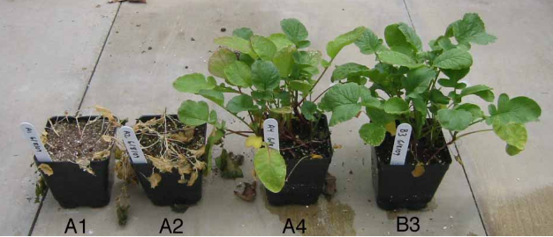
Figure Captions
Example of a bad figure caption:
Figure 1. Radish plants subjected to a freezing treatment.

Slide 9
Figure Captions
Better figure caption:
Figure 1. Radish plants showing the effects of freezing at -15C for 2h (A1 and A2) compared with control plants (A4 and B3) kept at room temperature. The plants in pots A1 and A4 were cold acclimated for 2 days at 2.5 C prior to freezing or room temperature treatments. The plants in pots A2 and B3 were not cold acclimated and were kept at room temperature (~ 25C) for 2 days prior to freezing or room temperature treatments. Following the freezing or room temperature treatments, plants were kept in a greenhouse for one week.

Slide 10
Figure Captions
Which plants were in which condition (Materials and Design)
Better figure caption:
Figure 1. Radish plants showing the effects of freezing at -15C for 2h (A1 and A2) compared with control plants (A4 and B3) kept at room temperature. The plants in pots A1 and A4 were cold acclimated for 2 days at 2.5 C prior to freezing or room temperature treatments. The plants in pots A2 and B3 were not cold acclimated and were kept at room temperature (~ 25C) for 2 days prior to freezing or room temperature treatments. Following the freezing or room temperature treatments, plants were kept in a greenhouse for one week.

Slide 11
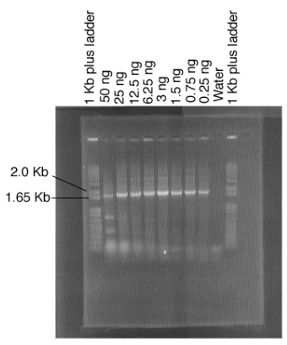
Figure Caption
Bad Example
Figure 2. PCR amplification of the 18S ribosomal RNA gene from Saccharomyces cerevisiae.

Slide 12
Figure Caption
Better Example:
Figure 2. An ethidium bromide stained agarose gel showing DNA fragments produced by PCR amplification of the 18S ribosomal RNA gene from Saccharomyces cerevisiae. The amount of genomic DNA used as template was varied from 50 ng to 0.25 ng. Lanes one and eleven contain a 1Kb plus DNA ladder (Invitrogen); the 2.0 and 1.65 Kb fragments are labeled. The amount of genomic DNA used as template for PCR amplification is indicated above each lane. For the negative control, sterile distilled water was used in place of template DNA

Slide 13
Figure Caption
Different conditions in the study (Design & Materials
Better Example:
Figure 2. An ethidium bromide stained agarose gel showing DNA fragments produced by PCR amplification of the 18S ribosomal RNA gene from Saccharomyces cerevisiae. The amount of genomic DNA used as template was varied from 50 ng to 0.25 ng. Lanes one and eleven contain a 1Kb plus DNA ladder (Invitrogen); the 2.0 and 1.65 Kb fragments are labeled. The amount of genomic DNA used as template for PCR amplification is indicated above each lane. For the negative control, sterile distilled water was used in place of template DNA

Slide 14
Figure Caption
Key elements of the figure
Different conditions in the study (Design & Materials
Better Example:
Figure 2. An ethidium bromide stained agarose gel showing DNA fragments produced by PCR amplification of the 18S ribosomal RNA gene from Saccharomyces cerevisiae. The amount of genomic DNA used as template was varied from 50 ng to 0.25 ng. Lanes one and eleven contain a 1Kb plus DNA ladder (Invitrogen); the 2.0 and 1.65 Kb fragments are labeled. The amount of genomic DNA used as template for PCR amplification is indicated above each lane. For the negative control, sterile distilled water was used in place of template DNA

Slide 15
Figure Caption
The results of the study could be summarized in the text alone without a figure
The figure is to help convince the readers of your conclusions (give evidence that what you say is true)
“Here are the results and this is an image of the PCR test as proof”
“These are my results, and here are the images of the plants as proof”

Slide 16
Summary
Results section show general trends, calculations, and statistics
Tips: Organize this into different sections for different research questions
Start with general demographics, then specific research question results
Table and Figure captions show key elements and design
All figures and tables must be in the order they are mentioned in the text

Slide 17
Group Practice
There is a text online about “squirrel data” which describes a very simple experiment with the results
Use the information given and write a results section + figure captions for the figures provided. You can place the figures in the results section or at the end. Make sure they are in the correct order.
When writing the results section, organize it in a logical way (add sections if necessary)
You can make up any additional details and calculations
*Remember: You have to report non-significant data that answers the research question*

Slide 18
Presentations Group 5 & 6
Focus the presentation on the results section of a paper
Include a brief introduction to the topic and a short summary of their methods
Presentation should include descriptions of any of the figures and tables used
Include a response:
Is everything controlled for?
Are there other things to measure?
Are the research questions answered?
Additional comments

