Slide 1

Association between perceived stress and hypertension in Chinese adults: a population-based survey
Hu Xi
December 16, 2022

Slide 2


Background Information
Present situation
Hypertension
The largest factor of disability-adjusted life-years
The incidence rate among Chinese adults increased
Psychological stress
One of the main risk factors of CVD
The aim of the article

Slide 3

Materials and methods
Data collection method
Data sources:
10th China Health and Nutrition Survey (CHNS) in 2015
Multistage, stratified, random cluster process was used
Samples from 12 provinces
Judgement of hypertension
Self-reported doctors diagnose hypertension
Use antihypertensive drugs.
Detection marker | Range
systolic blood pressure (SBP) | ≥ 140mmHg
diastolic blood pressure (DBP) | ≥ 90mmHg

Slide 4

Materials and methods
Data collection method
Measurement of Perceived pressure:
Through 14 item perceived pressure scale (PSS-14).
Total score ranges from 0 to 56,
Higher scores → Higher perceived levels of stress
Covariates of participants
Gender, age, marital status, education level,
Per capita family income, employment status,
Living area, current smoking and drinking situation
Mark | Scores
Q1 | 0-18
Q2 | 19-23
Q3 | 24-27
Q4 | 28-52

Slide 5
Materials and methods
Sample selection and Statistical analysis
Sample selection :
Excluding participants who were pregnant or lacked data on the above covariates
A total of 10,823 samples left.
Statistical analysis method

Slide 6

Materials and methods
Sample selection and Statistical analysis
Draw conclusions:
Under the three different models
Subgroup analysis and Sensitivity analysis
Whether the conclusions differ from the covariates
Check the robustness of the conclusion
No | Characteristics
Model 1 | Unadjusted
Model 2 | Adjusted for age and sex
Model 3 | Adjusted for the other above covariates

Slide 7
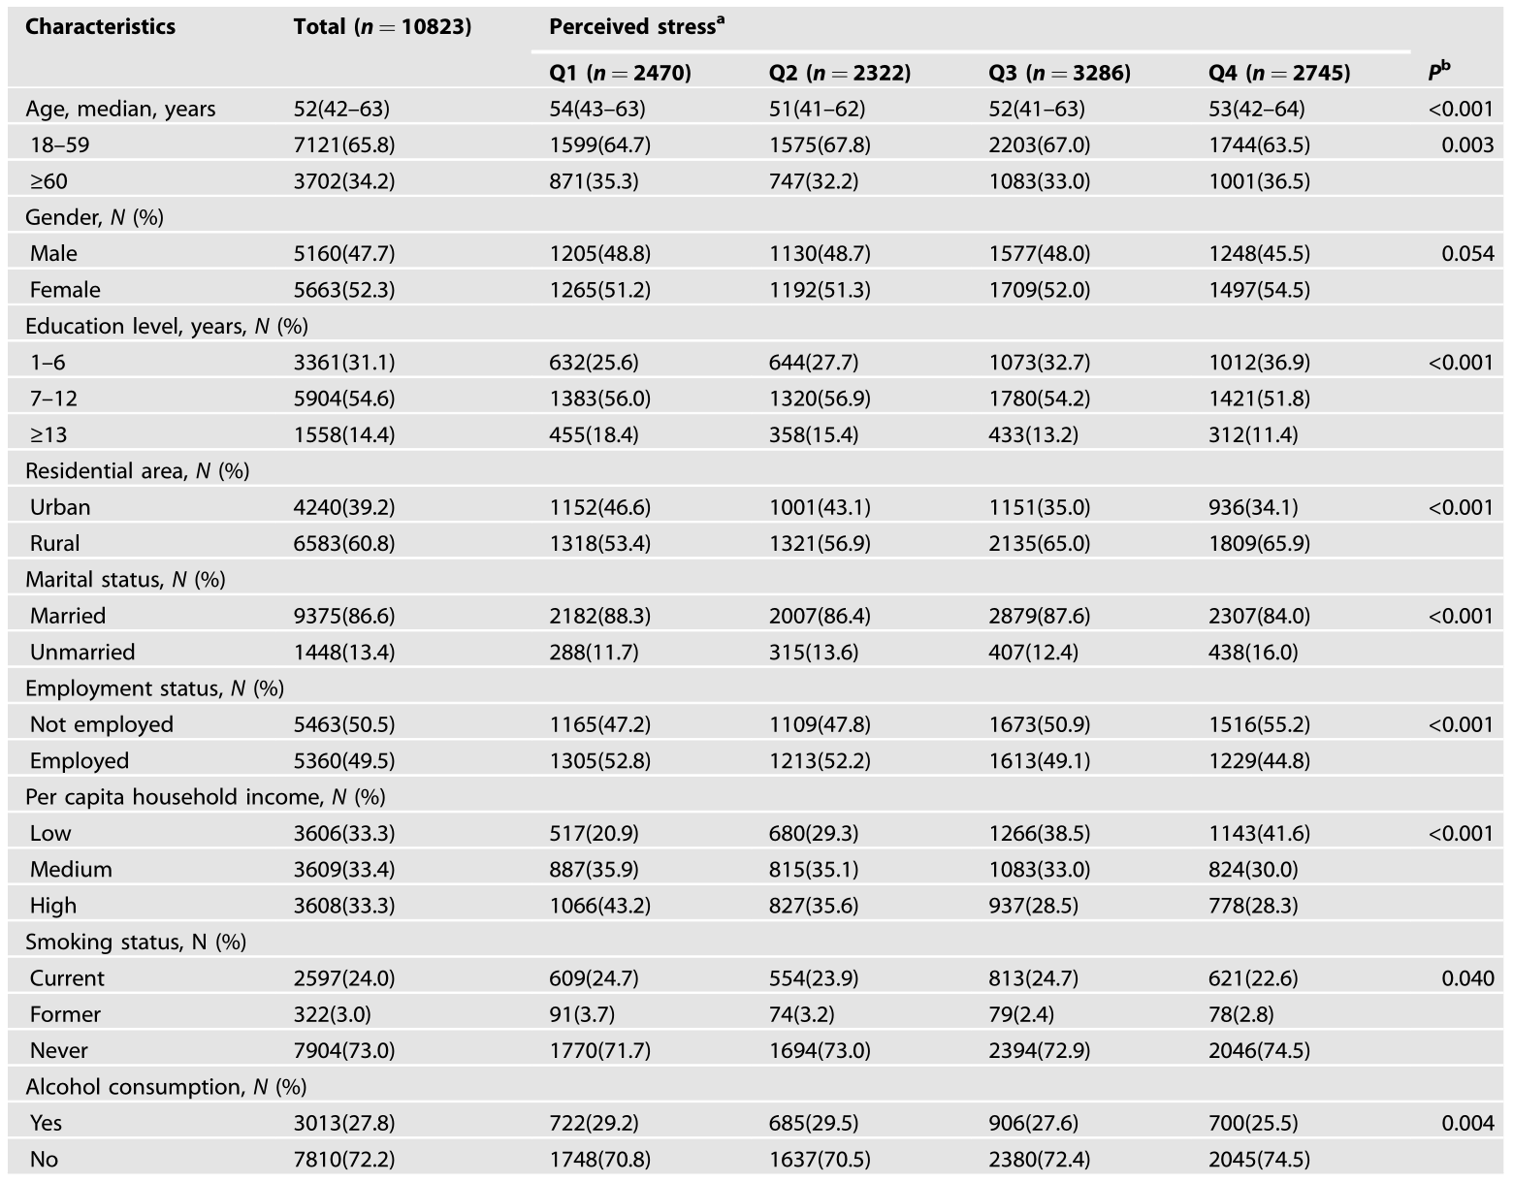
Conclusions
Characteristic of the participants
Older
Female
Had never smoked
Had low education level
Unmarried
lived in rural areas
Unemployed
Had lower annual household income per capita or lower alcohol consumption

Slide 8
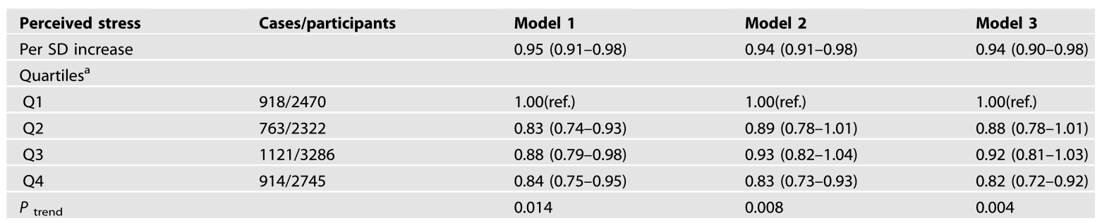
Conclusions
Association between perceived stress and hypertension
Every SD increase in perceived stress was associated with a 6% lower risk of hypertension
The relationship between perceived stress and hypertension is inversely related

Slide 9
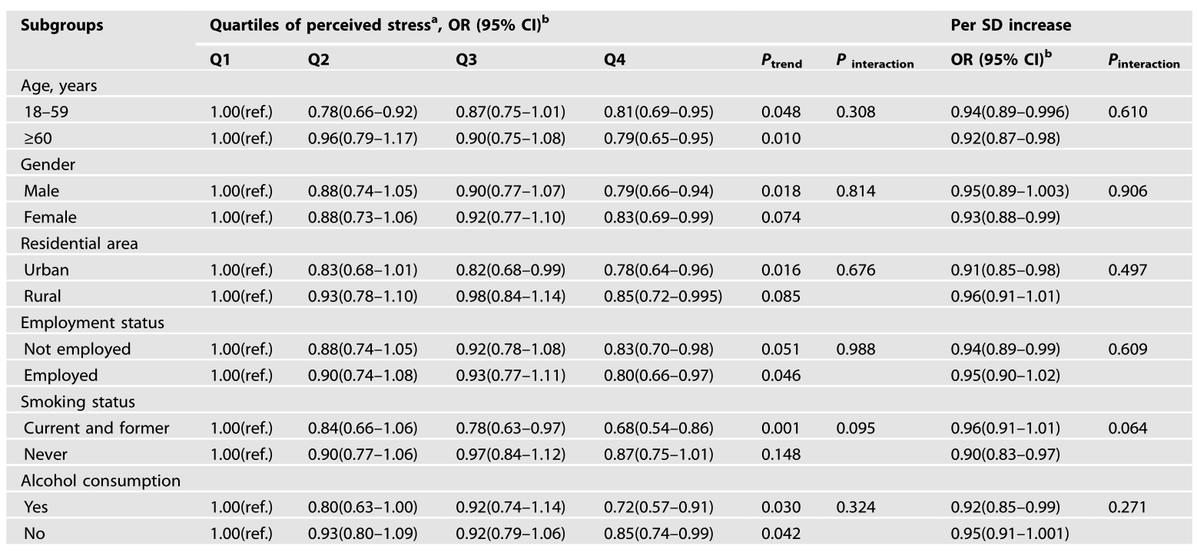
Conclusions
Subgroup analyses and sensitivity analyses
No interaction was found in the subgroups between perceived stress and the prevalence of hypertension
After removing samples that meet the conditions described previously, the inverse association remained consistent

Slide 10
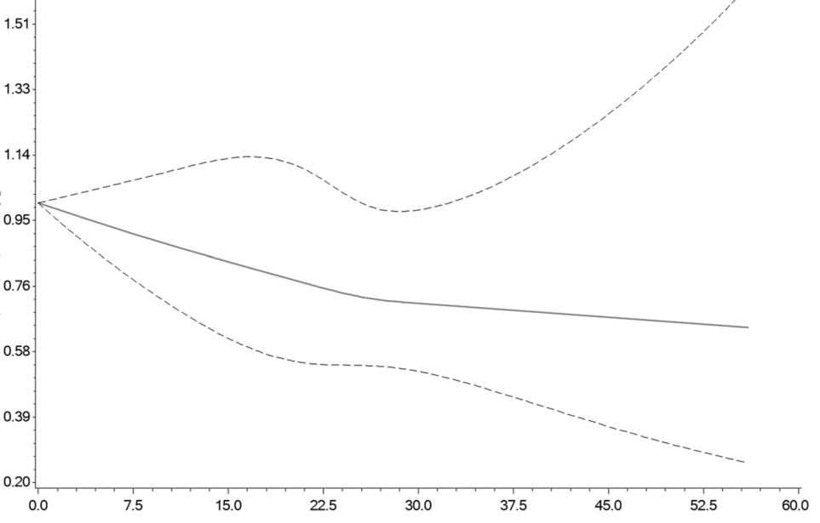
Discussion
Conclusions and discussion
Association between perceived stress and hypertension
Inversely
Independent of the covariates above
Mechanism of the inverse relationship
Remain unclear
Possible hypotheses
——Suppressed expression of stress factors
——BP-related hypoalgesia
——Dietary reasons

Slide 11

Discussion
Analysis of the advantages and disadvantages
Advantages
A large-scale sample
Standardized data collection procedures
Disadvantages
Step | Disadvantages
Survey | Uncertainty of objective pressure sources in the survey
Data analysis | Lack of longitudinal data analysis
Conclusion | Unclear influence of possible unmeasured factors on conclusions

Slide 12
Thanks !
Hu Xi
December 16, 2022

