Slide 1
Industrial to Management
Course Teacher
Prof. Dr. Md. Rabiul Islam
Head, Dept. of Humanities

Slide 2
What Is Management?

Slide 3
What Is Management?
F.W. Taylor (1911), the father of scientific management: 'Management is the art of knowing what you want to do ... in the best and cheapest way.'

Slide 4
What Is Management?
Peter Drucker (1954), who attempted to narrow the debate: 'It is a multi­purpose organ that manages a business and manages managers and manages workers and work.'

Slide 5
What Is Management?
Harold Koontz (1961): 'Management is the art of getting things done through and with people in formally organized groups. It is the art of creating the environment in which people can perform and individuals could cooperate towards attaining of group goals. It is the art of remov­ing blocks to such performance, a way of optimizing efficiency in reach­ing goals.'

Slide 6
What Is Management?
George R. Terry (1977): 'Management is a distinct process consisting of planning, organizing, actuating, and controlling, performed to determine and accomplish the objectives by the use of people and resources.'

Slide 7
What Is Management?
Management is a set of activities (including planning and decision making, organizing, leading, and controlling) that direct at an organization’s resources (human, financial, physical, and information) with the aim of achieving organizational goals in an efficient and effective manner.

Slide 8
What Is Management?
Management is optimization of constraining resources to achieve some intended goals.
'Resources' is a broad term and it encompasses everything that we require as inputs, including knowledge and information inputs.
Resources are not available in abundance.
There always exist resource constraints.
Every organization tries to achieve its charted goals and objectives through efficient management and proper allocation of scarce resources.

Slide 9
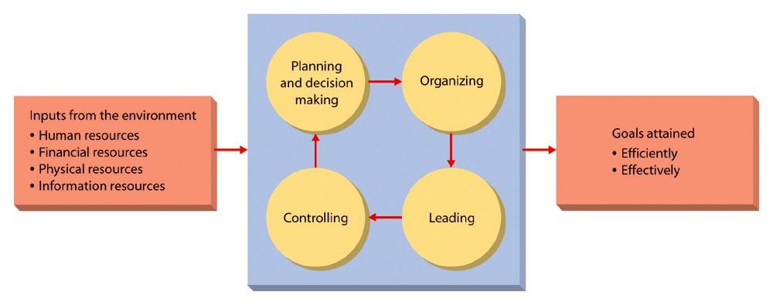
Management Cont…

Slide 10
Characteristics of Management
1. Management is an organized activity.
2. Management is aligned with organizational objectives.
3. Management optimizes constraining resources.
4. Management works with and through people.
5. Management is decision making.
6. Management is a science as well as an art.
7. Management is universal and intangible.
8. Management is an inter-disciplinary approach.
9. Management is a social process.
10. Management is a strategic function.
11. Management is a profession.

Slide 11
Different Dimensions of Management
Productivity orientation
  concerned with increased productivity
Human relations orientation
  emphasize on relationships among people
Decision-making orientation
  focus on decision making as the primary function of management
Leadership orientation
  highlights leadership as the essence of management
Process orientation

Slide 12
Efficiency and Effectiveness
Efficiency
  By efficient, we mean using resources wisely and in a cost effective way
Effectiveness
  By effective, we mean making the right decisions and successfully implementing them.

Slide 13
Decision Situations
Efficient but not effective
Effective but not efficient
Both efficient and effective
Neither efficient nor effective
https://www.zippia.com/advice/efficiency-vs-effectiveness/

Slide 14
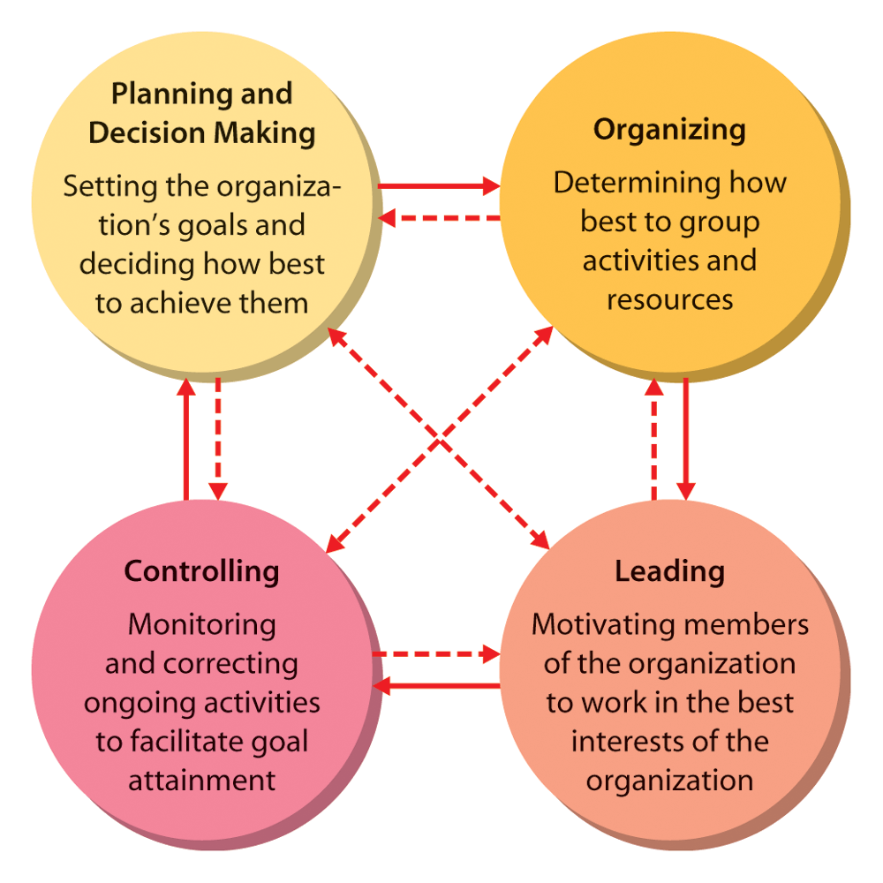
The Management Process / Functions

Slide 15
Planning
Planning is deciding in advance what is to be done.
It is the future course of action

Slide 16
Types of Plans
Organizational Level
Corporate
Divisional
Functional
Time Period
Long range
Medium range
Short range
Focus
Strategic
Operational
Tactical

Slide 17
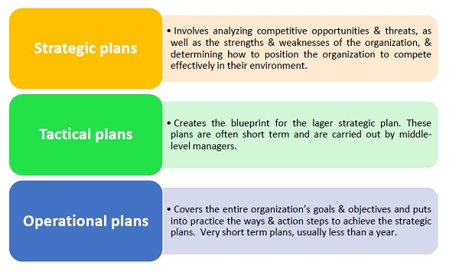
Types of Planning

Slide 18
Decision-making
Decision-making is the act of choosing one alternative from among a set of alternatives.

Slide 19
Decision-making Steps/Process
Recognizing and defining the nature of a decision situation,
Identifying alternatives,
Evaluating alternatives,
Choosing the "best" alternative,
Putting it to practice and
Follow up.

Slide 20
Organizing
Organizing means determining how activities and resources are to be grouped.
The basic elements of organizing include
  job design,
  departmentalization,
  authority relationships,
  span of control, and
  line and staff roles.

Slide 21
Leading
Leading means the set of processes used to get members of the organization to work together to further the interests of the organization.
Leading involves a number of different activities and processes such as,
  motivating employees,
  leader's efforts to influence others,
  managing interpersonal relations and communication,
  managing work groups and teams

Slide 22
Controlling
Controlling means monitoring organizational progress toward goal attainment.
It includes a series of activities such as
  determining standard,
  measurement of actual performance,
  identifying deviation if any, and
  taking corrective actions if any deviation is found.

Slide 23
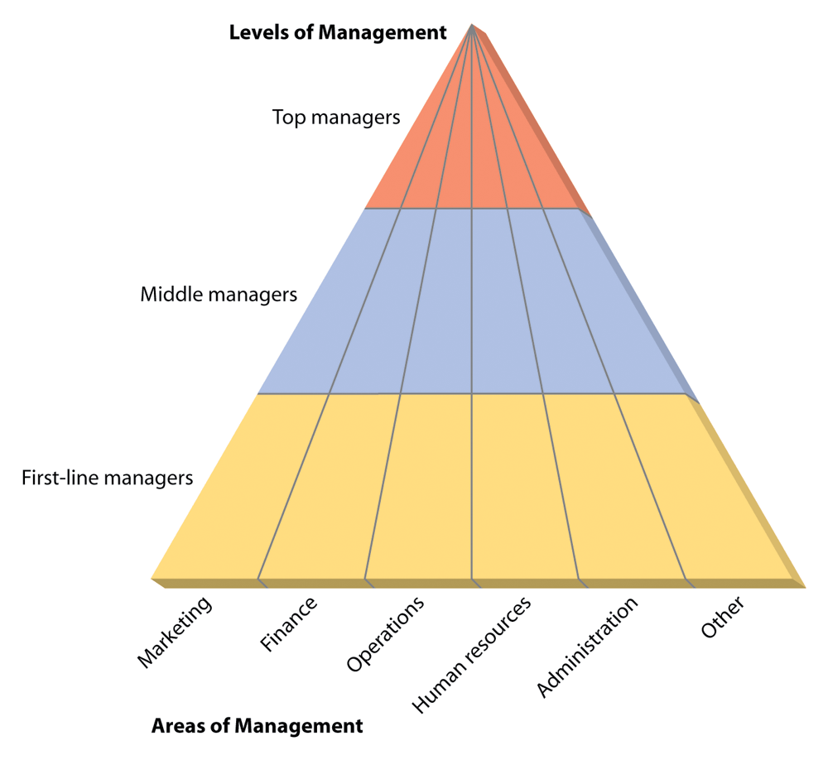
Kinds of Managers

Slide 24

Top Managers
Small group of executives who manage the overall organization, the strategic level.
Titles: president, vice president, chief executive officer (CEO)
Their functions and responsibilities are diverse and varied including making strategy, policies & plans and so on.
They determine the fate of the organization.
They represent the organization with other organizations, government representatives, and foreign countries and so on.

Slide 25
Middle Managers
The largest group that implements the strategies developed at the top and coordinates and supervise the activities of the first line managers.
The titles include operations managers, divisional head, regional managers etc.

Slide 26


First-Line Managers
Supervise and coordinate the activities of operating employees.

Slide 27

The fundamental management skills
Technical Skills: Necessary to accomplish or understand the specific kind of work being done.
  These skills are especially important for first line managers.

Slide 28
Management skills cont…
2. Interpersonal Skills: The ability to communicate with, understand, and motivate both individuals and groups.
  Be able to get along with: Subordinates, Peers, and those at higher levels.

Slide 29
Management skills cont…
3. Conceptual Skills: A manager’s ability to think in the abstract. The mental capacity to:
  Understand organizational goals and its environment.
  How the organization is structured.
  Viewing the organization as system.

Slide 30
Management skills cont…
4. Diagnostic Skills: Skills that enable a manager to visualize the most appropriate response to a situation.
5. Communication Skills: A manager’s abilities both to
  effectively convey ideas and information to others and
  effectively receive ideas and information from others

Slide 31
Management skills cont…
6. Decision-making Skills: A manager’s ability to
  correctly recognize and define problems and opportunities and
  select an appropriate course of action to solve problems and capitalize on opportunities.
7. Time-management Skills: The manager’s ability to
  prioritize work,
  to work efficiently, and
  to delegate appropriately.

Slide 32
Principles of Administrative Management
Henri Fayol (29 July 1841 – 19 November 1925) was a French mining engineer, mining executive, author and director of mines who developed a general theory of business administration that is often called Fayolism.
He is widely acknowledged as a founder of modern management method.

Slide 33
Principles of Administrative Mgt Cont…
1. Division of labor
  It is the principle of job specialization, where each job is broken down into small parts and then assigns the responsibility to the competent person.
  It will enhance the employee's expertise about the particular job.
2. Authority and accountability
  It clearly defines the rights and responsibility of manager.
  It defines the area of action, initiative and responsibility of each manager.

Slide 34
Principles of Administrative Mgt Cont…
3. Discipline
  Members in an organization need to respect the rules and agreements that govern the organization. To Fayol, discipline will result from
  good leadership at all level of organization,
  fair agreements, and
  judiciously enforced penalties for infractions.

Slide 35
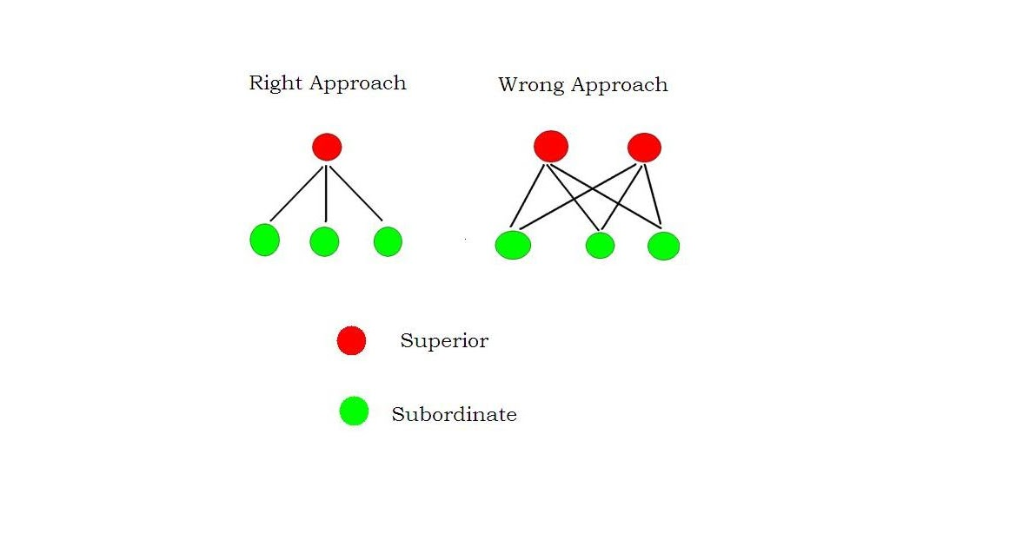
Principles of Administrative Mgt Cont…
4. Unity of command
  It is the safeguard against dualism of control.
  Each employee must receive his or her instructions about a particular operation from only one person.
  Fayol believed that if an employee was responsible to more than one superior, conflict in instruction and confusion of authority would result.

Slide 36
Principles of Administrative Mgt Cont…
5. Unity of direction
  Those operations within an organization that have the same objectives should be directed by only one manager.
  For example, the personnel department in a company should not have two directors each with a different hiring policy.
6. Superiority of general interest over individual interests
  In any undertakings the interests of employees should not take precedence over the interests of the organization.

Slide 37
Principles of Administrative Mgt Cont…
7. Remuneration
  Adequate remuneration secures a committed work force and sustains employee's interest and participation.
  Compensation for work done should be fair to both employees and employer.
8. Centralization
  Decreasing the role of subordinates in decision making is centralization; increasing their role is decentralization.
  Fayol believed that manager should retain final responsibility but they also need to give their subordinates enough authority to do their jobs properly.

Slide 38
Principles of Administrative Mgt Cont…
9. Scalar chain
  Scalar chain is the principle of the observance of the chain of command, which discourages level jumping unless and until serious situation occurs.
10. Order
  Materials and people should be in the right place at the right time.
  In particular people should be in the jobs best suited for them.

Slide 39
Principles of Administrative Mgt Cont…
11. Equity
  Equity is the law of the social world, which alone secures loyalty of employees and their cooperation.
  Manager should be both friendly and fair to their subordinates.
12. Stability and security
  It is a basic motivation for attention to work, interest and sustained efforts of the employees.
  To Fayol a high employee turnover rate is not good for efficient functioning of an organization.

Slide 40
Principles of Administrative Mgt Cont…
13. Initiative
  Subordinates should be given freedom to imagine and carry out their plans even some mistakes result.
14. Esprit de corps
  It means cooperation and fellow feeling.
  It means everybody helps everybody else in a close spirit of teamwork.

Slide 41
Principles of Scientific Management
Frederick Winslow Taylor (March 20, 1856 – March 21, 1915) was an American mechanical engineer who sought to improve industrial efficiency
He was one of the first management consultants.
Taylor was one of the intellectual leaders of the Efficiency Movement and his ideas, broadly conceived, were highly influential in the Progressive Era (1890s–1920s).
In 1911, Taylor summed up his efficiency techniques in his book The Principles of Scientific Management which, in 2001, Fellows of the Academy of Management voted the most influential management book of the twentieth century.
His pioneering work in applying engineering principles to the work done on the factory floor was instrumental in the creation and development of the branch of engineering that is now known as industrial engineering.
Taylor is known as the father of scientific management

Slide 42
Principles of Scientific Management Cont…
1. Science instead of rule of thumb
  Develop a science for each element of a worker’s job that replaces rule of thumb.
  Use scientific method rather than intuition and experience to determine the work methods and tools.
  Ensure that each motion or movement of workers is the most efficient possible.
  Lay down standard time, standard methods, tools and working conditions for each task.
2. Functional specialization
  Functional specialization should be a part of every job.
  Every worker should be a specialist in what he did and should know his job well.

Slide 43
Principles of Scientific Management Cont…
3. Selection and Development
  Scientific selection, training and development of workers.
  Tests should be used to identify the right person for each job.
  A worker should be given job for which he is most suitable.
4. Planning and scheduling
  Planning and scheduling of the work to ensure availability of materials and other resources at the right place, right time, and in proper condition.

Slide 44
Principles of Scientific Management Cont…
5. Standard time and method
  Standards with respect to methods and time for each task should be established.
  Workers movements and the time needed to complete every movement should be scientifically studied.
  Jobs should be redesigned incorporating highly efficient motions with specific time required for each step in a task.
6. Wage incentives
  Wage incentives should be an integral part of each job.
  Workers should be paid a bonus if they complete the task before the standard time.
  Different wage rates should be paid for different jobs.

Slide 45
Principles of Scientific Management Cont…
7. Co-operation
  Close co-operation between management and workers to accomplish work in accordance with scientific method.
  Management can secure higher profits only when workers perform their jobs with maximum efficiency.
  Similarly, workers can expect higher wages only when management adopts an enlightened attitude toward them.
  Instead of fighting on sharing the gains of productivity, the two sides should work together to maximize productivity so that each can get a larger share.
  Both stand to gain by maximizing output.
  There should be a mental change in both parties from conflict to cooperation.

Slide 46
Principles of Scientific Management Cont…
8. Division of responsibility
  A more equal division of responsibility between management and workers.
  Planning should be separated from doing.
  Planning will be the responsibility of management and doing will be the responsibility of workers.

