Slide 1
CSE3505 - Foundations of Data Analytics
J-Component Review 3
Stanley Kingston
Gaurav Prasanna
Vignesh S

Slide 2
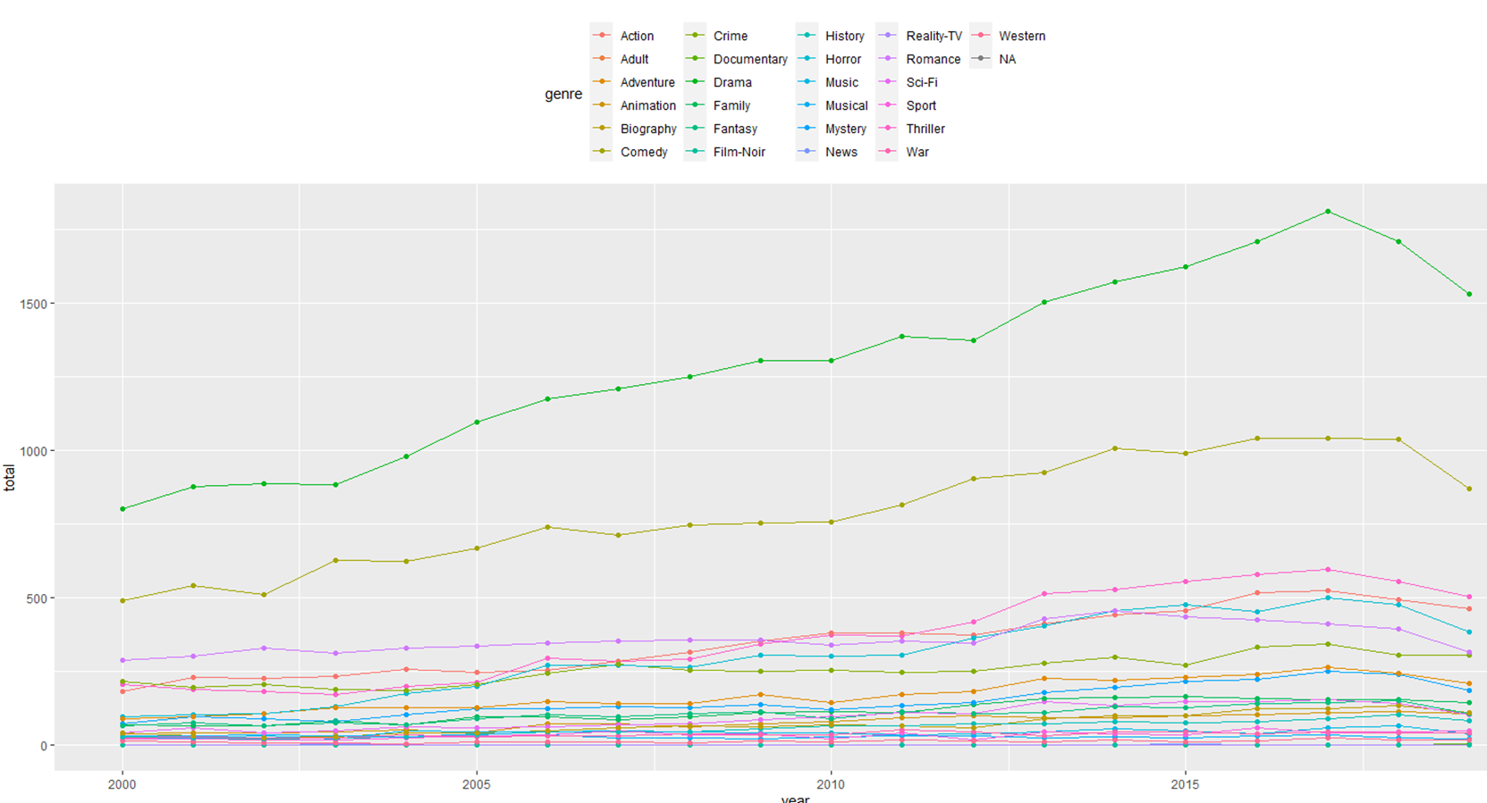
Inference: Drama and Comedy highest releases in past 20 years.

Slide 3
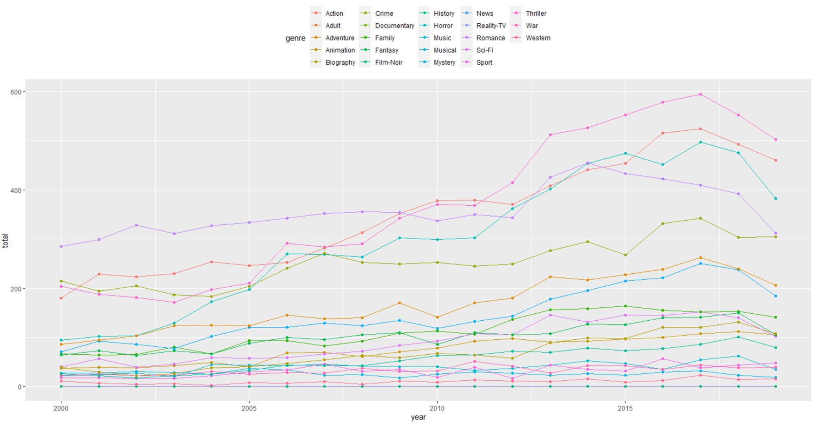
Inference: Horror Movies release is rapidly growing from 2000.

Slide 4
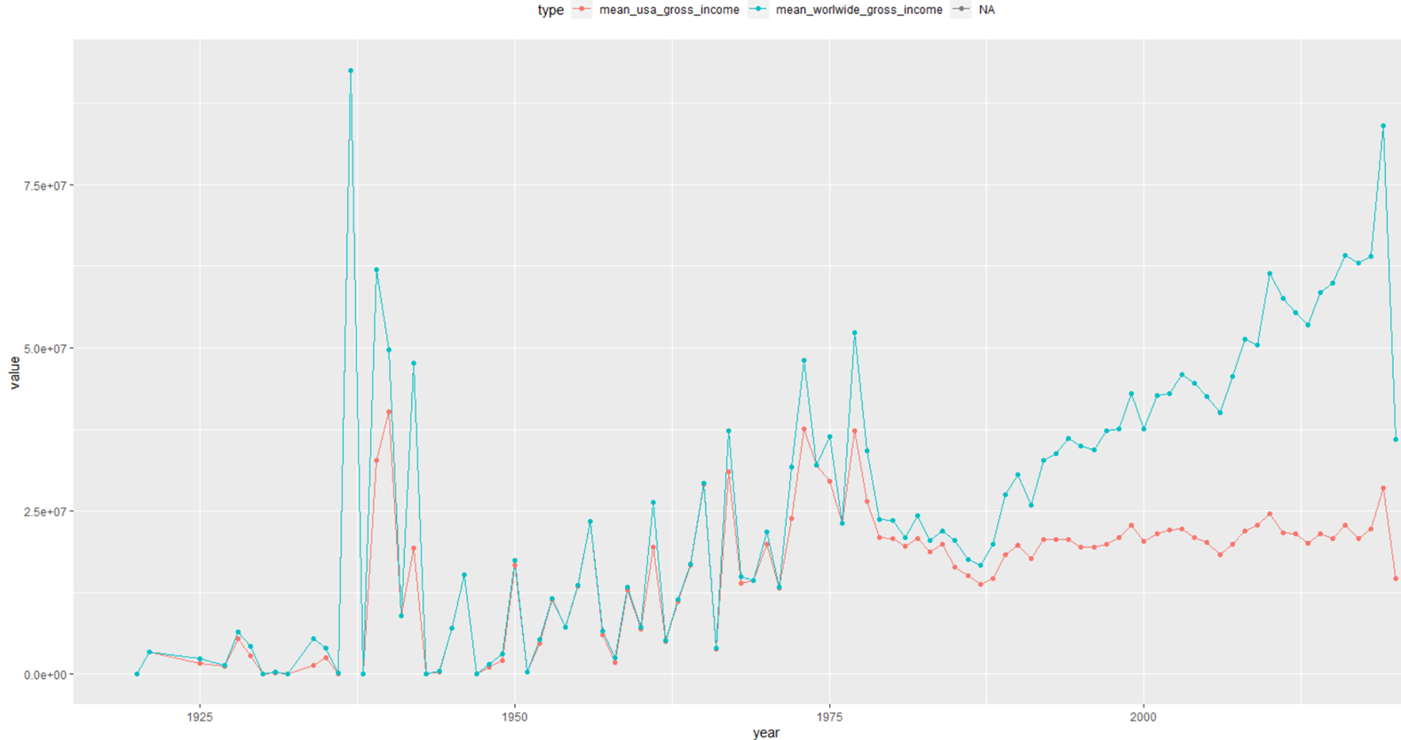
Inference: we could see the increase of grossing worldwide other than USA

Slide 5
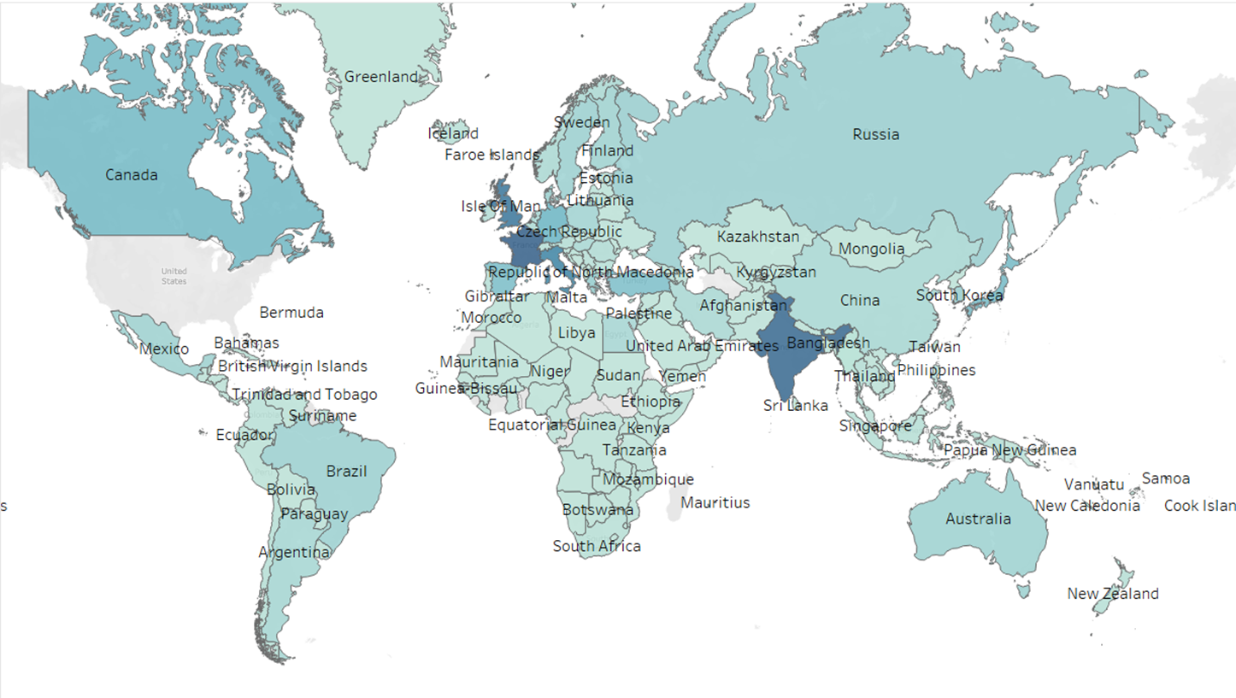
Inference: comedy genre is dominated by India, France and UK.

Slide 6
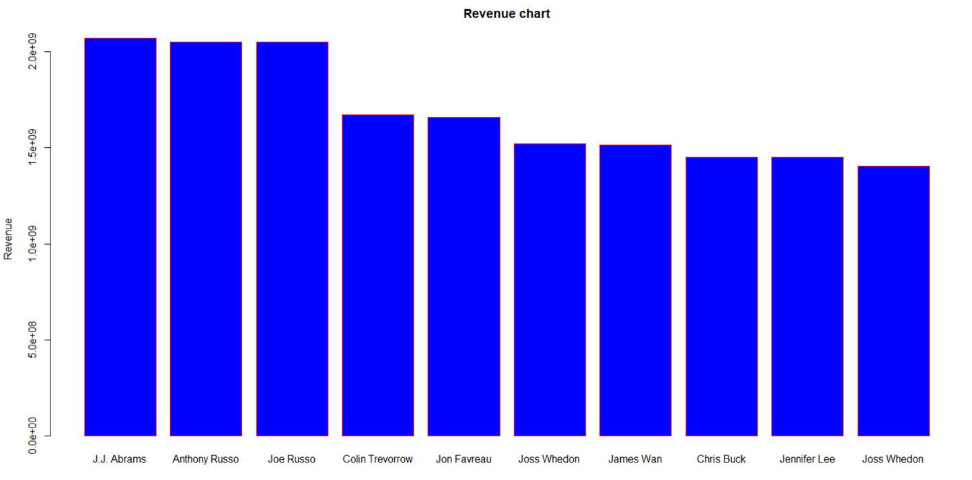
Inference: Shows which director has the highest gross revenue.

Slide 7
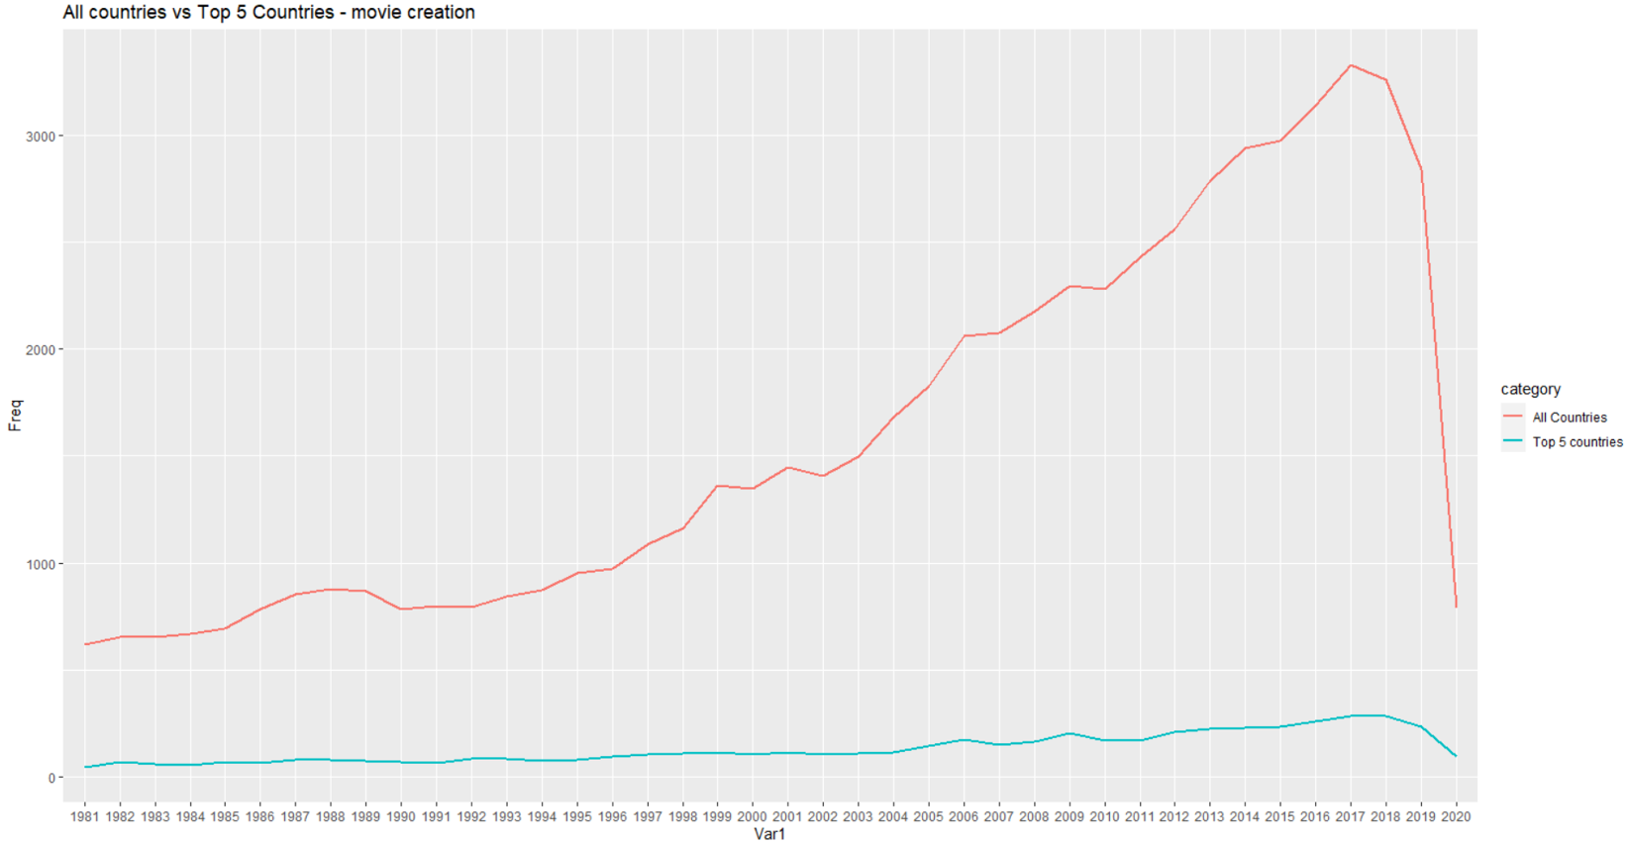
Inference: The pandemic affected the Film industry Soo hard that the total movies created in 2020 is almost equal to that of movies created in 1980.

Slide 8
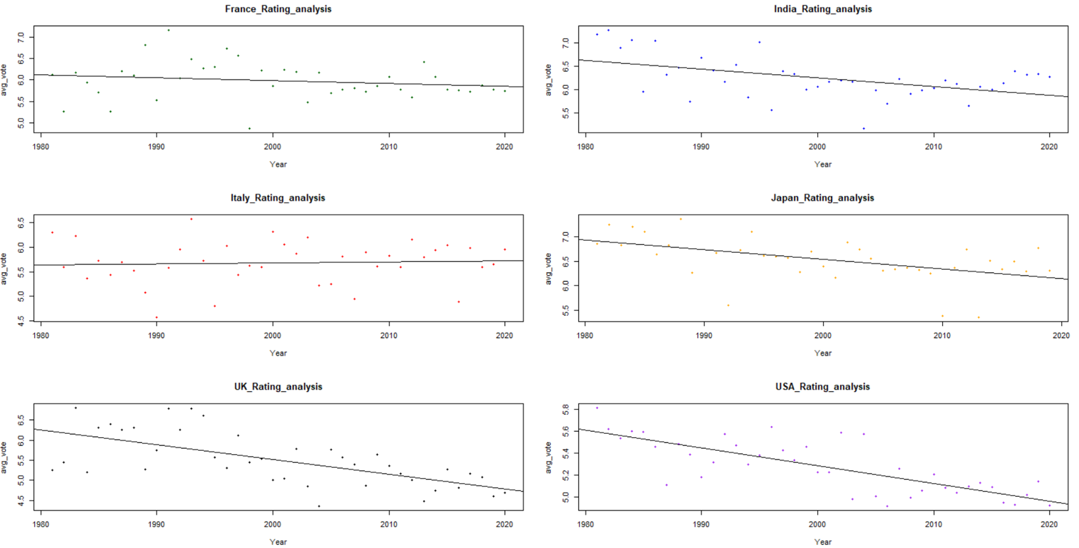
Inference: Italy’s performance towards rating is much better when compared to that of the UK’s plot where it drastically decreases from 6.3 to 4.6 over 40 years.

Slide 9
Inference: USA contributes the most towards all genres except for animation where Japan contributes for 43.5%.

Slide 10
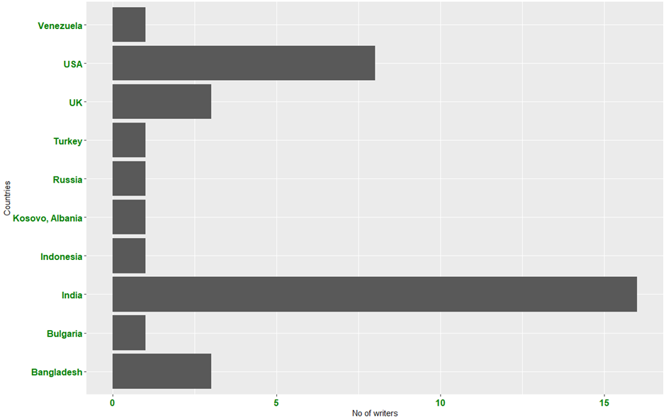
Inference: By filtering out the movies having IMDB rating >= 9.0, we can clearly visualize the count of the most voted writers in each country.

Slide 11
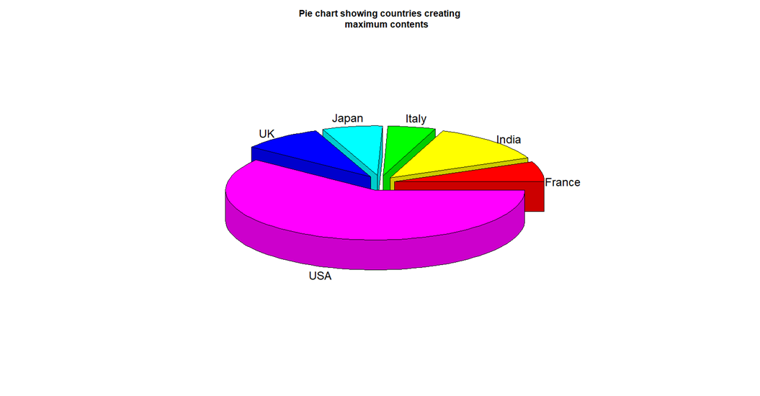
Inference:

Slide 12
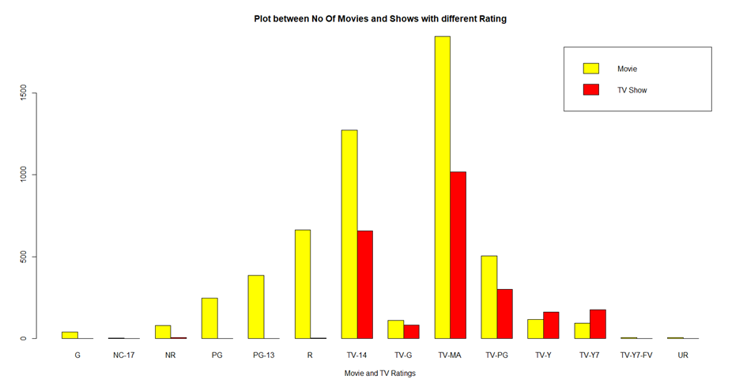
Inference:

Slide 13
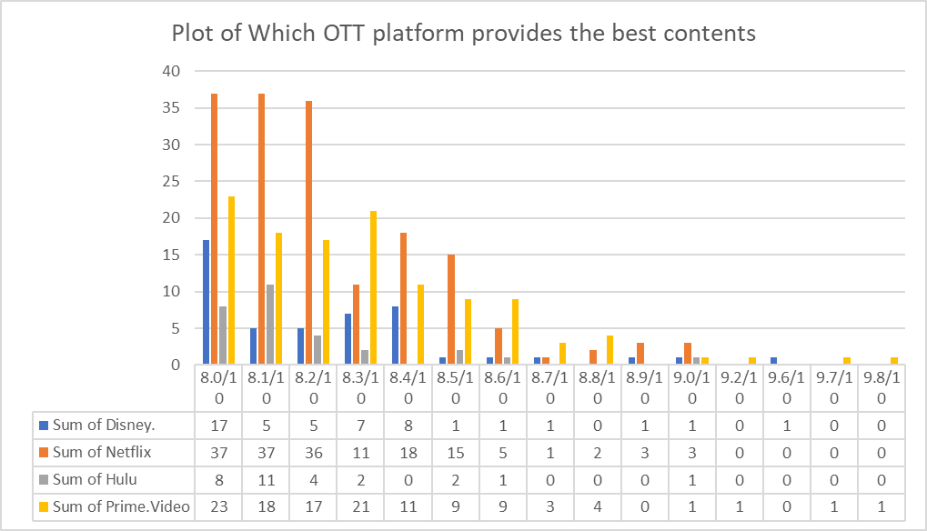
Inference:

Slide 14
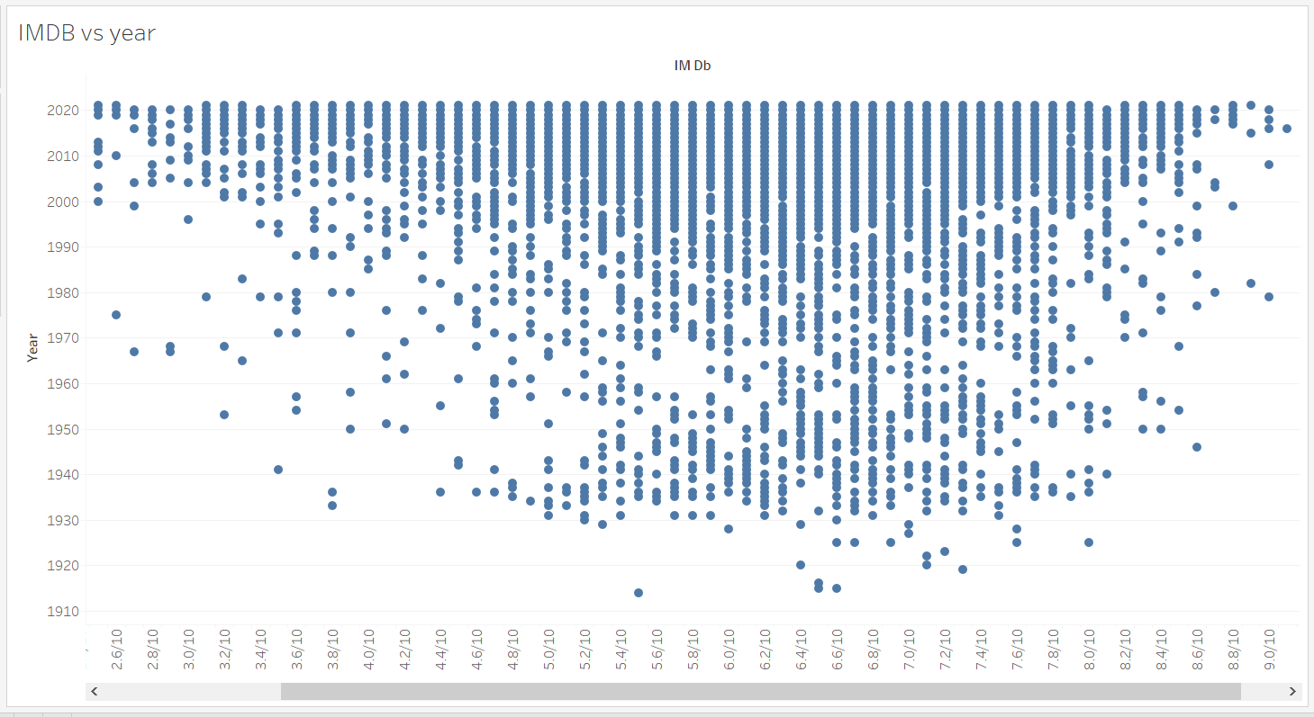
Inference:

