Slide 1
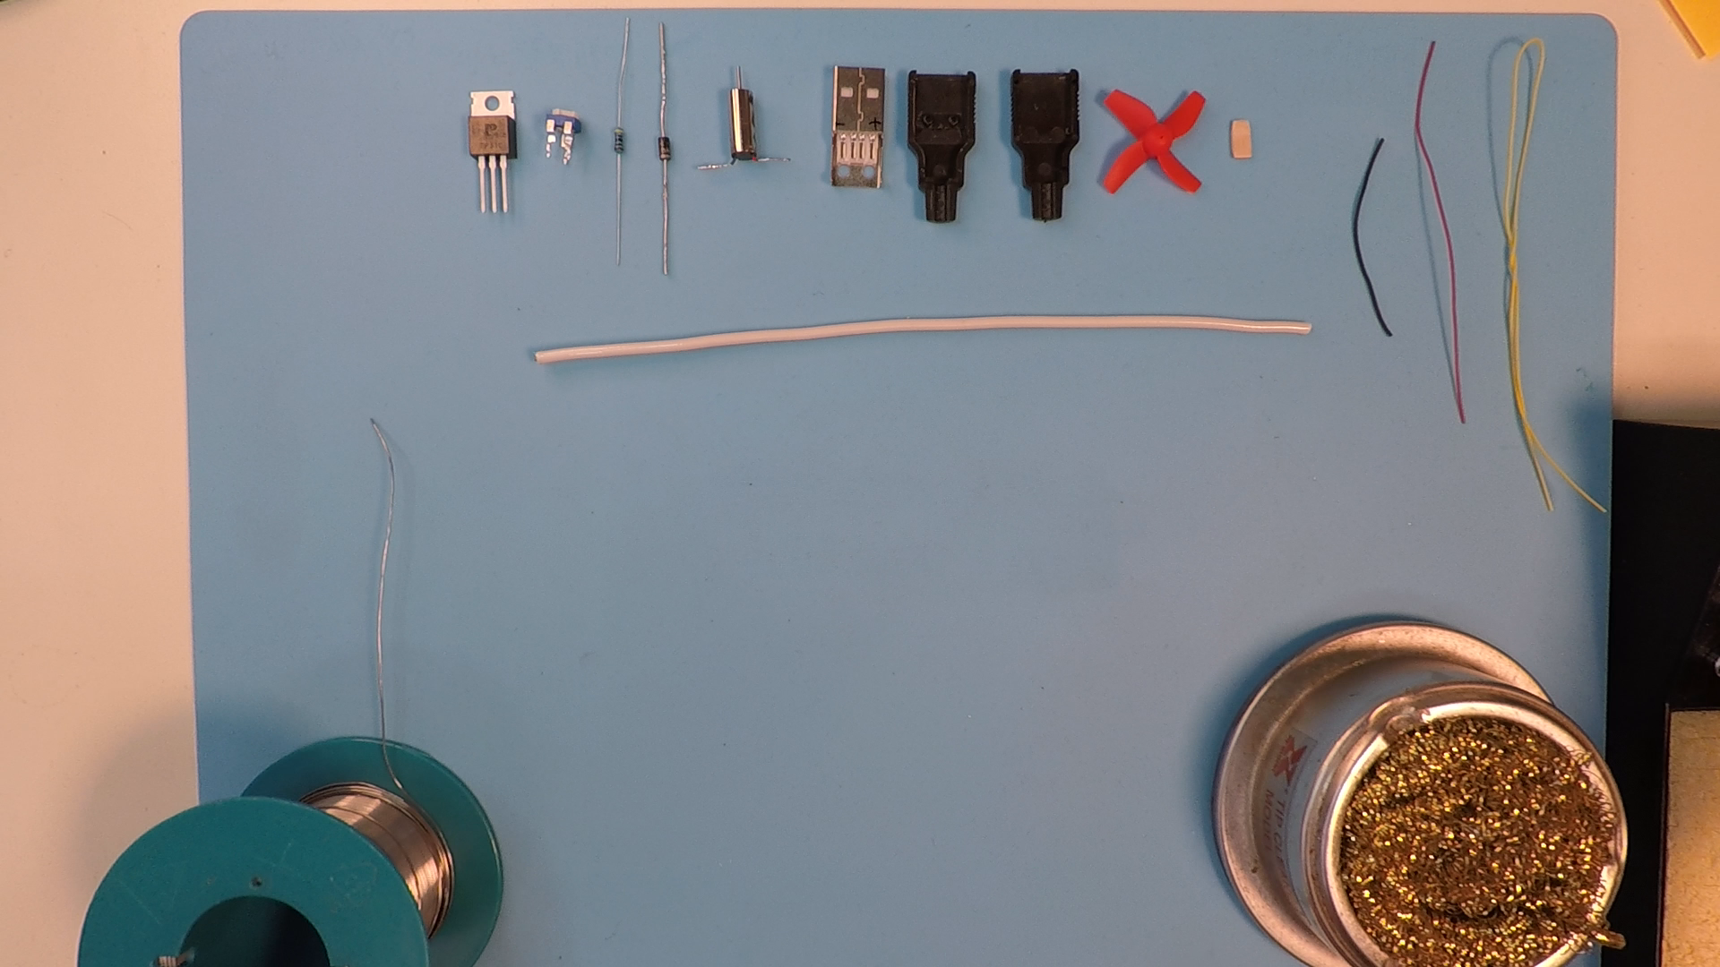
Transistor (Q1)
14 AWG cable for support
Resistor (R1)
Wood piece for turning potentiometer
30 AWG cables for wiring
Diode (D1)
Motor (M)
Propeller
USB Connector Shells

