Slide 1

Virtual Monster Manual
Chris, Noah, Samantha, Sheldon

Slide 2
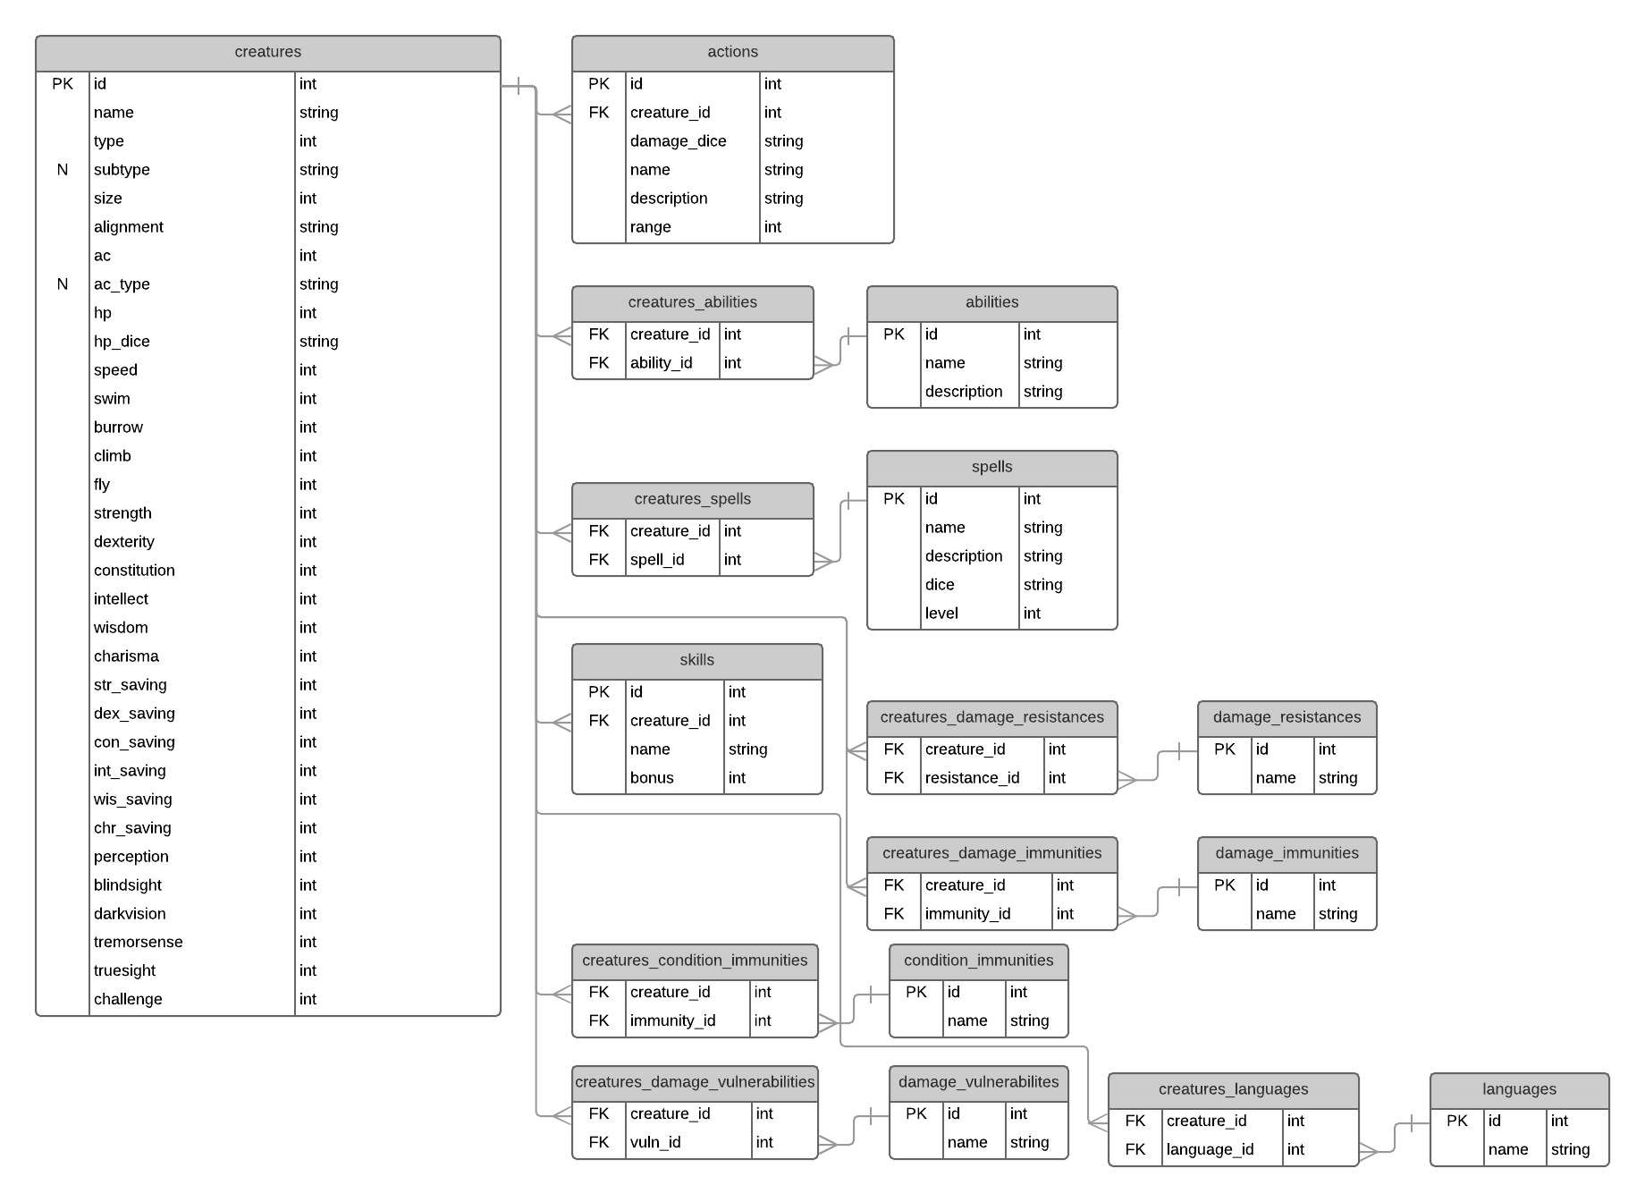

Slide 3
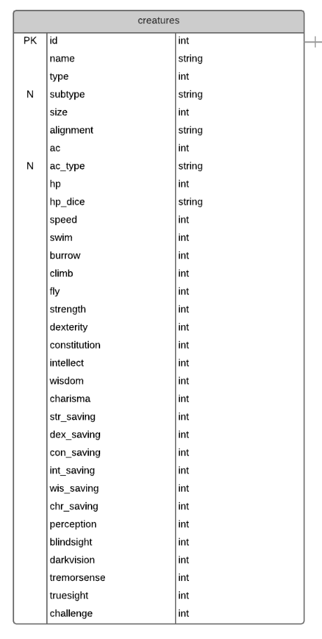

Slide 4
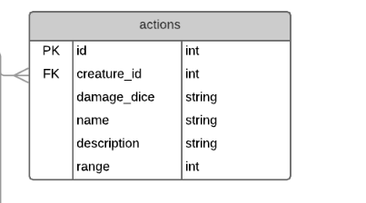
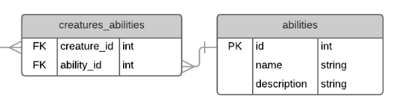

Slide 5
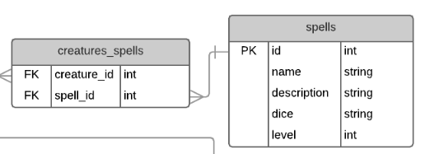
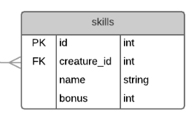

Slide 6
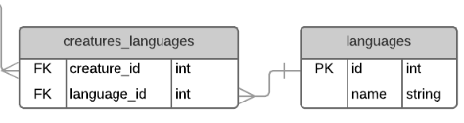
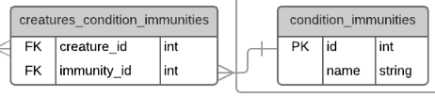

Slide 7
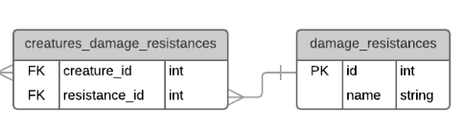
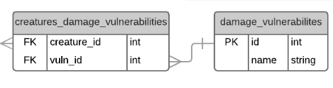
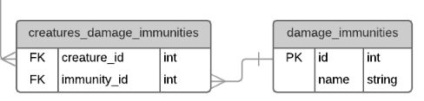

Slide 8
Next Steps
Get these set up as Rails models
Scaffold pages for CRUD operations
Think about database integrity
If a row gets deleted, what happens to related tables?
What’s a safe way to delete creatures, abilities, etc.
Figure out how to compare creatures

