Slide 1

Virtual Monster Manual
Chris, Noah, Samantha, Sheldon

Slide 2
D&D Monster Manual: What is it?
A collection of statistics of creatures in Dungeons & Dragons, a tabletop Roleplaying game
One of the three main books needed to play the Dungeons & Dragons game
The main book for creating encounters for the players

Slide 3
Who is the Target Audience
Players of the game
Those looking up creature statistics
Game masters designing encounters for players

Slide 4
Why a database for the Monster Manual
It is difficult to look through
It is a large PDF, and it is difficult to go to specific pages
Having a database would be significantly faster to look through
Organize by weaknesses, hit points, resistances, name, challenge rating
Allows detailed searching and provides additional context to abilities and creatures
Similar but more or less challenging?
Similar abilities, different types?
There are 14 creature types, organized alphabetically by name in the book

Slide 5
Design
Administrative Section
Add/edit/delete data
Modify relationships within data (for similarity-based lookup)
User Section
Search the data
Sort by type, name, abilities
Reports
Compare creatures by similarity, difference
Create sets of creatures for encounters

Slide 6
What is the data?
Creatures
Actions
Attacks
Bonus Actions
Things a creature can do
Abilities
Effects a creature has
Can be passive, can occur at death
Multiple attacks, water breathing, shapeshifting
Spells
Monster Types

Slide 7
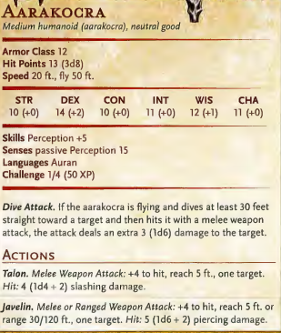
Creatures
Names
Resistances
Hitpoints
Ability Scores
Skills
Armor Class
Actions
Legendary Actions
Challenge Rating
Speed
Size
Notes:
Names are specific to each creature.
The resistances although not specific change from creature to creature, with the Aarakocra, they don’t have any resistances.
Hit points are how much damage each creature can take before dying, theses differ from creature to creature, some have the same number of dice used.
Ability Scores, there are five, Strength, Dexterity, Constitution, Intelligence, Wisdom, and Charisma, each affect different aspects of the game in different ways.
Armor class is a number the player has to roll to hit a creature this differs from each creature, some having high numbers and some having low numbers.
Actions, there are three actions a thing can take in there turn, the actions lets it use its weapon, or in the case of legendary actions they have a number of points they can use and each action uses a number of those points.
Challenge rating is a way to let the organizer of the fights know how challenging the creature is, and how much experience they players get if the beat/kill the monster.
Speed is how fast the creature moves on the field.
Size is how large a creature is there is Tiny, Small, Medium, Large, Huge, and Gargantuan, tiny being a foot or less, Medium being average human heights, Huge is almost triple a human, with Gargantuan being approximately the size of extremely large buildings.

Slide 8
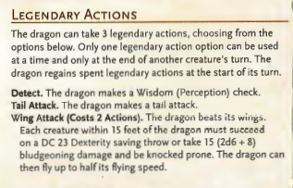
Actions
Three things something can take on their turn
Movement
Attack
Bonus Action
Attack
Melee normally have a range of 5ft to 10ft
Ranged attacks vary, some could be 80 ft, or 150ft
Anywhere from a d4 to a d12 damage
Bonus Action
Much more options
May have effects, may do damage
Casting a spell
Not all creatures have Legendary Actions

Slide 9
Spells
Spells have levels
Cantrip
1-9
Cantrips can be cast at any time as much as the caster would like
The spells that correspond to levels have restrictions
Specific number of castings per day
Some require materials to be consumed upon casting the spell
Some are utility, slowing down falling
Some are pure combat, doing damage, and perhaps moving people against their will

Slide 10
Summary
Searchable database of the D&D Monster Manual
More ergonomic than the book
Captures data about creatures, abilities, spells
Allows filtering, advanced searching
Shows similarities of creatures
Allows creation and saving of creature sets

