Slide 1

Virtual Monster Manual
Chris, Noah, Samantha, Sheldon

Slide 2
What we Have Done
Got the tables set up as Rails models.
Have the pages for CRUD operations on creatures scaffolded.
The beginning stages for creating the webpage.

Slide 3
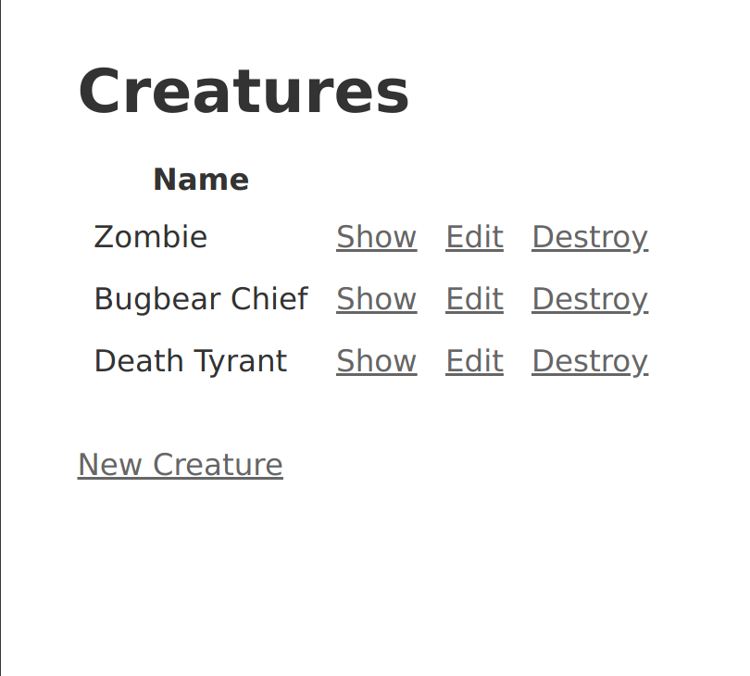

Slide 4
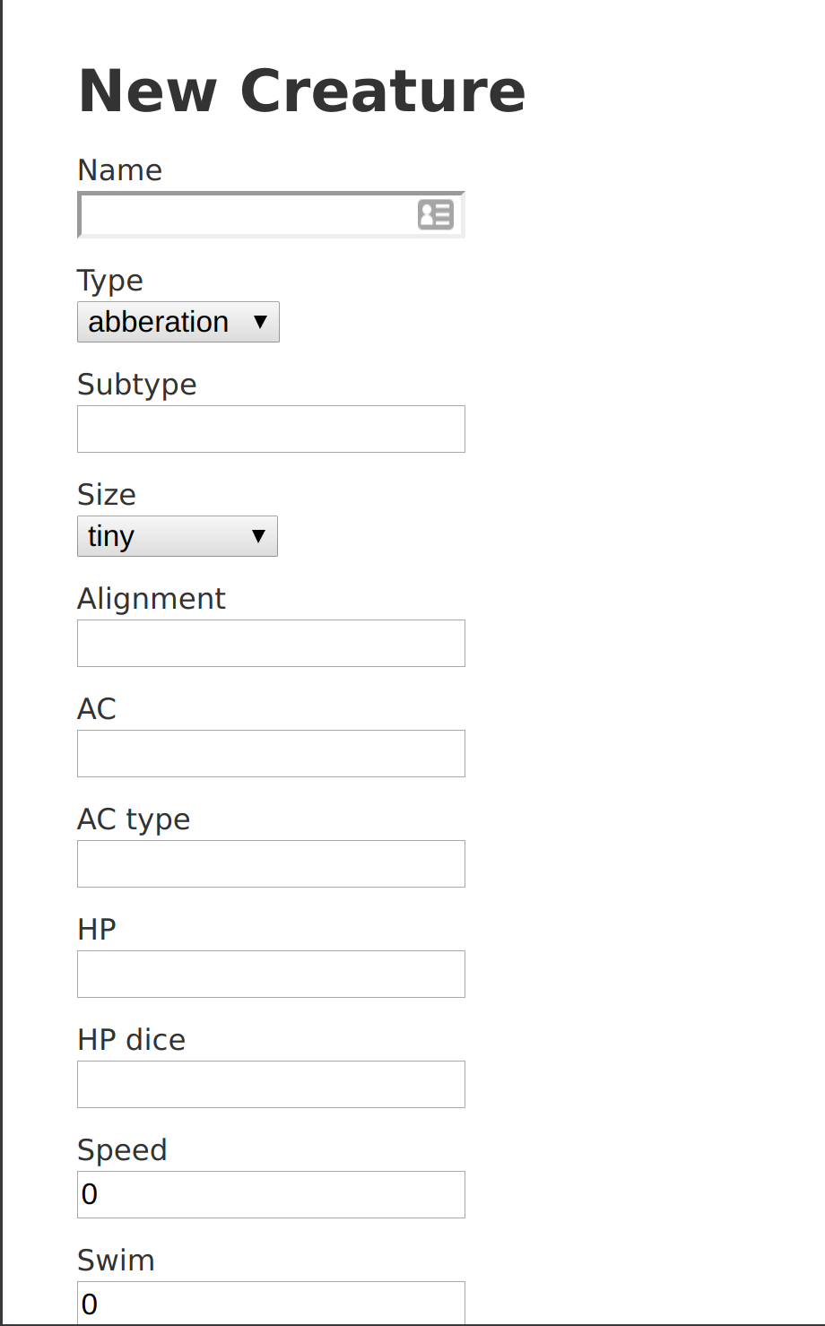
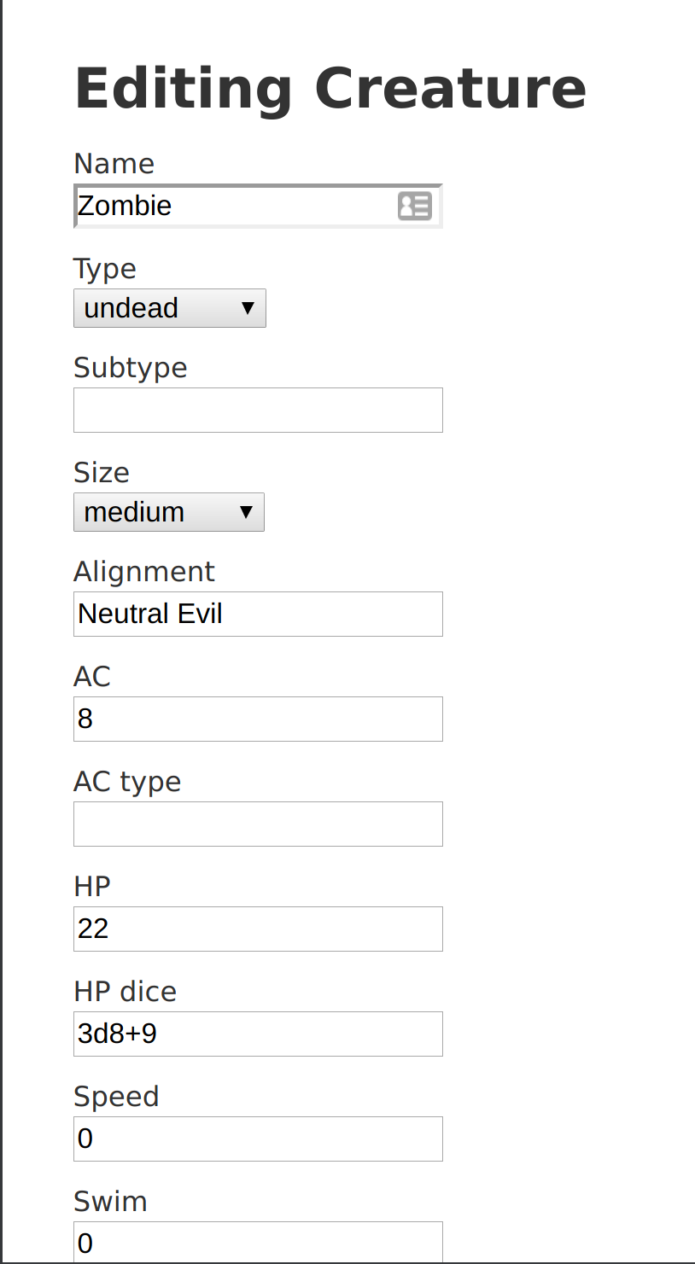

Slide 5
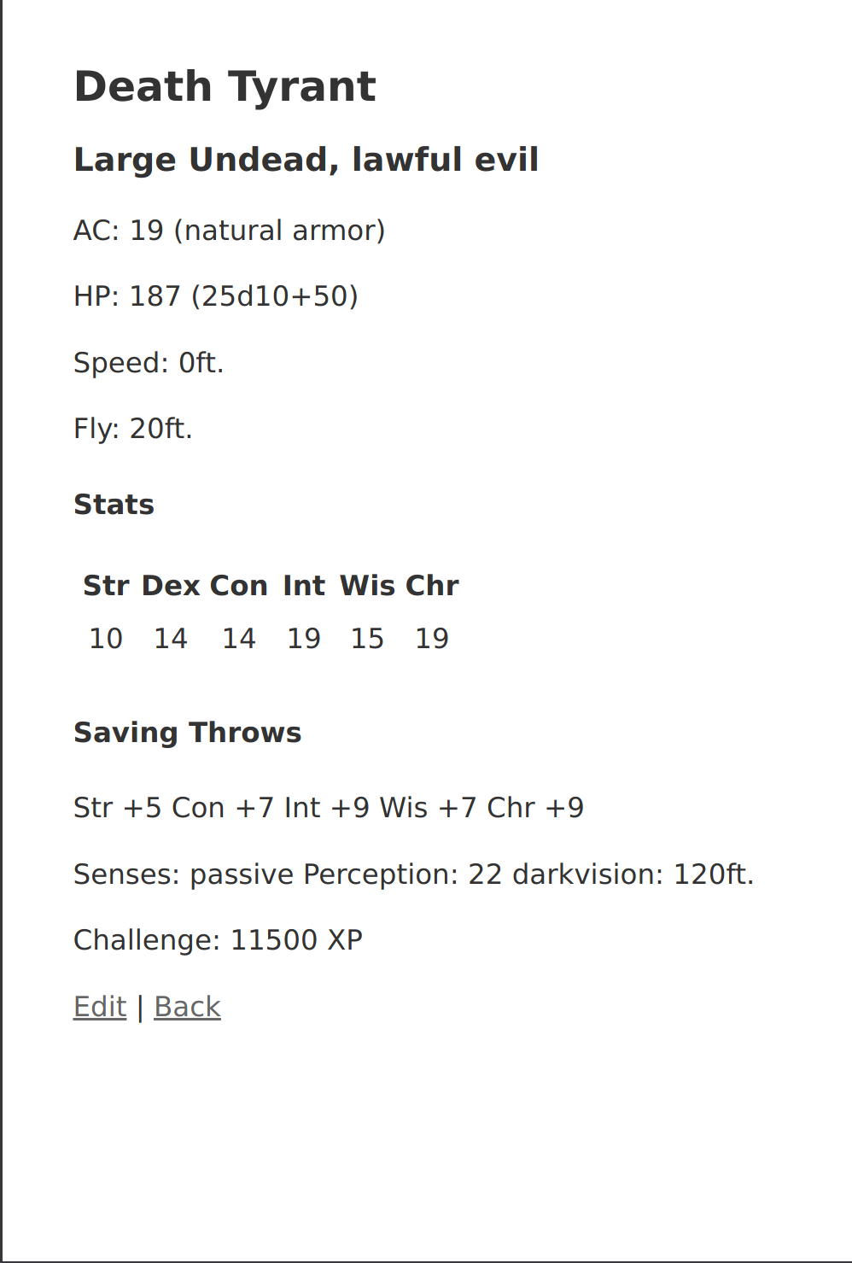

Slide 6
Creatures Example

Slide 7
Problems
Issues with some members getting git set up
Unfamiliar with github workflow
Issues with ruby
Incompatible ruby versions
Mostly resolved
Updated ruby
Instructions on using github

Slide 8
Next Steps
Finish the rest of the CRUD pages
Site layout with CSS
User model
Search page

