Slide 1

Virtual Monster Manual
Chris, Noah, Samantha, Sheldon

Slide 2
Scaffolds
Damage Vulnerabilities
Condition Immunities
Damage Immunities
Damage Resistances

Slide 3
CSS
Navbar and input styling
Navbar will be extended to add a search bar in certain pages (the main search page, model-specific searching)

Slide 4
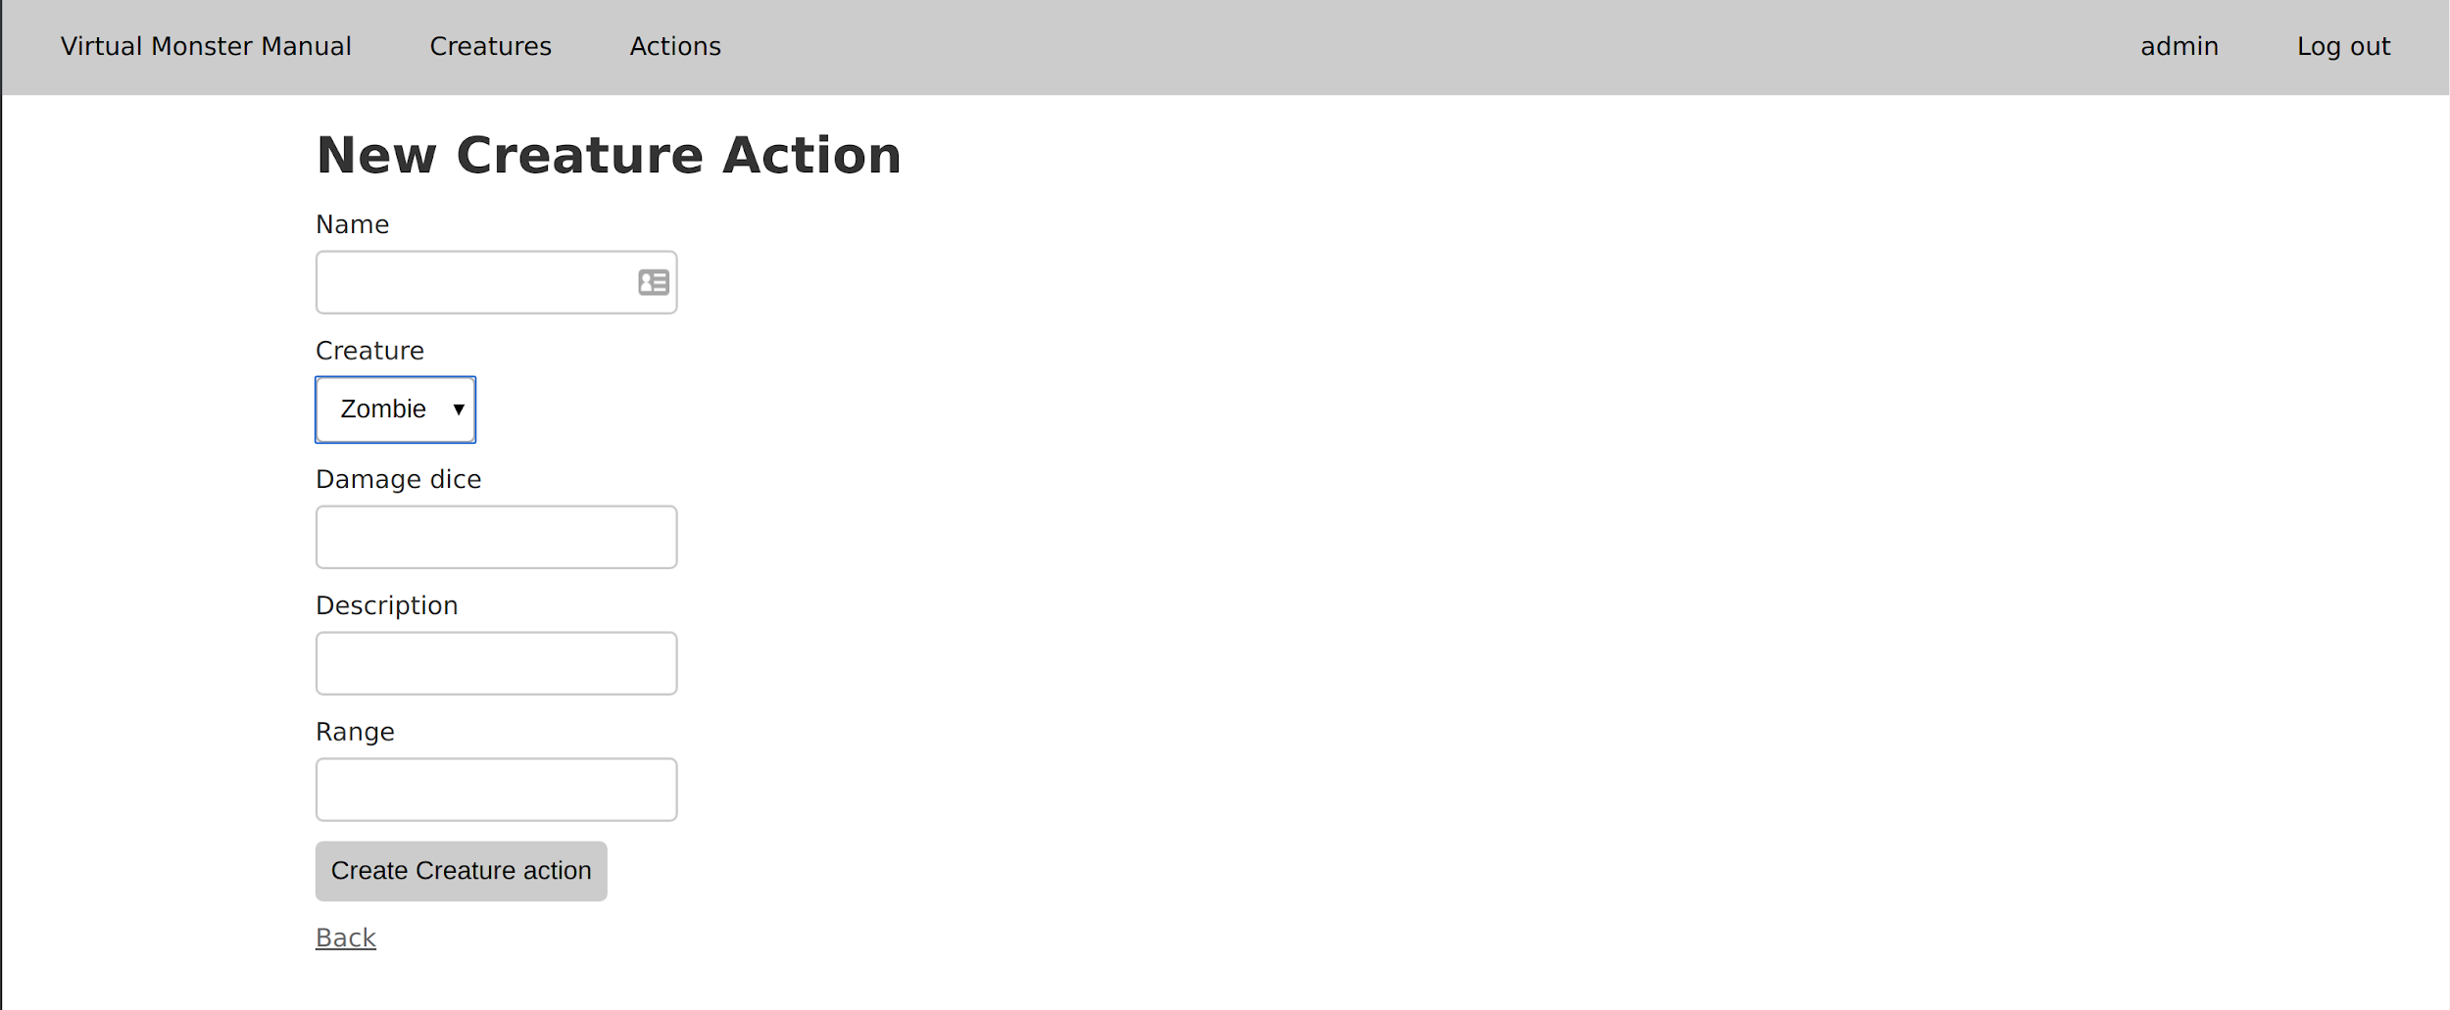

Slide 5
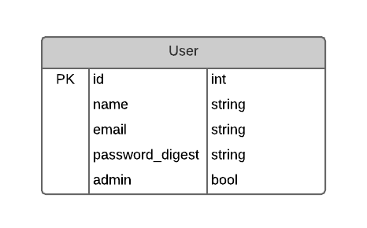
User models
Basic User model with name, email, password, and admin flag
To be used for saving sets of creatures
Also login, registration, user pages
Authentication to restrict edit, delete access

Slide 6
Demo

Slide 7
Next
Basic searching
Creature sets
Admin user by default
Complex creature form
Integrate adding actions, abilities, etc.

