Slide 1

Virtual Monster Manual
Chris, Noah, Samantha, Sheldon

Slide 2
Introduction
Searchable interface for the Dungeons & Dragons Monster Manual
Dungeons & Dragons (D&D) is a tabletop RPG
Monster Manual is its list of all enemies in the game
Goal is to provide easy interface to search and store creatures
Manual itself is a large pdf, hard to navigate to find specifics
Players and dungeon masters would benefit from an easy interface
Made with Ruby on Rails
Developed on github, coordinated via slack

Slide 3
Requirements
Store the Monster Manual
Search creatures by their attributes
Search creatures by other model’s attributes
Skills, spells, actions, abilities
Let users save sets of creatures as private/public
Allow other users to see public creature sets, hide private
Secure app
Admin and normal users with different access
Normal users can’t access admin side

Slide 4
The Database
One main model with associated models
Creatures is the main model
Other models have 1:many or many:many association
Creatures
Creature Actions
Attacks a creature has
Abilities
Passive abilities a creature has
Skills
Spells
Damage resistances, immunities, and vulnerabilities
Condition immunities

Slide 5
Triggers
Triggers on creature names to convert them to lower case on insert/update
Used to ensure consistency
Converted into title case in rails
Uses the hair trigger gem

Slide 6
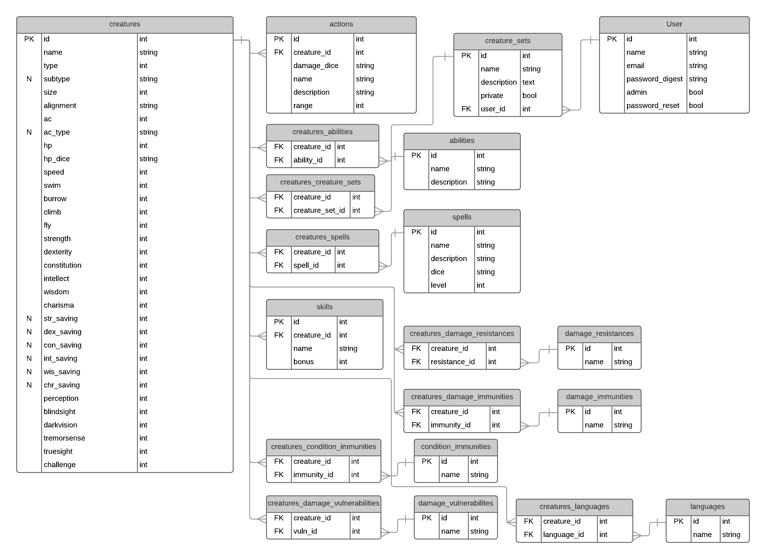
ERD

Slide 7
Design
Administration
Admins can modify creatures and other models through a single form page
Admins can modify and delete models through individual pages
Users
Users can search the list of creatures based on their attributes and their associated models’ attributes
Users can create sets of creatures and other users may browse public sets
Security
App is accessed through a landing page that lets users sign up or log in.
Users cannot access administrative forms
Users cannot modify other users

Slide 8
Search
Search is done via SQL, with select statement built in rails
When a search is requested, the given attributes are used for a WHERE key LIKE “%value%” clause
Multiple keys are concatenated with ANDs
Searching multiple models uses left outer joins and similar WHERE clause, with table names added
Javascript re-renders the search page without refresh

Slide 9
Demo

