Slide 1
SCIENTIFIC EXCHANGE ON MODELING & SIMULATION FOR RADIATION STERILIZATION
October 6, 2025

Slide 2
Science & Engineering of Radiation Processing (SERP)

Slide 3
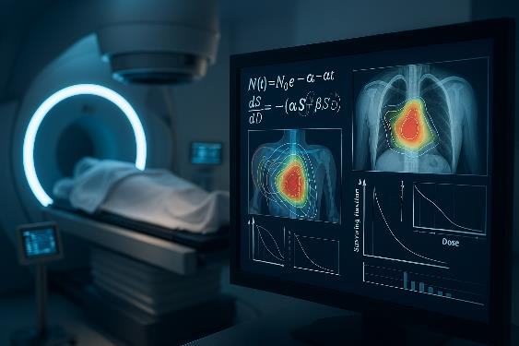
Scientific Exchange Highlights
Occurred September 16-17, 2025, at National Institute of Standards and Technology
Interdisciplinary Collaboration
Experts from industry, academia, regulatory bodies, and standards organizations collaborated to advance modeling for radiation sterilization.
Consensus and Roadmap Development
Roughly 50 participants focused on building consensus and shaping a roadmap for robust, traceable modeling and simulation methods.
Agenda
Over two days, the scientific exchange at NIST featured plenary talks, breakout sessions, and panel discussions that traced the evolution of modeling in radiation processing and regulatory science, explored lessons from radiation oncology, identified barriers and opportunities for standardization, showcased real-world case studies and a mock FDA submission validating simulation against physical measurements, and concluded with collaborative planning for standards development, regulatory engagement, and future exchanges.
Notes:
Image source: Microsoft 365 content library
The Scientific Exchange on Modeling & Simulation for Radiation Sterilization was held at NIST Gaithersburg in September 2025. It united experts from industry, academia, regulatory bodies, and standards organizations. Key goals included advancing consensus and shaping a roadmap for robust, traceable modeling, co-hosted by NIST and CIRMS.
6

Slide 4
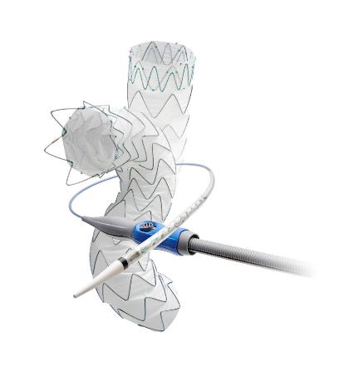
Technical Insights & Case Studies
Functional Equivalence
Technical insights from the event highlighted the versatility and value of modeling in radiation sterilization, emphasizing that functional equivalence—achieving the same safety and efficacy outcomes as physical testing—is central to the acceptance of simulation methods.
Modeling vs Physical Testing
Monte Carlo simulations, using tools like RayXpert and MCNP, enable accurate dose mapping, shielding design, and validation against physical measurements, which are essential for ensuring device safety and efficacy, especially when physical testing is impractical.
Real-world Application Examples
Industry, academia, and government case studies presented by Johnson&Johnson, Georgia Institute of Technology, and the National Institute of Health.
Medtronic, “Medtronic’s Endurant II/IIs Stent Graft System Receives CE Mark For Use With ChEVAR Parallel Graft Technique,” 9 December 2016.
Notes:
Image source: Microsoft 365 content library
Monte Carlo simulations using tools like RayXpert and MCNP enable precise dose mapping and validation. Modeling demonstrates functional equivalence to physical testing, supporting safety and efficacy. Applications include device development, regulatory submissions, and CAPA. For example, stent sterilization modeling highlights reliability and versatility in real-world scenarios.
<number>

Slide 5
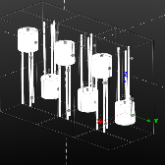
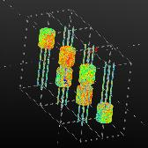
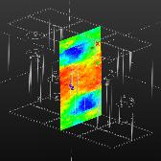
Regulatory Insights & Modeling
Modeling as Regulatory Evidence
A mock FDA submission demonstrated how RayXpert simulation can be integrated into regulatory filings for radiation sterilization. The primary objective of this mock FDA Q-submission is to demonstrate how simulation data aligns with Performance Qualification (PQ) measurements, thereby supporting the device's regulatory justification.
Standards and Programs
The FDA recognizes simulation modeling as credible evidence for device submissions, ensuring scientific rigor and credibility. ASME V&V 40-2018 standard and the MDDT program support reliable model credibility and streamline device submissions.
Simulation for Compliance and Innovation
Mock submissions using validated simulations show how modeling aids regulatory compliance and supports innovative device development.
Notes:
Image source: Microsoft 365 content library
The FDA accepts modeling as credible evidence in device submissions, supported by the ASME V&V 40-2018 standard for model credibility. The Medical Device Development Tools (MDDT) program helps streamline submissions. A mock submission using RayXpert simulation, validated against ISO 11137 standards, demonstrates how simulation enhances regulatory compliance and aids innovation.
<number>

Slide 6


Outcomes & Future Roadmap
Consensus on Standardization
Despite success in other sectors, modeling for industrial sterilization remains underutilized, slowing innovation and efficiency improvements. Participants agreed on the importance of unified standards for verification, validation, and quantifying uncertainty to ensure reliability.
Identified Key Barriers
Absence of clear guidance and scientific consensus makes it difficult to implement modeling practices widely and consistently. Major barriers are training gaps, insufficient quality metrics, and regulatory acceptance, impacting progress and safety.
Action Plan for Advancement
There is a strong demand for robust frameworks addressing verification, validation, and uncertainty quantification in modeling.
Next steps involve developing standards, organizing round-robin studies, and embedding priorities in strategic reports for innovation.
Notes:
Image source: Microsoft 365 content library
The event achieved consensus on the need for standardized verification, validation, and uncertainty quantification. Key barriers include training gaps, lack of quality metrics, and regulatory acceptance. Action items moving forward are to develop standards, promote round-robin studies, and integrate priorities into the CIRMS Needs Report, emphasizing collaboration for innovation and safety.
<number>

Slide 7
Spencer Mickum
Principal Scientist, Radiation Technology
Spencer_Mickum@STERIS.com

