Slide 1
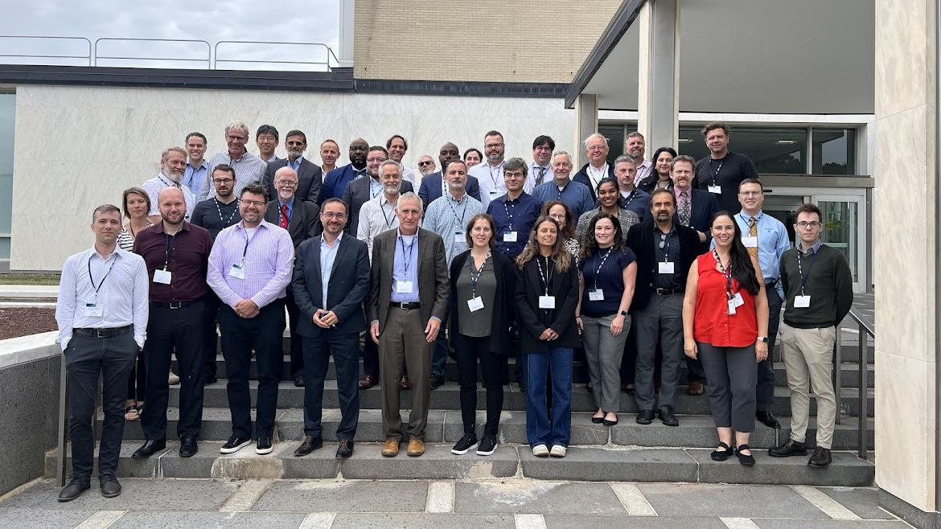
Scientific Exchange on Modeling and Simulation for Radiation Sterilization
September 16-17, 2025

Slide 2
Overview
The modeling workshop was a focused two-day scientific exchange on modeling and simulation for radiation processing, held at NIST in September 2025.
The event brought together government, industry, academia, and regulatory stakeholders to address how mathematical modeling could be better integrated into radiation sterilization processes.
Workshop Structure and Participants
The workshop featured morning presentations covering radiation simulation, mathematical methods, and radiation therapy perspectives, followed by afternoon breakout sessions focused on building credibility and developing standards.
Key Problem Identified
The central challenge addressed was that while mathematical modeling works well in radiation oncology and other industries, it's not routinely used in radiation sterilization workflows.
The primary barrier is economic - dose mapping costs $5,000-$10,000, while benchmarking a mathematical model can cost $50,000-$100,000, making the investment difficult to justify.

Slide 3
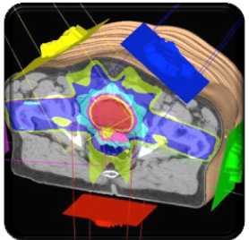
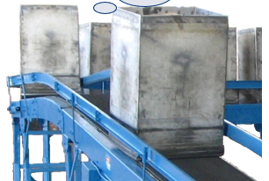
“Same” Problem, except for dose and scale
Focused clinical beam (2 Gy to ~1 cm region):
Objective: deliver a low dose precisely to a small, localized volume
Challenge: complex modeling and simulation to account for scattering, heterogeneity of tissues, beam shaping, and patient-specific anatomy
Verification: relies heavily on computational modeling, treatment planning systems, and imaging, with physical measurements used sparingly for quality assurance.
Large-scale processing (20 kGy to ~1 m region):
Objective: deliver a very high dose uniformly to a large bulk product
Challenge: relies on uniformity and reproducibility across pallets or containers, where modeling plays a smaller role and physical dosimetry is the foundation for process control.
Verification: traceable physical dosimetry, with routine dose mapping and reproducibility checks to confirm uniformity across the irradiation volume

Slide 4
Stakeholders, 47 registrants, 30 organizations
Academia
Georgia Institute of Technology
Johns Hopkins University
University of Pennsylvania
Government
FDA (U.S. Food and Drug Administration)
CDRH (Center for Devices and Radiological Health)
NIST (National Institute of Standards and Technology)
NIH/NCI (National Institutes of Health / National Cancer Institute)
Pacific Northwest National Laboratory (DOE national lab)
Oak Ridge National Laboratory (DOE national lab)
Industry
Testing, Standards & Certification
BSI (British Standards Institution, certification and standards)
TÜV SÜD (testing, inspection, and certification services)
Applied Research Associates, Inc. (engineering and applied science R&D)
Industry
Medical Devices & Healthcare
Medtronic (medical devices)
Boston Scientific (medical devices)
Johnson & Johnson (medical devices / healthcare products)
Becton Dickinson (medical technology and diagnostics)
Sartorius (biopharmaceutical and lab technologies)
Meissner Consulting GmbH (biotech/consulting, single-use systems)
StarFish Medical (medical device design & development)
Triple Ring Technologies (medical and biotech engineering/consulting)
Industry
Radiation Processing / Sterilization
STERIS (infection prevention, sterilization solutions)
STERIS AST (Applied Sterilization Technologies, contract sterilization)
Sterigenics (contract sterilization)
Steritek (contract sterilization services)
BGS-US LLC (radiation sterilization, subsidiary of BGS Germany)
Nordion (Cobalt-60 supply, irradiation technologies)
Aerial (radiation processing / dosimetry)
Reveam Inc (electron beam food sterilization)
TRAD Tests & Radiations (dosimetry and radiation testing services)
IBA (Ion Beam Applications, radiation therapy and industrial irradiation)
Ebeam Consulting LLC (electron beam sterilization consulting)

Slide 5
Major Outcomes
1. Framework for Credibility
The workshop established that any modeling approach must be tied to known dosimetry standards.
The consensus was to build a framework based on continuous testing with dosimetry, combining virtual dosimetry with physical measurements rather than replacing them entirely.
2. Three Key Application Areas
Participants identified where modeling could make the biggest impact:
  Enhancing dosimetry: Reducing physical dosimetry requirements in performance qualification (PQ) submissions and guiding optimal dosimeter placement
  Supporting parametric release: Using models to set process parameter bounds without testing each scenario physically
  Advancing regulatory submissions: Particularly through FDA's master file pilot program
3. Regulatory Support
A significant finding was that regulators want to see more simulation in radiation sterilization - they just need proper justification.
The FDA representatives emphasized they're supportive of modeling approaches when credibility is demonstrated.

Slide 6
Major Outcomes and Consensus, continued
Technical Requirements Identified
The workshop highlighted several technical needs:
  Standardized phantoms for model validation
  Proficiency testing programs similar to those in radiation therapy
  Uncertainty quantification and sensitivity analysis protocols
  Competency assessment frameworks for modelers

Slide 7
Action Items
Foundational
Establish consensus standards and quality systems for verification, validation, and quality assurance, leveraging existing frameworks and organizations (e.g., ASTM, AAPM).
Develop a library of validated use cases with specific application contexts to demonstrate credibility and impact.
Create proficiency testing programs that incorporate modeling components to benchmark performance and build confidence.
Strategic Development
Form a CDRH-led working group to develop a specific use case and roadmap, including exploration of consortium funding mechanisms to support project development.
Develop a white paper articulating the benefits of modeling from multiple stakeholder perspectives, serving as a unifying reference and outreach tool.
Communication and Engagement
Organize a webinar to summarize meeting outcomes, highlight action items, and engage broader stakeholders.

Slide 8
Challenges and Limitations
The workshop identified that more focused time was needed to hammer out implementation details.
While the framework was established, significant work remains to develop the specific standards and validation approaches needed for widespread adoption.
The event successfully demonstrated strong collaboration potential between radiation sterilization and radiation therapy communities, with significant cross-pollination of ideas and approaches between the two fields.

Slide 9
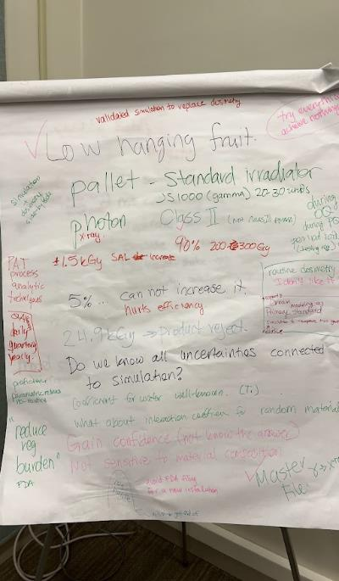
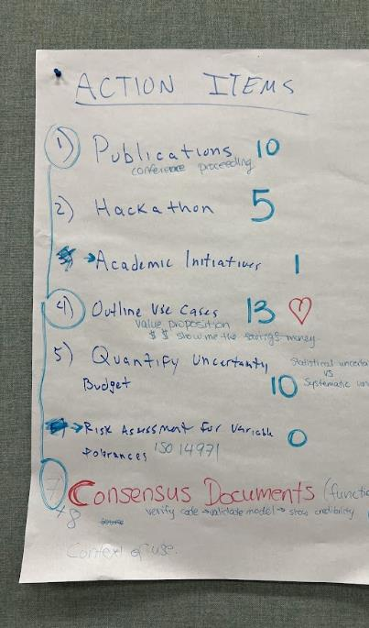
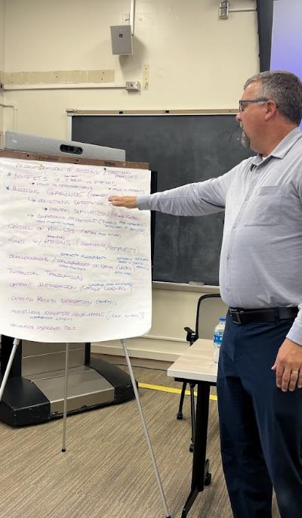

Slide 10
White paper outline: Enhancing the Credibility of Simulation in Sterilization
1. Executive Summary
  Brief overview of the role of modeling and simulation in sterilization.
  Meeting outcomes: consensus on roadmap elements, credibility needs, and community priorities.
  Action plan: white paper, webinar, working group, and funding pathways.
2. Introduction & Context
  Importance of modeling and simulation in sterilization.
  Current challenges: lack of credibility, standardization, and regulatory alignment.
  Purpose of this white paper: define roadmap, align community, and build trust in simulation.
3. Overview of the Discussion
  Goals of the session: credibility, roadmap development.
  Key ideas discussed: publications, hackathons, academic engagement, proficiency testing.
  Summary of proficiency testing and consensus standards.
4. Prioritizing Key Elements for a Roadmap
  Proficiency testing and modeling proficiency guidelines.
  Consensus standards for methodology and validation.
  Quantifying uncertainty budgets.
  Sensitivity analysis and uncertainty qualification (UQ).
    Recommendation: focus on a single, well-defined use case.

Slide 11
White paper outline: Enhancing the Credibility of Simulation in Sterilization
5. Developing a Practical Roadmap
  Establishing a standard reference case.
  Need for periodic validation and reproducibility checks.
  Characterization of phantoms and CAD drawing standards.
  Incorporating ancillary equipment and real-time data into models.
  Potential credentialing processes (lessons from radiation therapy).
6. Building Credibility with Regulators
  Benefits of modeling for patients, industry, and regulators.
  Supporting regulatory submissions with simulation data.
  Importance of process control and traceability to the virtual dose.
  Competency assessment to build confidence.
7. Leveraging Existing Resources and Standards
  Role of ASTM, AAPM, and other frameworks.
  Aligning with existing forums and standards organizations.
  Need for modeling proficiency guidelines.
  Exploring funding opportunities: grants, CDRH consortium support.

Slide 12
White paper outline: Enhancing the Credibility of Simulation in Sterilization
8. Developing a Use Case & Working Group
  Rationale for starting with a simple, practical use case.
  Potential models to build on (e.g., syringe).
  Use case as a driver for credibility, engagement, and testing the roadmap.
  Establishment of a working group under CDRH to lead development.
9. Engaging the Academic Community
  Motivating participation through publications, credit, and training opportunities.
  Integrating academic research with industry needs.
  Roadmap alignment to ensure achievable goals.
  Webinars, workshops, and events to sustain engagement.
10. Final Thoughts & Next Steps
  Reaffirming patient health and safety as the ultimate goal.
  Need for compromise, collaboration, and shared accountability.
Next steps:
  Draft and circulate white paper.
  Host webinar to summarize outcomes and recruit participants.
  Form working group and define initial use case.
  Explore funding mechanisms (grants, consortium support).

