Slide 1


Python x Flask
Workshop by Ciro Autiero and Adrian Lorenzi Dainesi

Slide 2
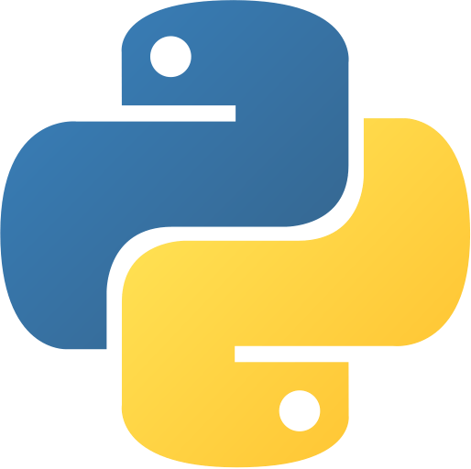
Python
Programming Language
High Level
Interpreted
Created at 1991

Slide 3

Flask
Framework
Development web
MicroFramework
Created at 2010

Slide 4
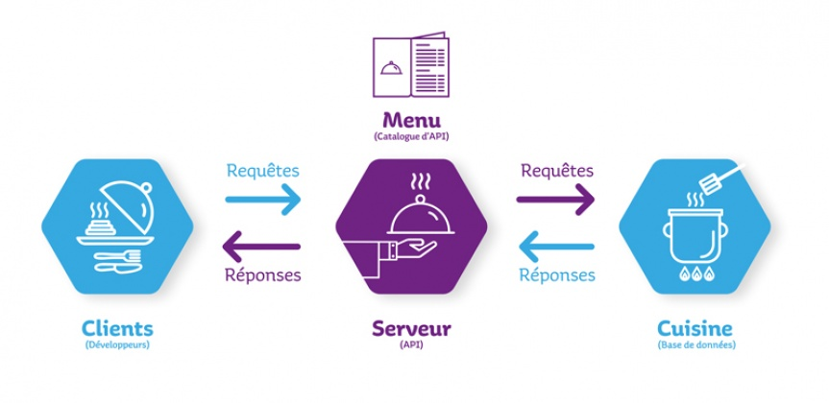
API
Application Protocol Interface

Slide 5

Git Clone and Start !
git@github.com:ciro-di-marzio/HaloufApiFlask.git

