Slide 1

Convalescent Home Nutrition Planner
Larder
Demo Day
This presentation contains a brief overview of our MVP product including problem statement, target user, MVP description, risks and mitigation, and next steps.

Slide 2
Content overview
Larder
Our Team
MVP Description & Demo
Problem Statement
Risks & Mitigation
Target User
Next Steps

Slide 3

Our team
Larder
Student A
Student B
Student C
Student D
Frontend Development
Code Merge
LLM Integration and RAG
Data Handling
Backend Development

Slide 4

“In the United States, nearly seventy percent of older adults will need some form of long-term care, and roughly 1.02 million seniors currently live in residential care communities.”
Larder
CDC National Center for Health Statistics
2022

Slide 5

Convalescent homes are often understaffed and inadequately trained in elder care. One critical area is nutrition planning, where AI can help reduce cognitive load, ensure dietary safety (e.g., for chronic conditions like diabetes), and support cost-effective resource use.
Larder
THE PROBLEM

Slide 6

Larder addresses this challenge by offering a nutrition-focused AI agent that generates weekly, individualized meal plans aligned with patient health profiles, helping reduce planning overhead and improve clinical outcomes.
Larder
OUR MISSION
Convalescent home staff could significantly benefit from an AI agent to help with resource planning to lower costs and maintain patient health by delivering safe, individualized care.

Slide 7

Convalescent Home Staff
Larder
Spotlight Target User
Key responsibilities:
Overseeing ~40 patients above the age of 65
Administering 3 meals and afternoon snacks conforming to individual dietary and medication restrictions
Ordering weekly procurement of meals

Slide 8
A web page for convalescent home staff to input user data, extract daily, individualized nutrition plans, and leverage aggregated weekly procurement plan.
Larder
THE SOLUTION
Patient Profile Management
Maintains a repository of all patients with the ability to seamlessly add and remove patients
Individualized Meal Plans
Creates daily meal plans including breakfast, lunch, afternoon snack, and dinner while adhering to dietary restrictions from medication and pre-existing health conditions
Weekly Procurement
Streamlines weekly procurement plans by aggregating individualized meal plans

Slide 9
MVP Description
Larder
OBJECTIVES
Data Handling
LLM & RAG
Frontend Development
Backend Development
Build and clean datasets (recipes + disease rules) to match meals with patient conditions. Standardize ingredients and prepare data for safe, personalized nutrition plans.
Generate meal suggestions to avoid food prohibited by allergies and medication while providing a balanced diet
Figma: Design user journey draft
Gemini: Improve color, font and interactivity to cultivate Nurturing Theme
Handles API endpoints (retrieving patient/meal plan data), business logic, LLM integration, and data models (for patients, daily meal plans, weekly procurement plans)

Slide 10
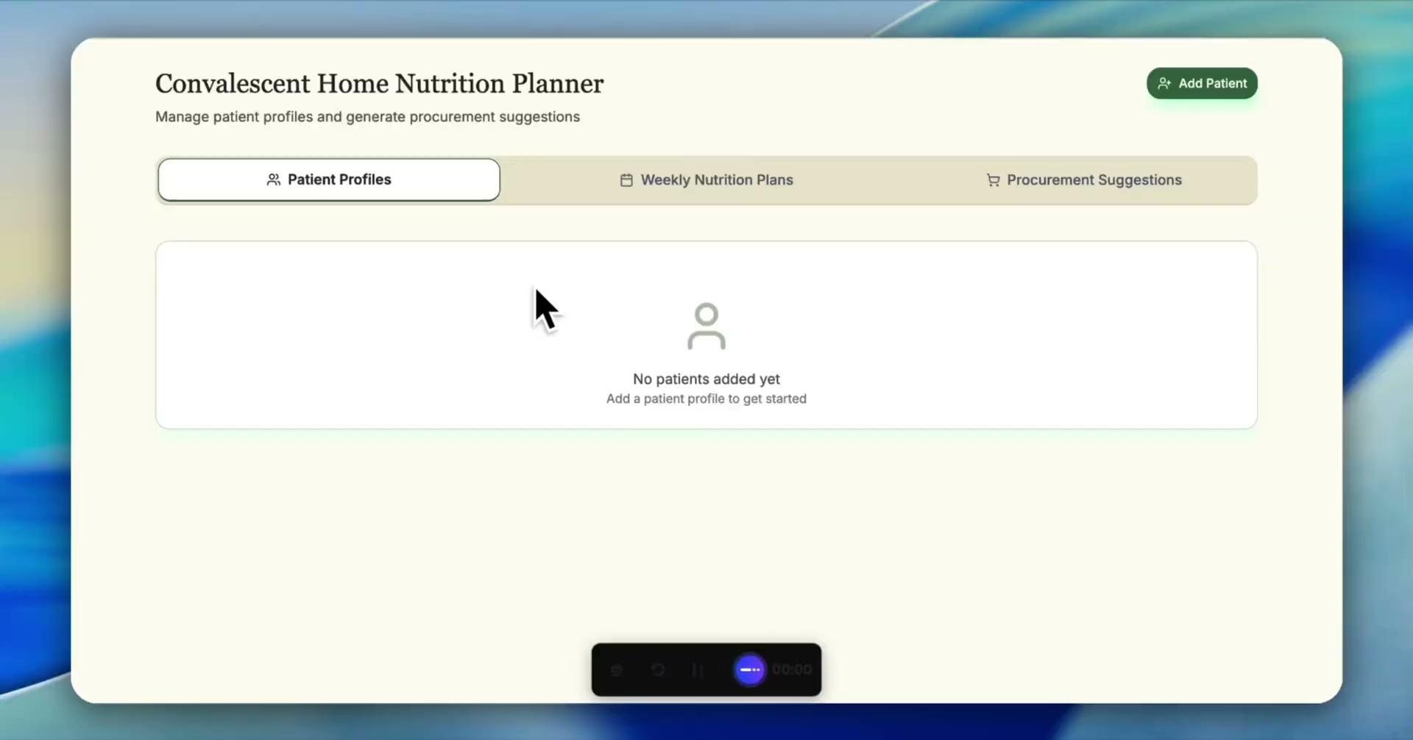
MVP Demo
Larder

Slide 11
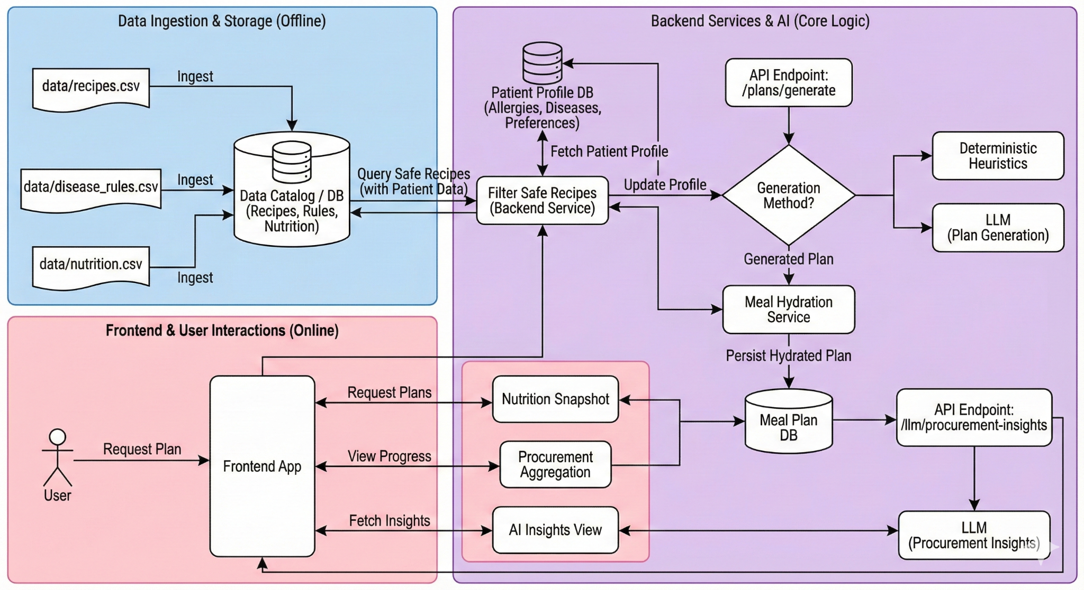
Technical Diagram
Larder

Slide 12
Technical Diagram
Larder
apps/
backend/ ← FastAPI backend
frontend/ ← Vite + React + Tailwind interface
data/
Disease_rules.csv
Recipes_with_Ingredients.csv
Frontend: React, TypeScript, Tailwind CSS, shadcn/ui, React Query, Lucide
Backend: FastAPI, SQLAlchemy, Pydantic, Uvicorn
LLM: OpenAI GPT-4o-mini
Database: SQLite/ PostgreSQL
Tooling: npm, pip/venv, Makefile, Dockerfiles, CSV import scripts

Slide 13
Risks & Mitigation
Larder
AI Hallucinations
Risk: AI may suggest meals that violate patient restrictions.
Mitigation: Apply strict filtering rules from disease-to-food mappings before AI generation. Block unsafe ingredients at the data level.
Patient Data Privacy
Risk: Sensitive patient data could leak between sessions or users.
Mitigation: Anonymize patient profiles, store data locally, and implement user-controlled data deletion. LLM inputs are tightly scoped per user.
Data Reliability
Risk: Missing disease-food links could allow unsafe meals through.
Mitigation: Maintain curated rule-based dataset (Disease_rules.csv) and expand coverage iteratively with medical guidelines (e.g., ADA, DASH).

Slide 14
Next Steps:
Larder
Market Expansion
Expand to Assisted Living & Home Health Care (Direct-to-Consumer app).
Family Portal: Allow family members to view their parents' nutrition logs.
Technical Integration
Implement "Plate Waste Analysis" (using Computer Vision) to track what patients actually ate vs. planned.
Validation
Deploy MVP to 3 partner convalescent homes.
Collect feedback on Chef UX and recipe variety.

Slide 15
Thank you
Larder
We look forward to answering any questions you may have

