Slide 1
Efficient Intent Detection via Vector Retrieval
Rafael L. Cirolini — UNISINOS

Slide 2
Motivation
• Fine-tuning requires large labeled datasets and retraining cycles.
• Inflexible when adding new intents or handling OOS queries.
• Need for low-latency, scalable, and maintenance-friendly alternatives.

Slide 3
Objective
• Propose a retrieval-based method using pre-trained sentence transformers.
• Avoid fine-tuning while maintaining high accuracy and OOS coverage.
• Complement vector-based pipeline with symbolic OWL ontology insights.

Slide 4
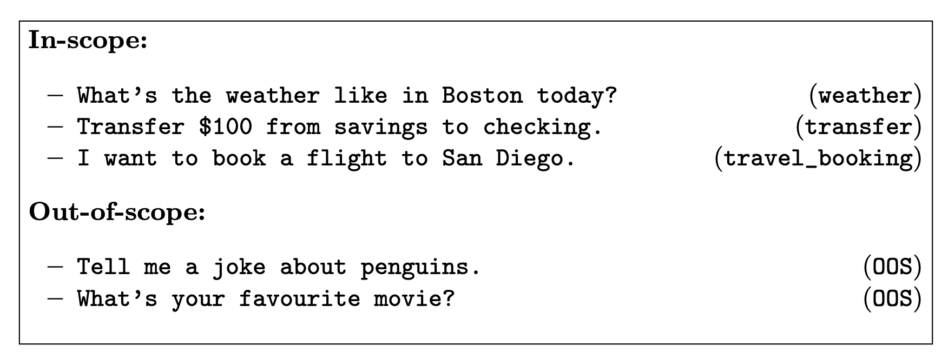
Dataset Used – Clinc‑OOS Plus
150 known intents + special OOS class
Example: “What’s the weather like in Boston today?” → weather
Example: “Tell me a joke about penguins.” → OOS

Slide 5
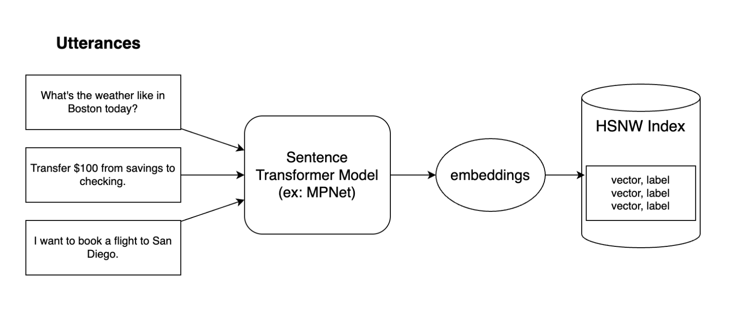
Embedding Generation and Indexing
Using SentenceTransformer (e.g., all‑mpnet‑base‑v2)
Sentences converted into dense vectors
Stored in labelled FAISS HNSW index

Slide 6
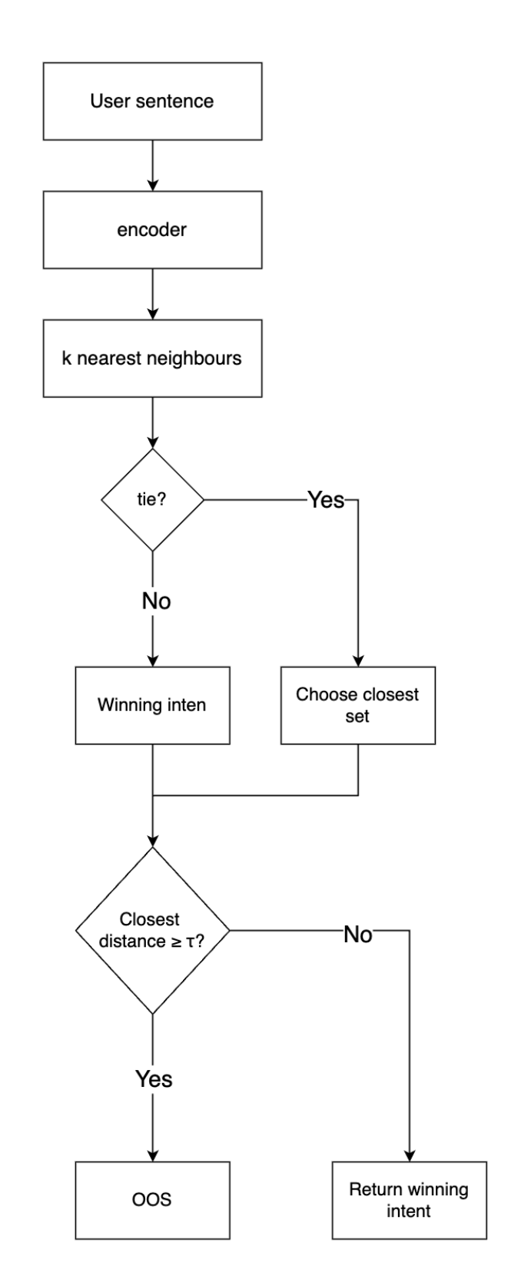
Inference Step by Step
1. Encode the input sentence
2. Search for the k nearest neighbors
3. Majority vote or lowest average distance (tie‑break)
4. Se similaridade < τ → classifica como OOS

Slide 7
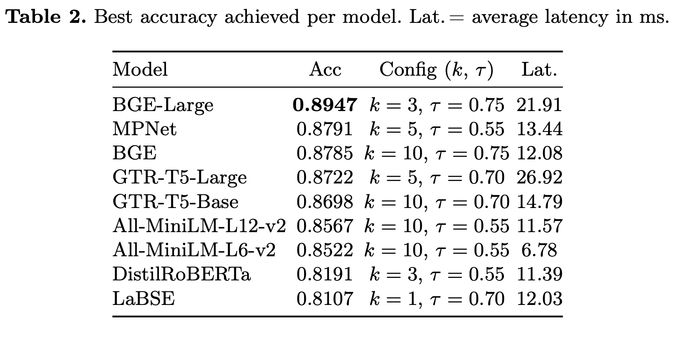
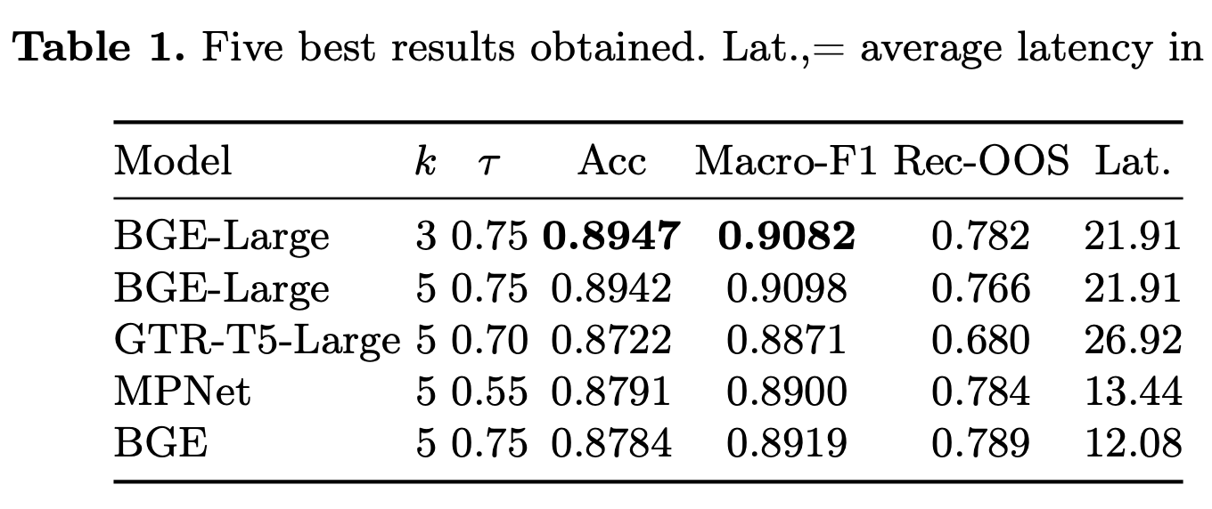
Evaluation Results
Melhor configuração: BGE-Large + k=3 + τ=0.75
Accuracy: 89.47%, Macro-F1: 90.98%
OOS Recall: 78.2%, Latency: 21.9 ms

Slide 8
Main Contributions
• Benchmark of 9 sentence-transformers on Clinc-OOS Plus.
• Recall-OOS for out-of-scope detection.
• Pipeline deployable without retraining.
• Ontological modeling of intents using OWL + SPARQL.

Slide 9
Methodology Overview
1. Encode utterances into vectors using frozen transformer.
2. Store (vector, label) pairs in FAISS (HNSW).
3. Infer intent via k-NN voting + threshold τ for OOS.

Slide 10
Experimental Setup
• Dataset: Clinc-OOS Plus (150 intents + OOS class).
• Models: MPNet, BGE, GTR-T5, MiniLM, etc.
• Parameters: k ∈ {1,3,5,10,20}, τ ∈ {0.40, 0.55, 0.70, 0.75}
• Metrics: Accuracy, Macro-F1, Recall-OOS, Latency

Slide 11
Discussion
• Retrieval-only models competitive with fine-tuned ones.
• MPNet and BGE offer excellent balance between accuracy and latency.
• Incremental deployment without retraining is a major advantage.

Slide 12
Symbolic View: OWL Ontologies
• Intents as owl:Class; utterances as individuals.
• SPARQL enables validation and audit (e.g., duplicates, coverage).
• Enhances explainability and integration with semantic agents.

Slide 13
Conclusion
• BGE-Large reached 89.4% accuracy, 90.9% Macro-F1.
• Retrieval methods enable scalable, fast, accurate intent detection.
• Ontologies offer semantic structure and quality inspection.

Slide 14
Future Work
• Cross-encoder re-ranking on top-k neighbors.
• Class-adaptive OOS thresholds (τ_c).
• Multilingual evaluation (e.g., LaBSE).
• Ontology-integrated hybrid models.

