Slide 1

Universidad Politécnica de Tulancingo
Tulancingo, Hidalgo 06 de Febrero del 2019
Ingeniería Electrónica y Telecomunicaciones Materia: Ingles VII Examen oral Catedrático: Hortencia Montes Vera Alumno:Zarate Blake Cirey

Slide 2

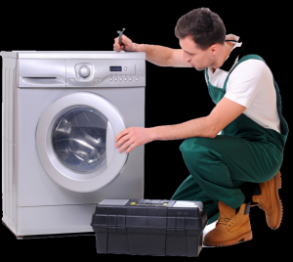
Have you ever had work done on your house by a bad contractor?

Slide 3
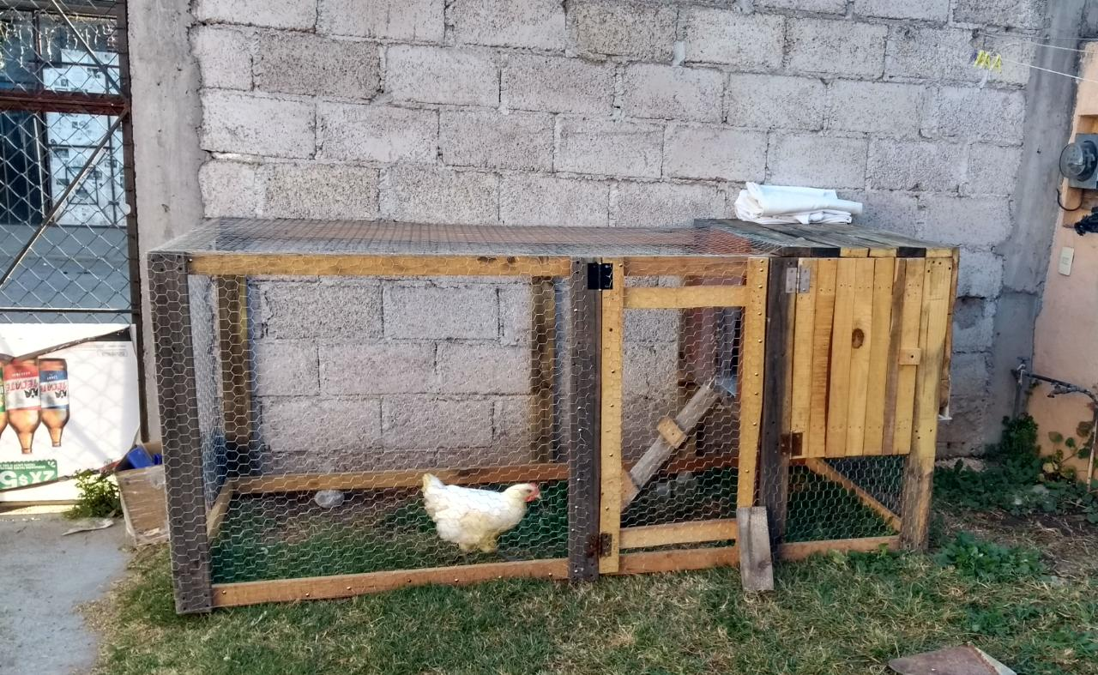
When did you last have something done on your house ?what was it ?

Slide 4
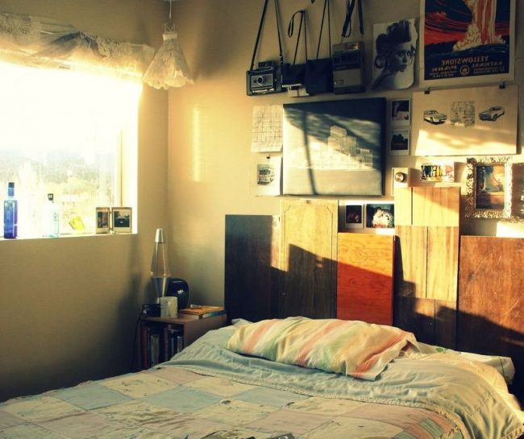
Are you good at DIY(Do It Yourself)?what was the last job you did on your home?

Slide 5
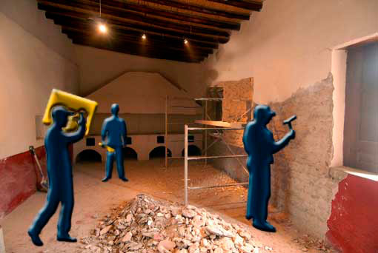

Slide 6
Music in english should be listened by students boox in english should be read by students conversation in engliish must be done by students audios in english must be done by students
TIPS TO LEARN ENGLISH

