Slide 1
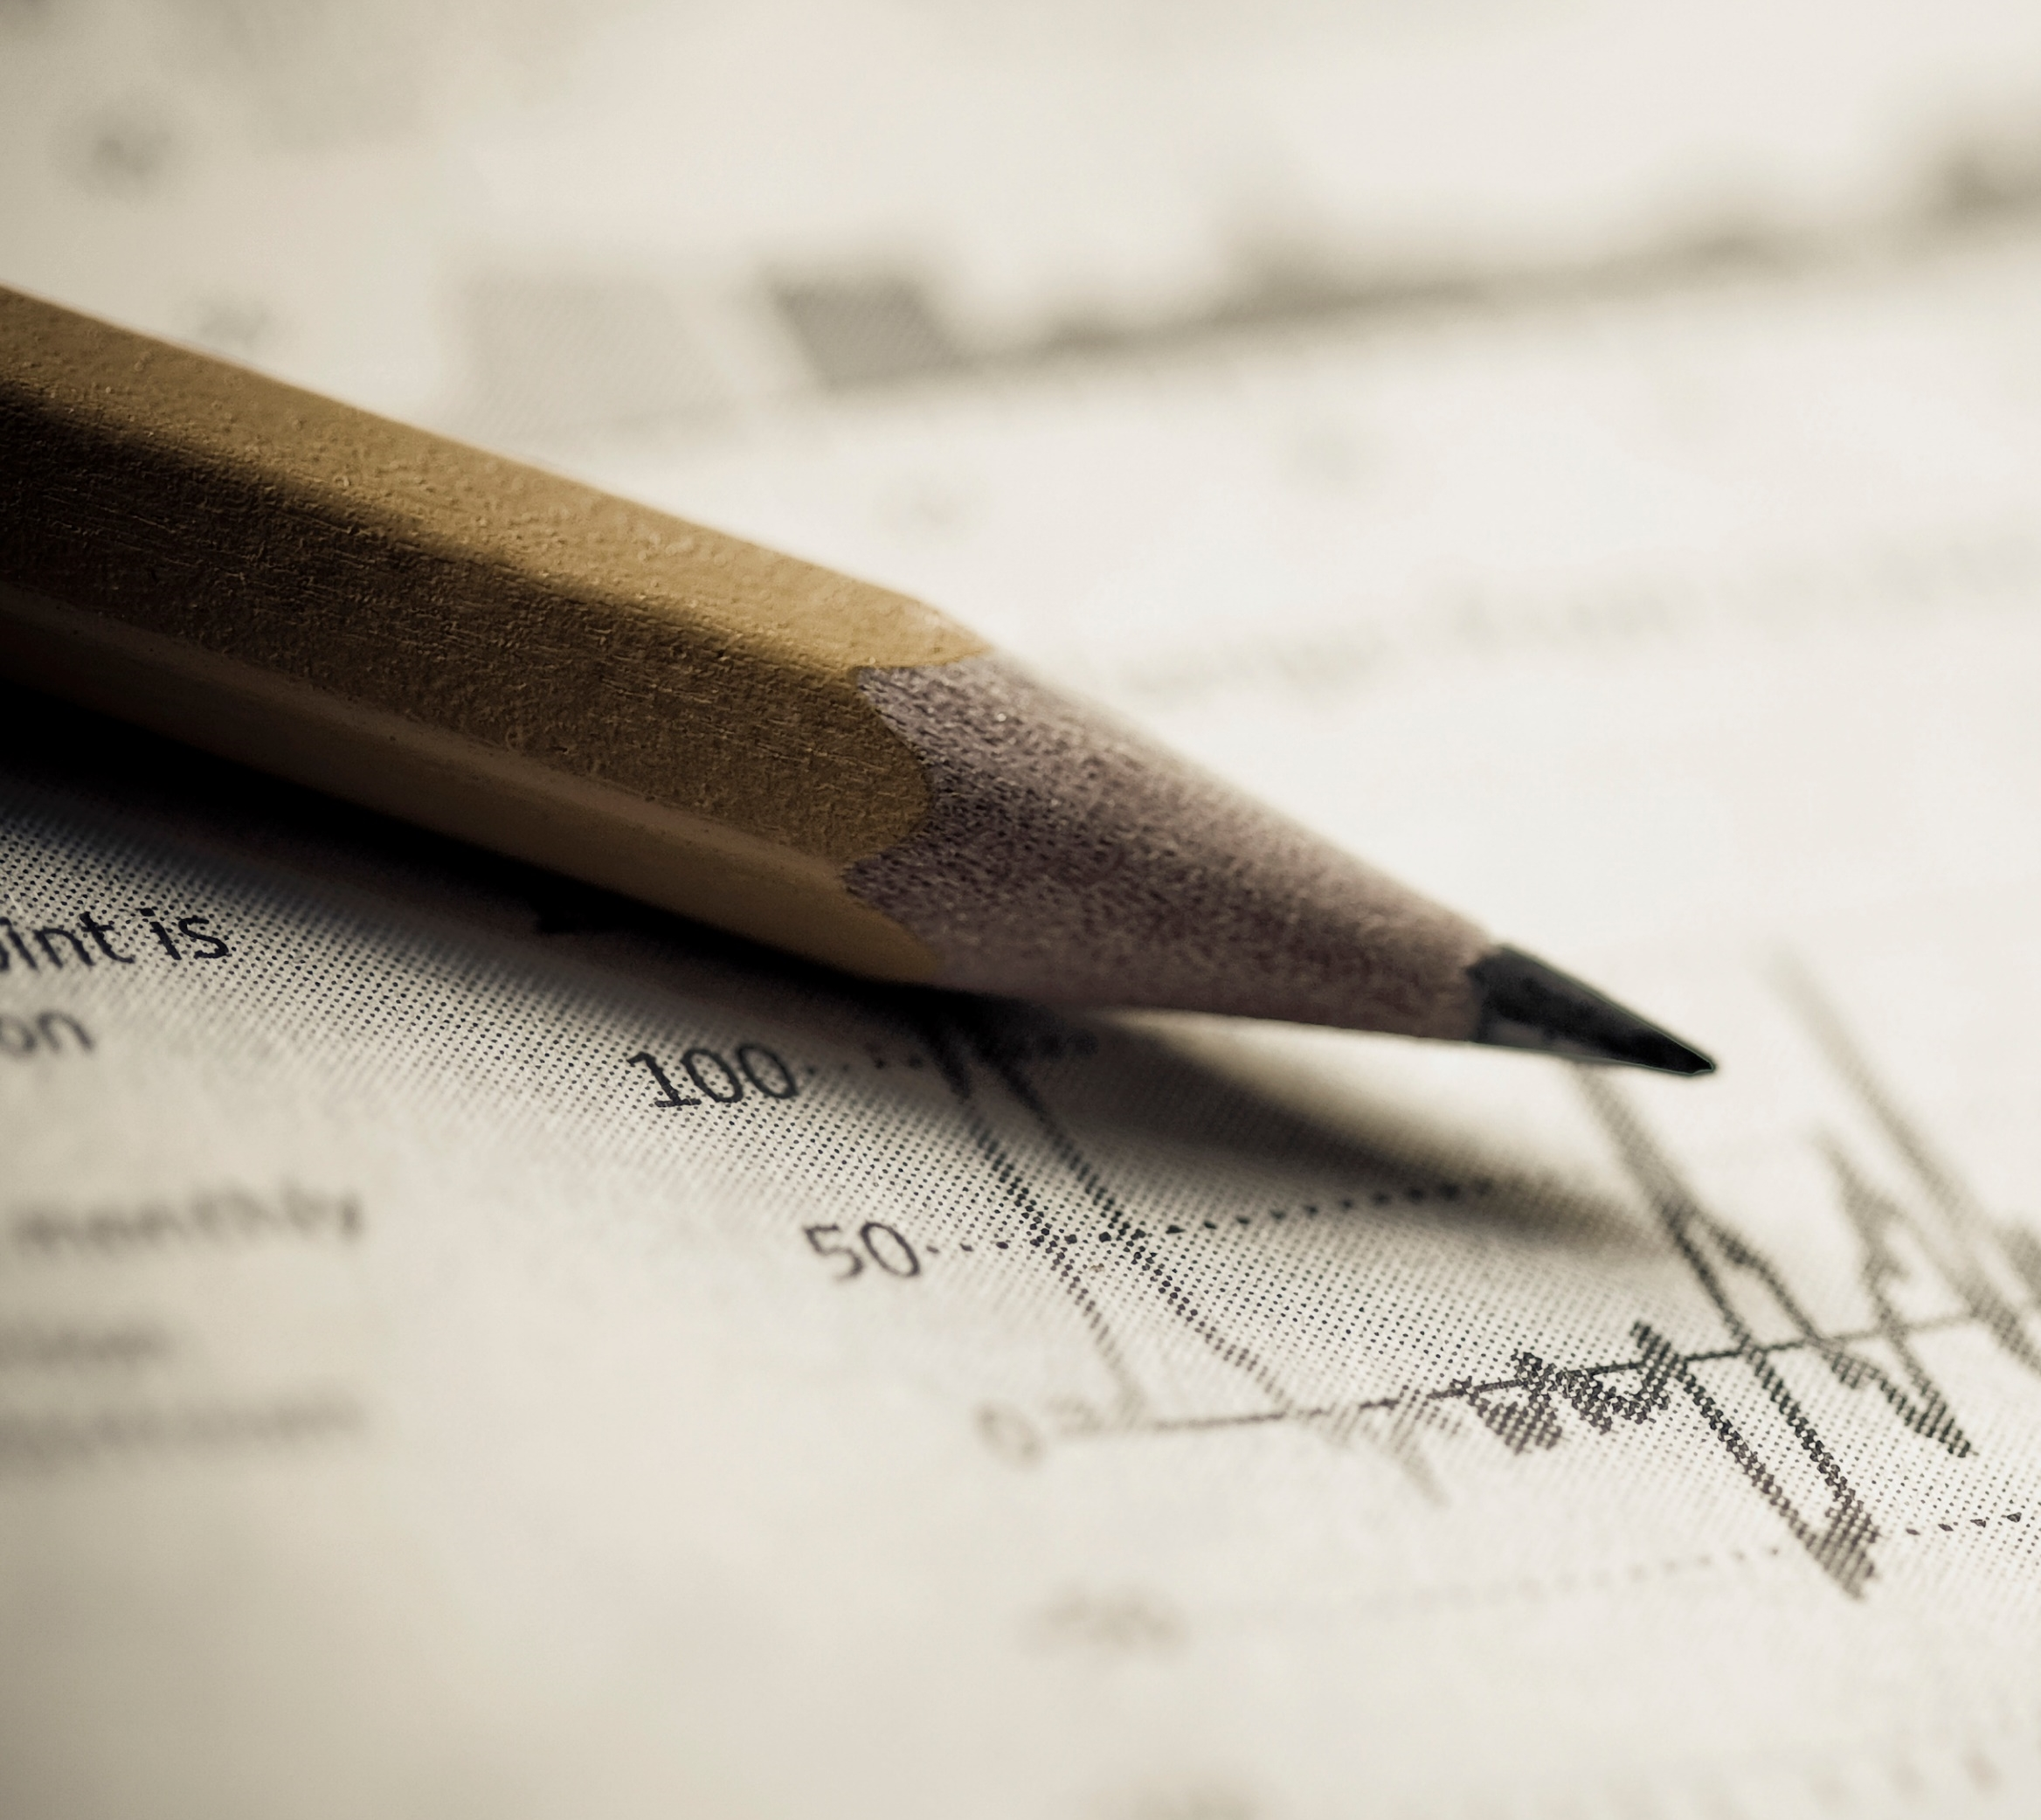
Capstone Project Proposal
Potential members:
Cirus Chakma (SSE),
Progga Barua (ISE),
Amartya Chakma (ISE),
Muhammad Mujtaba (ISE)

Slide 2
CNH East Paint Line Cure Oven Redesign & Smart Energy Optimization
Investigating why CNH's East cure oven
is consuming more natural gas than
expected and developing physical and
software-based methods to reduce unnecessary energy consumption.

Slide 3
WHY are we doing this?
Problem:
East cure oven
Unexpectedly high natural-gas consumption
Cost + CO₂ + unknown cause
Estimated Energy Loss: 4,900 GJ
Natural gas lost: $ 36,000
Core Question: Why is the East oven consuming more natural gas than expected?

Slide 4
WHO – Users & Stakeholders
Design for the people who need to understand, operate , validate and act on oven performance
CNH Engineers
Need to understand when and why energy performance is abnormal
Oven Operators
Need clear information without disrupting existing oven controls
Paint Engineering
Define acceptable curing and production conditions
CNH Management
Interested in operating cost, energy and CO2 reduction
ISE Team
Redesigning the oven after investing the physical sources of heat and energy loss
SSE Member
Turns process data into energy-performance insight

Slide 5
WHO – User & Business Pain Points
Understanding the challenges faced by CNH users and the business
Users - CNH Engineers/ Operators
Business - CNH
Raw data doesn’t clearly reveal excessive energy use.
Engineers need to know when and why it happens.
They need evidence to focus further physical investigation.
East oven has significant energy loss.
The exact cause is still unknown.
Higher gas use increases cost and CO₂ emissions.
CNH needs evidence to prioritize improvements
Need: A way to identify when and under what conditions energy is being wasted, so engineers can investigate the physical cause and determine appropriate improvements.

Slide 6
WHAT- Proposed Solution
A combined physical engineering and software decision support approach
East + West Oven Data
Expected-Consumption Model
Actual vs. Expected Consumption
Potential Inefficiency Detection
Engineering Recommendations
ISE
Heat transfer, insulation, airflow, openings
SSE
Process collected data, expected-consumption model
Exhaust, burners, equipment, physical redesign
Abnormal energy-consumption detection, recommendations, engineering dashboard

Slide 7
WHAT- SSE Solution
What aspects of the solution software is aiming to bring
Input
Oven data:
Analysis
Predict expected energy use
Output
Detect inefficient operation
Identify better operating conditions.
Energy performance summary
Trends and alerts
Flagged abnormal periods
Temperature
gas use
conveyor speed
burner operation etc
Recommend candidate operating conditions

Slide 8
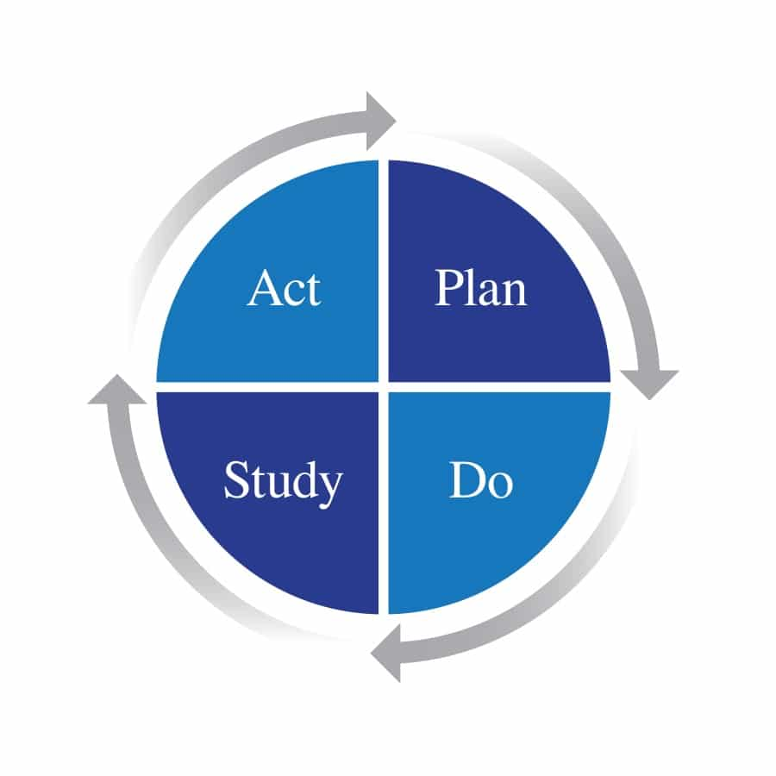
HOW: Plan-Do-Study-Act
Plan: Define software requirements, available oven data, and goals of software functionality.
Do: Build the software for energy prediction, inefficiency detection, and operating recommendations.
Study: Evaluate model results, software performance, and ISE + CNH feedback.
Act: Improve the software, models, and recommendations, then iterate.

Slide 9
UVP- What makes the project valuable?
Operates the oven and handles existing control and safety functions.
Uses historical or real-time process data to evaluate oven energy performance.
Predict expected consumption • flag abnormal energy use • support engineering recommendations
•Add energy-performance intelligence without replacing CNH’s existing control and safety systems.
Complement the existing system—not replace it.

Slide 10
Competitor / Alternative Analysis
At this stage, compare against the approaches CNH already has rather than inventing unsupported commercial competitors.
Alternative
Strength
Weakness
Competition Value
Opportunity
Existing control / HMI
Already operates the oven
Does not diagnose the identified energy loss
Reliable equipment operation
Add higher-level energy analysis
Historical energy-loss estimate
Shows that a loss exists
Primarily retrospective
Establishes the problem
Continuous condition-based analysis
Commercial Software
Production-ready and higher capabilites in terms of features
Has generic solution model and is not tailored
Is specifically built to treat and measure the re-designed machine
Measure the performance of re-design
Competitive strategy: complement existing controls by adding energy-performance intelligence.
8

Slide 11
Value and What Success Looks Like
The project should produce actionable engineering insight—not just another dashboard
Engineering Value
User Value
Identify when, where, and under what conditions energy loss occurs.
Turn raw process values into understandable energy-performance information.
Business Value
Long-Term Value
Support reductions in natural-gas waste, cost, and associated CO₂.
Continue evaluating energy performance after physical improvements are made.
Goal: determine WHY the loss occurs, WHEN inefficient operation occurs, and WHAT improvements are actionable.

Slide 12
What We Are Still Validating
These are design questions to resolve through data, observation, stakeholder feedback, and iteration.
• What exact East/West process and natural-gas data can CNH provide?
• Who should be treated as the primary software user?
• What curing and safety constraints must recommendations respect?
• How much historical data is available and at what resolution?
• Can East and West performance be compared under equivalent operating conditions?
• What success metrics matter most to CNH engineers and management?
10

Slide 13
Questions?

