Slide 1
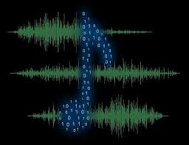
Audio Conversion and Manipulation (aka project aardvark)
Group members:
-Mike
-Chris
-Brendan

Slide 2
Summary
Group Introduction
Repository review
The Project
Problems we ran into
Final Product
Conclusion

Slide 3
Group Introduction
Brendan Nestor: International Trade and Finance Major
Chris Irwin: Computer Science Major
Mike Zielewski: Computer Science Major
Group Name: Aardvarks Anonymous
Project Name: Project Aardvark

Slide 4

Repository / Website
GitHub
Website
Group log

Slide 5
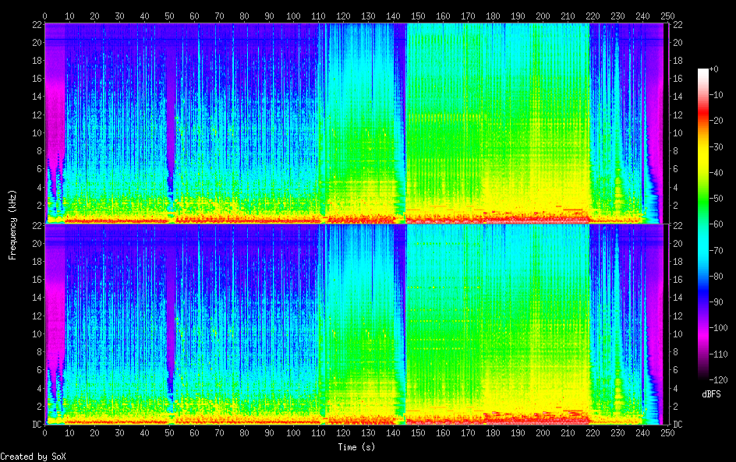
The Project
The Original Idea
Develop audio program to manipulate audio data
Utilize Digital Signal Processing (DSP)
The code
Decoding Wave files
FFT (Fast Fourier Transform) Algorithm
Bash commands
Use of Bash script to
execute commands in
Linux

Slide 6
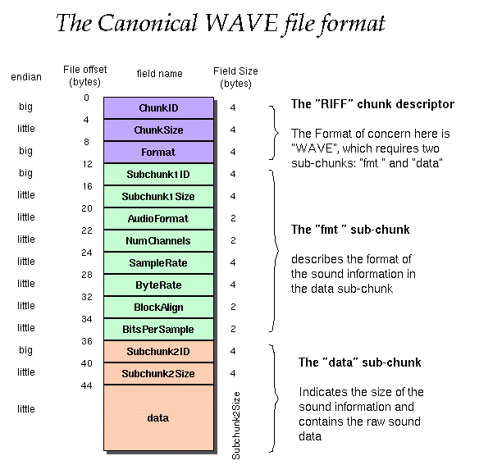
Wave files
Waveform Audio File Format
Chunks of data

Slide 7
Problems we ran into
Understanding and implementation of researched source code
Discovering complexity of Java libraries
Jtransforms
tritonus
Building a GUI with limited Java experience
JavaFX
Creating website other than GitHub Wiki page
Bash Scripting
Decimals in Bash

Slide 8
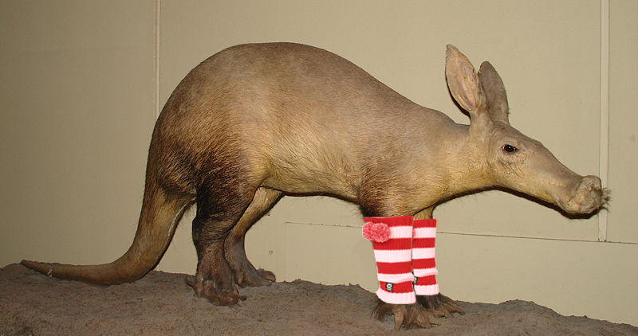
SOX
$sox [FILENAME] –n stat
$sox normalize-audio –a [INSERT AMPLITUDE] [FILENAME]
$sox [FILENAME] –n spectrogram

Slide 9
Conclusion
What we learned
Team work
Researching
Utilization of Linux and repositories

Slide 10
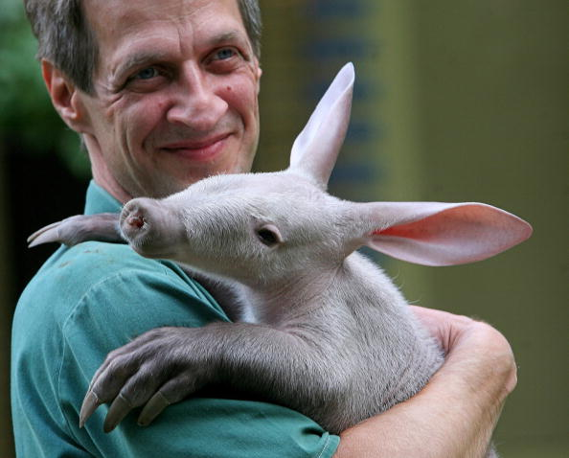
The END!
/\
/ |\
/ /\ \
/ / \ \
/ / \ \
/_/ \_\
\ '` /
| || |
| || |
| || |
| || |
| || |
| || |
| || |
| || |
| || |
/ | || | \
/( | || | )\
|`\_ | || | _/'|
|`. `-._ | || | _,-' ,'|
( ` . `-._ | _--_ | _,-' , ' )
`.._ ` . `-./.__.\.-' , ' _,-'
`-._ ` | / \ | ' _,-'
`-._/ |_()_| \_,-'
___.-' ______ `-,
'-----. |______| /
\ ______ /
| \> </ /
\________/
_]______[_
| |
|________|
]______[#
| |
|________|
| |
|________|
_]______[_
| |
|________|
]____[
.' `.
| < > |>
<| < >|
`.____.'
We love you and thanks for all the cheese.
http://www.reocities.com/TimesSquare/Dungeon/1561/core.htm

