Slide 1

FAMU Financial Aid AI: Style Guide

Slide 2
Table of Contents
Introduction … 3
Mission Statement … 5
Logotype … 6
Typography … 7

Slide 3
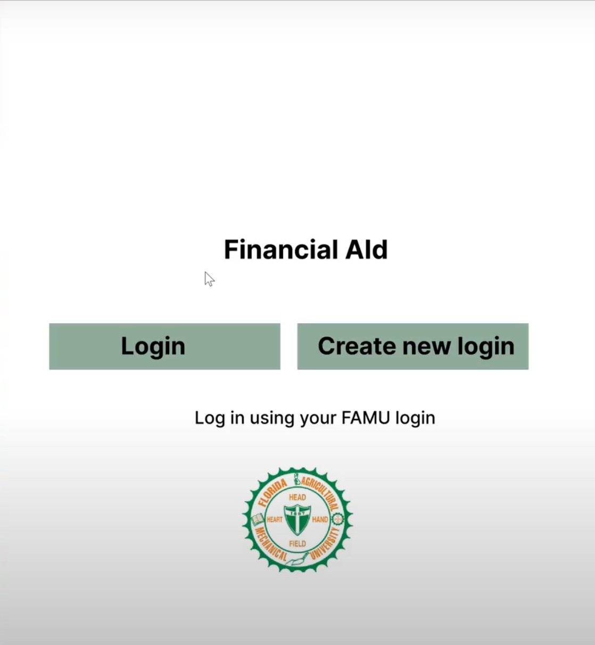
Introduction
Our system goes beyond traditional approaches, leveraging advanced algorithms to analyze user input and deliver tailored financial aid solutions. This innovative approach involves the seamless integration of various APIs and services, enhancing the functionality and effectiveness of our system.

Slide 4
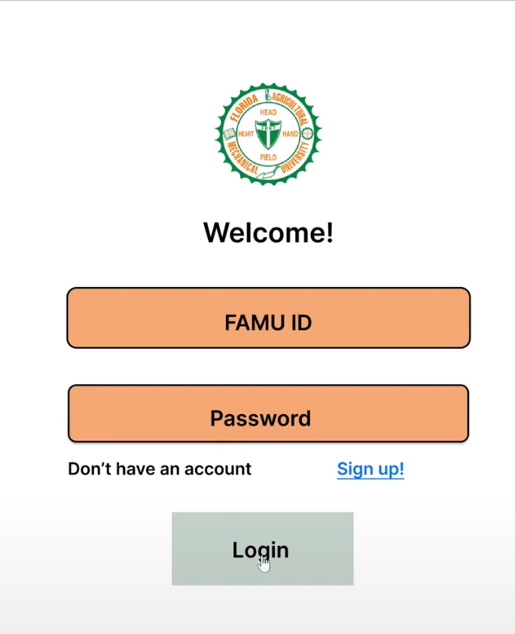
Introduction Cont.
Our AI-powered financial aid system is designed to address the unique challenges faced by users seeking financial assistance. By harnessing the power of artificial intelligence, we aim to provide efficient and personalized solutions to the problems presented by our users. This comprehensive style guide has been crafted to ensure a consistent and cohesive representation of our brand across all communication channels.

Slide 5

Mission Statement
With this tool our mission is to revolutionize the accessibility and efficiency of financial aid solutions through cutting-edge AI technology. We are dedicated to empowering individuals facing financial challenges by providing personalized and innovative assistance. By leveraging the power of artificial intelligence, we strive to be a beacon of support, ensuring that everyone has equal access to opportunities for financial well-being. Through our commitment to user-centric design and continuous improvement, we aim to make a positive and lasting impact on the lives of those seeking financial assistance

Slide 6



Logotype
As the main identifier for FAMU, the FAMU symbol welcome pageis placed on the.
For apps mainly developed for tablets, and especially if the format is landscape, the principal and same design as for web applications may be applied. This means that the symbol is placed in the upper and center portion of the welcome page

Slide 7
Typography
For titles Modern Love (Headings) is used.
For subheadlines/content Elephant is used.
Title: Modern Love (Headings)
a. Font size: 48px and Up
b. Text: Upper and Lowercase
c. Letter spacing : 0
Title: Elephant
a. Font size: 24px and Up
b. Text: Upper and Lowercase
c. Letter spacing : 0

Slide 8

Colors
“Fang orange" R:238 G:118 B:36 and "Venom green" R:27 G:86 B:51
The Famu Color palette heavily relies on the use of logo colors and colors similar to it. The color palette mostly consists of colors with natural warm tones.
In mobile apps black or white are primarily used as background colors

Slide 9
Colors Cont.

Slide 10
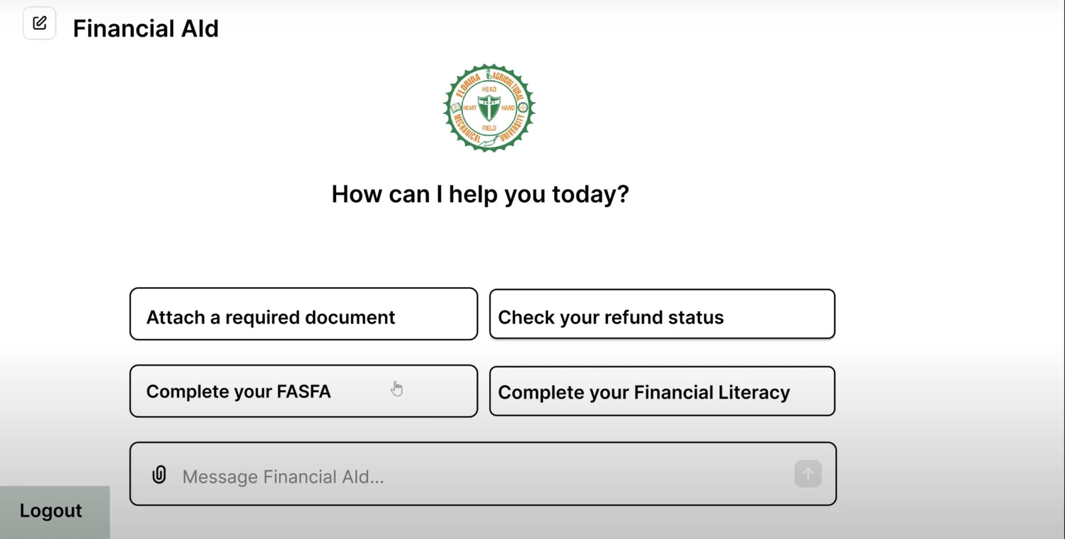
Colors Cont.

Slide 11


Don'ts
Don’t use unapproved colors.
Don’t reproduce any part of the FAMU logotype in any other color than original colors.
Do not try to reinvent Famu Logo

