Slide 1

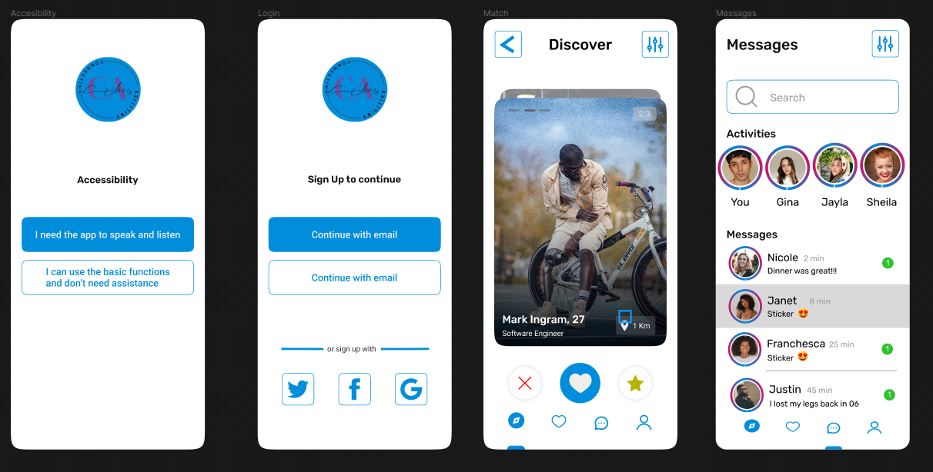
ConnectAbility
Jaiden Howard, Jamaal Floyd, Michael Mondelice, Christopher Perez
FAMU CS
Introduction
Materials & Methods
Conclusions
Overview: ConnectAbility is an innovative mobile app that enhances social interactions for people with disabilities. It acts as a bridge, reducing the social gap by offering a tailored digital space where users can forge meaningful connections.
Target Audience: Specifically crafted for individuals facing various disabilities –physical, auditory, visual, or cognitive, ensuring that physical constraints do not limit social interaction.
Vision: To create an inclusive, barrier-free social platform where every user feels valued, understood, and connected.
Technology
Laptops for software development and design.
Microsoft Suite for project documentation.
Figma for UI/UX design and wireframes.
draw.io for creating data flow diagrams.
Development Process
SWOT analysis and Use Case Assessment for initial planning.
Designing wireframes in Figma for user interface layout.
Using draw.io for visualizing data flows within the app.
Preparing an RFQ to outline project requirements and select vendors.
Implementing the app using agile development methodologies.
Insights Gained: In-depth understanding of the challenges faced by the disabled community in digital spaces. Enhanced skills in accessible app design and development.
Challenges Overcome: Balancing diverse accessibility needs, ensuring compliance with international accessibility standards, and integrating complex functionalities like voice navigation in a user-friendly manner.
Future Directions: Plans to integrate AI for personalized user experiences and expand functionalities to include more interactive elements like video communication.
Objectives
Enhance Social Interaction: Provide an accessible platform for social engagement, catering to various disabilities.
Accessibility and User Customization: Offer an intuitive, customizable interface with features like voice commands and screen readers.
Community Building: Create forums, groups, and event features to foster supportive communities and real-world connections.
Security and Privacy: Ensure robust data protection and a safe user environment, adhering to privacy regulations.
Collaborative Development: Involve community feedback in the app's evolution to ensure it meets user needs.
Educational Aspect: Incorporate resources to educate about disabilities and support personal development.
Results
References
Tinder: Used Tinder as a reference for the wireframe of project
Web Content Accessibility Guidelines (WCAG): This set of guidelines from the W3C provides recommendations for making web content more accessible.
American Association of People with Disabilities (AAPD): Connect with AAPD for insights into various disability communities.
Google Maps API: Referencing Google Maps for their location-based features, allows users to find and connect with others in their vicinity.
Twilio API: For SMS and voice communication features, referencing Twilio provided a reliable API for messaging and calling.
Acknowledgments
Jamaal Floyd : jamaal1.floyd@famu.edu
Michael Mondelice: michael1.mondelice@famu.edu
Jaiden Howard: jaiden1.howard@famu.edu
Christopher Perez: christopher1.perez@famu.edu

