Slide 1
Foundation
Chanel Victorin
Mykhael Cleveland
Carla Medacier
Toluwanimi Bankole​

Slide 2
What is Foundation?
Foundation is a front-end CSS framework developed by ZURB. It offers comprehensive templates, tools, and other resources to simplify web development.

Slide 3
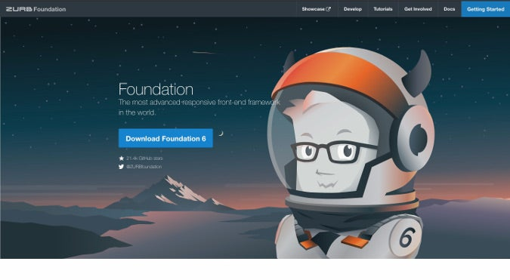
Features
Building Blocks, Templates, and Lessons: Offers a rich repository of building blocks, highly customizable templates, and educational lessons.
Customization of Downloadable Foundation Versions: Flexibility allows you to customize downloadable versions to match your project, saving you time and effort in customizing.
Comprehensive Code Package: Provides a complete code package, including CSS, and JS. This streamlines your development process.
ZURB Template Offering: ZURB template is a comprehensive toolkit with features like JS processing, image compression, and style guide creation..
Modules: allows users to pick and choose specific elements as needed
Responsiveness: automatically adjusts the layout of a website or web application based on its screen size and the device it is being viewed on
This Photo by Unknown Author is licensed under CC BY-SA

Slide 4
Why Use foundation?
Ease of use
Very easy to view templates based on different categories and copy and paste code straight to VS Code.
The documentation in the framework does a great job of explaining what we are looking at and how it ties into the rest of the code
Gives needed details to use it to the best of our ability
Applications
Allows you to save time when implementing css, premade templates/files
Global styling: Ensures consistent styling between files
Right to Left Support: easily adapts components to work with languages that read right to left
Flexbox Mode: streamlines how layouts are made, making sizing and alignment of elements easier
XY Grid: works very similarly to the standard float grid, but includes a number of useful features only possible with Flexbox, like horizontal and vertical alignment, automatic sizing and a full vertical grid

Slide 5
Audience Question!
What type of code packages are included?

Slide 6






Famous Users
This Photo by Unknown Author is licensed under CC BY
This Photo by Unknown author is licensed under CC BY-NC.
This Photo by Unknown Author is licensed under CC BY-SA
This Photo by Unknown Author is licensed under CC BY
This Photo by Unknown Author is licensed under CC BY-SA
This Photo by Unknown author is licensed under CC BY-SA.

Slide 7
summary
Foundation allows you to:
Implement templates to save time coding
Have responsive and interactive web pages
Create websites with uniform design styles
Streamline layouts
Any Questions?

Slide 8
THANK YOU !

