Slide 1
Conditionals and Loops

Slide 2
Review
Primitive Data Types & Variables
int, long
ﬂoat, double
boolean
char
String
Mathematical operators: + -­‐ * / %
Comparison: < > <= >= ==

Slide 3
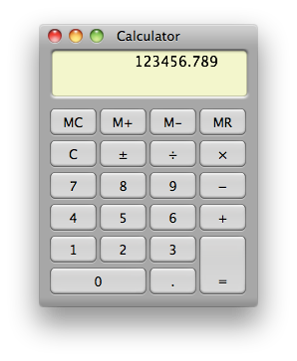
A Foundation for Programming
any program you might want to write
objects
functions and modules graphics, sound, and image I/O arrays
conditionals and loops Math text I/O
primitive data types assignment statements
last lecture: equivalent
to a calculator

Slide 4
A Foundation for Programming
any program you might want to write
objects functions and modules
graphics, sound, and image I/O arrays
conditionals and loops Math text I/O
primitive data types assignment statements

Slide 5
Control Flow
Programs execute one statement after another
Conditionals and loops allow us to control the ﬂow
boolean 1
statement 1
statement 2
statement 3
statement 4
true
false
statement 1
boolean 2
true
statement 2
false
statement 3
straight-­‐line control ﬂow
control ﬂow with conditionals and loops

Slide 6
Animations with PennDraw

Slide 7




The Inﬁnite While Loop
The inﬁnite while loop: executes the loop body repeatedly
Execute statement 1
Execute statement 2
– ...
– Repeat
statement 2
while (true) {
statement 1;
statement 2;
}
true
statement 1
boolean expression
loop body

Slide 8
What will this do?
System.out.print(“Program running”);
while (true) {
System.out.print(“.”);
}
System.out.println(); System.out.println(“Program Exiting”);

Slide 9
Using PennDraw for animation
PennDraw.enableAnimation(10)
Animation at 10 frames per second
PennDraw.advance()
PennDraw.disableAnimation()
Notes:
Advance shows the next image/rotate the canvas aroun

Slide 10
Using PennDraw for Animation
public static void main(String[] args) { PennDraw.setCanvasSize(500, 500); PennDraw.enableAnimation(30);
while (true) { // repeats forever
// draw frame of animation (your code here)
PennDraw.advance(); // display next frame
}
}

Slide 11
In-­‐Class Demo: Bouncing Ball

Slide 12

Notes:
How did you like HW00? https://www.polleverywhere.com/multiple_choice_polls/fD5JP7pT1EqEJ1Ort7VpO

Slide 13
Notes:
What should variable a be declared as and what does it equal? ____ a = 3 / 2 + 1.5 * 2 https://www.polleverywhere.com/multiple_choice_polls/I6TXuxtSoIt89xr4SBYRJ

Slide 14
Notes:
What does c equal? boolean c = 'a' < 'b' https://www.polleverywhere.com/multiple_choice_polls/jYCf6uecaK6xbFk4dVV2n

Slide 15
Notes:
What is a declared as and if it runs, what does it equal? _____ a = 2.0 / 0 https://www.polleverywhere.com/multiple_choice_polls/zDEcYYt8c1eVPV0YHsIT6

Slide 16
Equations of Motion (Simpliﬁed)
s = displacement t = time
v = velocity
a = acceleration
Constant acceleration (a) s_{i+1} = s_{i} + v_{i} Δt
v_{i+1} = v_{i} + a Δt

Slide 17


In-­‐Class Demo: Bouncing Ball

Slide 18

Conditionals

Slide 19


If Statement
The if statement: A common branching structure
Evaluate a boolean expression
If true, execute some statements
If false, execute other statements
boolean expression
if (boolean expression) {
//statement T;
can be any sequence
true
false
}
else {
//statement F;
}
of statements
statement T
statement F

Slide 20

How could we write a program to model this parking sign?
How do we provide a number to java?
Command - line arguments
args[0] is the ﬁrst argument, args[1] the second argument and so on
args[0] is a String

Slide 21
Command line arguments
To run programs you have written so far
java MyHouse
java HelloWorld
We’d like to be able to provide information at the command line
java HelloWorld John
want the program say “Hello John” as opposed to “Hello World”

Slide 22
Command line arguments
public class Hello {
public static void main (String[] args) { String name = args[0]; System.out.println("Hello " + name);
}
}

Slide 23
Command line arguments
args[0] will be a String
How to convert a String to an integer?
Integer.parseInt()

Slide 24
Back to parking sign Live coding ….

Slide 25
Relational Expressions
< less than
> is greater than
<= is less than or equal to
>= is greater than or equal to
== is equivalent
!= is not equivalent

Slide 26
Relational Expressions: Examples
1. if ( true ) { … }
2. if ( 10 > 10 ) { … }
3. if ( 10 >= 10 ) { … }
4. if ( 'a' == 'a' ) { … }
5. if ( 'a' != 'a' ) { … }
6. if ( “Penn” != “penn”) { … }

Slide 27
Logical Expressions
&& logical conjunction (and)
both expressions must be true for conjunction to be true
|| logical disjunction (or)
either expression must be true for disjunction to be true
! logical negation (not)
true → false, false → true

Slide 28
Logical Expression Examples
1. if |  | ( (2 > 1) && (3 > 4) ) |  |  | { | … }
2. if |  | ( (‘b’ == ‘b’) && (1 + |  |  | 2 | == 3) ) { … }
3. if |  | ( !false ) { … }
4. if |  | ( !(1 < -1) ) { … }
5. if |  | ( !(10 < 20) || false |  |  | ) | { … }
6. | if | ( | !(10 > 20) && | (10 < 20) |  | ) | { | … | }
7. if |  | ( (true || false) && true |  |  |  | ) { |  | … | }
8. if |  | ( (true && false) || true |  |  |  | ) ) |  | { | … }
9. …

Slide 29
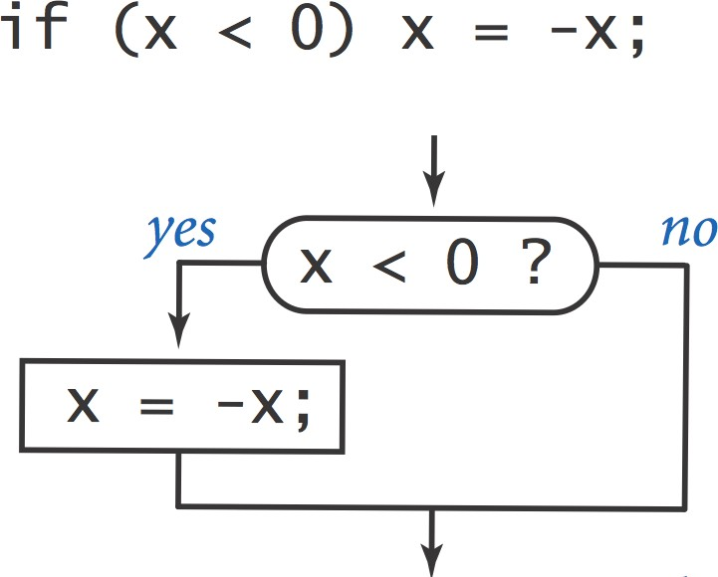
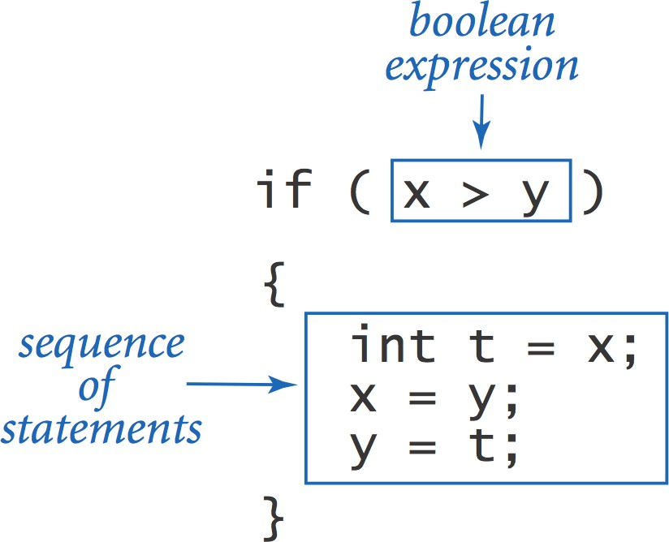
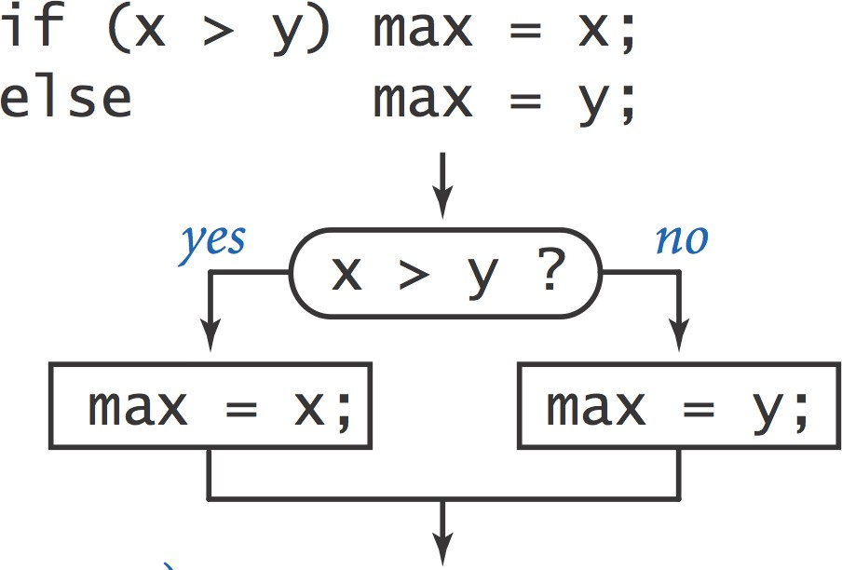
If Statement
The if statement: A common branching structure
Evaluate a boolean expression
If true, execute some statements
If false, execute other statements

Slide 30

If Statement
Ex. Take diﬀerent actions depending on the value of a variable
public class Flip {
public static void main(String[] args) { if (Math.random() < 0.5) {
System.out.println("Heads");
} else {
System.out.println("Tails");
}
}
% java Flip
Heads
% java Flip
Heads
% java Flip
Tails
% java Flip
Heads
}
26

Slide 31
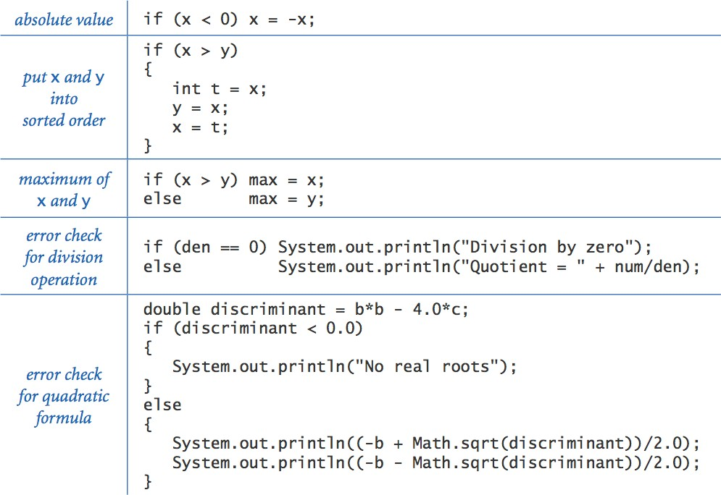
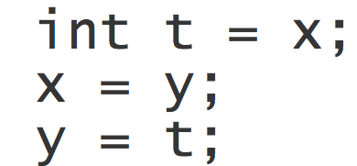
If Statement Examples

Slide 32


In-­‐Class Demo: Bouncing Ball

Slide 33
Conditionals: if-else-if-statement
if ( boolean_expression_1 ) {
statements;
} else if ( boolean_expression_2 ) {
statements;
} else if ( boolean_expression_3 ) {
statements;
} else {
statements;
}

Slide 34
Example: Graduated Income Tax
Pay a certain income tax rate depending on income:
Income Rate
0 – 47,450 22%
47,450 – 114,650 25%
114,650 – 174,700 28%
174,700 – 311,950 33%
311,950 -­‐ 35%
5 mutually exclusive alternatives

Slide 35
Nested If Statements
Use nested if statements to handle multiple alternatives
if (income < 47450) rate = 0.22; else {
if (income < 114650) rate = 0.25; else {
if (income < 174700) rate = 0.28; else {
if (income < 311950) rate = 0.33; else rate = 0.35;
}
}
}
Income | Rate
0 -­‐ 47,450 | 22%
47,450 – 114,650 | 25%
114,650 – 174,700 | 28%
174,700 – 311,950 | 33%
311,950 -­‐ | 35%

Slide 36
Nested If Statements
Income Rate
0 – 47,450 22%
47,450 – 114,650 25%
114,650 – 174,700 28%
174,700 – 311,950 33%
311,950 -­‐ 35%
5 mutually exclusive alternatives
Alternative shortened version:
double rate; if (income |  |  | < | 47450) | rate | = | 0.22;
else | if | (income | < | 114650) | rate | = | 0.25;
else | if | (income | < | 174700) | rate | = | 0.28;
else | if | (income | < | 311950) | rate | = | 0.33;
else |  |  |  |  | rate | = | 0.35;

Slide 37
Nested If Statements
What is wrong with the following implementation?
Income Rate
0 – 47,450 22%
47,450 – 114,650 25%
114,650 – 174,700 28%
174,700 – 311,950 33%
311,950 -­‐ 35%
5 mutually exclusive alternatives
double rate = 0.35; if (income < 47450) |  |  |  | rate | = | 0.22;
if | (income | < | 114650) | rate | = | 0.25;
if | (income | < | 174700) | rate | = | 0.28;
if | (income | < | 311950) | rate | = | 0.33;

Slide 38
Conditionals: switch-­‐statement
Works like a iif-else statement
Convenient for large numbers of value tests
switch( expression | ) | {
case label1: |  |  | // | label1 equals expression
statements; break;
case label2: |  |  | // | label2 equals expression
statements;
break;
default: statements; |  |  | // | Nothing matches
}

Slide 39
public static void main(String[] args) { int month = Integer.parseInt(args[0]); String monthString;
switch (month) {
case 1:
monthString = "January"; break;
monthString = "February"; break;
monthString = "March";
break;
monthString = "April"; break;
monthString = "May"; break;
monthString = "June"; break;
monthString = "July";
break;
monthString = "August";
break;
monthString = "September"; break;
case 2:
case 3:
case 4:
case 5:
case 6:
case 7:
case 8:
case 9:
case 10: monthString = "October"; break;
case 11: monthString = "November"; break;
case 12: monthString = "December";
break;
default: monthString = "Invalid month";
break;
}
System.out.println(monthString);
}
35

Slide 40
An aside … Operators
+, -, *, / and …
i++; | equivalent to | i | = | i | + | 1;
i += | 2; equivalent to | i | = | i | + | 2;
i--; | equivalent to | i | = | i | – | 1;
i -= | 3; equivalent to | i | = | i | - | 3;
i *= | 2; equivalent to | i | = | i | * | 2;
i /= | 4; equivalent to | i | = | i | / | 4;
i % 3;
remainder after i is divided by 3 (modulo)

Slide 41
Iteration

Slide 42
Iteration
Repetition of a program block
Iterate when a block of code is to repeated multiple times.
Options
The while-­‐loop
The for-­‐loop

Slide 43
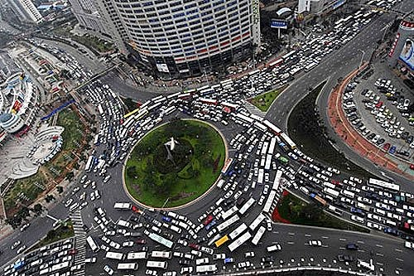
The While Loop

Slide 44

While Loop
The while loop: A common repetition structure
Evaluate a boolean expression
If true, execute some statements
– Repeat
loop continuation condition
statement 2
while (boolean expression) {
statement 1;
true
statement 1
boolean expression
statement 2;
loop body
}
false

Slide 45
The Inﬁnite While Loop, Re-­‐examined
System.out.print(“Program running”);
while (true) {
System.out.print(“.”);
}
System.out.println(); System.out.println(“Program Exiting”);

Slide 46

While Loop: Powers of Two
Example: Print powers of 2 that are ≤ 2^{N}
Increment i from 0 to N
Double v each time
Output:
 | 0 | 1
 | 1 | 2
 | 2 | 4
 | 3 | 8
 | 4 | 16
 | N | = 4
i | v | i <= | N
0 | 1 | true
1 | 2 | true
2 | 4 | true
3 | 8 | true
4 | 16 | true
5 | 32 | false
int i = 0; int v = 1;
while (i <= N) { System.out.println(i + " " + v); i++;
v = 2 * v;
}
42

Slide 47
While Loop Challenge
Q: Is there anything wrong with the following code for printing powers of 2?
int i = 0; int v = 1;
while (i <= N)
System.out.println(i + " " + v);
i = i + 1; v = 2 * v;

Slide 48
While Loop Challenge
Q: Is there anything wrong with the following code for printing powers of 2?
int i = 0; int v = 1;
while (i <= N)
System.out.println(i + " " + v);
i = i + 1; v = 2 * v;
A: Need curly braces around statements in while loop
otherwise it enters an inﬁnite loop, printing "0 1”

Slide 49
The 3 Parts of a Loop
…
int i = 1 ; initialization of loop control variable
// count from 1 to 100 while ( i < 101 ) {
System.out.println( i ) ;
test of loop termination condition
i = i + 1 ; modification of loop control variable
}

Slide 50
Example: Factorial
…
int factorial = 1; while (myNumber > 0) {
factorial *= myNumber;
--myNumber;
}
System.out.println(factorial);

Slide 51
Keyboard input
PennDraw.hasNextKeyTyped() – check to see if the user has pressed key
If the user presses a key,
PennDraw.hasNextKeyTyped() is true until and unless you write a line that processes the input
c = PennDraw.nextKeyTyped();

Slide 52
public class KeyboardInput {
public static void main(String[] args) { char c = 0;
double radius = 0.02; PennDraw.setCanvasSize(600, 600);
PennDraw.enableAnimation(10); while (c != 'q') {
if (PennDraw.hasNextKeyTyped()) { c = PennDraw.nextKeyTyped();
}
PennDraw.circle(0.5, 0.5, radius); radius = radius + 0.02;
PennDraw.advance();
}
}
}

Slide 53
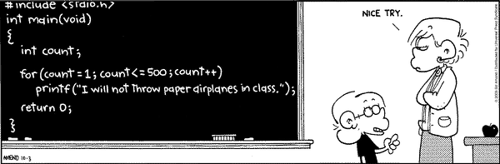
The For Loop
Copyright 2004, FoxTrot by Bill Amend
www.ucomics.com/foxtrot/2003/10/03

Slide 54
For Loops
Handles details of the counter-­‐controlled loop
“automatically”
The for loop structure includes:
the initialization of the the loop control variable,
the termination condition test, and
control variable modiﬁcation
for (int i = 1; i < 101; i = i + 1) {
initialization modification
} test

Slide 55
For Loop: Powers of Two
Example: Print powers of 2 that are ≤ 2^{N}
Increment i from 0 to N
Double v each time
Output:
 | 0 | 1
 | 1 | 2
 | 2 | 4
 | 3 | 8
 | 4 | 16
 | N | = 4
v | i | i <= | N
1 | 0 | true
2 | 1 | true
4 | 2 | true
8 | 3 | true
16 | 4 | true
32 | 5 | false
int v = 1;
for (int i = 0; i <= N; i++) { System.out.println(i + " " + v); v = 2 * v;
}
56

Slide 56
For Loop Examples
A for loop that counts from 0 to 9:
// modify part can be simply “i++”
for ( i = 0; i < 10; i = i + 1 ) {
System.out.println( i ) ;
}
…or we can count backwards by 2’s :
// modify part can be “i -= 2”
for ( i = 10; i > 0; i = i - 2 ) {
System.out.println( i ) ;
}

Slide 57
For loop examples
compute a ﬁnite sum (1 + 2 + …+ N) | int sum = 0; for (int i = 0; i <= N; i++) sum += i; System.out.println(sum);
print largest power of two less than or equal to N | int v = 0 ; for (v = 1; v <= N/2; v *= 2); System.out.println(v);

Slide 58
When Does a for Loop Initialize, Test and Modify?
Just as with a while loop, a for loop
initializes the loop control variable before beginning the first loop iteration
performs the loop termination test before each iteration of the loop
modifies the loop control variable at the very end of each iteration of the loop
The for loop is easier to write and read for counter-controlled loops.

Slide 59
public static void main(String[] args){ PennDraw.setCanvasSize(500,500);
double radius = 250.0; while ( radius > 1.0 ) {
PennDraw.circle(0.5, 0.5, radius / 500); radius = radius - 5.0;
}
}
public static void main(String[] args){ PennDraw.setCanvasSize(500,500);
for ( double radius = 250.0; radius > 1.0; radius -= 5.0 ) { PennDraw.circle(0.5, 0.5, radius / 500);
}
}

Slide 60
The break & continue Statements
The break & continue statements can be used in while and for loops to skip the remaining statements in the loop body:
break causes the looping itself to abort
continue causes the next turn of the loop to start
In a for loop, the modification step will still be executed

Slide 61
Example: Break in a For-Loop
…
int | i;
for | (i = 1; i < if (i == 5) | 10; i = i + 1) { {
OUTPUT:
1 2 3 4
Broke out of loop at i = 5
break;
}
System.out.println(i);
}
System.out.println(“\nBroke out of loop at i = “ + i);

Slide 62
Example: Continue in a For-Loop
…
int i;
for (i = 1; i < 10; i = i + 1) { if (i == 5) {
continue;
}
System.out.println(i);
}
System.out.println(“Done”);
OUTPUT:
1 2 3 4 6 7 8 9
Done

Slide 63
Problem: Continue in While-Loop
// // | This seems equivalent in previous slide—but | to is | for loop it??
…
OUTPUT:
int i = 1;
while (i < 10) { if (i == 5) {
continue;
}
System.out.println(i); i = i + 1;
}
System.out.println(“Done”);
???

Slide 64
Variable Scope
Variable scope:
That set of code statements in which the variable is known to the compiler
Where it can be referenced in your program
Limited to the code block in which it is defined
– A code block is a set of code enclosed in braces ({ })
One interesting application of this principle allowed in Java involves the for loop construct

Slide 65
Scoping and the For-Loop Index
Can declare and initialize variables in the heading of a for loop
These variables are local to the for-loop
They may be reused in other loops
int count = 1;
for (int i = 0; i < 10; i++){
count *= 2;
}
//using 'i' here generates a compiler error

