Slide 1
Week 4: SwiftUI State Management
CIS 1951: iOS Programming
Notes:
New format: brief lecture on concepts first, then allllll live coding
Laptop down for lecture part please!

Slide 2
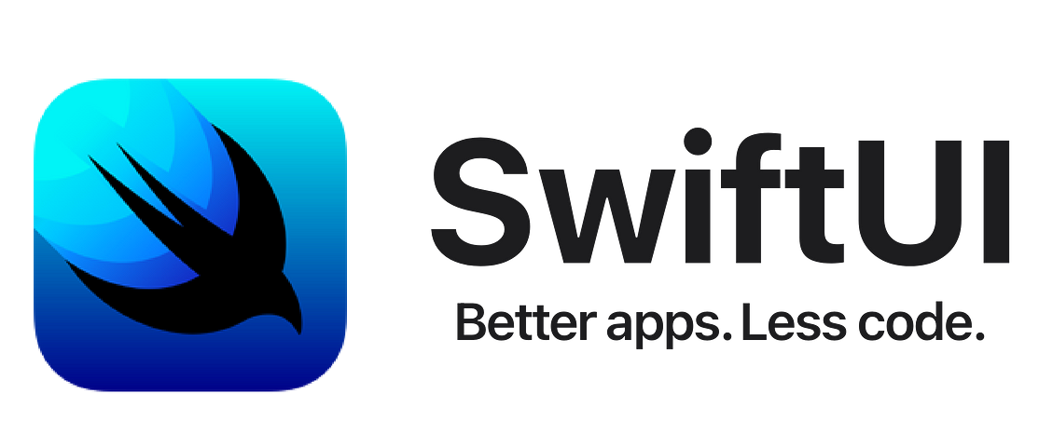
Last Week: SwiftUI Fundamentals
What is SwiftUI
Why do SwiftUI
How to SwiftUI
Views, layouts, modifiers, lists, scrolling views
Any questions?
Notes:
Okay, now we know how to create UI’s. The UI we currently create are static, like a painting or Figma sketch - it’s not yet a full app. To turn it into a full app, we need to program some sort of state that holds info and/or reacts to user interaction.

Slide 3
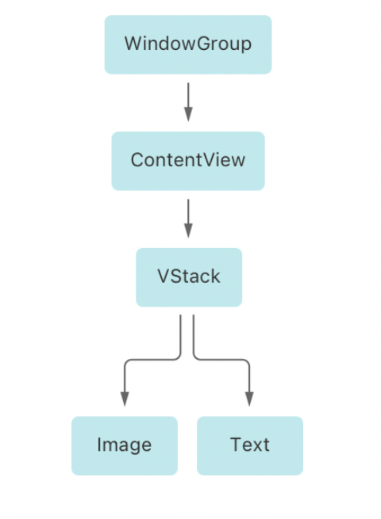
What is a View Hierarchy?
https://velog.io/@mm723/SwiftUI
Notes:
Before we dive into state management, let’s get on the same page with some terminologies…
In SwiftUI, a view hierarchy is the structure and organization of views in a UI. It defines the layout of views relative to other views.
Often drawn as a tree
Parent, child, sibling relationships

Slide 4
What is State Management?
Definition: The process of handling changes to data to ensure your UI reflects the current state of the application
Significance: Makes your app dynamic and interactive
Notes:
Definition: State management refers to the handling of data that determines the UI's appearance at any given moment.
Importance in SwiftUI: Essential for creating dynamic and interactive applications. SwiftUI's design is inherently reactive, updating the UI in response to state changes.
Impact on UI and UX: Proper state management ensures a seamless and intuitive user experience by keeping the UI in sync with the underlying data.

Slide 5
Property Wrappers in SwiftUI
Attributes that add additional behavior or functionality to properties
We will introduce:
@State
@Binding
@ObservedObject
@StateObject
@EnvironmentObject
Notes:
Q: What are properties?
A: A property is an attribute/variable in a class/struct (e.g. a variable in your UI)
=> Property wrappers in SwiftUI are special attributes that add additional behavior or functionality to properties, such as managing state, binding data, or accessing environment values.

Slide 6
@State
Function: Declare a source of truth for data local to a view
Use Case: Used for simple local data
e.g. a toggle status, input text, or a counter
Ownership: The view owns the data
Scope: Private to the view where it is declared
Notes:
Introduce `@State` as the simplest form of state management in SwiftUI, ideal for UI elements managed by a single view.
Highlight that `@State` variables are private to the view, emphasizing data encapsulation.

Slide 7
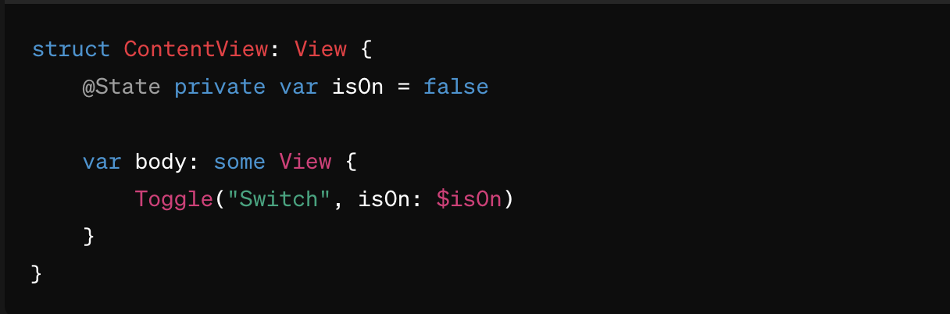
@State
Notes:
Explain the `$` prefix for binding and how it enables two-way communication between the UI and the state.
Bindings create a connection between a view or UI component, like a `Toggle`, and some data, like a boolean `isOn`
How do we create a custom view that takes in a binding? Next slide!

Slide 8
@Binding
Function: Allows a view to mutate data owned by its parent view
Use Case: Ideal for sharing state without owning it
Ownership: The data is owned elsewhere, and `@Binding` allows a view to mutate it
Scope: Between parent and child views or between sibling views

Slide 9
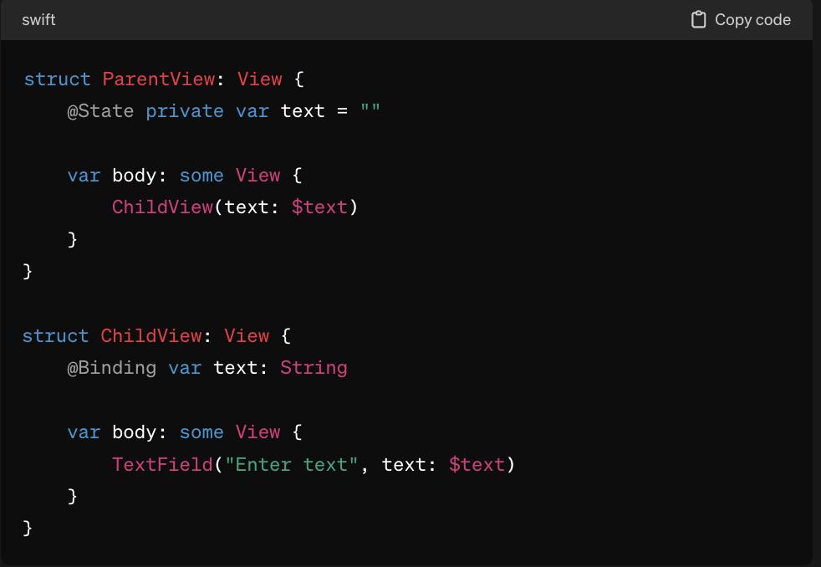
@Binding
Notes:
The binding is a reference to the parent’s state

Slide 10
@ObservedObject
Function: Used with external references that conform to `ObservableObject`; enables reaction to changes in these objects
Use Case: Best for more complex data models shared across multiple views
Ownership: The data is owned outside the view, typically in shared view models
Scope: External to the view, shared across multiple views
Notes:
We’ll talk about MVVM next week… But basically, a view model is a class that manages data and talks to UI about data. Usually, your @ObservedObject is a view model class type
@Binding vs. @ObservedObject:
@Binding has restrictions in which views you can pass to (children or sibling), whereas @ObservedObject doesn’t.
When you need to share across many places, use @ObservedObject

Slide 11
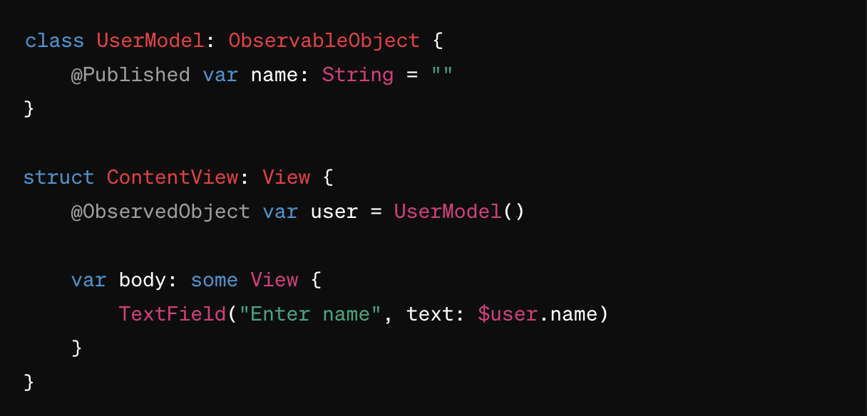
@ObservedObject
Notes:
`ObservableObject` protocol, `@Published` property wrapper
Stress the importance of the `@Published` property wrapper for notifying the UI about changes.
Properties within an ObservableObject without the `@Published` wrapper will not update the UI on change
Explain how changes to `user.name` will automatically update the UI.

Slide 12
@StateObject
Function: Similar to `@ObservedObject`, but used when the view creates and owns the observable object
Use Case: Ideal when a view needs to own the observable object
Ownership: The view owns the `ObservableObject`
Scope: Local to the view but can be passed to child views

Slide 13
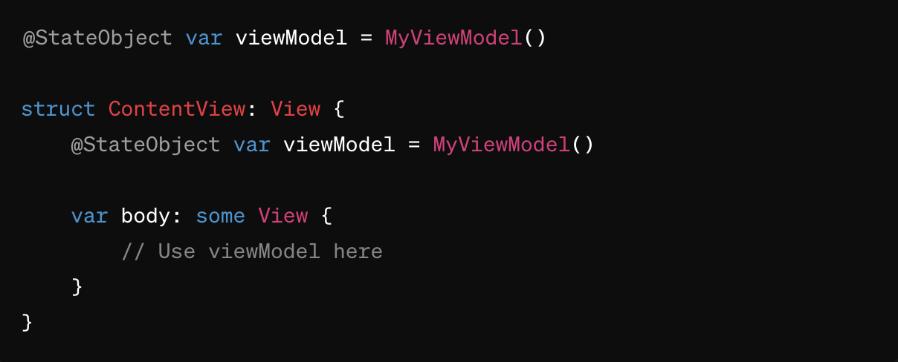
@StateObject

Slide 14
@EnvironmentObject
Function: Used to access shared data from the environment
Use Case: Ideal for data accessed by many views within an app
e.g. user settings or themes
Ownership: The data is owned by an ancestor view that places it into the environment
Scope: Across multiple views, typically deep in the view hierarchy
Notes:
`@EnvironmentObject` as a powerful tool for passing data deeply through the view hierarchy without manually passing it down through each level.
Allows for clean and efficient data access across the app
Passes compile-time checks even without the data being present in the direct parent or one of the siblings. However, it requires the data to be provided in the environment of the current view or any of its ancestors. Otherwise, your app will crash at runtime.

Slide 15
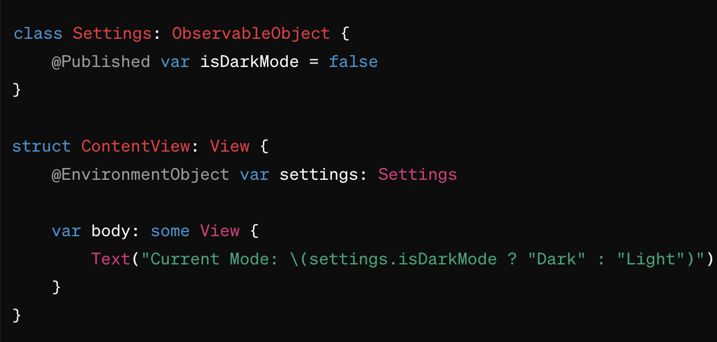
@EnvironmentObject

Slide 16
Okay, that was a lot…

Slide 17
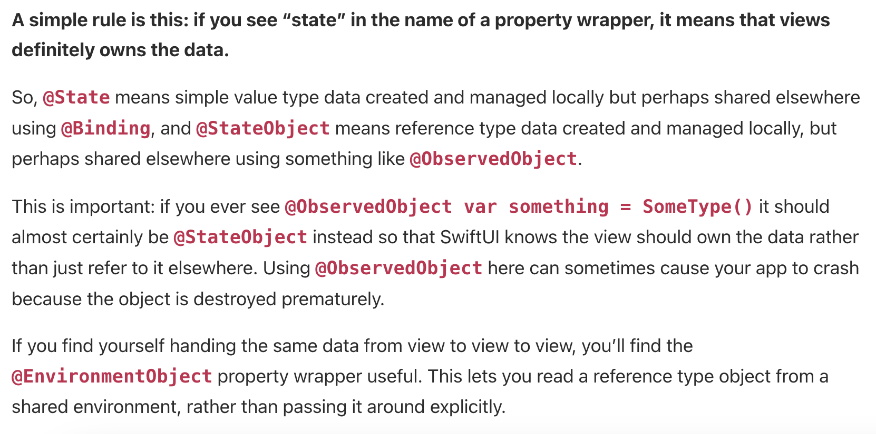
"All SwiftUI property wrappers explained and compared." Hacking with Swift ❤️
Notes:
Let students read this piece out loud (4 students, one per paragraph)
I highly recommend this article as an extension, people should go read it after class

Slide 18
One More: .onChange Modifier
Observes changes to a specific state or binding and performs an action
Useful when you want to trigger a specific side effect or action as a result of a state change without directly tying that action to the view's rendering logic
Notes:
Why `.onChange` alongside `@State`?
Decoupling Side Effects from View Updates: In some cases, updating the UI is not the only action you need to take when a piece of data changes. For example, you might want to save the new value to a database, log an event, or trigger a network request.`.onChange` allows you to perform these side effects in response to state changes without cluttering your view body.
Efficiency: Sometimes reacting to every single change in a state variable to perform complex operations can be inefficient, especially if those operations are computationally expensive or involve I/O operations. `.onChange` lets you execute these operations only when necessary.
Conditional Logic: It's useful when you need to check the new value of a state variable against its previous value or against other conditions before deciding to perform an action.

Slide 19
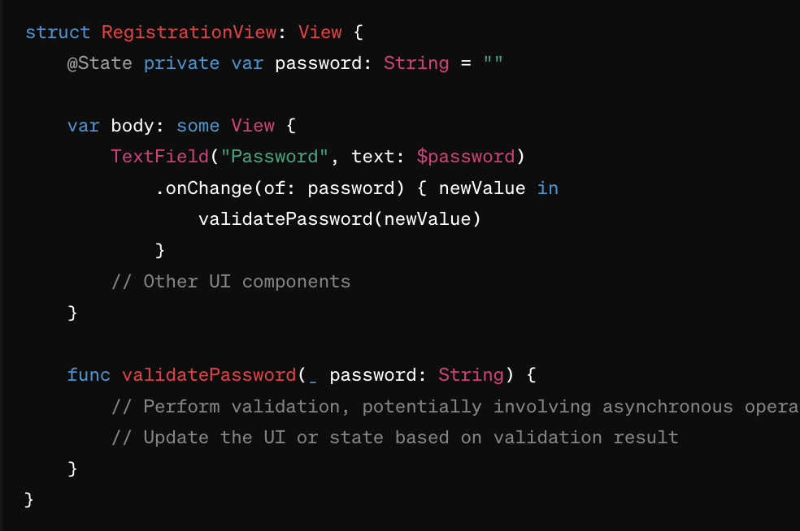
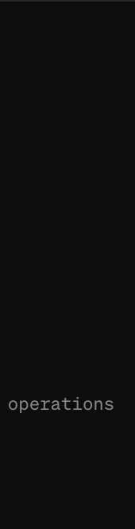
One More: .onChange Modifier
Notes:
Without .onChange:
You would have to perform the validation directly in the view body or as part of the view's update logic, which can lead to unnecessarily complex views and repeated validations even when not needed.
With .onChange:
You can set up an @State variable for the input field (e.g., password).
Use .onChange to trigger the validation only when the input changes.
Perform the validation, which could be an asynchronous operation, and then update another @State variable or display a message based on the result, without interfering with the main view rendering logic.
=> allows for a clean separation of concerns, makes code more readable, maintainable, and efficient
Can optionally capture old value as well: ```.onChange(of: name) { oldValue, newValue in … }```

Slide 20
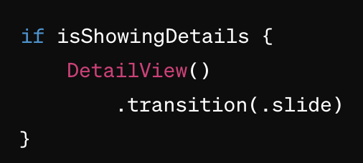
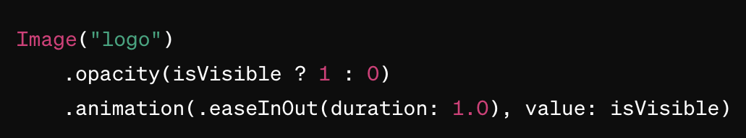
Animations and Transitions
It’s easy to do in SwiftUI!
.animation
.transition
Notes:
The final slide, I promise :)))
Explore different animation and transition effects at home! There are lots

Slide 21
Live Coding Time 🛠️
Notes:
Task Manager app - link on website
Add/edit tasks
Display tasks in a list
Mark tasks as done
Use basic animations

Slide 22
Today, We Learned…
View hierarchy
State management
Property wrappers
@State, @Binding, @ObservedObject, @StateObject, @EnvironmentObject
.onChange modifier
Animations and transitions

Slide 23
Next Time…
Week 5: App Lifecycle and Structure
Hw1 is due Mon, 2/12 @ 11:59PM

