Slide 1
weather.js
Goals
Use the Yahoo Weather API to get the current weather for where the user is located
Use JavaScript, jQuery & AJAX
Have a fallback if the predicted location is incorrect or the user wishes to change the location

Slide 2
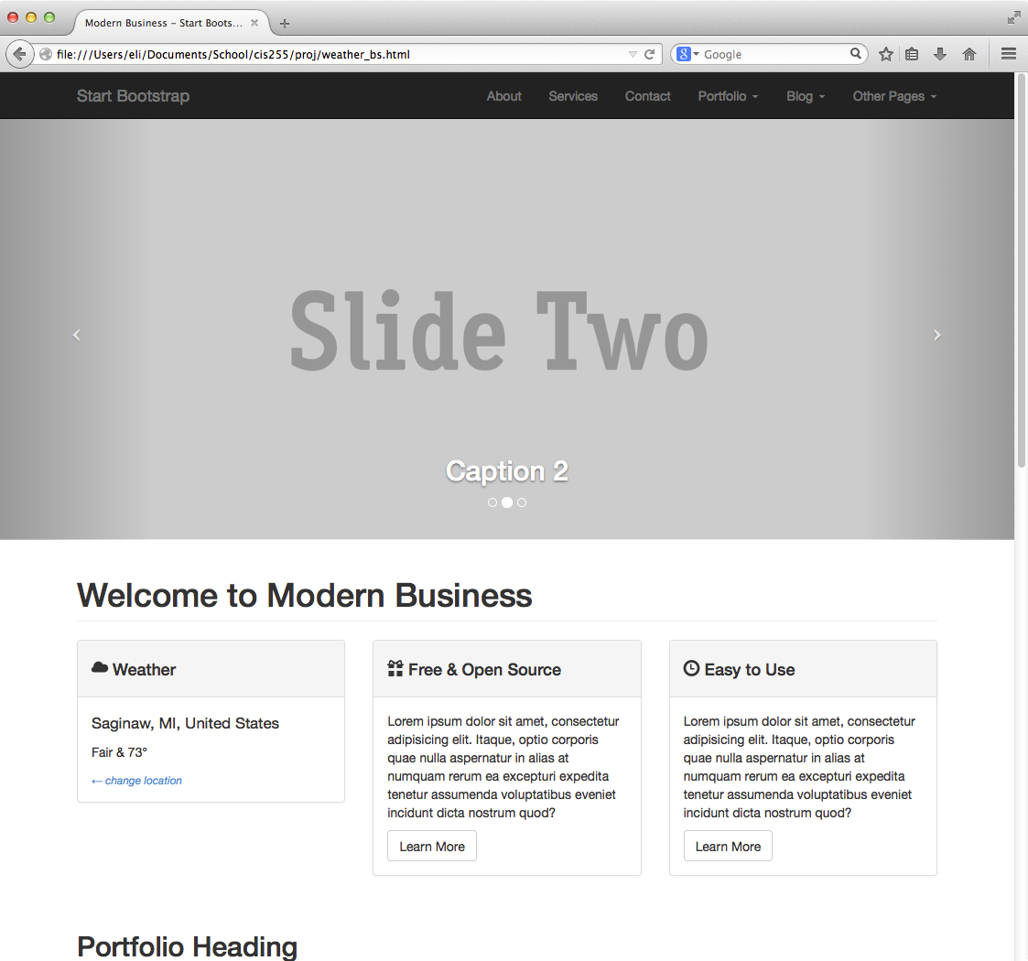
Finished Product

Slide 3
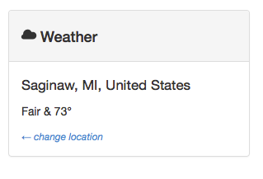
Up Close & Personal

Slide 4
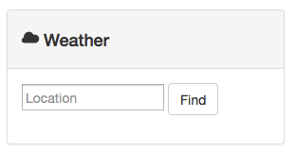
Changing Location

Slide 5
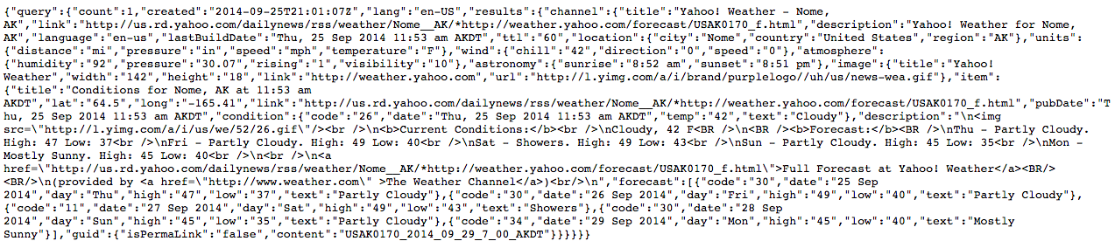
Yahoo Weather API
The Weather API returns data in a JSON format, this makes it really easy for us as web developers to parse it using JavaScript
The url to get this data looks something like this:
https://query.yahooapis.com/v1/public/yql?q=SELECT * FROM weather.forecast WHERE woeid in (select woeid from geo.places(1) where text='Saginaw, MI') and u='f'&format=json
And returns data that looks like this:

Slide 6
HTML Markup
The first thing we want to do is change our HTML webpage so that we can change it dynamically with the JavaScript we're going to write.
Find where it says:
<div class=”col-md-4”>

Slide 7
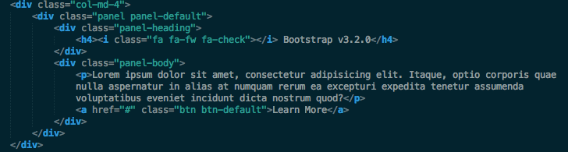
HTML Markup cont.
It will look something like this

Slide 8
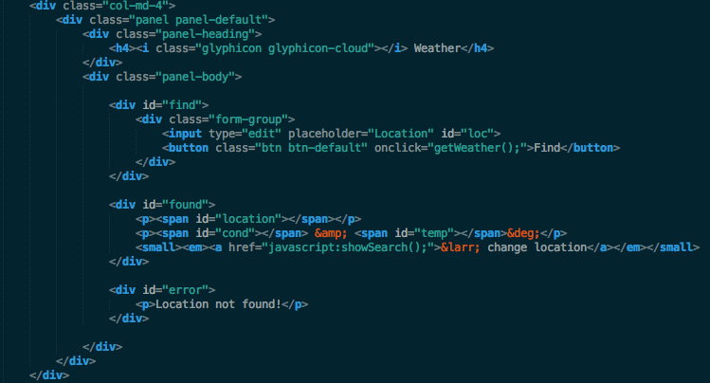
HTML Markup cont.
This is what we're going to change it to

Slide 9
The JavaScript File
Create a file in the js subdirectory of your project called weather.js
Open it up in your favorite text editor and let's get started.
We're going to create a function to call that will get our weather information then translate it into our HTML elements that we created earlier.

Slide 10

function getWeather()
The first function we are going to create is called getWeather() which, surprisingly, will get the weather

Slide 11

Location
First we're going to assume that the user is manually entering their location so we'll create a variable and get the data from the input box
document.getElementById('”loc”).value gets the value that is in the HTML
element that has the id of “loc”

Slide 12

URL
Now we're going to define the url where we will send a request to
It's a really long string so just copy it from the link below but essentially we insert our
location variable into the url string so we can make a custom API call
http://svsu.edu/~ecwilson/cis255/url.txt

Slide 13
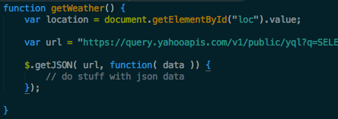
Get JSON
Now we're going to use jQuery/AJAX to use the url we just created and it will request that url and return the response that we can use
This allows us to access the JSON data that is returned when we request
that URL from Yahoo

Slide 14
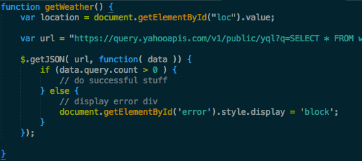
Data is Necessary
We need to do some error checking first, did we actually get any data back?
data is an object that was returned and query is an element of it and count is an element
of the query object. If we don't have any successful information then we will display an
error div telling the user to put in valid data

Slide 15
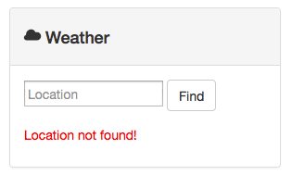
! ! ! Error ! ! !

Slide 16
International
The object that we are going to be using for location is data.query.results.channel.location
And it has 3 elements
  City
  Region
  Country
Not all international countries have a region element so we need to test for that and only display it, if the location has it

Slide 17
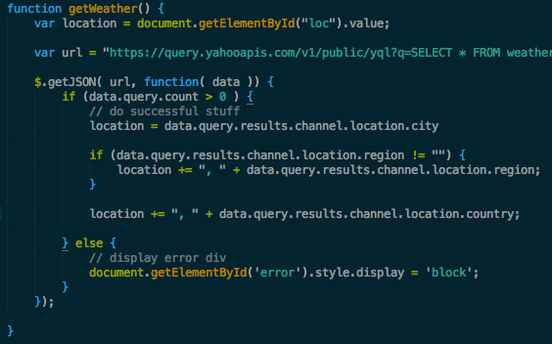
International Test
All objects will have a city attribute so we but that in our location string, if it has a
region element then we will add that to the location string and lastly we will add
the country element to the location string

Slide 18
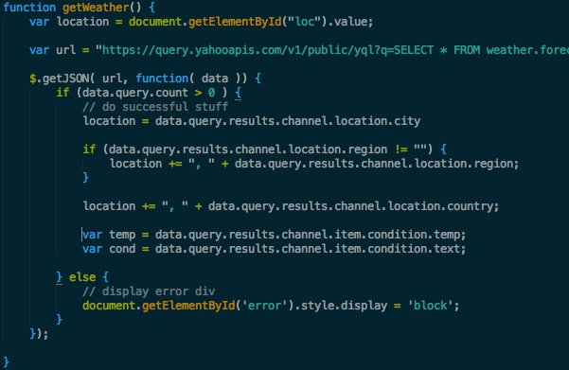
Temperature & Condition
Temperature & condition are in the object condition
data.query.results.channel.item.condition.temp
data.query.results.channel.item.condition.text

Slide 19
Find & Found
Remember those two div's from before in HTML? If not, we have one with the id “find” and one with the id of “found”
Find is going to display the search box
Found is going to display the location, temperature & condition
We need to utilize CSS & JavaScript for this to work

Slide 20

CSS
Add this to your CSS file
Found won't display by default as well as the error div. The rest is just some custom
Styling to make it all look nicer.

Slide 21
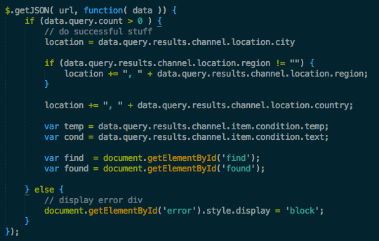
JavaScript
We created two variables to store the two divs so we can use them later easier

Slide 22
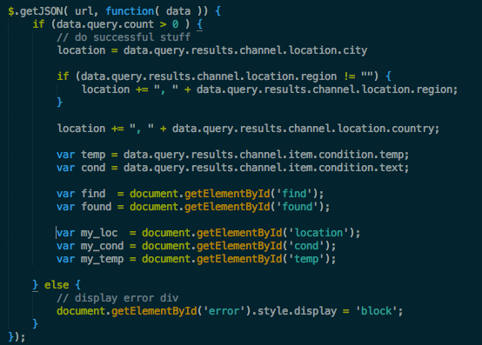
Span
Also earlier we had a couple span elements with id's in the HTML
We are going to store those elements as JavaScript variables so we can access them easier too.

Slide 23
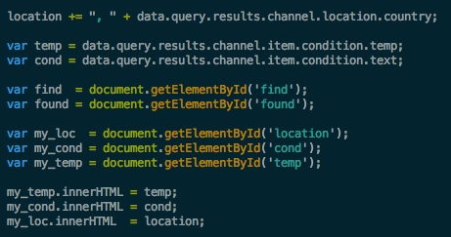
innerHTML
Now we're going to put our information into those span elements using the innerHTML attribute of those objects

Slide 24
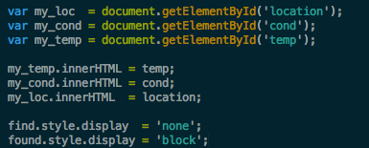
See ya!
So now we have all that information but remember how we hid it by default in our CSS?
Now we have to unhide it as well as hide the search part
In essence what we're doing is dynamically editing the CSS of those elements

Slide 25
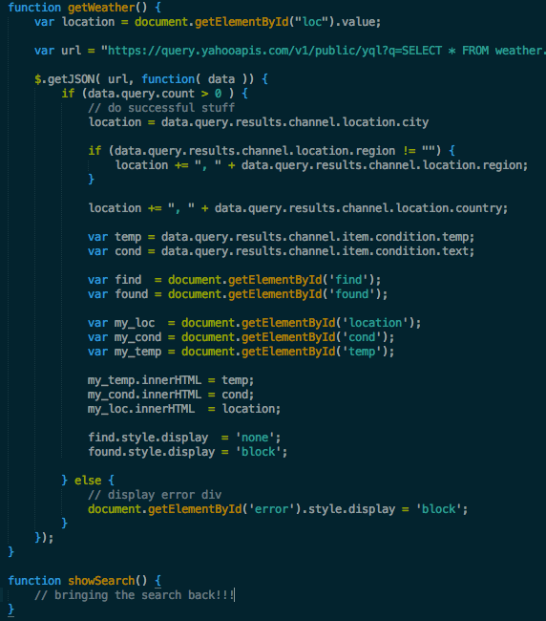
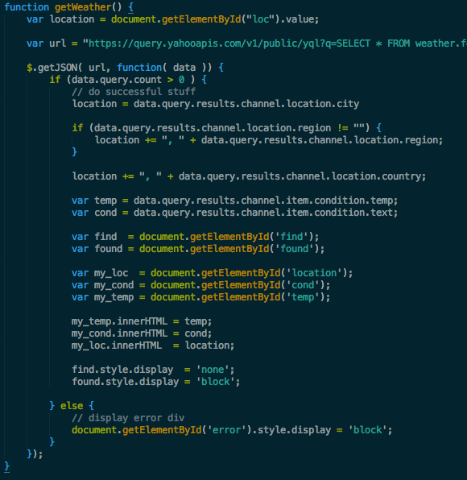
Make up your mind!
Alright let's say I want to change the location, we need a function to bring back that search box

Slide 26
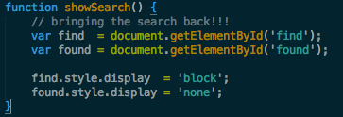
Bringing it back with style
To bring it back we're doing the opposite of before where we made it disappear. And our HMTL link calls this function to make the search bar reappear

Slide 27
Location, location, location
In the beginning remember how I said we're going to have this automagically get the users location? Let's do that.
We're going to use another API called ipinfo.io
It also returns JSON data, and we will call it when the document (webpage) loads using jQuery & AJAX

Slide 28
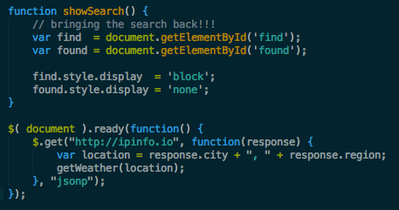
Are you ready for this?
After we get the users location we call our getWeather function using that location!
Wait... how does that work?

Slide 29

Modifications
Well it won't with how are current function is written, we need to add in a location parameter as well as checking to see if that parameter was passed to the function
The top of your function should look like the above now, we don't need an else
block because we just use the location variable that is passed into the function
as location

Slide 30

All done!
Well almost...
You need to link to the weather script in your index.html file or wherever you use it.
But... it needs to be linked after where jQuery is linked otherwise it won't work

Slide 31
Finished Product

Slide 32
Up Close & Personal

