Slide 1
Introduction to Cloud Computing
Dr. Xubin He
Computer and Information Sciences
Temple University
Courtesy: Some slides are adopted and modified from C. Borcea and M. Baker.
Notes:
ECE6130: Computer Architecture, T.T.U

Slide 2
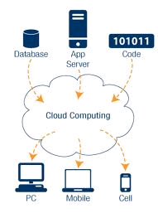

Cloud computing at a glance
Utility computing: our data and applications are hosted somewhere in the Internet (“in the cloud”)
  Most services we access over the Internet are in the cloud (e.g., Google, Amazon, etc)
Cloud infrastructure =
Data centers with
100,000’s servers

Slide 3
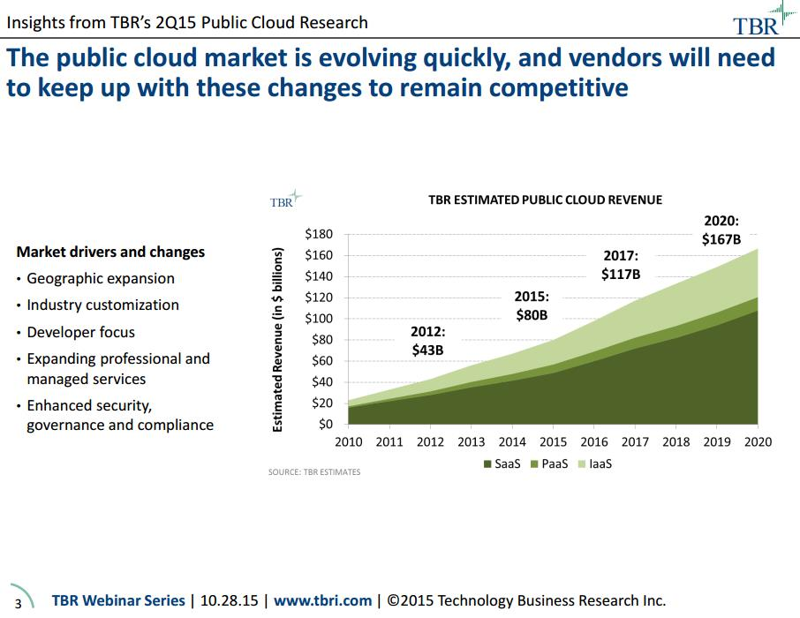
Cloud computing revenue

Slide 4
Outline
Cloud computing basics
Amazon Web Services (AWS)
An example to create an AWS EC2 instance

Slide 5
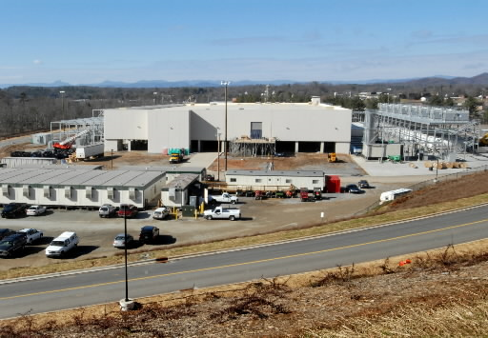
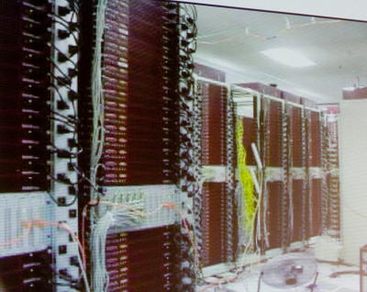
How it all started
Very large data centers with low utilization on average
  How about renting computers when load is low?

Slide 6
What is cloud computing?
Cloud computing means storing and accessing data and programs over the Internet instead of your computer's hard drive. – PC Mag
Cloud computing is the delivery of computing services—servers, storage, databases, networking, software, analytics, and more—over the Internet (“the cloud”). – Microsoft
Cloud computing is the on-demand delivery of compute power, database storage, applications, and other IT resources through a cloud services platform via the internet with pay-as-you-go pricing. –Amazon
A video on Youtube
A history of cloud computing, Computer Weekly

Slide 7
Types of services
X as a Service
Infrastructure-as-a-Service (IaaS)
  Virtual servers with unique IP addresses and blocks of storage on demand (e.g., Amazon EC2)
Platform-as-a-Service (PaaS)
  Set of software and development tools (API) hosted on the provider's servers (e.g., Windows Azure, Google AppEngine)
Software-as-a-Service (SaaS)
  The provider allows the customer only to use its applications

Slide 8
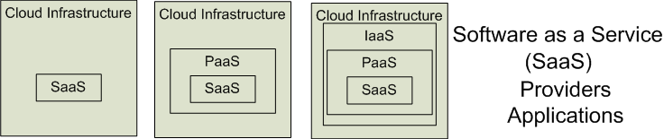
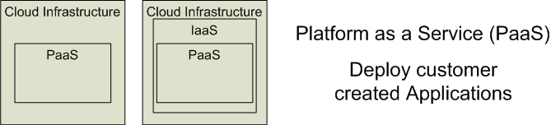

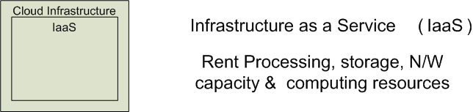


Cloud Service Models
Software as a Service (SaaS)
Platform as a Service (PaaS)
Infrastructure as a Service (IaaS)
SalesForce CRM
LotusLive
Adopted from: Effectively and Securely Using the Cloud Computing Paradigm by peter Mell, Tim Grance

Slide 9
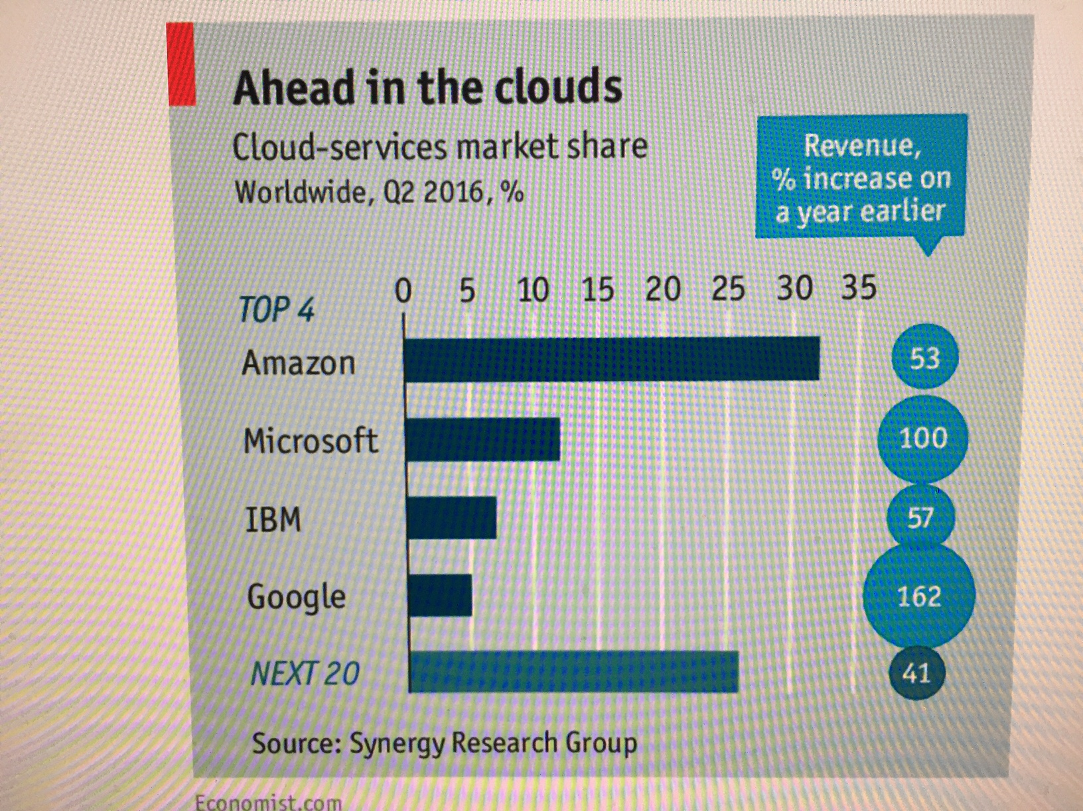
Top cloud players

Slide 10
Provider’s benefits
Renting an IT infrastructure to many users
Sharing of resources
Reduction of costs through scale
Centralized monitoring and maintenance
Control over software evolution
Control over service level agreements

Slide 11
Consumer’s benefits
Reduced capital expenditure for hardware, software, services
Reduced operational expenses - Pay as you go (dynamic provisioning)
Simple to achieve scalability and flexibility
More predictable costs

Slide 12
Virtualization
Virtual workspaces:
  An abstraction of an execution environment that can be made dynamically available to authorized clients by using well-defined protocols,
  Resource quota (e.g. CPU, memory share),
  Software configuration (e.g. O/S, provided services).
Implement on Virtual Machines (VMs):
  Abstraction of a physical host machine,
  Hypervisor intercepts and emulates instructions from VMs, and allows management of VMs,
  VMWare, Xen, KVM, etc.
Provide infrastructure API:
  Plug-ins to hardware/support structures
App
App
App
OS
OS
OS
Hypervisor
Hardware
Virtualized Stack

Slide 13
Virtual Machines
VM technology allows multiple virtual machines to run on a single physical machine.
App
App
App
App
App
Xen
Guest OS
(Linux)
Guest OS
(NetBSD)
Guest OS
(Windows)
VMWare
VM
VM
VM
Virtual Machine Monitor (VMM) / Hypervisor
UML
Denali
Hardware
etc.
Performance: Para-virtualization (e.g. Xen) is very close to raw physical performance!

Slide 14


Cloud: Efficiency Versus Control
Amazon AWS
Google Compute Engine
OpenStack
Windows Azure
Google AppEngine
= Managed for You | Standalone Servers | IaaS | PaaS | SaaS
Applications
Runtimes
Database
Operating System
Virtualization
Server
Storage
Networking
Efficiency
Control+Cost

Slide 15
Outline
Cloud computing basics
Amazon Web Services (AWS)
An example to create an EC2 instance

Slide 16




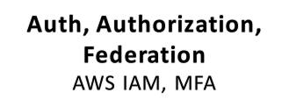
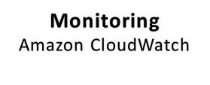
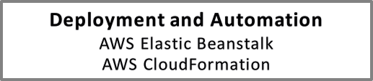
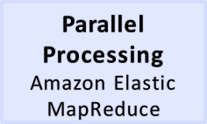
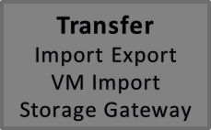
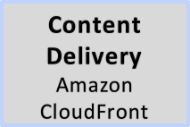
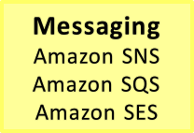
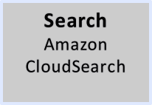
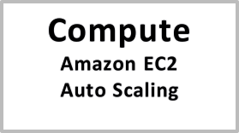
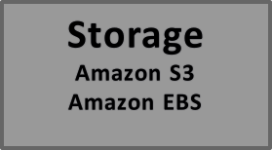
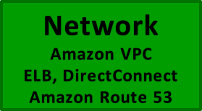
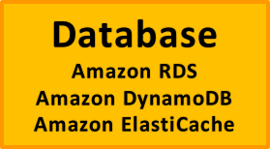
The AWS Cloud For Enterprises
Tools to access services
Cross Service features
High-level building blocks
Low-level building blocks
Note: This slide is adopted from J. Varia@Amazon

Slide 17
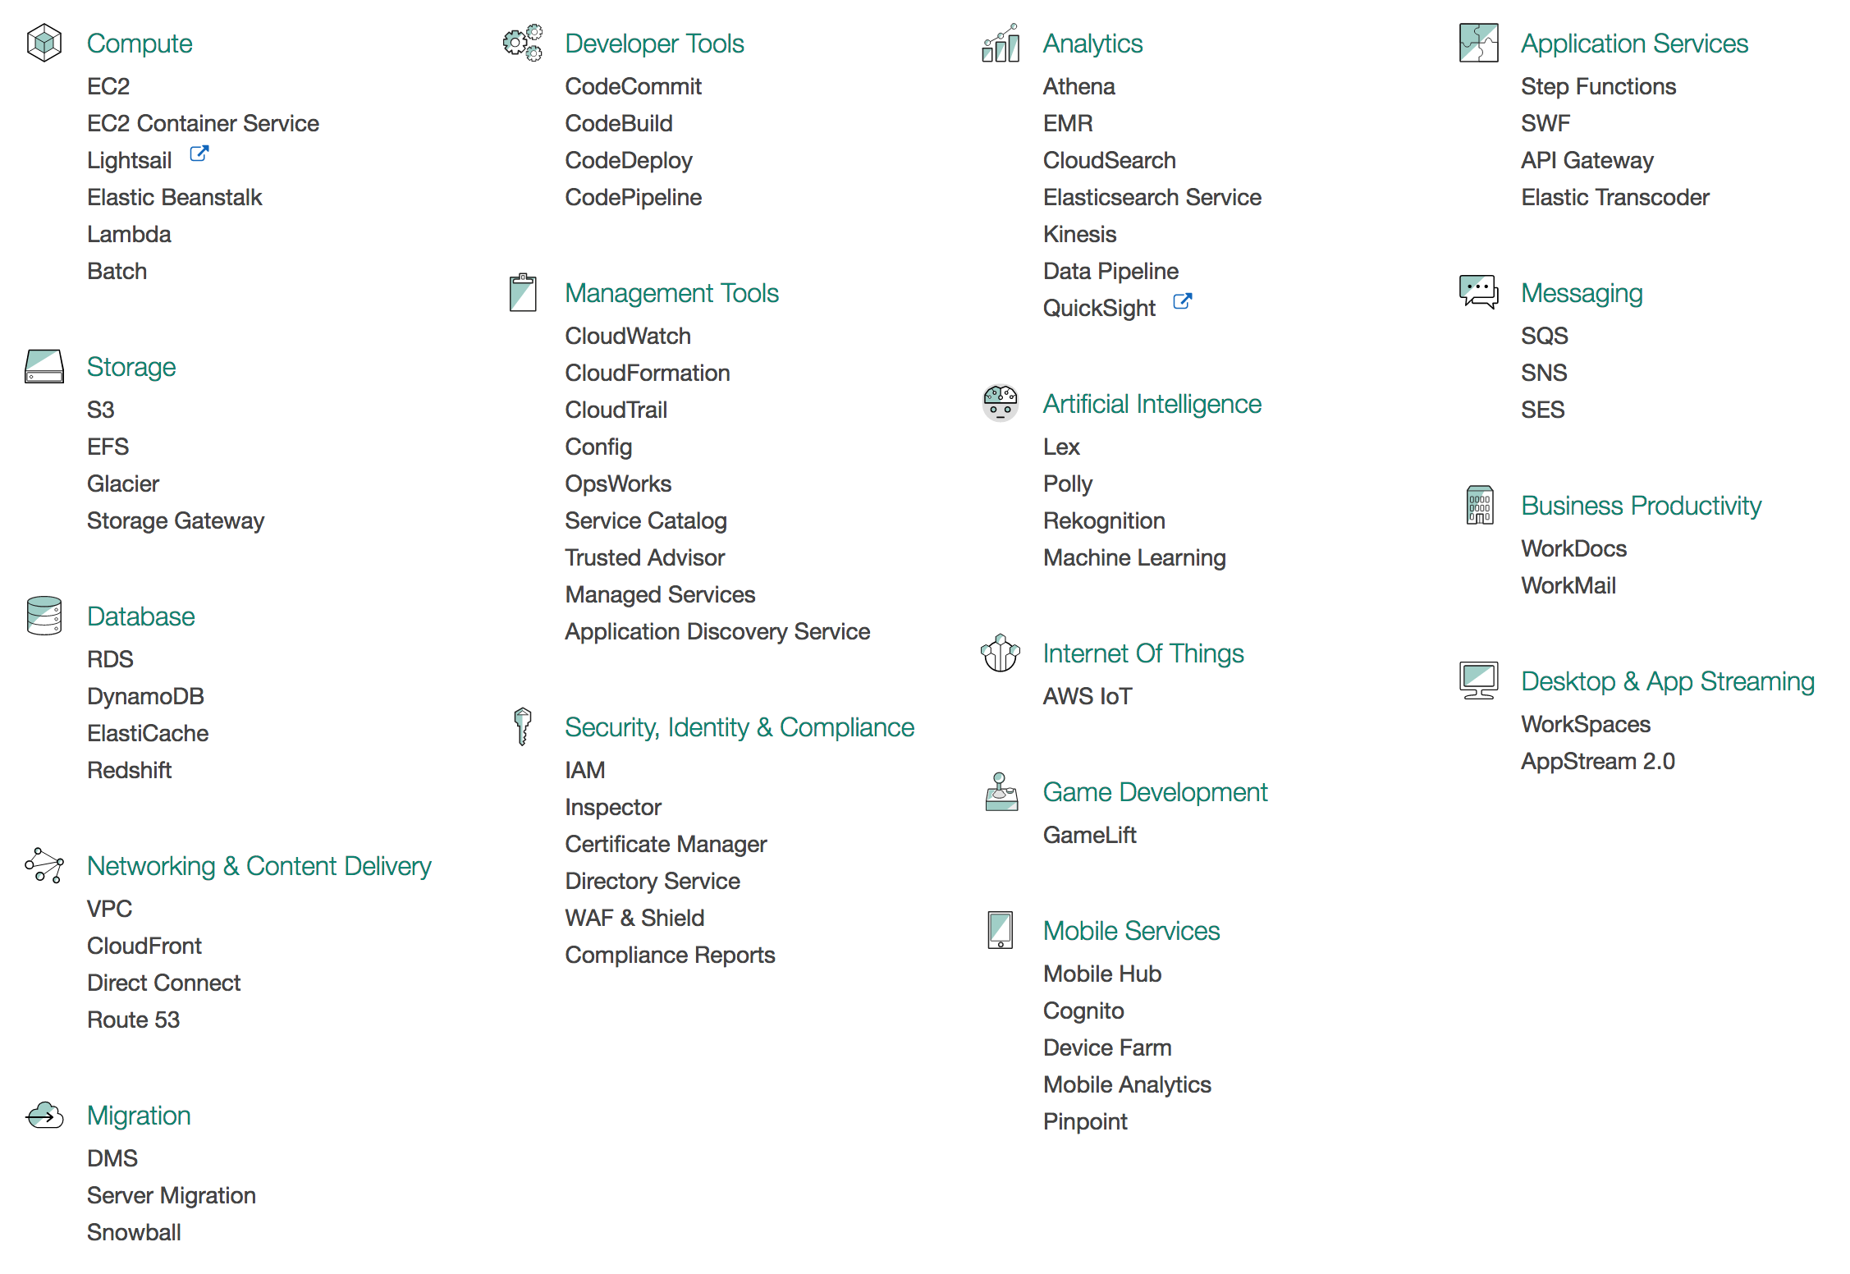
Amazon Web Services (AWS)

Slide 18
AWS service: Compute and monitoring
Compute
  Elastic Compute Cloud (EC2): launch on-demand virtual machines (instances)
  Elastic MapReduce: automatically starts Hadoop implementation of MapReduce for parallel applications
    Amazon handles cluster management
  Auto Scaling: seamlessly increase/decrease number of EC2 instances function of load
    Done based on metrics reported by CloudWatch
Monitoring
  CloudWatch: monitor cloud resources such as CPU cycles, disk access, network traffic

Slide 19
EC2 instances
Instances: Virtual machines that run in the EC2 environment
  Each instance is like a “physical” machine that has its own CPU, memory, network interface, and disk space (volatile – data is lost when the instance is terminated)
  Xen used for virtualization
AMI (Amazon Machine Image): Encrypted file that captures a complete snapshot of an EC2 instance at a point in time, including its software, configuration, and data
  Images are stored in S3 and serve as boot disks for instances
  Linux/Solaris and Windows images publicly available
  Users can create AMI from scratch: start from any public AMI, install & customize the software needed, and then store it as private AMI to use later on

Slide 20
AWS Service: Storage
  Simple Storage Service (S3): provide persistent storage
    Independent of EC2 instances
    EC2 instances need to “download” data from S3 in order to access it (cannot issue read/write to S3)
  Amazon Glacier: low-cost storage service that provides secure and durable storage for data archiving and backup
    Advantage over S3: offload the administrative burdens of operating and scaling storage + cost
    Disadvantage: slower than S3
  Storage Gateway: securely store data to the AWS cloud for scalable and cost-effective storage
    All data is securely transferred to AWS over SSL and stored encrypted in Amazon S3 using AES 256-bit encryption
  Elastic Block Store (EBS): provide block level storage volumes (virtual disk, i.e., disk-like) to EC2 instances
    Persistent even after instances are terminated
    Instances have to mount EBSs (EFS)

Slide 21
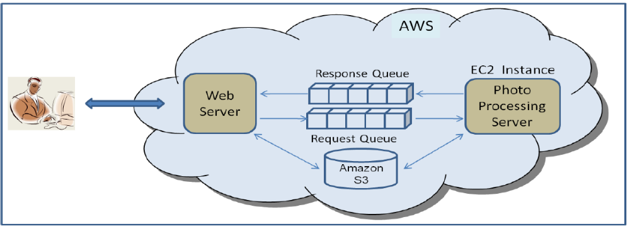
Online photo processing service
Users submit Photos and specify operations they want over their photos:
  Red eye detection, Cropping, Re-coloring, etc
Requests are put on Request Queue and photos are saved in S3 storage area
Photo Processing Server gets the request, retrieves photos from S3 storage, performs processing, and sends result using Response Queue

Slide 22
Case study
The New York Times used AWS to create PDF files of its whole archive
  100 Amazon EC2 instances running Hadoop application
  Processed 4TB of raw TIFF image data (stored in S3) into 11 million finished PDFs
  Running time: 24 hours
  Cost: $240 (not including bandwidth)
New York Times report

Slide 23
Outline
Cloud computing basics
Amazon Web Services (AWS)
An example to create an AWS EC2 instance

Slide 24
Terminology
Instance: One running virtual machine.
Instance Type: hardware configuration: cores, memory, disk etc.
Amazon Machine Image (AMI): Description of an instance. It provides the information required to launch an instance.
Key Pair: Credentials used to access VM from command line.
Region: Geographic location, price, laws, network locality.
EBS: Elastic Block Store: provides persistent block level storage volumes for use with Amazon EC2 instances in the AWS Cloud.

Slide 25
Getting Started with Amazon EC2
Step 1: Sign up for Amazon EC2
Step 2: Create a key pair
Step 3: Launch an Amazon EC2 instance
Step 4: Connect to the instance
Step 5: Customize the instance
Step 6: Terminate instance and delete the volume created

Slide 26
AWS access
Create Amazon account
  http://aws.amazon.com
Apply as a student for free credits
  http://aws.amazon.com/education/awseducate

Slide 27
Instance types
Some typical instance types:
  General purpose: T2, M4, M3
  Compute optimized: C4, C3
  Memory optimized: X1, R4, R3
  Accelerated computing instances: P2, G2, F1
  Storage optimized: I2, D2
https://aws.amazon.com/ec2/instance-types/

Slide 28
More resources
Online documentation
  Amazon Web Services
  Google AppEngine
  Microsoft Azure
Public cloud war: AWS vs Azure vs Google
Cloud computing tutorial for beginners:
  https://www.youtube.com/watch?v=LICA-ILkO4w
Google data center video: https://www.youtube.com/watch?v=XZmGGAbHqa0

