Slide 1
OSINT Investigator
Automated external-OSINT investigation — from one seed to a cited intelligence graph
Give it a seed (domain, email, username, name, IP…) → it pivots through open sources, builds a confidence-tiered entity graph, and produces a cited CTI report.
External OSINT only · Runs locally · Never fabricates a finding.
Open source (MIT) · agent-vendor-agnostic (Claude Code or OpenAI Codex)
Analyst briefing · 2026
Notes:
A force-multiplier for an OSINT analyst. It does the tedious collection and first-pass link analysis at machine speed, and shows its work so you can trust or challenge every line. I'll finish with a real case where it mapped a ticket-fraud network from one URL.

Slide 2
WHAT IT IS
One seed in → a cited intelligence graph out
THE PROBLEM
An analyst handed one selector faces hours of manual lookups across dozens of tools — then has to keep every link straight by hand.
THREE PROPERTIES THAT MAKE IT TRUSTWORTHY
1. No hallucination
Every claim traces to a specific tool output or source URL.
2. Full audit trail
Every tool run logged raw; the graph is reproducible.
3. Honest about limits
Gaps are documented, never faked.
WHAT THIS DOES
• Runs the right tools automatically (ontology-driven, not hardcoded)
• Analyzes raw output and grades every finding by confidence
• Pivots on its own findings — loops until the leads run dry
• Red-teams itself before writing a report
• Ships a narrative report — every finding cited to tool output
OSINT Investigator · external-OSINT only · runs locally
BLUF
Notes:
The headline for an analyst is the pivoting and confidence tiering. The headline for IT is the three properties on the right — local, auditable, external-only.

Slide 3
OPERATIONAL CONCEPT (OV-1)
Distinct agents, each a labeled SKILL — with an adversarial red team as its own stage
LAUNCH
SUPERVISOR
skill: investigate.md
skill: supervisor.md
detect type · create case
the analyst brain — routes via the ontology, analyzes, TIERS, commits the graph, pivots
dispatches 3 collector agents ↓
① STRUCTURED collector
② WEB-SEARCH collector
③ ACTIVE collector
skill: gatherer.md
skill: web_searcher.md
skill: active_collector.md
58 typed tools — whois/rdap, dns, crt.sh, sherlock, shodan…
real web searches + page fetches · snippet-as-evidence · cites everything
touches the target's own site for tracker/analytics IDs (ownership corroborator) · passive-first OPSEC
▸ PAID CTI (roadmap): Shodan · DNSlytics · Flare
all three collect RAW · log everything · NEVER write the graph (the raw / analysis split)
ANALYZE + TIER + COMMIT
highly likely / probable / possible
+ PIVOT each new entity (loop)
RED TEAM (separate agent)
skill: red_team.md
Mode 1: challenge the analysis
Mode 2: ground the report
REPORT WRITER
skill: report-writer.md
narrative CTI report
OUTPUTS
graph · report
bibliography · log
Separation of powers: collectors fetch · the supervisor alone analyzes & tiers · an INDEPENDENT red team tries to break the conclusions before they ship.
OSINT Investigator · external-OSINT only · runs locally
OV-1
Notes:
Walk left to right. Each box is a distinct agent running a named skill file. Three separate collectors — structured (typed tools; paid CTI like Shodan/DNSlytics/Flare plugs in here), web-search, and active. They only collect; the supervisor is the only brain that analyzes and tiers. The red team is its own agent — it challenges the analysis (Mode 1) and grounds the report (Mode 2) before anything ships.

Slide 4
THE ROUTING BRAIN
A knowledge base of selector CATEGORIES decides what runs — nothing hardcoded
Identity
28 types
92
selector types the ontology can reason about
58
runnable tools wired in
● live coverage
● roadmap
Routing: plan_collection(). Pivoting: each type declares what it YIELDS. A test enforces the ontology can't lie about what runs.
username · email · name · phone · handles
Infrastructure
11 types
domain · IP · URL · ASN · certificates
Financial
5 types
crypto wallets (BTC / ETH)
Malware
3 types
file hashes · IOCs
Media
5 types
images · EXIF / geolocation
Geospatial
3 types
coordinates · addresses
Transport · Security · Social · Device
10 types
plates · VIN · creds · devices
+ uncatalogued roadmap types
49 types
reachable via web-search fallback
OSINT Investigator · external-OSINT only · runs locally
Ontology → categories
Notes:
The system reasons in categories. Identity and Infrastructure are where the live tool coverage is deepest — exactly what most investigations need. The rest is a roadmap, and a bare selector always has the web-search line as a fallback. A regression test keeps the self-description honest.

Slide 5
THE TOOLS
A sample of the 58 tools running now — real names, grouped by selector
DOMAIN (16)
whois_lookup · rdap · dns_lookup · dnsrecon · crtsh · certspotter · tls_cert · http_title · urlscan · wayback · theharvester · cloud_buckets · web_tech_fingerprint
IP (11)
ip_geolocation · ipinfo · shodan_internetdb · reverse_dns · ripestat_network · bgpview_ip · greynoise_community · reverse_ip · robtex_ip · urlscan
USERNAME (8)
sherlock · maigret · naminter · linkook · socialscan · github_user · reddit_about · google_dork_generator
EMAIL (8)
holehe · user_scanner · hudsonrock_email · xposedornot_email · disify · socialscan · gravatar_check · pgp_keyserver
NAME / COMPANY (11)
wikipedia_search · wikidata_search · gleif_lei · sec_edgar_fts · aleph_occrp · courtlistener_search · hibp_name_search · name_to_username
PHONE · CRYPTO · IMAGE · TRACKER
phonenumbers · ignorant · phoneinfoga · blockstream_btc · blockchain_btc · exiftool · web_tech_fingerprint · tracker_reverse
Each tool is a small declarative spec (endpoint + parser). Optional CLIs and keyed APIs degrade gracefully — the system runs with zero keys.
OSINT Investigator · external-OSINT only · runs locally
Tools in use
Notes:
These are real tool names in the registry today, grouped by what they run against. Best-in-class on the core selectors — domain, IP, username, email, name. Each is a readable spec, so IT can see exactly what every tool touches.

Slide 6
SOFTWARE LAYDOWN
Small, auditable, standard — pure-Python engine
CORE DEPENDENCIES (7, pinned in requirements.txt)
WHAT WE BUILT (~48 Python modules under src/)
requests
HTTP client for all API tools
core/ selector detection + investigation state
ontology/ the routing brain + honesty annotator
tools/ 58 tools via HttpTool/CliTool specs + registry
graph/ NetworkX graph + vis.js visualizer
report/ narrative report (MD + HTML + Mermaid)
logger/ the raw audit trail
scripts/health_check.py the safety gate (registry + floor + 3 suites)
One command — ./bootstrap.sh — builds and self-verifies. Full install list in the appendix.
networkx
the investigation graph
python-whois
WHOIS lookups
dnspython
DNS records
beautifulsoup4
HTML parsing
mmh3
favicon hashing (ownership corroborator)
phonenumbers
phone parsing/validation
OSINT Investigator · external-OSINT only · runs locally
Software laydown
Notes:
Seven mainstream open-source packages, everything pinned, one command to build and self-verify. No black box — the whole dependency list is on one slide, and the exact install list is in the appendix.

Slide 7
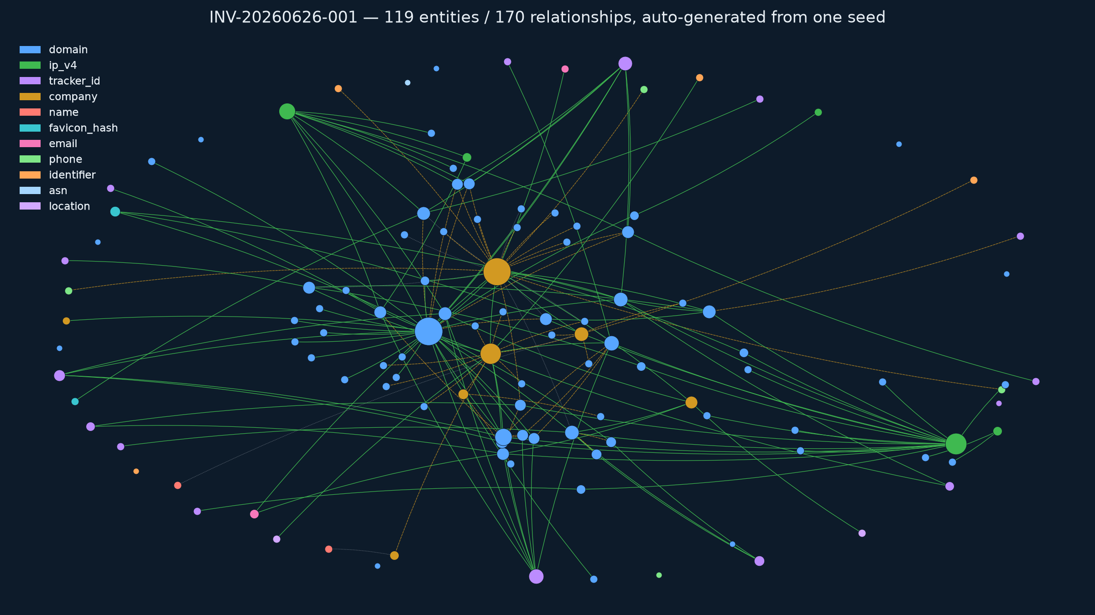
USE CASE · TICKET-FRAUD NETWORK
One scam URL → a mapped network (auto-generated)
SEED
colosseumdiroma-tickets.com
a fake Colosseum ticket-resale site
WHAT THE PIVOTS BUILT
• Registration — WHOIS/RDAP → registrant org 'The Walker Tours LLC'
• Hosting estate — domain → AWS IPs → co-hosted lookalikes → loop
• Content IDs — the active line pulled 15 tracker/analytics IDs
TIERED HONESTLY
96 highly likely · 14 probable · 9 possible
Weak leads kept as pivots, not dropped. NOT over-sold as a 75-site scam estate — AWS nameservers & the legit origin domains are flagged.
Real output: 119 entities / 170 relationships, colored by type (blue=domain, green=IP hub, amber=company, purple=tracker ID).
OSINT Investigator · external-OSINT only · runs locally
Use case 1/3
Notes:
Start at one URL. The system expanded the hosting neighborhood, fingerprinted the sites, and clustered them — automatically. This is the ACTUAL graph it produced: 119 entities from one seed. Note the two big green nodes — shared hosting IPs — and the amber company nodes where attribution lands.

Slide 8
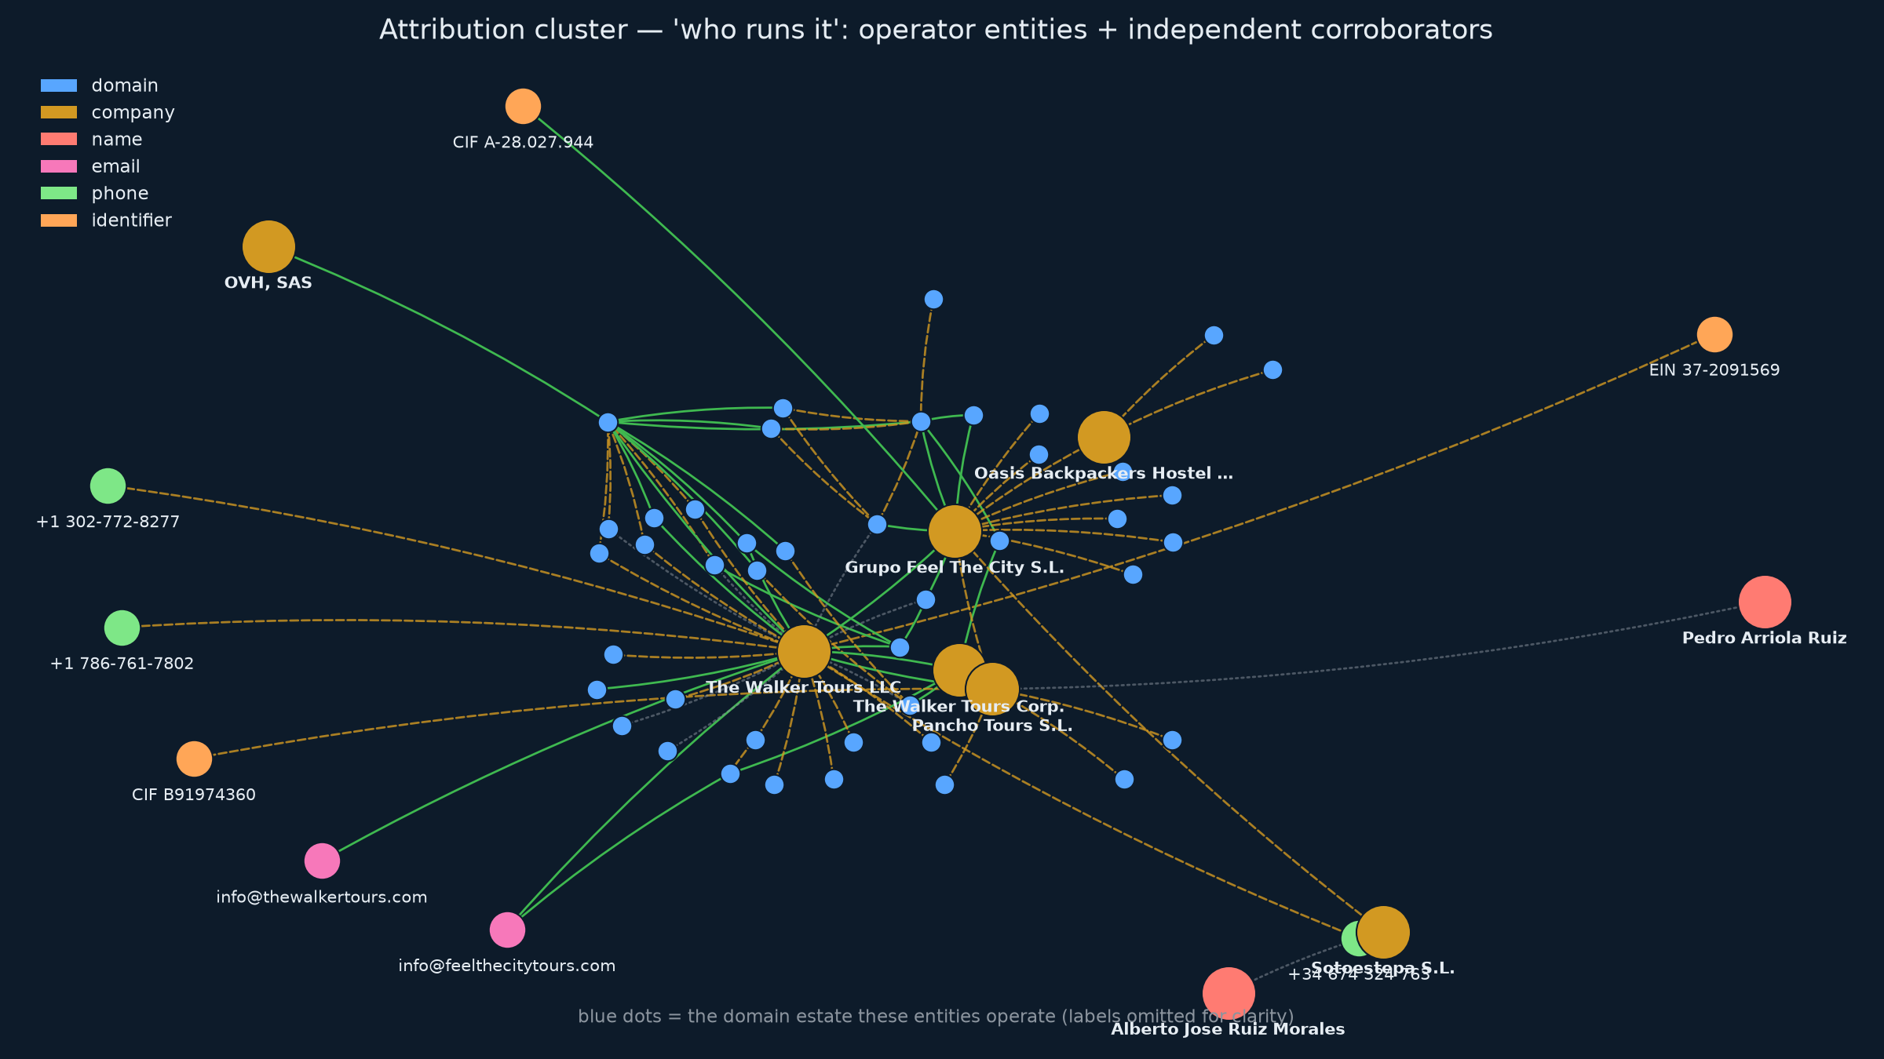
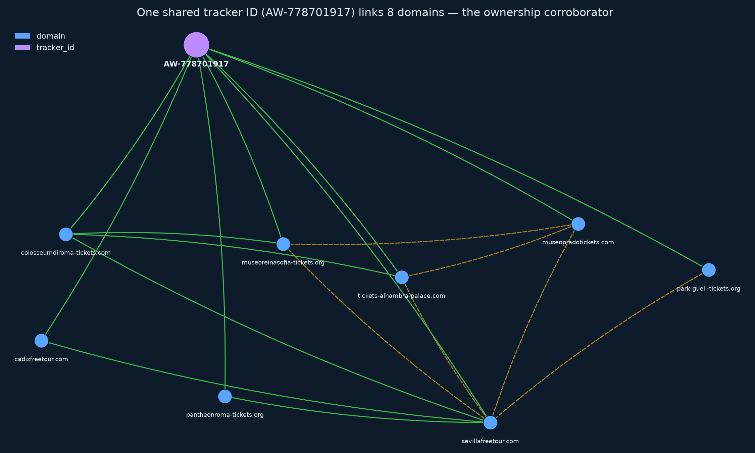
USE CASE · WHAT IT PROVES
Who runs it — and the independent evidence that ties them together
THE CORROBORATOR MECHANISM
One shared Google Ads ID (AW-778701917) links 8 scam domains. A shared strong tracker ID is the independent evidence that upgrades ‘co-hosted’ to ‘same operator’.
‘Who runs it’: real operator entities the pivots recovered — Walker Tours LLC/Corp., Pancho Tours, Grupo Feel The City, shared EIN 37-2091569, CIFs, names, emails, phones.
OSINT Investigator · external-OSINT only · runs locally
Use case 2/3
Notes:
Left: the attribution cluster — real companies, a shared federal EIN, Spanish CIFs, names, contact emails and phones the system recovered. Right: HOW it knows — a single shared analytics ID tying eight domains together. That shared ID is the independent corroborator our doctrine requires before claiming common ownership.

Slide 9
USE CASE · THE TRUST STORY
The system pressure-tests itself and refuses to over-claim
1
An early pass read the estate as TWO operators.
2
The RED-TEAM gate challenged the merge: ‘shared hosting ≠ shared ownership — show an independent corroborator.’
3
A deeper pivot found the GOLD STANDARD: the seed itself ran a strong UA-131208121-1 analytics property in its 2024 Wayback snapshot — the same property as sevillafreetour.com.
4
On SIX independent corroborators, red-team round 3 REVISED the conclusion to ONE operator group: Grupo Feel The City S.L. (Seville), fronted by two US shells sharing federal EIN 37-2091569.
5
It distinguished the LEGITIMATE 2010 origin tour business from the 2024–26 scam build-out — and flagged the legit brand must NOT be labelled a scam.
Why it matters: it argued with itself on the record, changed its mind on evidence, and drew a clean line around the innocent business. Every step is in the audit log.
OSINT Investigator · external-OSINT only · runs locally
Use case 3/3
Notes:
If a tool only ever confirms its first guess, you can't trust it. This one argued with itself on the record, upgraded its conclusion when the evidence justified it, and protected the innocent business. That discipline is what makes machine-assisted attribution safe to brief.

Slide 10
WHY IT SHOULD APPROVE · 1
Where the data goes
CONCERN: data egress / data handling
Runs entirely on the local machine. No server, no cloud service, no account required to operate.
External OSINT only — by design and scope. Never ingests internal/corporate data; internal-data analysis is explicitly out of scope.
What leaves the machine is only the selector, sent to PUBLIC sources (WHOIS/DNS/CT logs, search engines, public APIs) — the same requests an analyst makes in a browser.
Results stay on disk. investigations/ and the .env key file are git-ignored — case data and keys are never committed or pushed.
Passive-first OPSEC. The active line prefers archived (Wayback) copies before any live request; generic user-agent; no crawling; proxy seam for attribution control.
Net: the tool's network behavior is a subset of normal analyst browsing, from the local machine, against public sources only.
OSINT Investigator · external-OSINT only · runs locally
IT approval · data egress
Notes:
Nothing internal goes in. What goes out is the same public lookups an analyst runs manually. Results and keys never leave the box and are never committed to git.

Slide 11
WHY IT SHOULD APPROVE · 2
Dependency & tool provenance (supply chain)
Seven pinned, mainstream open-source packages. The entire core dependency list fits on one slide (requirements.txt). No obscure runtime.
Declarative tool registry. Every one of the 58 tools is a small, readable spec (endpoint + parser) — auditable at a glance; no hidden collection.
No bespoke scraping allowed. Collection goes only through registered, reviewed tools; the doctrine forbids ad-hoc scripts.
Optional extras are opt-in and degrade gracefully. Fully functional with zero keys and zero extra installs.
MIT-licensed — open for review and download.
BUILT-IN SAFETY GOVERNANCE (bonus)
A health gate (health_check.py) + 3 regression suites gate every change · a capability-lock defines what must never regress · a separate System Manager role maintains it conservatively.
OSINT Investigator · external-OSINT only · runs locally
IT approval · provenance
Notes:
Everything a supply-chain reviewer wants: short pinned dependency list, every tool is a readable spec, no hidden network calls, opt-in extras, permissive license, and an automated gate that proves the system still works after any change.

Slide 12
CLOSE
Ready, open, and built to be trusted
WHAT THIS GIVES THE TEAM
• An analyst force-multiplier: seed → cited, confidence-tiered graph + report, automatically, with a full audit trail
• Proven on a real ticket-fraud network — mapped, attributed, and self-corrected without over-claiming
• Safe by construction: local · external-only · auditable · honest about limits
AVAILABLE NOW
Open-source (MIT): github.com/cis379/osint-investigator-v3 (public)
One command to stand up (./bootstrap.sh), health-gated, Mac / Linux / Windows · drive it with Claude Code or Codex
THE ASK: approval to run it locally, external-OSINT only, as an analyst tool.
OSINT Investigator · external-OSINT only · runs locally
Close
Notes:
It's ready, it's open, and it's built to be trusted. I'm asking for the green light to use it as a local analyst tool — and I'm happy to walk IT through the code and the audit trail.

Slide 13
APPENDIX
Exactly what must be installed (full software footprint)
REQUIRED
OPTIONAL — external OSINT CLIs (degrade gracefully)
Python 3.10+
7 pip packages (requirements.txt):
requests · networkx · python-whois · dnspython · beautifulsoup4 · mmh3 · phonenumbers
→ one command: ./bootstrap.sh does all of the below + a health check
pipx install:
sherlock-project · maigret · holehe · theHarvester · socialscan · dnsrecon · socid-extractor · user-scanner · linkook
pip (into venv): naminter · ignorant
system pkg: exiftool (brew / apt / winget)
OPTIONAL — keyed APIs (.env, OFF by default; the system runs fully without any)
Paid/keyed CTI that plugs into the STRUCTURED collector: Shodan · DNSlytics · Flare · VirusTotal · AbuseIPDB · GreyNoise
Each degrades to a clear ‘needs KEY’ skip when absent — no key is required to operate.
Footprint summary: one Python venv + up to ~11 well-known OSINT CLIs + one binary (exiftool). No services, no daemons, no admin rights required.
OSINT Investigator · external-OSINT only · runs locally
Appendix · install
Notes:
This is the complete software footprint for IT. Required is just Python plus seven packages. Everything else is optional and degrades gracefully. bootstrap.sh installs it all and runs the health check. Paid CTI keys (Shodan/DNSlytics/Flare) are opt-in and plug into the structured collector.

