Slide 1
Tutorial On:
FlareMISPService
(Java / SpringBoot / Rest WebService)
GitLab URL: http://10.23.219.229/flare/FLAREmispService

Slide 2
FlareMispService is basically a REST Web Service
wrapper around the functionality of CTI-Toolkit
Web Service’s responsibilities:
Run a Scheduler to wake up & use CTIToolkit to do work.
Read the configuration file and pass values as args to CTIToolkit.
Provide a basic REST API for interacting with CTIToolkit.
Reload configurable properties from file system
Check TAXI connectivity
Check MISP connectivity
Manually start a Poll for work to do (outputs XML only)
Manually start a Poll for work to do (outputs MISP Event to MISP Server)
Handle request from Scheduler to do work (MISP).
Restart Scheduler (assuming it crashed or failed auto startup)
Display list of Quartz Jobs (only 1 recurring job unless you program more)
Stop all Quartz Jobs

Slide 3
FlareMispService (REST Service wrapping around CTI-Toolkit)
FlareMispService
(Java based)
SpringBoot
REST Service
TAXII
SERVER
MISP
SERVER
<- ??? ->
PyMisp →
REST API on MISP SERVER
CTI
STIX
(XML)
MISP Event
(JSON)
Toolkit
(python based)
Quartz
Scheduler

Slide 4
FlareMispService (Configuration Properties File)
FlareMispService
/opt/mtc/config/
config.properties
** If you modify any of the configuration values, you must use the URL: “/refreshConfig “
This will:
Stop the Job and Scheduler.
Reload the props into mem.
Restart the Scheduler/Jobs.
All properties in the config file are loaded once at startup.
Afterwards, the only values read are the ‘Begin’ and ‘End’ Timestamps which are used by CTIToolkit to determine which STIX records are pulled from FLARE TAXI.
CTI
Toolkit
Quartz
Scheduler

Slide 5
FlareMispService (Quartz Scheduler – Configure Frequency)
FlareMispService
/opt/mtc/config/
config.properties
Quartz
(java based)
mtc.quartz.frequency
The frequency property controls how much time (in minutes) must pass before polling the FLARE TAXI.
Scheduler configures a Job.
Job will be run at the frequency specified in the property.
Job is to kick off CTIToolkit for a poll of the FLARE TAXI Server.
Scheduler
Job
CTI
Job
Job
Toolkit

Slide 6
FlareMispService (CTI Toolkit – Begin/End Timestamps for Polling)
/opt/mtc/config/
config.properties
FlareMispService
stixtransclient.poll.beginTimestamp.MISP.stixToMisp
stixtransclient.poll.endTimestamp.MISP.stixToMisp
at Initialization time …
The ‘begin’ and ‘end’ timestamps are only updated if the CTI Toolkit can successfully complete it’s job. The timestamps are written to the config file to protect against termination of the Web Service. (maintain state)
Not possible to change after init ..
Must restart !!
TAXII
SERVER
CTI
MISP
SERVER
Toolkit

Slide 7
FlareMispService (CTI Toolkit – Begin/End Timestamps for Polling)
/opt/mtc/config/
config.properties
FlareMispService
stixtransclient.poll.beginTimestamp.MISP.stixToMisp
stixtransclient.poll.endTimestamp.MISP.stixToMisp
Deleting the lines completely and restarting the Web Service will use the default time stamp of the EPOCH (~ 1970)
Modifying the values requires a restart of the web service.
All other config values can be modified and reloaded into memory without a restart.
CTI
Toolkit

Slide 8
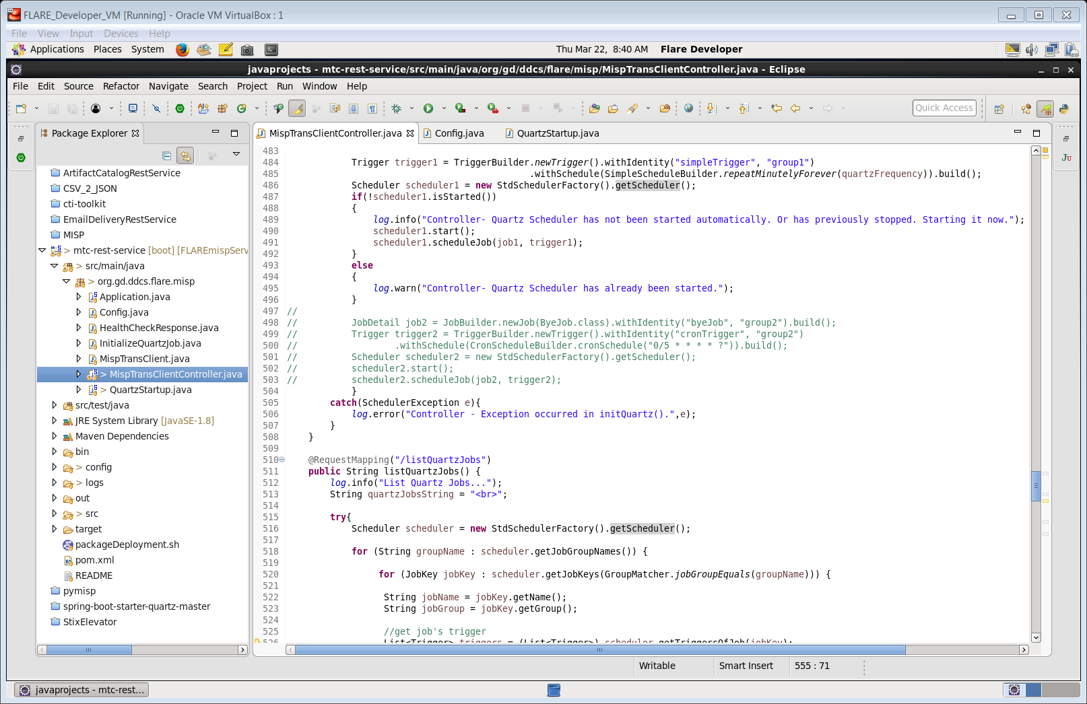
Eclipse Oxygen Interface. ‘mtc-rest-service’ === FlareMispService
MispTransCLientController.java
This is the “Controller” that handles all of the incoming
HTTP Requests for the
REST Service.
Every @RequestMapping you see represents a unique URL that this Service can respond to.
See our ACRS, and EDRS for other examples of REST Services implemented in SpringBoot.

Slide 9
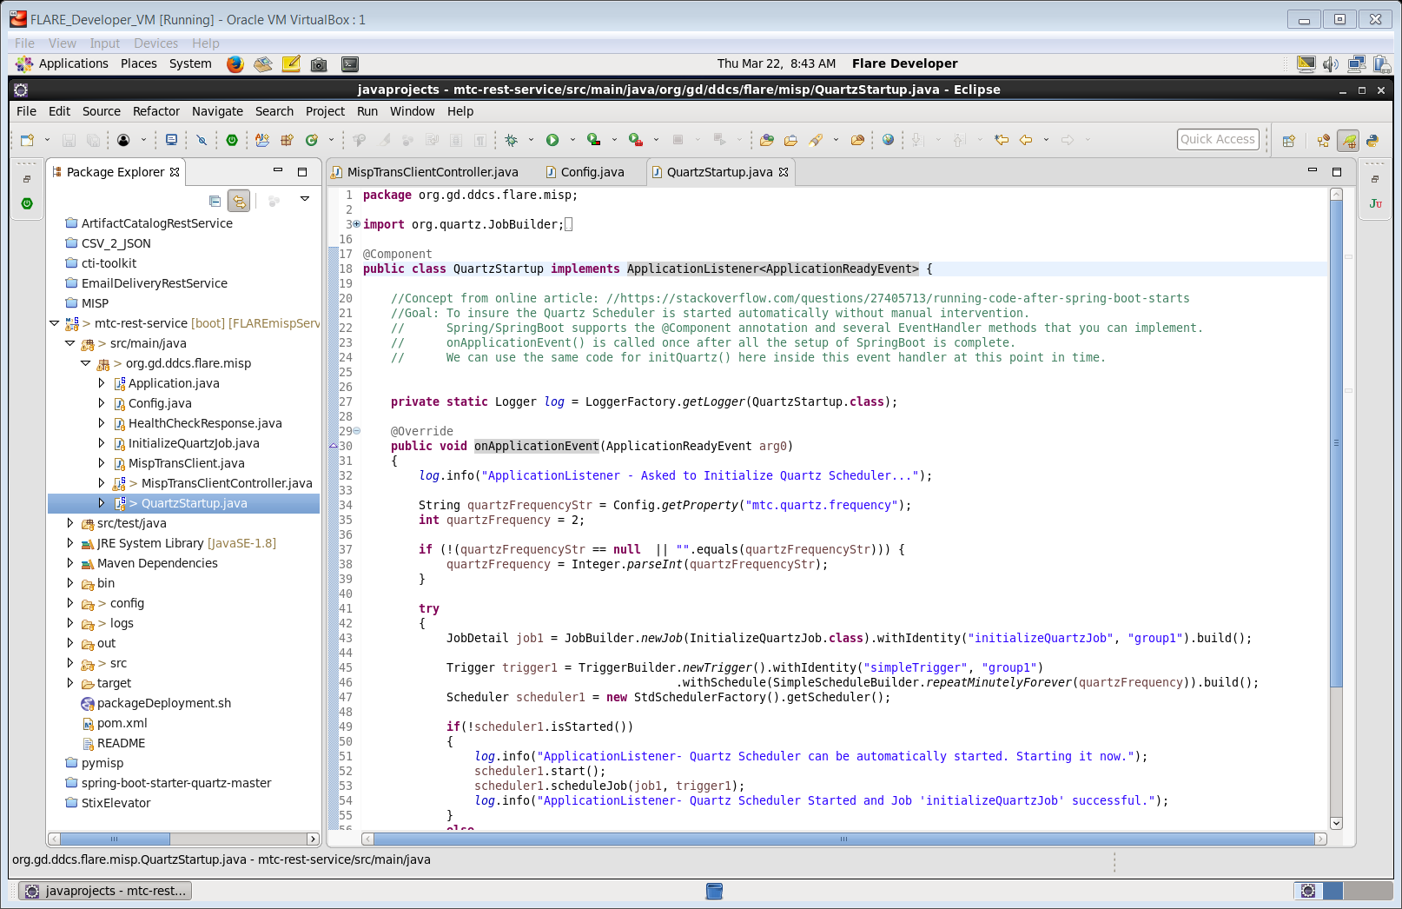
QuartStartup.java
Uses Spring Boot’s built-in Event Handlers to know when the program has been fully initialized. This is how we know when it’s safe to kick start the Quartz Scheduler.

Slide 10
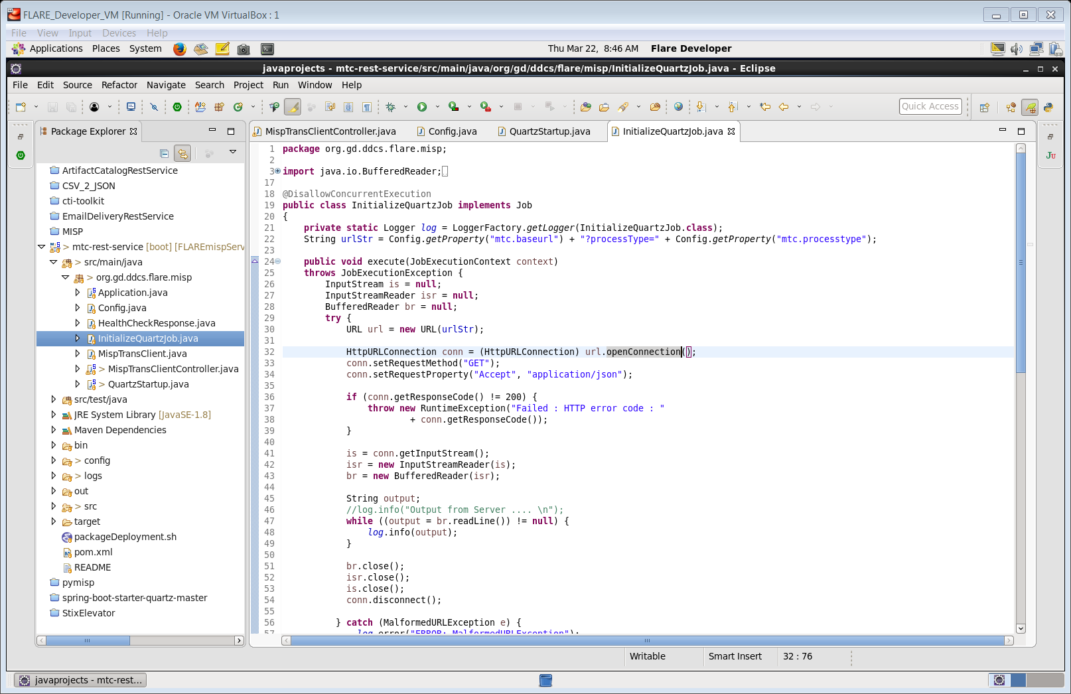
InitializeQuartzJob.java is implementing an Interface defined by the Quartz Scheduler project. ‘Job’ basically wants us to define what code must be executed when it’s time to do something.
In this case, the “Job” is always going to be generating a HTTP Request (to this same REST Service)
It will start a one-time poll via CTIToolkit, to search for STIX on the TAXI Server, convert it to MISP event and then upload it to the MISP Server.
(Assuming that ‘mtc.processtype’ config property is set to the string ‘stixToMisp’)

Slide 11
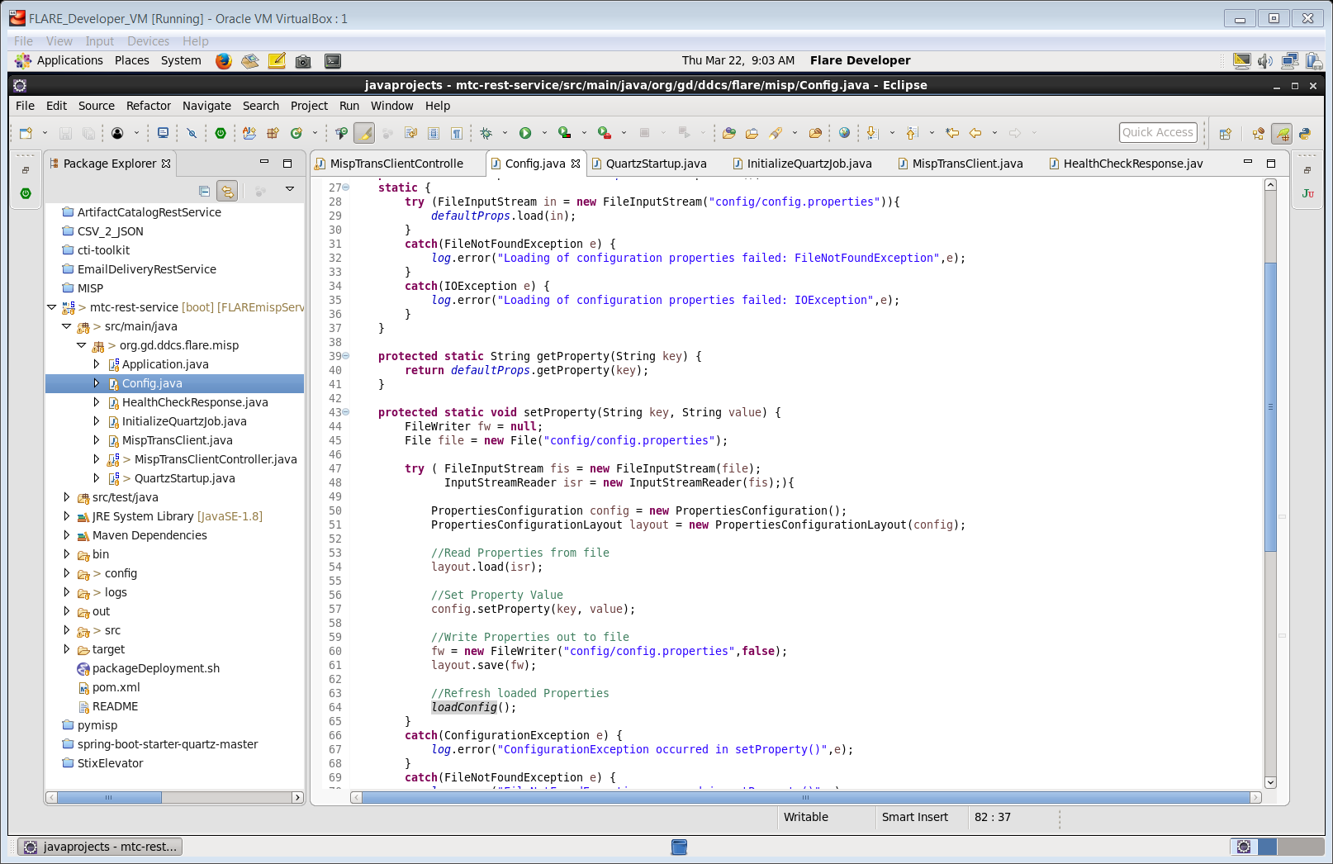
Config.java
This is not a typical implementation for how to handle Configuration Files in SpringBoot. A lot of Springboot can do ‘autowiring’ and ‘autoconfig’ for you . But you have to set it up properly.
Pay special attention to the ‘setProperty’ method because it’s not just setting values in-memory.. It’s also persiting to the file system config.properties file too.

Slide 12

Writing to file.
This is because the config.properties file is being used store the last known start/end dates for the previous successful poll.

Slide 13
The config.properties file is being used for two things… it’s a bit overly complex and could be simplified with refactoring (if time permits.)
The concern was to make sure we don’t always retrieve the same data sets from TAXI Server over and over again (especially with large data sets in Production.) So to minimize this, the only option available via CTIToolkit was to use it’s command line arguments that can specify a start and end time.
ONLY AFTER a successful retrieval from Taxi, successful conversion from Stix to MISP, and successful upload to the MISP server, will the begin/end dates in the config.properties file be updated.
This allows the application to pick up where it left off in the event of a runtime crash, system reboot, etc.
The Dates are cached in memory too. These date fields are the only ones that can’t be easily changed while the application is running. If you need to modify the begin/end dates to something else, you must stop this FlareMispService application, modify the confi.properties file, and then restart FlareMispService.
All other configuration properties can be successfully modified at runtime.
Note however, that you need to manually browse to the URL: “/refreshConfig” in order to insure that the new property values are read from the filesystem, loaded into memory, and then the Quartz Scheduler (and it’s Job(s)) are restarted in the proper order.

Slide 14
Developer Notes
Login to the server that hosts the service
cd to directory “/opt/mtc”
run the command: “runFLAREmispService.sh”
Note: since this java service uses Tomcat, the port configured for Tomcat must be available. Otherwise the application will fail to start.
If it’s already running, no other copy will start.
For example: Seen on the command line:
***************************
APPLICATION FAILED TO START
***************************
Description:
The Tomcat connector configured to listen on port 8080 failed to start.
The port may already be in use or the connector may be misconfigured.

Slide 15
Testing / Administration
Of FlareMispService

Slide 16
Tester Notes: Verify the FlareMispService is running…
If the FlareMispService is running… you should be able to get the following URLs to respond:
Verify the Quartz Scheduler is Up and Running
URL: http://localhost:8080/listQuartzJobs
﻿Quartz Jobs: [jobName] : initializeQuartzJob [groupName] : group1 - Thu Mar 22 12:30:25 EDT 2018<r>
Verify connectivity to MISP Server
URL: http://localhost:8080/checkMispStatus
﻿{"resourceType":"Misp","resource":"http://10.23.218.173","statusCode":200}
Verify connectivity to FLARE TAXI Server
URL: http://localhost:8080/checkTaxiiStatus
﻿{"resourceType":"FLARE/TAXII","resource":"https://10.23.218.172:8443","statusCode":200}
Verify the configuration property file can be loaded/reloaded
URL: http://localhost:8080/refreshConfig
<blank page result is fine>

Slide 17
Tester Notes: Verify the FlareMispService can do work…
Connect to FLARE TAXI, download any new STIX, then save as XML to temporary directory “/opt/mtc/out”
URL: http://localhost:8080/misptransclient?processType=xmlOutput
Result:
﻿{"id":5,"status":"Success","detailedStatus":"Completed sucessfully","processType":"xmlOutput","collection":"MISP","beginTimestamp":"2018-03-22T11:10:56+00:00","endTimeStamp":"2018-03-22T12:33:05+00:00"}
Connect to FLARE TAXI, convert new STIX to MISP, then upload to MISP Server
URL: http://localhost:8080/misptransclient?processType=stixToMisp
Result:
﻿{"id":7,"status":"Success","detailedStatus":"Completed sucessfully","processType":"stixToMisp","collection":"MISP","beginTimestamp":"2018-03-22T12:33:23+00:00","endTimeStamp":"2018-03-22T12:34:18+00:00"}
Login to MISP Server to verify if new MISP Events show up
URL: http://10.23.218.173/users/login
User: admin@admin.test

