Slide 1

Network Traffic Analysis with
https://github.com/idaholab/Malcolm

Slide 2
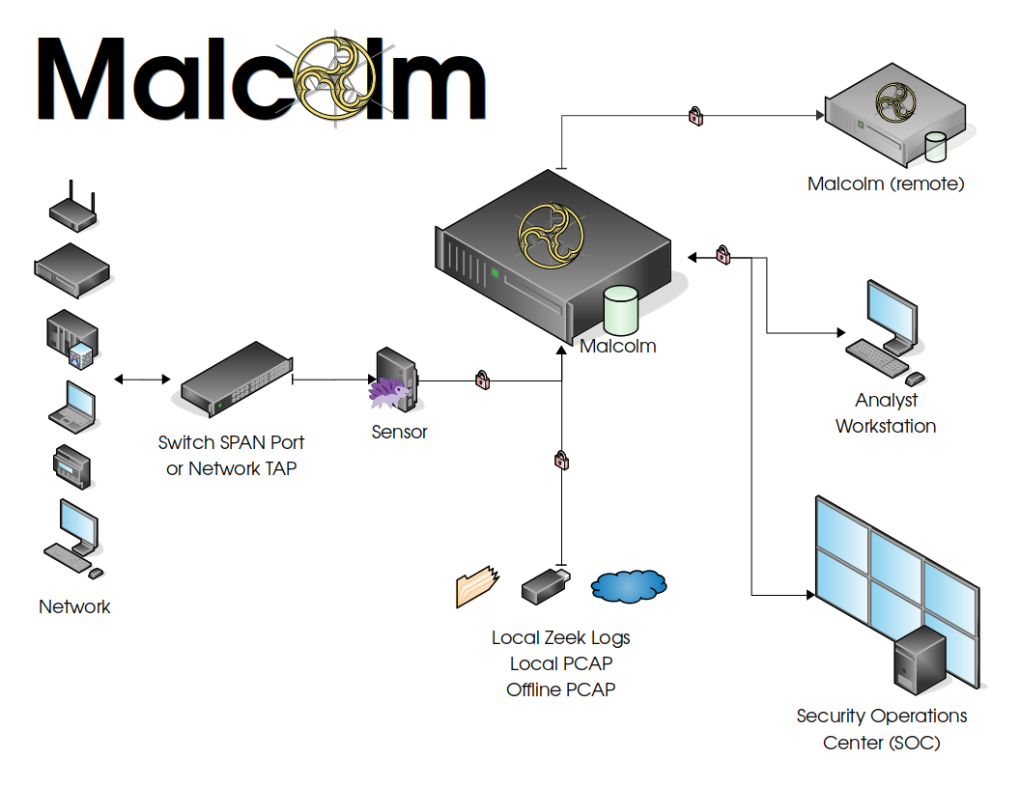
https://github.com/idaholab/Malcolm
Malcolm is a powerful, easily deployable network traffic analysis tool suite for full packet capture artifacts (PCAP files) and Zeek logs.
Notes:
Malcolm is an easily deployable collection of open source tools for network traffic analysis that aims to be “greater than the sum of its parts.” It provides a framework of interoperability for these tools (which we’ll discuss through the course of this presentation) to provide visibility into the network traffic it inspects.
Malcolm is flexible: it can be used as a standalone tool for deployments or one-off analyses, or as part of a larger long-term network deployment with dedicated network sensors, integration with domain authentication servers and forwarding collected enriched log data offsite to another Malcolm instance.
Developed at the Idaho National Lab under the direction of the US Department of Homeland Security’s CISA, Malcolm aims to give special focus to traffic found in industrial control systems networks, while still remaining useful in typical corporate IT environments.

Slide 3









Malcolm leverages industry-standard open source tools, including:
… and more!
Elastic Stack
CyberChef
Supported Protocols
Internet layer Border Gateway Protocol (BGP) Building Automation and Control (BACnet) Bristol Standard Asynchronous Protocol (BSAP) Distributed Computing Environment / Remote Procedure Calls (DCE/RPC) Dynamic Host Configuration Protocol (DHCP) Distributed Network Protocol 3 (DNP3) Domain Name System (DNS) EtherCAT EtherNet/IP / Common Industrial Protocol (CIP) FTP (File Transfer Protocol) Google Quick UDP Internet Connections (gQUIC) Hypertext Transfer Protocol (HTTP) IPsec Internet Relay Chat (IRC) Lightweight Directory Access Protocol (LDAP) Kerberos Modbus MQ Telemetry Transport (MQTT) MySQL NT Lan Manager (NTLM) Network Time Protocol (NTP) Oracle | OpenVPN PostgreSQL Process Field Net (PROFINET) Remote Authentication Dial-In User Service (RADIUS) Remote Desktop Protocol (RDP) Remote Framebuffer (RFB / VNC) S7comm / Connection Oriented Transport Protocol (COTP) Session Initiation Protocol (SIP) Server Message Block (SMB) / Common Internet File System (CIFS) Simple Mail Transfer Protocol Simple Network Management Protocol SOCKS Secure Shell (SSH) Secure Sockets Layer (SSL) / Transport Layer Security (TLS) Syslog Tabular Data Stream Telnet / remote shell (rsh) / remote login (rlogin) TFTP (Trivial File Transfer Protocol) WireGuard tunnel protocols (GTP, GRE, Teredo, AYIYA, IP-in-IP, etc.)
Common ICS protocols are listed in bold
Notes:
The components comprising Malcolm are industry-standard open source tools, which makes it easy to integrate Malcolm with other solutions in those tools’ respective ecosystems and straightforward to contribute to the project.
Malcolm’s primary components are the Elastic Stack (namely, Elasticsearch, Logstash, Kibana and Beats); the Zeek network security monitor (formerly Bro); and Arkime (formerly Moloch), a tool for large-scale indexed packet capture and search.
Malcolm can interpret network traffic across dozens of application protocols, including several protocols commonly seen in OT networks. Much of Malcolm’s development is dedicated to improving Malcolm’s coverage of protocols used by ICS devices.

Slide 4

Installation and configuration
Runs on any OS with Docker (Linux, macOS, Windows)
Alternately, Linux-based Malcolm OS can be installed on hardware or in a virtual machine
Minimum requirements: 12+ GB RAM, 4+ CPU cores, 8 GB storage + “enough” storage for traffic and logs
Read
  https://github.com/idaholab/Malcolm#QuickStart
Watch
  Malcolm Network Traffic Analysis Tool Suite
Notes:
Malcolm can be installed and run on any system that supports Docker, a containerization platform for software services. It has been tested on Linux, macOS and Microsoft Windows.
Most modern commodity hardware (including laptops, desktops and servers) are configured with the resources needed to run Malcolm. Available system memory tends to be the most crucial, with 12GB as a minimum and 16GB or more recommended.
This presentation does not cover installation and configuration of Malcolm. Please refer to the documentation and examples found at the links provided.

Slide 5
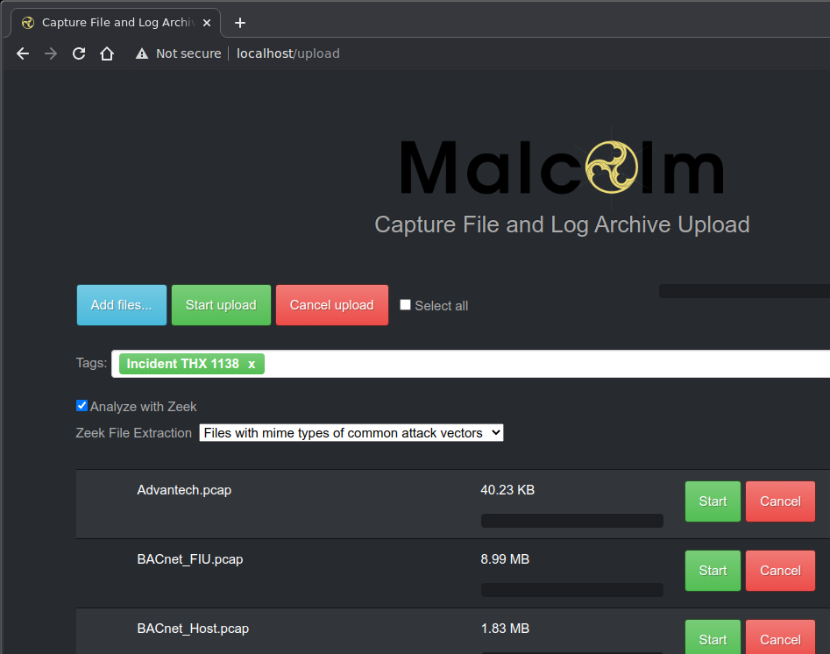
Artifact upload
https://localhost/upload once Malcolm is running*
Apply searchable tags
Enable Zeek analysis
and file extraction
  Can also be enabled in
  global defaults
Upload PCAP files
or archived Zeek logs
  pcapng not supported yet
*Links and examples assume Malcolm is accessible on localhost, YMMV depending configuration
Notes:
Once Malcolm is up and running, it must be provided with captured network traffic to interpret, index and present for analysis. While this may be accomplished by dedicated network sensors, this presentation will address the use case of previously captured network traffic artifacts: namely, PCAP files.
Malcolm’s user interfaces are accessible via web browser. PCAP files can be uploaded into Malcolm for processing by accessing /upload on the host on which Malcolm is running.
Prior to starting the upload, “tags” may be added which will allow the data from the PCAP file(s) being uploaded to be searchable using those tags later on. Other behavior relating to how the PCAP file is parsed can also be customized on this page.

Slide 6

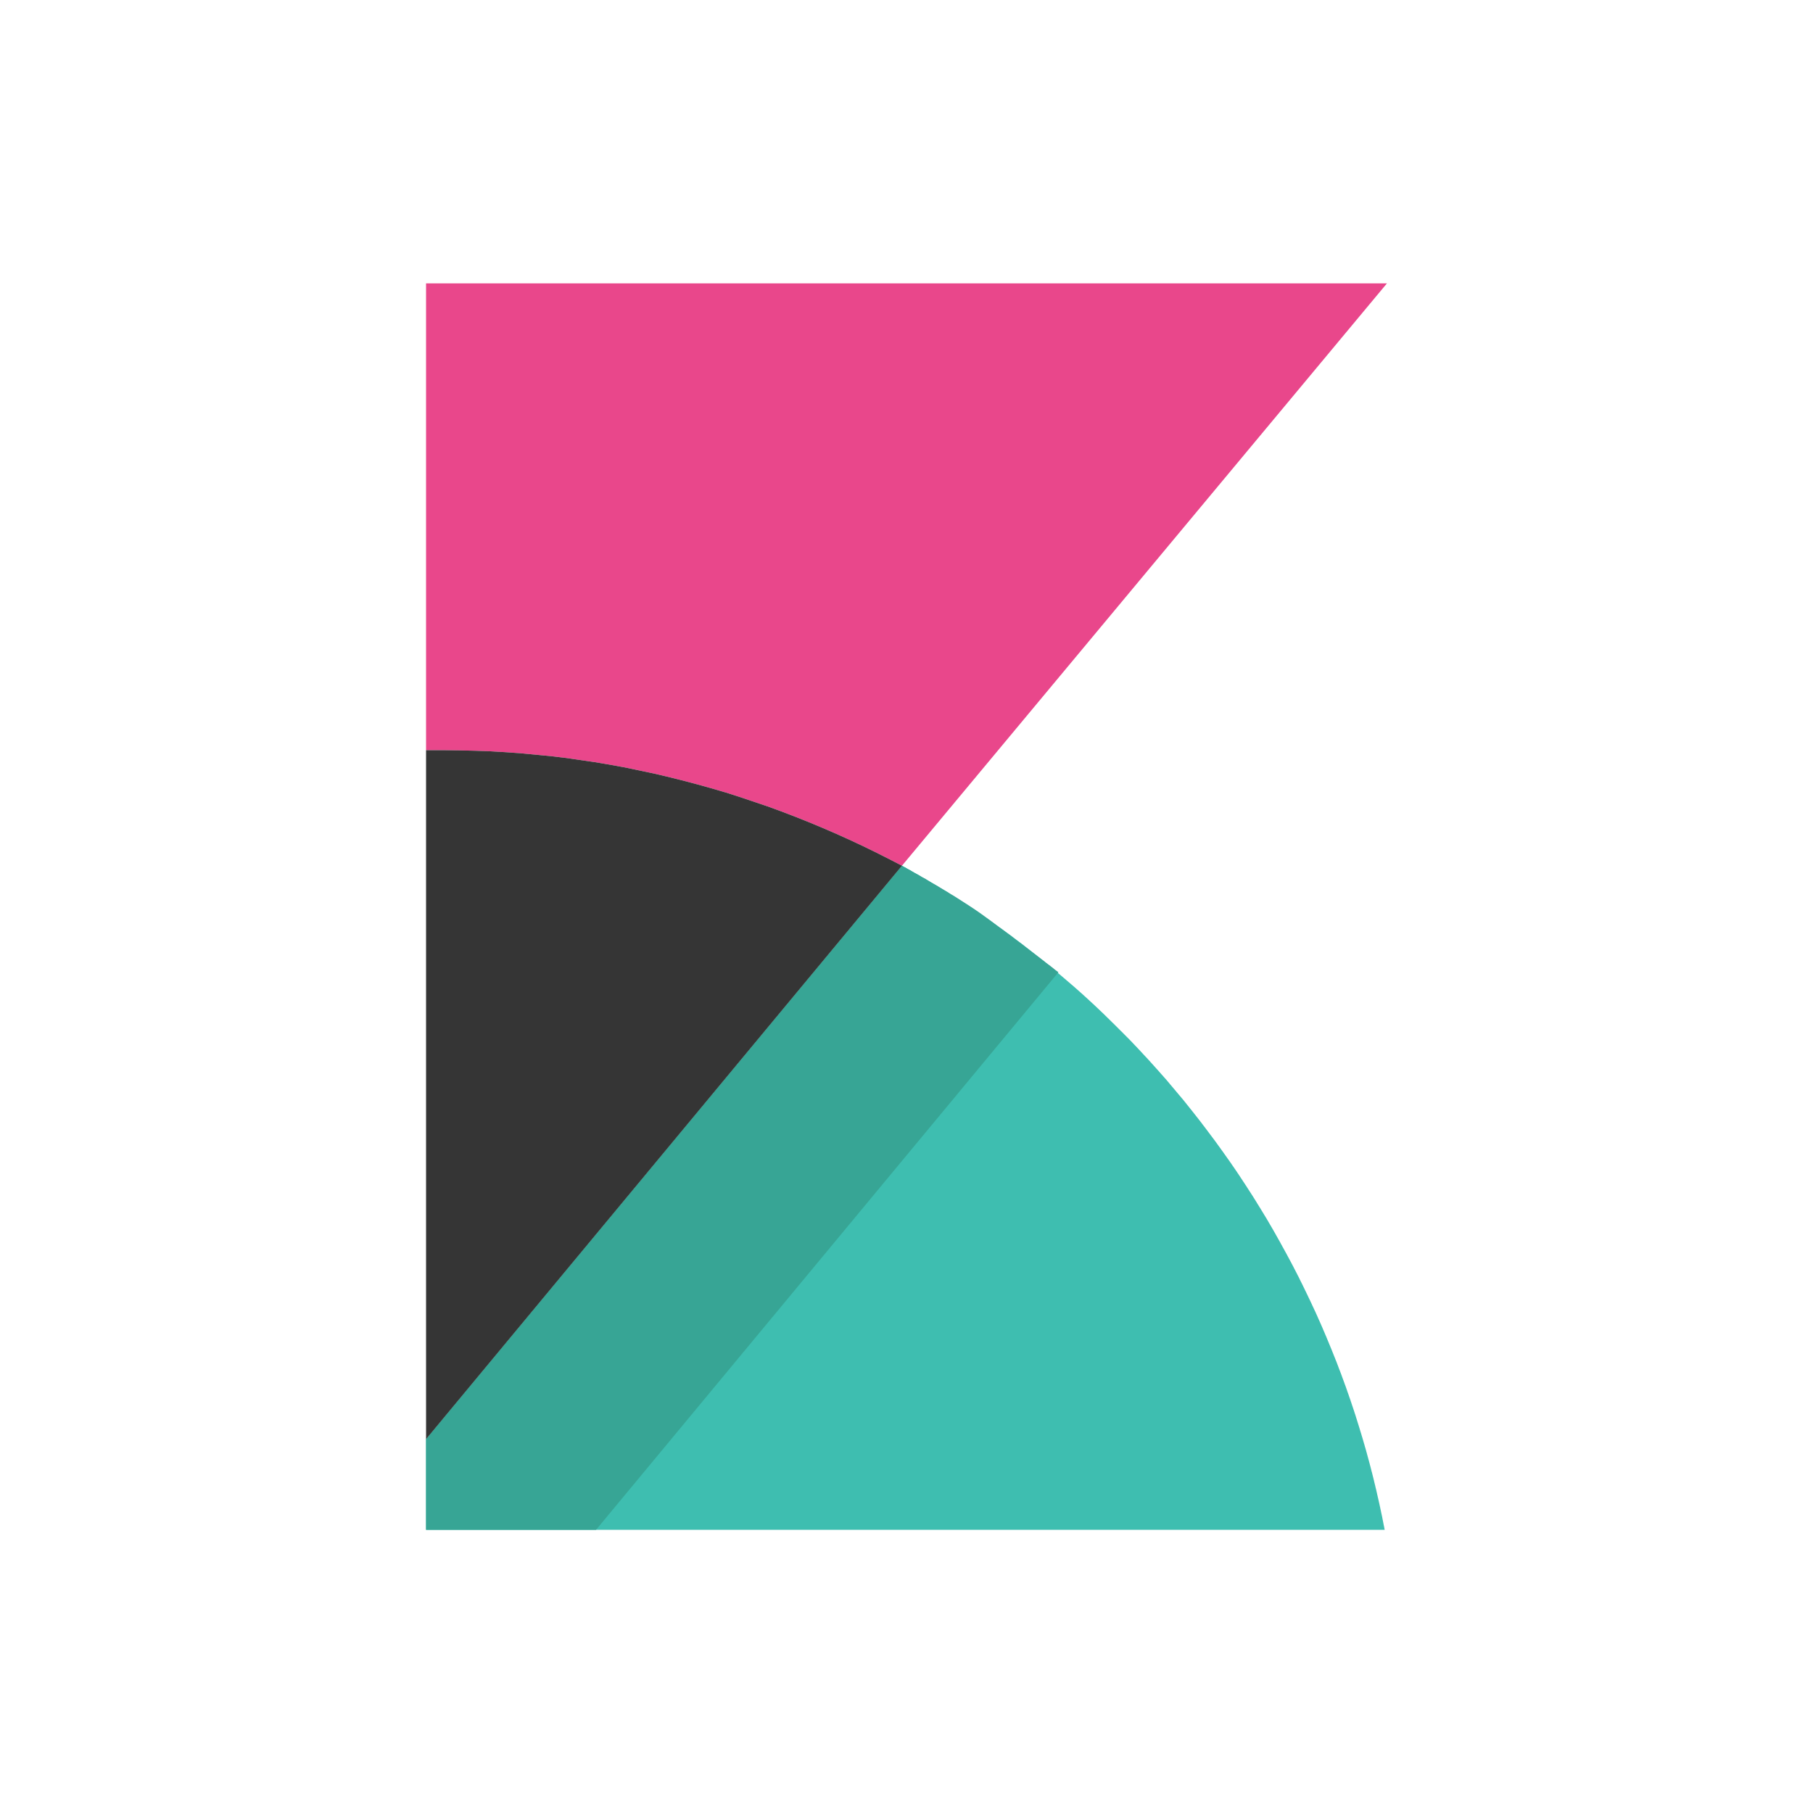




Malcolm PCAP processing pipeline
Carved File Scan
(hash- or signature-based)
Kibana
Analyst
Zeek
Logstash
(parsing & enrichment)
Filebeat
Elasticsearch
PCAP upload
Arkime Viewer
Arkime capture
Local Zeek Logs
Local PCAP
Offline PCAP
Local Zeek Logs
Local PCAP
Offline PCAP
Notes:
An uploaded PCAP file goes through several steps on its way to becoming enriched, indexed and user-searchable.
Upon upload, Malcolm generates metadata for the network traffic represented in a PCAP file using both Zeek and moloch-capture.
Arkime’s moloch-capture aggregates metadata for a particular network connection into what it calls a “session” record, which written to Elasticsearch for indexing.
Zeek generates several log files, primarily broken out by application protocol, which contains metadata similar to that generated by moloch-capture. Malcolm can also leverage Zeek’s ability to “carve” out files transferred over the network. These files can be scanned (for example, by an antivirus tool) or preserved for analysis with external tools. The Zeek logs are forwarded by Filebeat to Logstash for further enrichment, normalized to the same field schema as the corresponding Arkime sessions and then indexed into Elasticsearch.
Once ingested by Elasticsearch, Malcolm provides two interfaces for visualizing network traffic: Kibana and Arkime Viewer.

Slide 7
Log enrichment
Logstash enriches Zeek log data
  MAC addresses to hardware vendor
  GeoIP and ASN lookups
  Internal/external traffic based on IP ranges
  Reverse DNS lookups
  DNS query and hostname entropy analysis
  Connection fingerprinting (JA3 for TLS, HASSH for SSH, Community ID for flows)
Notes:
Before taking a harder look at the Kibana and Arkime UIs, let’s talk a moment about fields Logstash can use to enrich log data before it is written to the database.
MAC addresses are mapped to hardware manufacturers where possible (to indicate, for example, whether a device was manufactured by Schneider Electric, Schweitzer Engineering or Rockwell Automation)
GeoIP, ASN and (optionally) reverse DNS lookups are performed for routable IP addresses
Character frequency analysis is performed for DNS responses and some other hostnames to detect DGA (domain generation algorithm) hostnames often used by malware
Community-standard fingerprinting algorithms are applied where applicable to allow Malcolm’s data to be cross-referenced with other tools

Slide 8
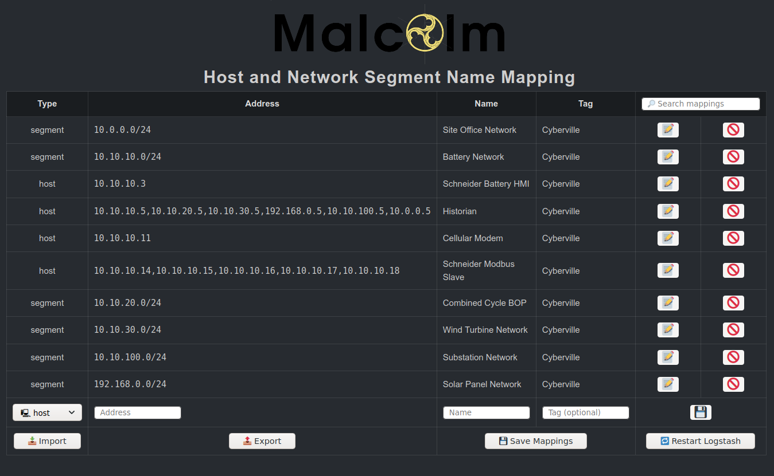
Custom host and subnet name assignment
https://localhost/name-map-ui
Assign
custom names
to network
hosts and
segments
Notes:
The Host and Network Segment Name Mapping interface allows you to assign names for network segments and hosts based on IP and/or MAC addresses in Zeek logs.
As Zeek logs are processed into Malcolm's Elasticsearch instance, the log's source and destination IP and MAC address fields (zeek.orig_h, zeek.resp_h, zeek.orig_l2_addr, and zeek.resp_l2_addr, respectively) are compared against the list of “host” addresses provided. When a match is found, a new field is added to the log: zeek.orig_hostname or zeek.resp_hostname, depending on whether the matching address belongs to the originating or responding host. For traffic matching the list of “segment” addresses provided, zeek.orig_segment and zeek.resp_segment fields are added. If both zeek.orig_segment and zeek.resp_segment are added to a log, and if they contain different values, the tag cross_segment will be added to the log's tags field for convenient identification of cross-segment traffic.
If the "required tag" field is specified, a log must also contain that value in its tags field in addition to matching the IP or MAC address specified in order for the corresponding name assignment to be made.

Slide 9
Kibana
https://localhost/kibana
Front end for enriched Zeek logs
Search with Kibana Query Language or Lucene Query Syntax
Dashboards
  Overviews: Overview, Security Overview, ICS/IoT Security Overview, Connections, Actions and Results, Files, Executables, Software, Notices, Weird and Signatures
  Protocol-specific: prebuilt for all protocols Malcolm understands
  WYSIWYG editors to create custom visualizations and dashboards
  Great for drilling down from high-level trends of network traffic to specific items of interest
Notes:
Kibana is one of Malcolm’s two user interfaces for visualizing log data.
Where Kibana really shines is in providing intuitive interactive representations of log data that simplify the process of recognizing and narrowing in on important network events: starting from a high-level overview and being able to quickly “drill-down” to the traffic of an individual host or connection of interest.
Malcolm comes with dozens of prebuilt visualizations specifically for data ingested from Zeek logs. Its dashboards fall into two categories: overview dashboards and protocol-specific dashboards. We’ll review some of these in a moment.
Aside from its prebuilt offerings, Kibana provides an easy drag-and-drop WYSIWYG editor for creating new visualizations on the fly.

Slide 10
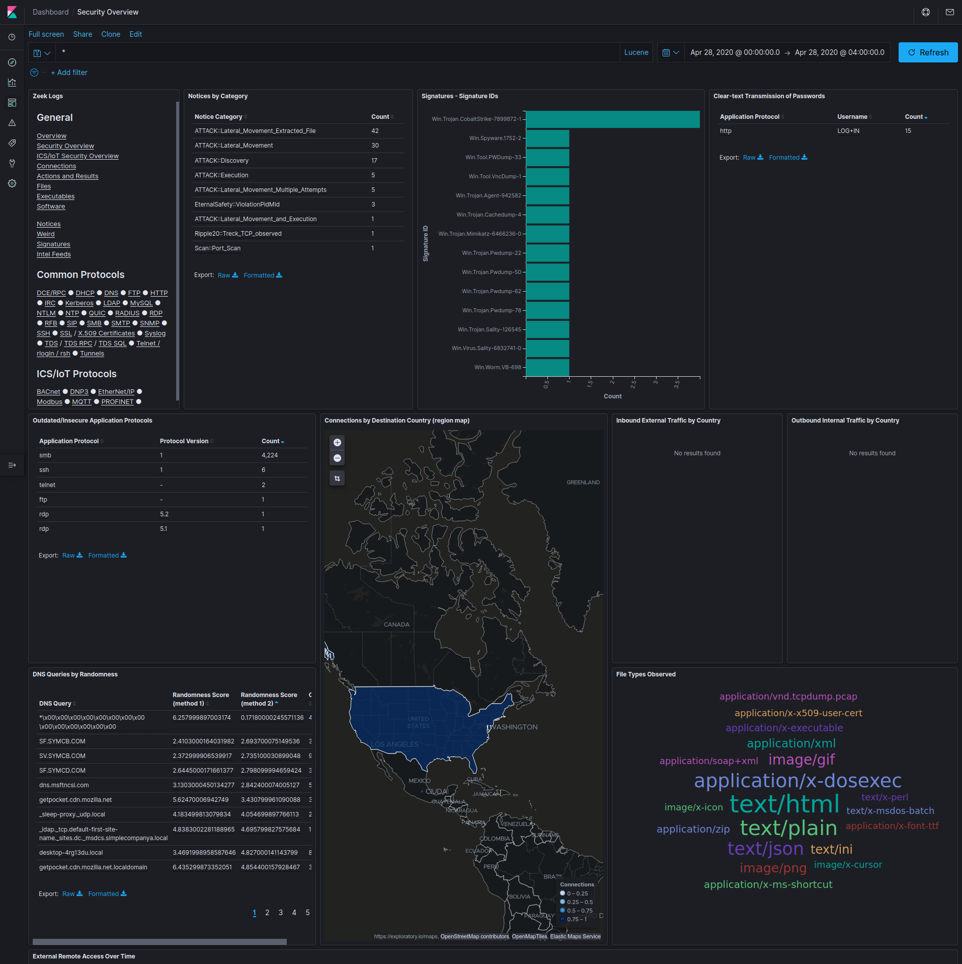
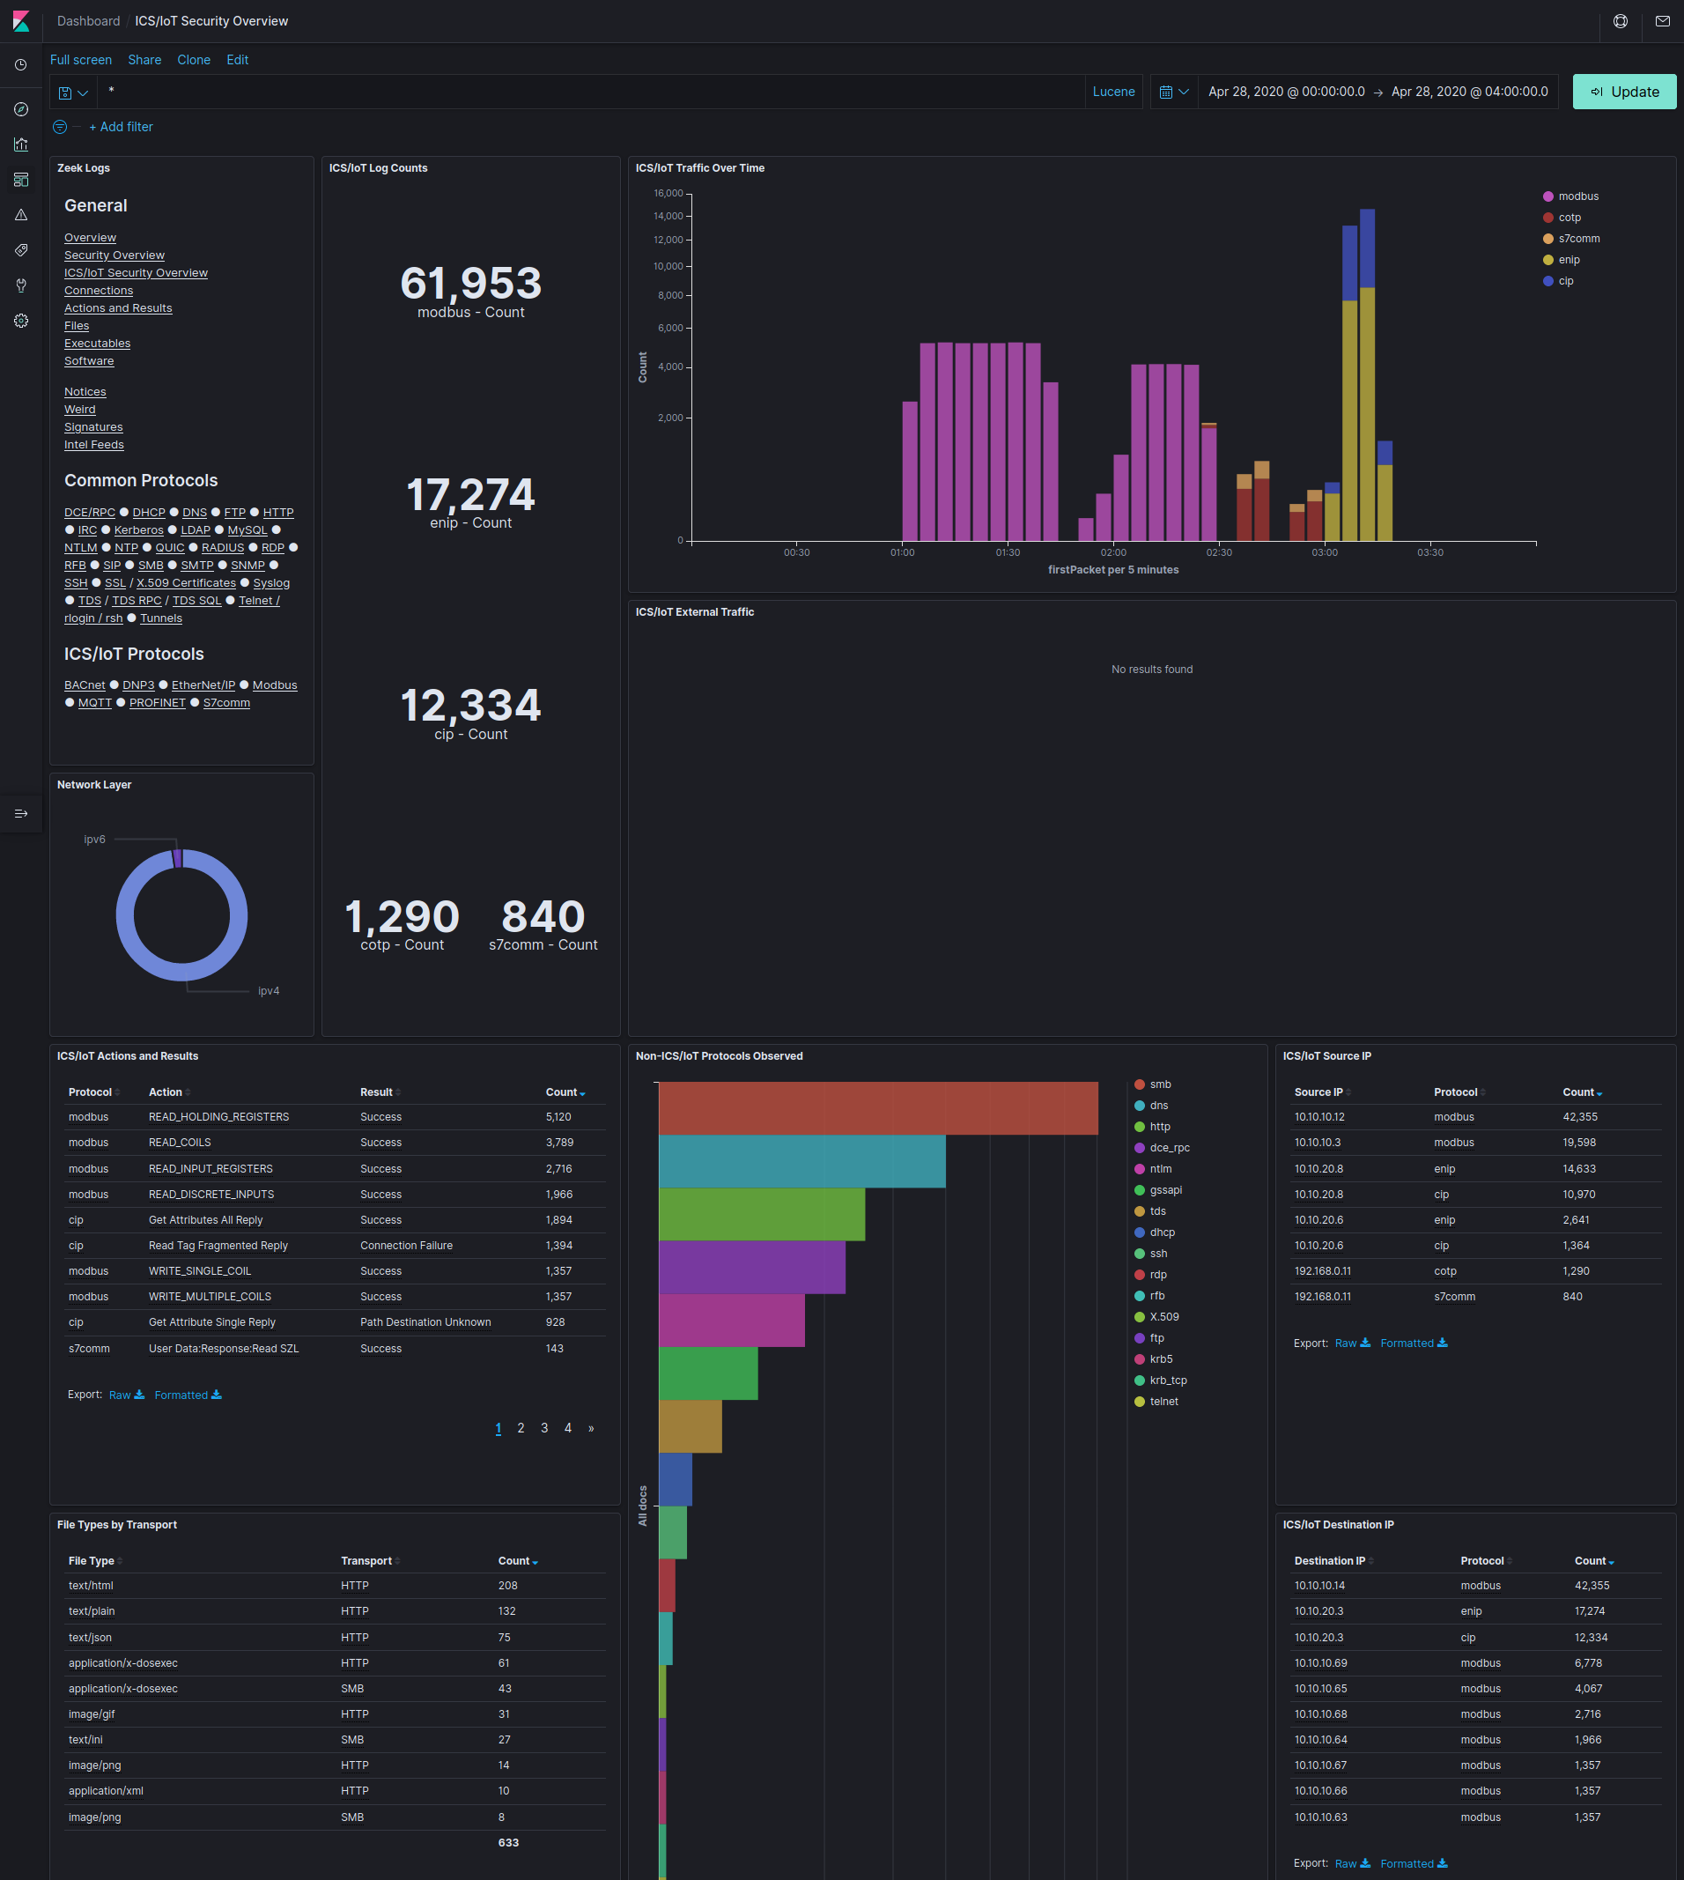
Kibana: Security & ICS/IoT Security Overview
Notes:
The Security Overview and ICS/IoT Security Overview dashboards highlight events that may be of particular interest from a security standpoint, including Zeek notices, signatures triggered from file scans, clear-text transmission of passwords, outdated or insecure versions of application protocols, traffic originating from or directed to public IP addresses, file transfers and more. These dashboards are a good place to start when looking for indicators of compromise or vulnerabilities in network traffic.

Slide 11
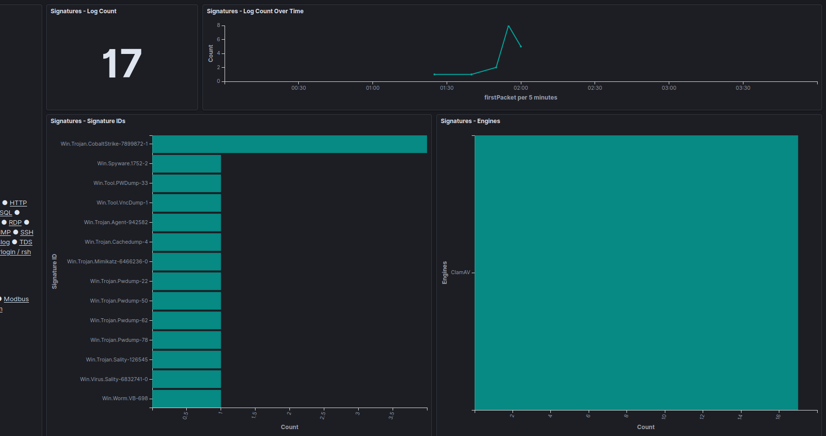
Kibana: Signatures
Reports hits from file scanning engines (e.g., ClamAV) against files carved from network traffic
Notes:
If Zeek file carving is enabled, questionable files will be written to the signatures log and reported in the signatures dashboard.
The Zeek connection UID (zeek.uid) and file UID (zeek.fuid) fields in these logs can be used to cross reference to other visualizations to provide the context for how file was transferred.
In addition to being reported in the signatures log, Malcolm can be configured to preserve files carved from network traffic (either all files or just suspicious ones) for further examination.

Slide 12
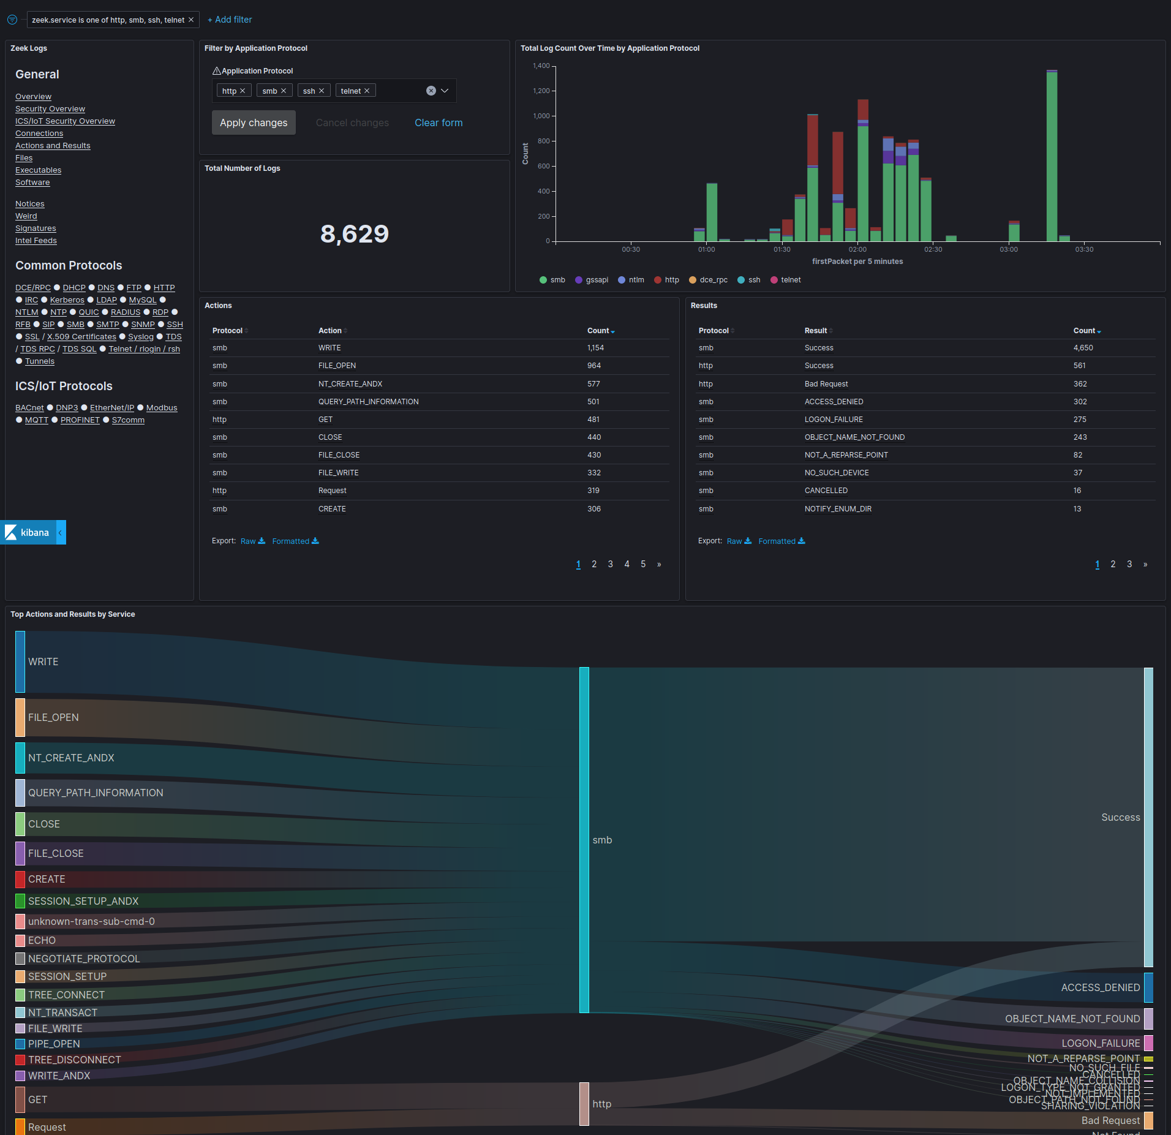
Kibana: Actions and Results
Malcolm normalizes “action” (e.g., write, read, create file, logon, logoff, etc.) and “result” (e.g., success, failure, access denied, not found) across protocols
Notes:
Where possible, Malcolm correlates common fields from across different protocols to allow you to view one device’s or application’s network traffic in the context of the other traffic occurring around it.
A good example of this is the Actions and Results dashboard, in which actions (such as “a file was written,” “a logon was attempted,” “a web page was requested”) and “results” (“success,” “access denied,” “page not found”) can be inspected together regardless of protocol.
For example, multiple failed HTTP authentication attempts, followed by a successful authenticated HTTP POST operation followed by successful reads and writes to a file server could indicate that a foothold was obtained in an HTTP server that allowed an adversary to pivot to another service in the network.

Slide 13
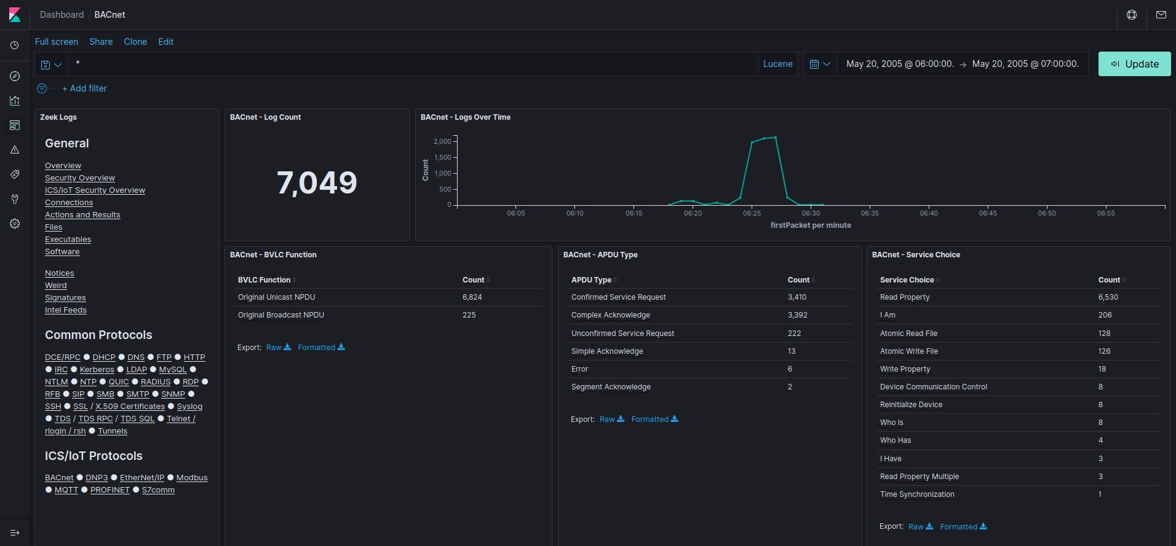
Kibana: ICS protocol dashboards
BACnet
Notes:
In addition to the overview dashboards, Malcolm provides dozens of dashboards tailored to specific application protocols, including protocols commonly used in industrial control systems networks.

Slide 14
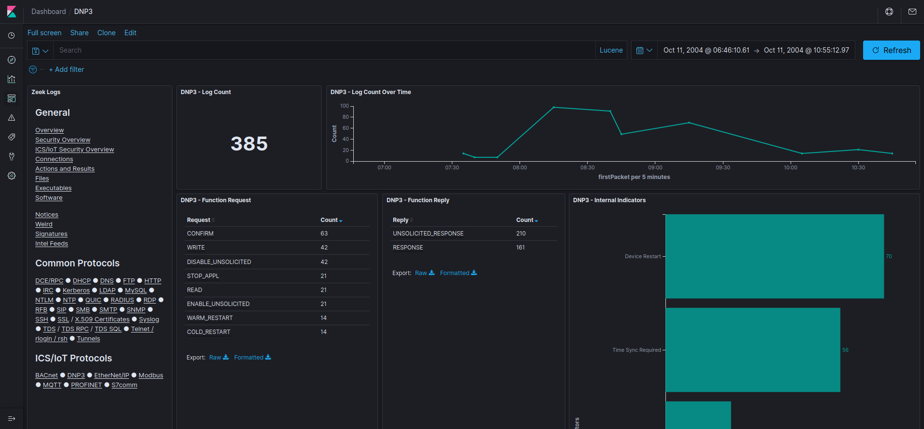
Kibana: ICS protocol dashboards
DNP3

Slide 15
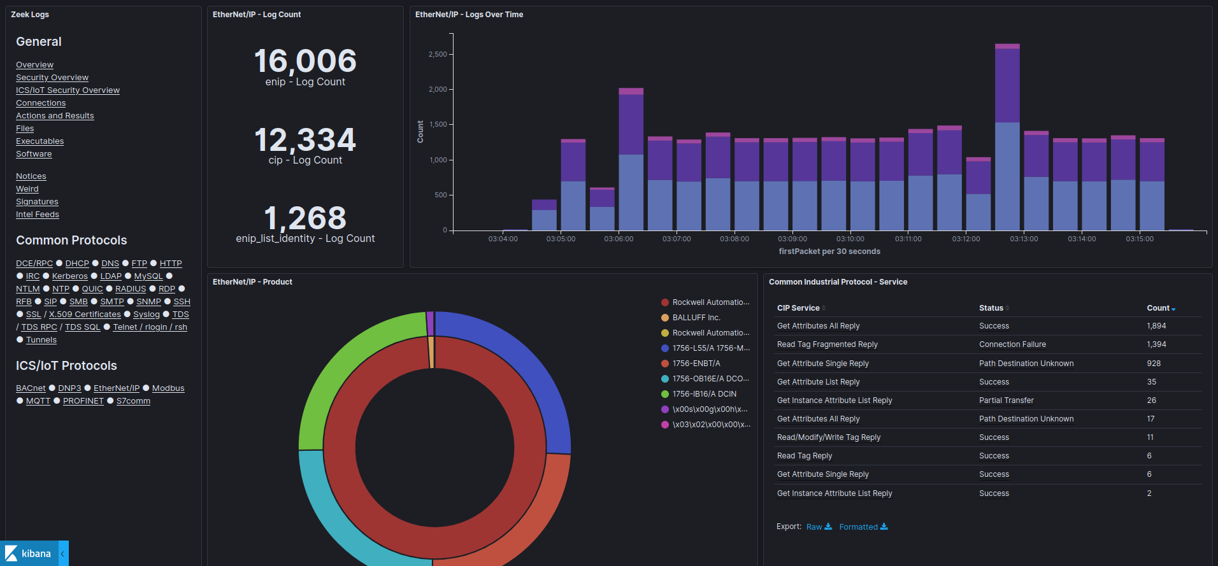
Kibana: ICS protocol dashboards
EtherNet/IP

Slide 16
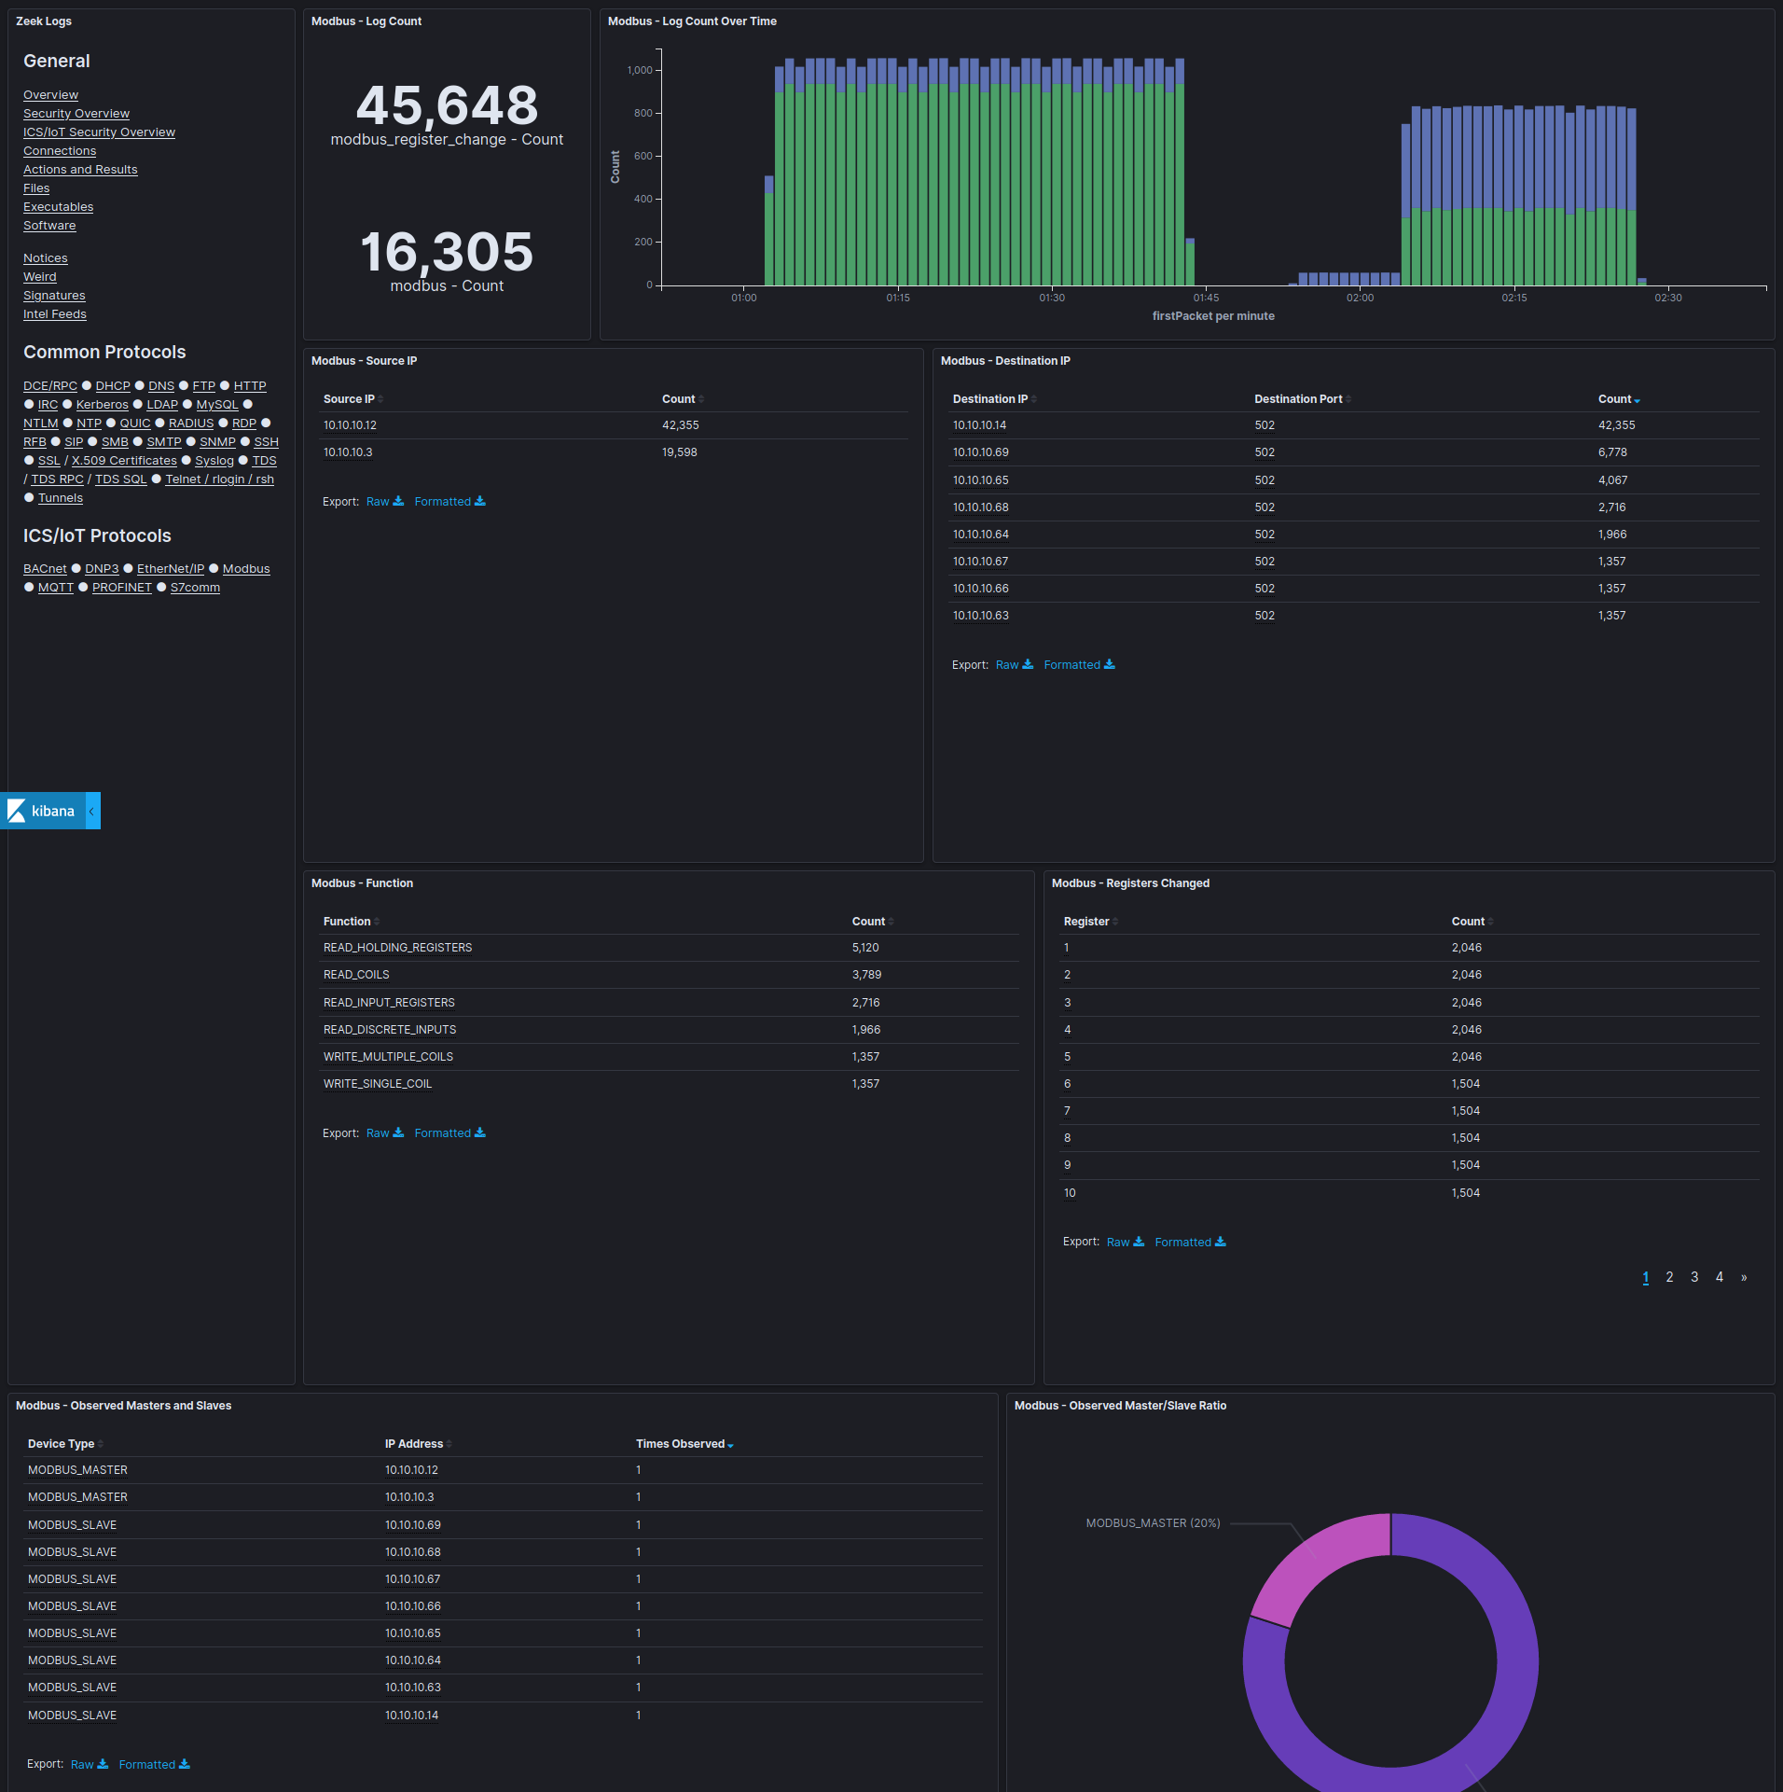
Kibana: ICS protocol dashboards
Modbus

Slide 17
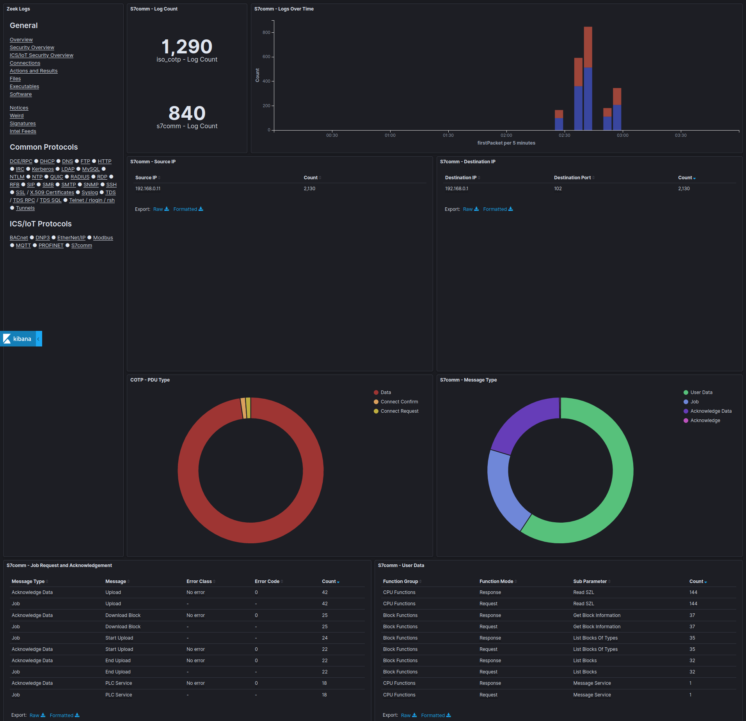
Kibana: ICS protocol dashboards
S7comm

Slide 18
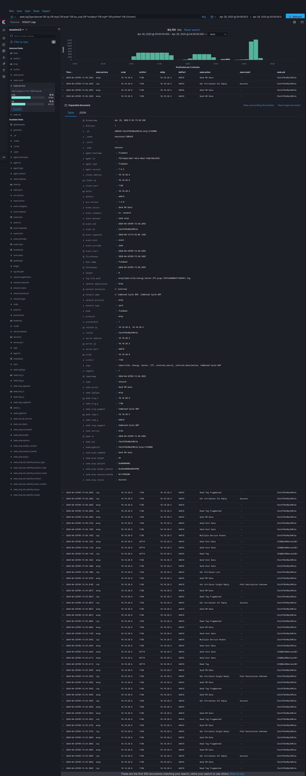
Kibana
Discover
  Field-level details
  of logs matching
  filter criteria
  Create and view
  saved searches
  View other events
  just before and
  after an event
Notes:
The Discover view enables you to view events on a record-by-record basis, similar to a session record in Arkime, which we’ll discuss in a moment, or to an individual line from a Zeek log.
The data table in the Discover view can be customized to display only the fields relevant to the traffic you’re interested in: for example, a “play-by-play” of an HTTP session could be reviewed by filtering on zeek.logType:http, sorting by Time and including the following fields in the table:
srcIp
zeek_http.user_agent
zeek_http.referrer
dstIp
zeek_http.host
zeek_http.uri
zeek_http.status_msg
This configuration could be stored as a saved search and returned to for future investigation.

Slide 19
Arkime
https://localhost/
Front end for both enriched Zeek logs
and Arkime sessions
Filter by Zeek logs or Arkime sessions; or, view both data sources together
“Wireshark at scale”: full PCAP availability for viewing packet payloads, exporting filtered and joined PCAP sessions and running deep-packet searches
Notes:
While Kibana is great for “at-a-glance” views and for creating custom visualizations, Arkime (formerly Moloch) provides another interface for examining network traffic that may be better suited to in-depth analysis and network forensics.
Earlier when we talked about the Malcolm PCAP processing pipeline, we mentioned two metadata representations of the same network traffic: the logs generated by Zeek and the session records generated by Arkime’s moloch-capture. While Malcolm’s Kibana dashboards are focused on the Zeek logs, its instance of Arkime can be used to view both Zeek logs and Arkime sessions together in the same interface.
Another strength of Arkime is its ability to tie the session metadata back to the original packets’ payloads, allowing you to view, search and export the data deeper in the PCAP that may not be referenced in the metadata. Arkime is able to efficiently deal with very large PCAP file sets, something that Wireshark struggles to do.

Slide 20
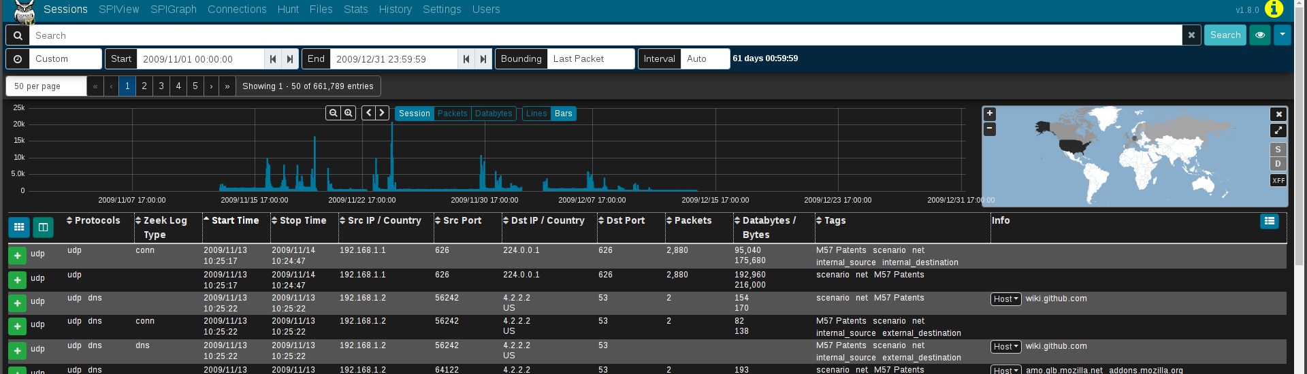
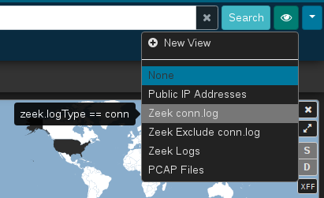
Arkime: Sessions
Field-level details of sessions/logs matching filters
Views: overlay saved filters on
current search
  E.g., show Arkime sessions vs.
  Zeek logs
Notes:
Arkime’s Sessions tab provides low-level details of the sessions being investigated (similar to Kibana’s Discover interface), whether they be Arkime sessions created from PCAP files or Zeek logs mapped to the Arkime session database schema.
The Sessions interface has various controls for applying time, geographic and field value filters to narrow the set of matching sessions.
The set of fields present in the sessions table can be customized, saved and later recalled. In addition, Arkime’s views (indicated by the eyeball 👁 icon) allow overlaying additional previously-specified filters onto the current sessions filters. For convenience, Malcolm provides several Arkime preconfigured views including several on the zeek.logType field.

Slide 21
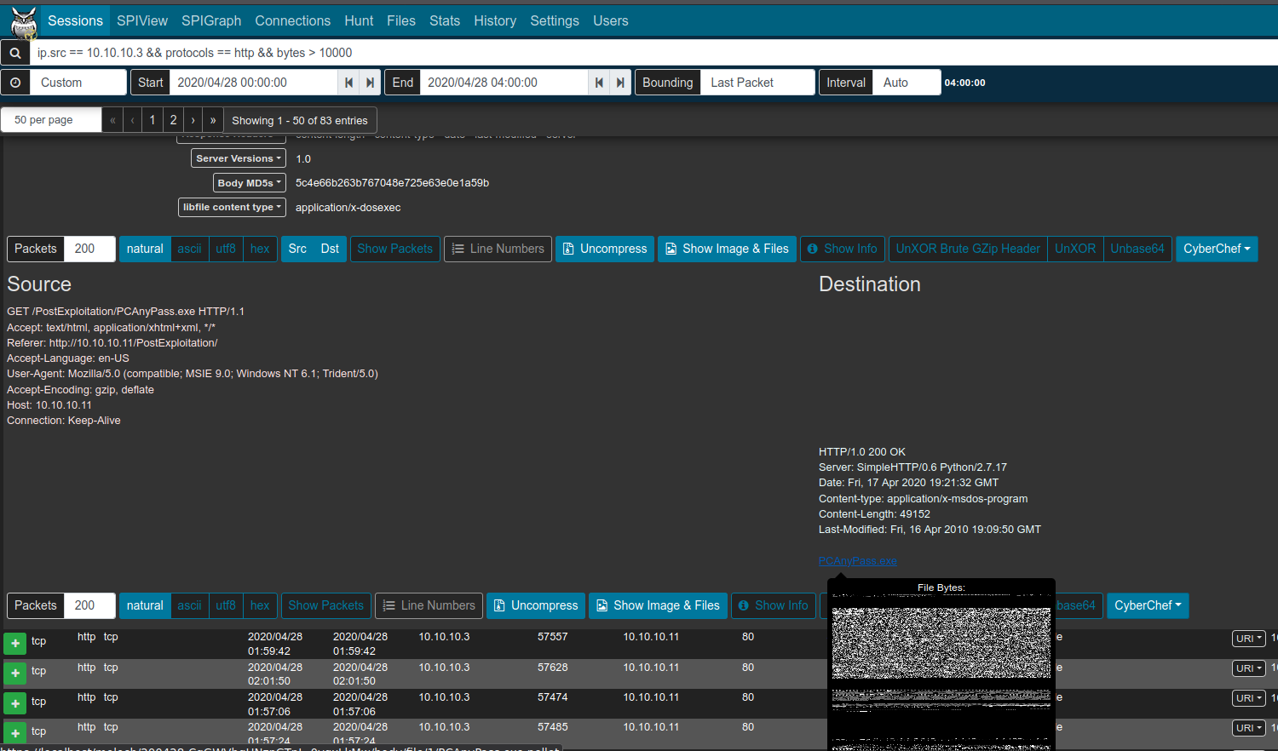
Arkime: Packet payloads
Displayed for Arkime sessions with full PCAP
File carving on the fly
Download session
PCAP
Examine payload
with CyberChef
Notes:
As mentioned, Arkime’s ability to tie a session record back to its original packet(s) is one of its greatest strengths. Details for individual sessions/logs can be expanded by clicking the plus ➕ icon on the left of each row. For Arkime session records, an additional Packets section will be visible underneath the metadata sections. When the details of a session of this type are expanded, Arkime will read the packet(s) comprising the session for display here. Various controls can be used to adjust how the packet is displayed (enabling natural decoding and enabling Show Images & Files may produce visually pleasing results), and other options (including PCAP download, carving images and files, applying decoding filters, and examining payloads in CyberChef) are available.

Slide 22
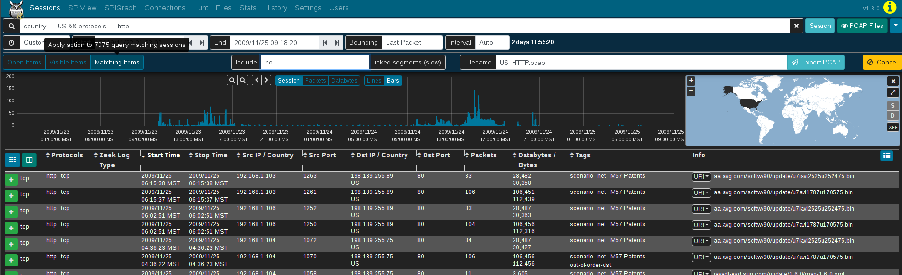
Arkime: PCAP Export
Creates a new PCAP file from filtered sessions
Include open, visible or all matching sessions
Apply “PCAP Files” view to sessions first
Narrow as much as possible prior to exporting (huge PCAP files are a pain)
Notes:
Clicking the down arrow ▼ icon to the far right of the search bar presents a list of actions including PCAP Export. When full PCAP sessions are displayed, the PCAP Export feature allows you to create a new PCAP file from the matching Arkime sessions, including controls for which sessions are included (open items, visible items, or all matching items) and whether or not to include linked segments. Click Export PCAP button to generate the PCAP, after which you'll be presented with a browser download dialog to save or open the file. Note that depending on the scope of the filters specified this might take a long time (or, possibly even time out).

Slide 23
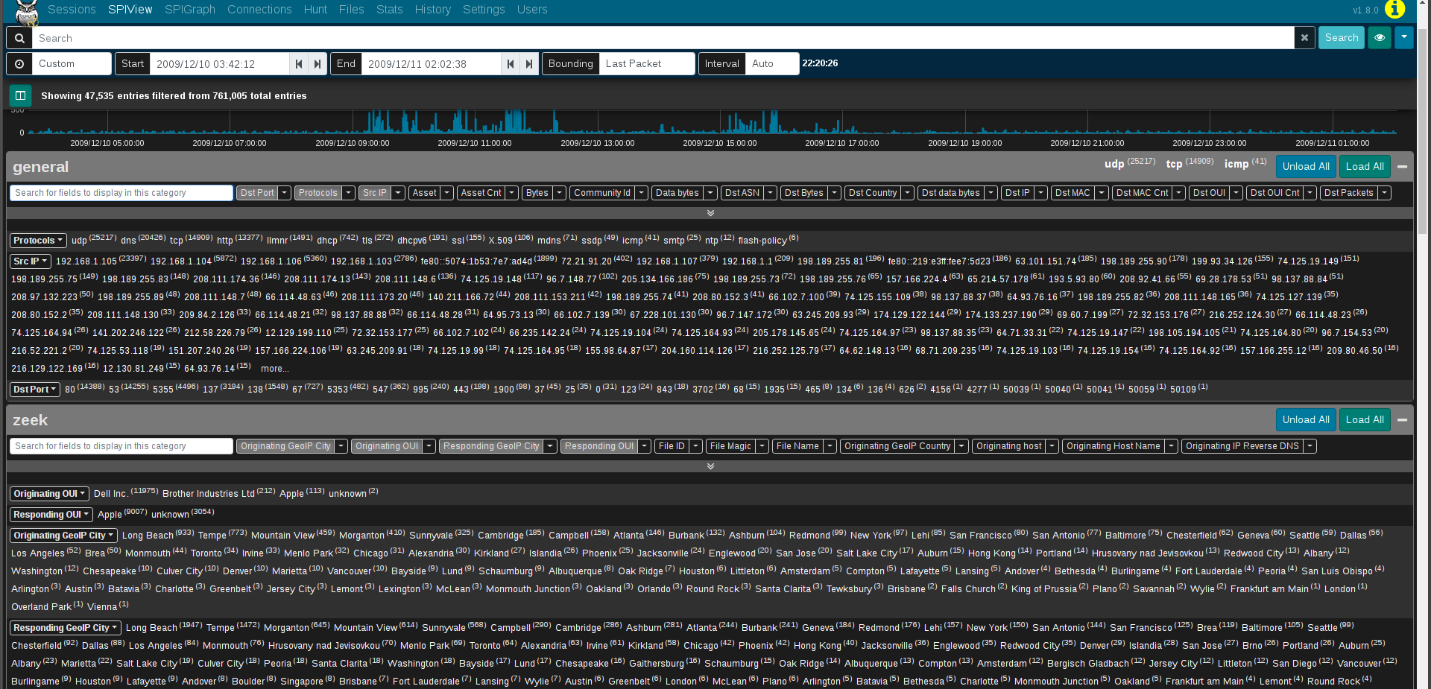
Arkime: SPIView
Explore “top n” and field cardinality for all fields of both Arkime sessions and Zeek logs
Apply filters or pivot to Sessions or SPIGraph view for field values of interest
Limit search
to ≤ 1 week
before using
as it runs
many queries
Notes:
Arkime's SPI (Session Profile Information) View provides a quick and easy-to-use interface for exploring session/log metrics. The SPIView page lists categories for general session metrics (e.g., protocol, source and destination IP addresses, sort and destination ports, etc.) as well as for all of various types of network understood by Arkime and Zeek. These categories can be expanded and the top n values displayed, along with each value's cardinality, for the fields of interest they contain.
Click the the plus ➕ icon to the right of a category to expand it. The values for specific fields are displayed by clicking the field description in the field list underneath the category name. The list of field names can be filtered by typing part of the field name in the Search for fields dialog to display in this category text input. The Load All and Unload All buttons can be used to toggle display of all of the fields belonging to that category. Once displayed, a field's name or one of its values may be clicked to provide further actions for filtering or displaying that field or its values. Of particular interest may be the Open [fieldname] SPI Graph option when clicking on a field's name. This will open a new tab with the SPI Graph populated with the field's top values.
Note that because the SPIView page can potentially run many queries, SPIView limits the search domain to seven days (in other words, seven indices, as each index represents one day's worth of data). When using SPIView, you will have best results if you limit your search time frame to less than or equal to seven days.

Slide 24
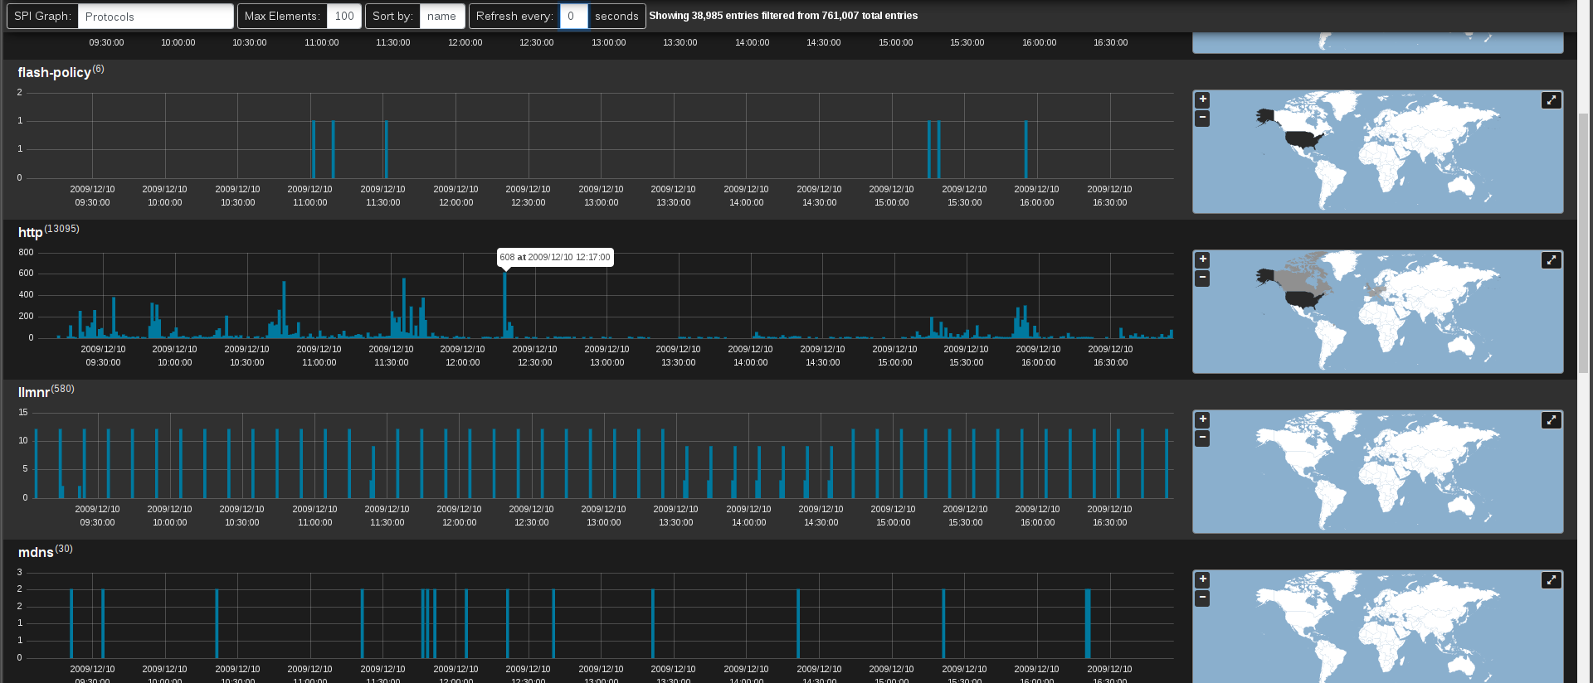
Arkime: SPIGraph
View “top n” field values chronologically and geographically
Identify trends and patterns in network traffic
Notes:
Arkime's SPI (Session Profile Information) Graph visualizes the occurrence of some field's top n values over time, and (optionally) geographically. This is particularly useful for identifying trends in a particular type of communication over time: traffic using a particular protocol when seen sparsely at regular intervals on that protocol's date histogram in the SPIGraph may indicate a connection check, polling, or beaconing (for example, see the llmnr protocol in the screenshot).
Controls can be found underneath the time bounding controls for selecting the field of interest, the number of elements to be displayed, the sort order, and a periodic refresh of the data.

Slide 25
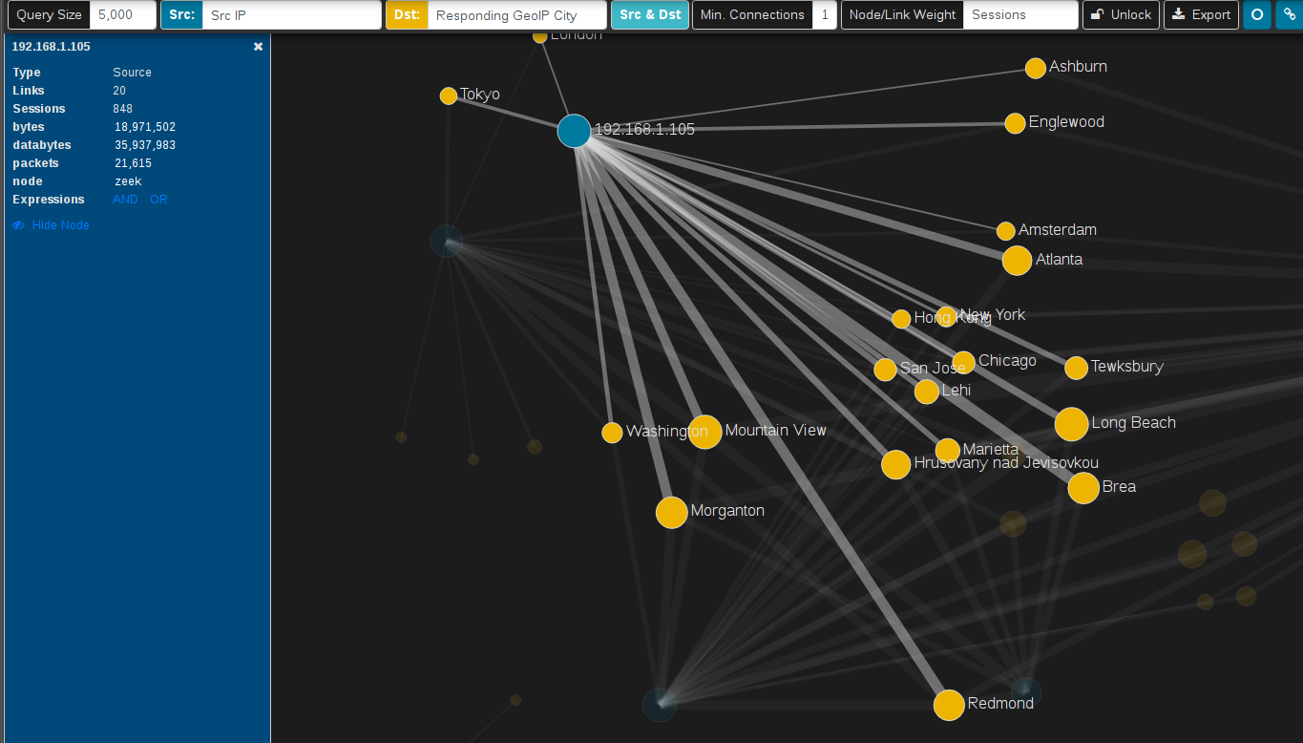
Arkime: Connections
Visualize logical relationship between hosts
Use any combination of fields for source and dest. nodes
Compare current vs. baseline traffic
Notes:
The Connections page presents network communications via a force-directed graph, making it easy to visualize logical relationships between network hosts.
Controls are available for specifying the query size (where smaller values will execute more quickly but may only contain an incomplete representation of the top n sessions, and larger values may take longer to execute but will be more complete), which fields to use as the source and destination for node values, a minimum connections threshold, and the method for determining the "weight" of the link between two nodes. As is the case with most other visualizations in Arkime, the graph is interactive: clicking on a node or the link between two nodes can be used to modify query filters, and the nodes themselves may be repositioned by dragging and dropping them. A node's color indicates whether it communicated as a source/originator, a destination/responder, or both.
While the default source and destination fields are Src IP and Dst IP:Dst Port, the Connections view is able to use any combination of any of the fields populated by Arkime and Zeek. For example:
Src OUI and Dst OUI (hardware manufacturers)
Src IP and Protocols
Originating Network Segment and Responding Network Segment
Originating GeoIP City and Responding GeoIP City
or any other combination of these or other fields.
A recent addition to this feature (and one developed specifically for Malcolm and then contributed back upstream to the Arkime project) is the ability to specify a “baseline” time frame in the Connections view to visualize changes to a network over time (e.g., new hosts or protocols appearing in your network).

Slide 26
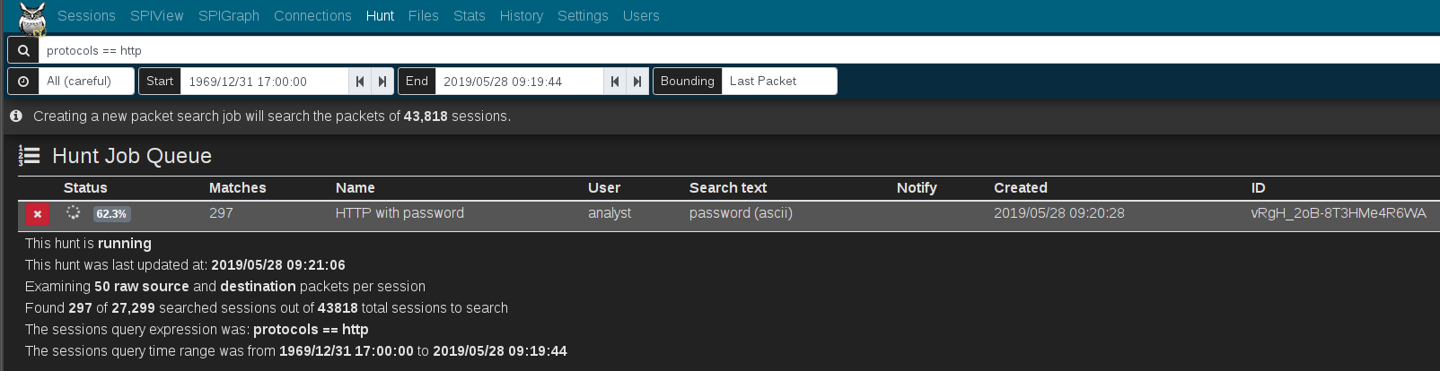
Arkime: Hunt
Deep-packet search (“PCAP grep”) of session payloads
Search for ASCII, hex codes or regular expression matches
Apply “PCAP Files” view to sessions first
Notes:
Arkime's Hunt feature allows an analyst to search within the packets themselves (including payload data) rather than simply searching the session metadata. The search string may be specified using ASCII (with or without case sensitivity), hex codes, or regular expressions. Once a hunt job is complete, matching sessions can be viewed in the Sessions view.
Clicking Create a packet search job on the Hunt page will allow you to specify the following parameters for a new hunt job:
a packet search job name
a maximum number of packets to examine per session
the search string and its format (ascii, ascii (case sensitive), hex, regex, or hex regex)
whether to search source packets, destination packets, or both
whether to search raw or reassembled packets
Click the ➕ Create button to begin the search. Arkime will scan the source PCAP files from which the sessions were created according to the search criteria. Note that whatever filters were specified when the hunt job is executed will apply to the hunt job as well; the number of sessions matching the current filters will be displayed above the hunt job parameters with text like "ⓘ Creating a new packet search job will search the packets of # sessions."
Once a hunt job is submitted, it will be assigned a unique hunt ID (a long unique string of characters like yuBHAGsBdljYmwGkbEMm) and its progress will be updated periodically in the Hunt Job Queue. More details for the hunt job can be viewed by expanding its row with the plus ➕ icon on the left.
When the hunt job is complete (and a minute or so has passed, as the huntId must be added to the matching session records in the database), click the folder icon on the right side of the hunt job row to open a new Sessions tab with the search bar prepopulated to filter for sessions with packets matching the search criteria. From this list of filtered sessions you can expand session details and explore packet payloads which matched the hunt search criteria.
The hunt feature is available only for sessions created from full packet capture data, not Zeek logs. This being the case, it is a good idea to click the eyeball 👁 icon and select the PCAP Files view to exclude Zeek logs from candidate sessions prior to using the hunt feature.

Slide 27
Using Arkime and Kibana together in Malcolm
Search syntax is different between Arkime and Kibana (and in some cases, so are field names): see Malcolm documentation for examples and Arkime helpDespite considerable overlap, there are differences in protocol parser support between Zeek and Arkime
  Learning the strengths of
  of each will help you more
  effectively find the good
  stuff
Zeek
both
Arkime
Notes:
Although Malcolm’s Kibana and Arkime interfaces provide two different views into the same network data, there are a few notable differences between the two:
The Arkime and Kibana search syntax is different.
Arkime uses its own field names in its user interface: for example, searching protocols == http in Arkime is equivalent to searching protocol:http in Kibana. Enabling Display Database Fields in the Fields section of Arkime’s help can help you map them.
Despite considerable overlap, there are differences in protocol parser support between Zeek and Arkime. In particular, Malcolm’s configuration of Zeek parses many more ICS protocols than Arkime.

Slide 28
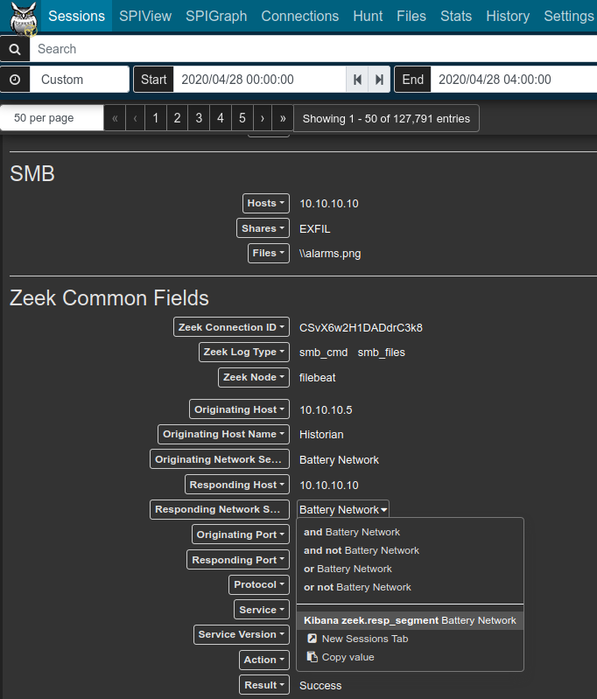
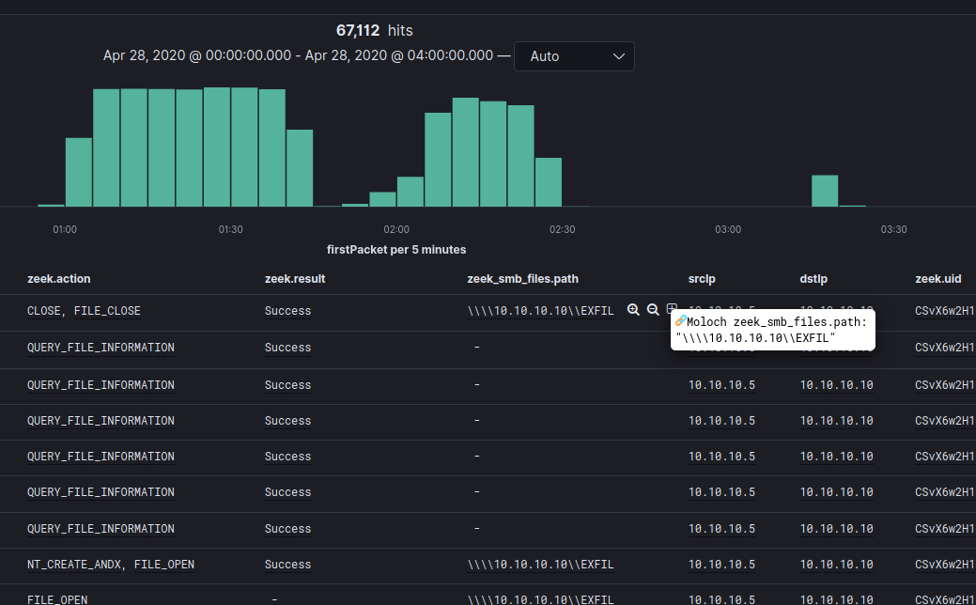
Pivots: Arkime ↔ Kibana
Arkime → Kibana
Kibana → Arkime
Check query search time frame after pivot: sometimes it gets lost in translation.
Notes:
Malcolm makes it easy to pivot between Arkime and Kibana.
To pivot from Arkime to Kibana, click on a field’s value to open its drop-down menu and choose Kibana [field name] [field value]. A new browser tab should open to Kibana’s Discover interface with that field value filter already applied.
To pivot from Kibana to Arkime, click the ⊞ or ⊕ (Details) icon next to a field’s value in a Kibana table component, then select Arkime [field name]: “[field value]”. A new browser tab should open to Arkime’s Sessions tab with the search filter applied.
Note that sometimes, especially when pivoting from Kibana to Arkime, the search time frame is not preserved and will have to manually be adjusted in the new tab.

Slide 29
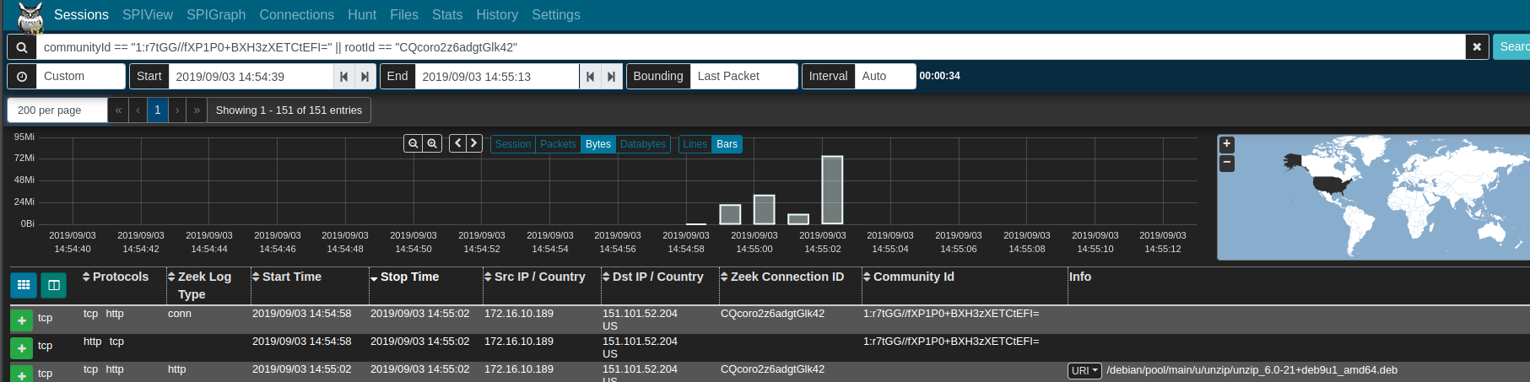
Correlating Arkime sessions and Zeek logs
Correlate Zeek logs and Arkime sessions using common fields
communityId fingerprints flows in both and can bridge the two
zeek.uid/rootId filters Zeek logs for the same session
Filter community ID OR’ed with zeek UID to see all Arkime sessions and Zeek logs for the same traffic
  communityId == "1:r7tGG//fXP1P0+BXH3zXETCtEFI=" || rootId == "CQcoro2z6adgtGlk42"
Notes:
As previously discussed, Arkime generates session records containing metadata about network connections. Zeek generates similar session metadata, linking network events to sessions via a connection UID. Malcolm aims to facilitate analysis of Zeek logs by mapping values from Zeek logs to the Arkime session database schema for equivalent fields, and by creating new "native" Arkime database fields for all the other Zeek log values for which there is not currently an equivalent in Arkime. The Fields section of Arkime’s help provides a list of known fields across both the Arkime and Zeek data sources.
In this way, when full packet capture is an option, analysis of PCAP files can be enhanced by the additional information Zeek provides. When full packet capture is not an option, similar analysis can still be performed using the same interfaces and processes using the Zeek logs alone. The values of records created from Zeek logs can be expanded and viewed like any native Arkime session by clicking the plus ➕ icon to the left of the record in the Sessions view. However, note that when dealing with these Zeek records the full packet contents are not available, so buttons dealing with viewing and exporting PCAP information will not behave as they would for records from PCAP files. Other than that, Zeek records and their values are usable in Malcolm just like native PCAP session records.
A few fields of particular mention that help limit returned results to those Zeek logs and Arkime session records generated from the same network connection are Community ID and Zeek's connection UID (zeek.uid), which Malcolm maps to Arkime’s rootId field.
Community ID is a specification for standard flow hashing published by Corelight with the intent of making it easier to pivot from one dataset (e.g., Arkime sessions) to another (e.g., Zeek conn.log entries). In Malcolm both Arkime and Zeek populate this value, which makes it possible to filter for a specific network connection and see both data sources' results for that connection.
The rootId field is used by Arkime to link session records together when a particular session has too many packets to be represented by a single session. When normalizing Zeek logs to Arkime's schema, Malcolm piggybacks on rootId to store Zeek's connection UID to crossreference entries across Zeek log types. The connection UID is also stored in zeek.uid.
Filtering on community ID OR'ed with zeek UID (e.g., communityId == "1:r7tGG//fXP1P0+BXH3zXETCtEFI=" || rootId == "CQcoro2z6adgtGlk42") is an effective way to see both the Arkime sessions and Zeek logs generated by a particular network connection.

Slide 30
Search tips
Always check your search time frame
“Zoom in” (apply filters) for a particular field value, pivot to another field then “zoom out” (remove filters)
Most UI controls can work with any data field (1000+)
Filter on zeek.logType (e.g., conn to see conn.log)
Filter on protocol or both Arkime and Zeek regardless of data source (e.g., protocol:http in Kibana and protocols == http in Arkime)
tags field
  Populated for both Arkime sessions and Zeek logs with tags provided on upload and words extracted from filenames
  internal_source, internal_destination, external_source, external_destination, cross_segment
Notes:
Finally, here are a few tips for effective searching in Kibana and Arkime:
Always check your search time frame. If you’re not seeing the data you’re expecting to see, often it’s because the data lies outside of the window of time you’re searching.
An effective technique for investigating is to “zoom in” (for example, narrowing in on a particular file type transferred), pivot to another field (select the source IP address that transferred the file) then “zoom out” (removing the file type filter to see what other activity that source IP was involved in).
Most elements in both Kibana and Arkime are interactive and can be configured to work with any of the more than 1000+ data fields Malcolm knows about.
Learn how to filter on common fields like Zeek log type and network application protocol.
Utilize the tags field in your searches, including prepopulated tags like based on public/private IP address space, tags populated based on the host and segment mapping you’ve configured and tags populated based on PCAP filenames.

Slide 31
Thanks! Visit Malcolm on GitHub to read the docs, make suggestions, report issues and st r to show your support!

Slide 32



Malcolm is Copyright © 2020 Battelle Energy Alliance, LLC, and is developed and released through the cooperation of the Cybersecurity and Infrastructure Security Agency
of the US Department of Homeland Security.

