Slide 1



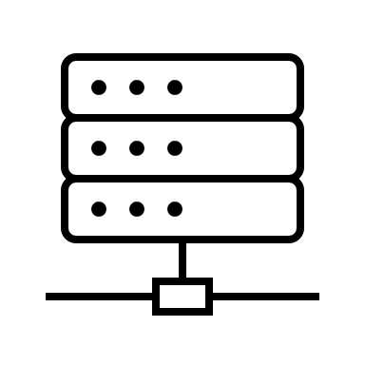

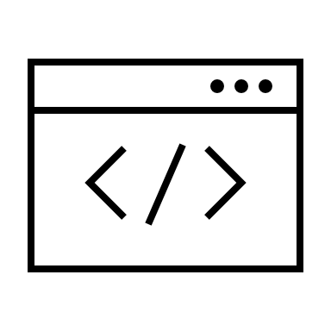

Posture & Exposure Report
CYBER HYGIENE
Prepared for: Department of Homeland Security Reporting period: 03/16/2021 to 03/31/2021

Slide 2
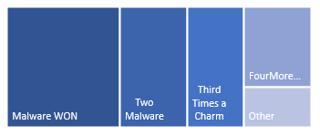
Credential Publication & Abuse
Exposed credentials put systems at risk for unauthorized access and users at risk for highly effective phishing attacks
Suspected Domain Masquerading
Registered domain names that are suspiciously similar to legitimate resources expose users to deception reliant attack vectors
Malware Activity & Vulnerabilities
Active infections and externally observable vulnerabilities are exposures that attackers exploit opportunistically
Web & Dark Web Mentions
Heightened public attention can indicate increased targeting and attack coordination, especially when attention is found on the dark web
Supplemental Reports & Annex
Additional documents and technical indicators that support information in this report to include raw findings
Posture & Exposure
Report Overview
1
22
32
2321
107
Credentials exposed in recent posts
Suspected domain masquerading alerts
Active malware associations
Inferred vulnerabilities found
Web and dark web mentions
Top Level Domains used for masquerading
Sources of credential exposures
Active malware associations and inferred vulnerabilities found via external observation
Web and dark web mentions over time
Dark web is defined as sources such as tor, i2p, etc.
Notes:
Executive Review

Slide 3
Threat actors can leverage credentials in many ways as they carry out an attack. When public and secret authentication keys are exposed together, unauthorized access is highly probable. However, even without a complete authentication set, an attacker can leverage any publicized information about a user for a tailored social engineering action. Since phishing is so commonly intertwined with credential exposures, phishing related activity is included in this section.
Credential
Publication & Abuse
Credential exposure incidents by date discovered
An exposure incident is a single publication, such as a Pastbin post, that may contain multiple credentials
Credentials exposed count per incident
Number of agency related credentials contained within incident
Sources of credential exposure incidents
Key Metrics

Slide 4
Users have a difficult time recognizing the difference between legitimate domain names and domains that are very slightly different. Threat actors will exploit this fact by hosting malicious code or fake webpages with domain names that are easily mistaken for an organization’s true resource. Any domain registration activity that appears to be intimidating a legitimate site is suspected of domain masquerading.
Suspected Domain Masquerading
Suspected domain masquerading by incident date of discovery
Top level domains used for suspected masquerading of agency assets
Sample of domains suspected of masquerading
Key Metrics

Slide 5
This section provides exposure information about servers and devices that comprise the agency’s digital infrastructure. Malicious actors will leverage weak points along the agency’s network perimeter in order to carry out their attacks. These weak points can be anything from a misconfigured device to existing internal infections such as botnet activity. An attacker could collect this publicly available open source information during reconnaissance.
Malware Activity & Vulnerabilities
Active malware associations with agency assets
Rows with zero values are active on other .gov assets
Active inferred vulnerabilities on agency assets
Rows with zero values are active on other .gov assets
Association count
Association count
Date of last observation for active malware and inferred vulnerabilities
Total days between first and last observation for active malware and inferred vulnerabilities
Key Metrics
<Metric Feed Here>
Association count
Association count
Days between first and last observation
Days between first and last observation

Slide 6
When an organization is receiving increased public focus, even when this focus is largely positive, there is some correlation with malicious targeting. Although it is not a definitive indicator, more mentions means more exposure. This is especially true when the sources of mentions come from the dark web where obfuscation techniques help hide threat actor’s coordination and attack execution.
Web & Dark Web Mentions
Web and “dark” web mentions over time
Dark web is defined as mentions from sources such as tor and i2p
Mentions count
Mentions categorized by source
Generic “Web” source has been filtered out due to the category’s overwhelming representation
Key Metrics
<Metric Feed Here>
Mentions count

Slide 7
This section contains summaries and links to supporting documentation, to include the raw data driving all visualizations, and other relevant publications.
Supplemental
Reports & Annex
Sample of raw indicators and incidents
Supplemental Reports

