Slide 1

CISAT Paper collective #1
August 16, 2024

Slide 2
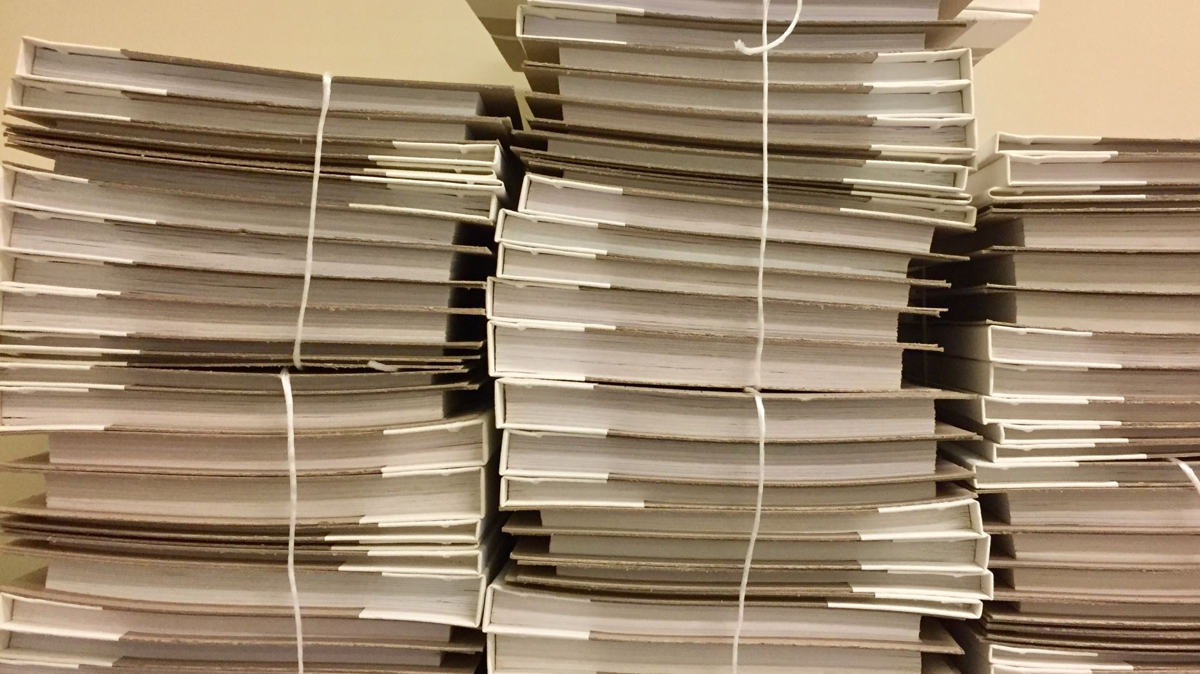
Today’s agenda
CISAT Paper Collective:
What is it?
Why is it?
Who is it for?
Guidelines
Where to find a paper
How to read a paper
Ways to Engage with the community

Slide 3

what is it?
Place to share research papers that get you excited!!
Seriously, these papers deserve a read ☺
Nuts and bolts:
~1 meeting per month, Fri. 12-1 PM
In person or remote option
2-3 papers presented each session (10-20 mins each)
Presentations should summarize the paper, explain why you liked it, and if applicable your interest in implementing it/seeking collaborators
Ideally presented by students - In need of presenters!! https://forms.gle/sBKBRFaR55ZxL6B66

Slide 4
why is it?
Provide you with a friendly forum to develop presentation skills
Allow students and faculty to discuss topics of interest to them
Foster research collaborations
Encourage reading academic papers
Provide exposure to a wide range of research topics
Build a community centered around curiosity and inquisitiveness
There are many places to present your own research, not many to introduce others to papers that simply get you psyched!

Slide 5

Who is it for?
You
Your friends
Anyone interested in technology

Slide 6
Community guidelines
Be respectful
Be supportive
Be mindful – the community is made up of individuals from a variety of backgrounds
Questions should be germane and move the discussion forward in a constructive way
Presentations should be professional in nature – i.e. no inappropriate images, language, etc.
Papers should have some technical or technology-related component, but can be from any field

Slide 7
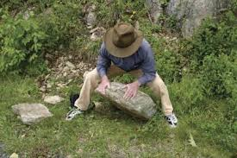
Where to find papers

Slide 8
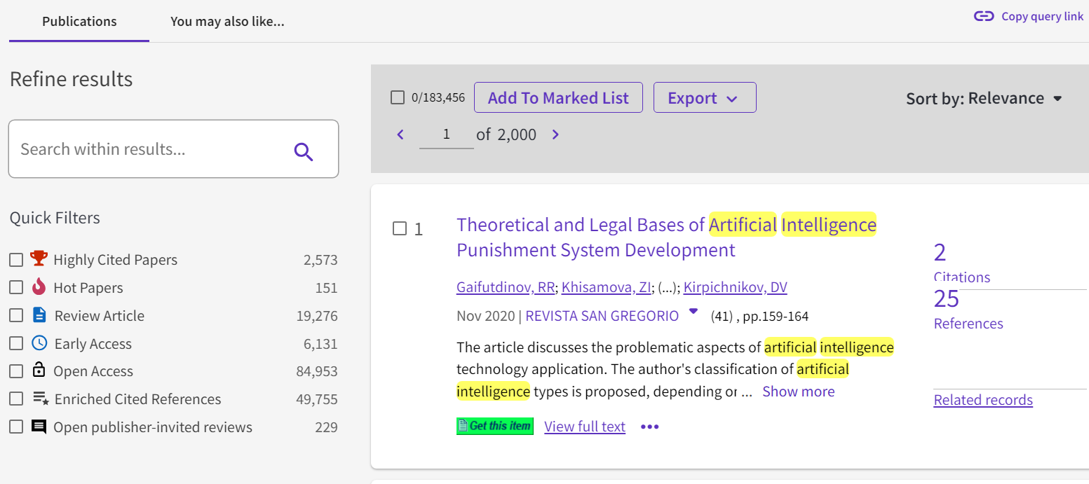
#1: Honnold mudd library
Your student tech fees pay for this – use it!!
Honnold Mudd Library: https://library.claremont.edu/
Many, many databases: https://libguides.libraries.claremont.edu/az/databases
Web of Science: https://www-webofscience-com.ccl.idm.oclc.org/wos/woscc/basic-search

Slide 9
Aggregators
HackerNews: https://news.ycombinator.com/
Lobste.rs (geared towards Rust programming language, but has much more): https://lobste.rs/
Reddit programming thread (covers more than programming): https://old.reddit.com/r/programming/
Devurls: https://devurls.com/

Slide 10
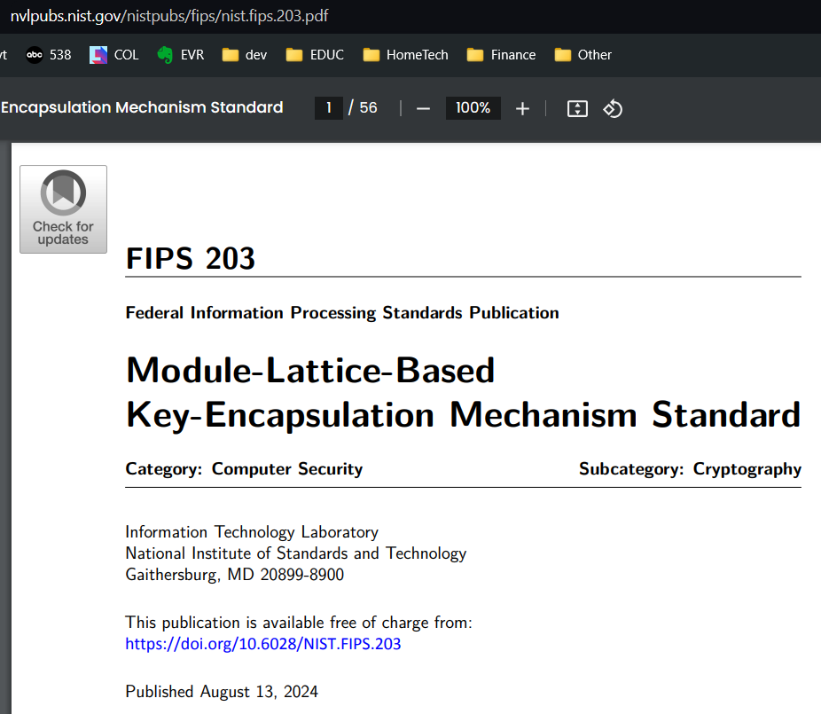

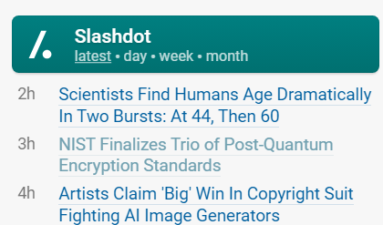
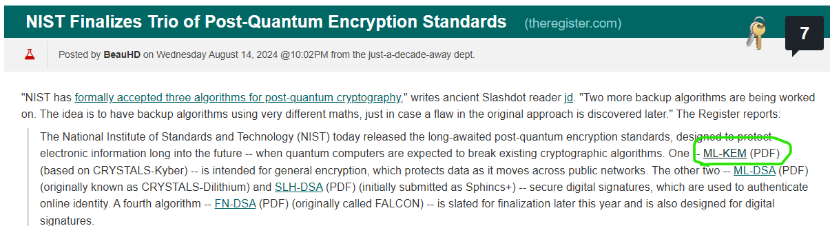
From aggregator -> article
Hmm…
sounds interesting
They mention
Specific algorithms,
ML-KEM…

Slide 11
Coursework
Your instructors provide curated course readings
Those readings have citations…

Slide 12
Search engines
Google Scholar (also available as a database @ Honnold-Mudd library)

Slide 13
Professional groups
ACM (Association for Computing Machinery)
ACM digital library: https://dl.acm.org/
Free access to articles published between 1951 – 2000

Slide 14
Reading groups
Papers we love (computer science): https://github.com/papers-we-love/papers-we-love
The CISAT Paper Collective!

Slide 15

How to read a paper

Slide 16
First “reading”
Quick, cursory scan
Mostly pay attention to:
Abstract & Introduction (at least parts of it)
Methods (how did they do what they did)
Results (what did they find)
Figures (Tables, Charts, Equations)

Slide 17
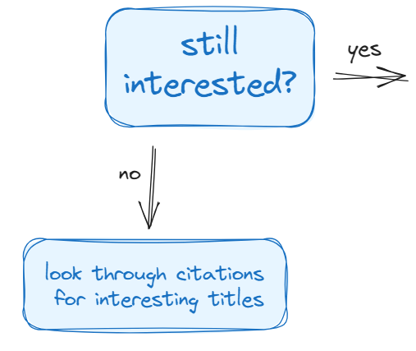
After the first reading
Is it relevant (to you)
Does it relate to topics you have studied/are researching?
Does it appear to offer something new/novel?
Might it contain a framework that you could use?
Does it employ methods that could be relevant to your work?
Develop specific questions for the paper (what else do you need to know to make sense of the work?)
Did they account for __?
Why did [didn’t] they __?
How did they develop __?

Slide 18
Second reading
Look for answers to your questions
Add context - dig into some of the details/specifics
As you read, think about where it fits in relation to:
Your understanding of the field
Other similar papers

Slide 19
Beyond a second reading
If you still have questions
Read again if you feel it likely to enhance your understanding
If you feel you need better understanding of some of the topics, investigate the citations related to those topics and return later
Summarize what you know (write notes)
Evaluate whether it is worth additional investment at this time

Slide 20

Engaging with the cpc community

Slide 21
How can you get involved?
Become a presenter!
https://forms.gle/sBKBRFaR55ZxL6B66
Github
cisat-paper-collective · GitHub
Presenters will be invited to join the Github Organization, where they can create Github Teams to continue their investigation of the topic and add collaborators
Paper repository (public)
Email listserv (uses google groups)
email to be added or search for the group name cisat-paper-collective

Slide 22

Paper #1

Slide 23
“The Correctness-Security Gap in Compiler Optimizations”
V. D’Silva, M. Payer, D. Song
IEEE Security and Privacy Workshops, IEEE 2015, pp. 73-87
https://doi.org/10.1109/SPW.2015.33

Slide 24
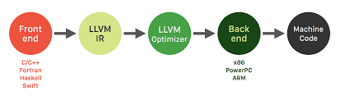

background
What is an optimizing compiler?
Compiler: translate the code you write into low-level code that the hardware executes
Optimizing: Looks at code in between the code you have written and the machine code that your hardware executes directly and adjusts it to increase speed
LLVM

Slide 25
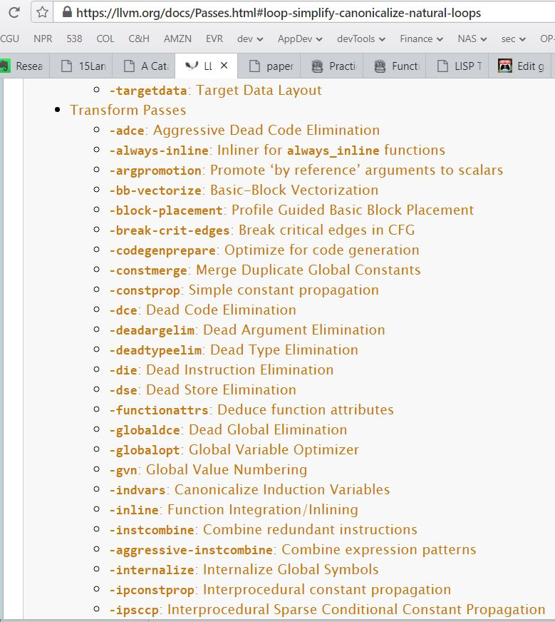
Background, cont’d
Examples of transformation
Passes (optimizations)

Slide 26
Paper summary
Describes security problems that can arise as a result of optimizations
Term this the “correctness-security gap”
not a code correctness problem – the optimizations are working properly, as expected
security errors introduced as a result of examining only program state (not machine state)
Developer expectations vs. Compiler expectations
Devs can purposefully want un-optimized code
Outline future efforts to identify and mitigate these security errors

Slide 27
methods
Workshop paper, not a journal publication
Empirical approach – walk through actual examples
Similar to case study, where examples are cases
Generalize to a larger conceptual problem

Slide 28
results
Demonstration of the problem
Need to more accurately model the state of the execution environment (not just program state)
Recommendations:
Deeper Understanding of the Correctness-Security Gap
Detection of Correctness-Security Violations
Implementing Security-Preserving Compilation

Slide 29
Some examples from the paper

Slide 30
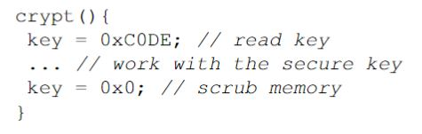
Example: Dead store elimination
What the optimization does
removes code that assigns a local variable that is not subsequently read
How it can compromise security
You might store a secret value, operate on it, then re-assign the variable so it cannot be subsequently accessed in memory

Slide 31
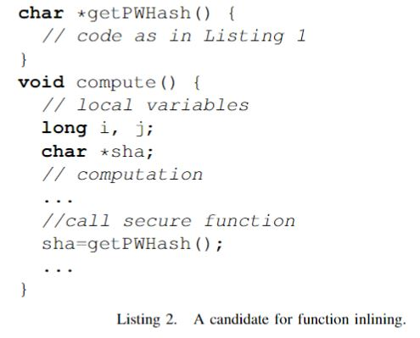
Example: function inlining
What the optimization does
Function call site replaced with body of function
Speed (and space) gains in avoiding continued calls to function - executes results of function calls in an expanded body
How it can compromise security
stack frames of caller and callee are merged - callee internals extended to entire caller scope
Awfter inlining, result of PWHash would now be available in compute() scope

Slide 32
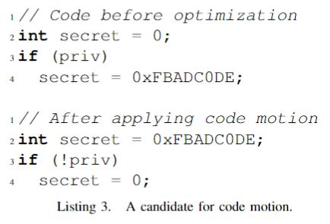
Example: code motion
What the optimization does
Reorders instructions when code is found to not affect subsequent statements
How it can compromise security
Code may be implementing a needed check
Initial code: if privacy flag is set, initialize the secret
Optimized code: sees that priv flag is often set, so it changes the order to initialize the secret and only set to 0 when priv plag is NOT set

Slide 33
Why I found it interesting
Contemplate ideas of what “correct” code means
This question (like many) has mutated in scope and specifics, but has been around a long time
“the term optimization is a misnomer in that it is not generally clear that a particular…optimizing transformation even results in an improvement to the program”
F. Allen, J. Cocke, “A Catalog of Optimizing Transformations”, Design and Optimization of Compilers, pp, 1-30, 1971.
Illuminated the world of compiler optimizations and programming language development with concrete, easy to understand examples
Offered many potential learning paths: LLVM compiler infrastructure, programming language development

Slide 34
How can you get involved?
Share a paper you enjoy with the group!
https://forms.gle/sBKBRFaR55ZxL6B66
Github
cisat-paper-collective · GitHub
Presenters will be invited to join the Github Organization, where they can create Github Teams to continue their investigation of the topic and add collaborators
Paper repository (public)
Email listserv (uses google groups)
email to be added or search for the group name cisat-paper-collective

