Slide 1

CISAT Paper collective #2
OCTOBER 17, 2024

Slide 2

what is the paper collective?
Place to share research papers that get you excited
Nuts and bolts:
~1 meeting per month, Fri. 12-1 PM
In person or remote option
2-3 papers presented each session (10-20 mins each)
Presentations should summarize the paper, explain why you liked it, and if applicable your interest in implementing it/seeking collaborators
In need of presenters!! https://forms.gle/sBKBRFaR55ZxL6B66

Slide 3
why is it?
Provide a friendly forum to develop presentation skills
Allow students and faculty to discuss topics of interest to them
Foster research collaborations
Encourage reading academic papers
Provide exposure to a wide range of research topics
Build community

Slide 4

Who is it for?
You
Your friends
Anyone interested in technology

Slide 5
Community guidelines
Be respectful
Be supportive
Be mindful
Be professional – no inappropriate images, language, etc.
Papers have technical or technology-related component, but can be from any field

Slide 6
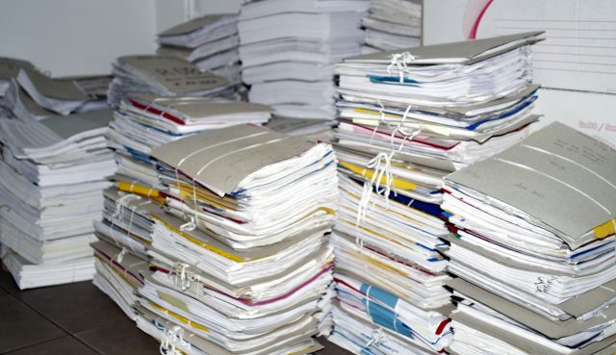
Where to find papers

Slide 7
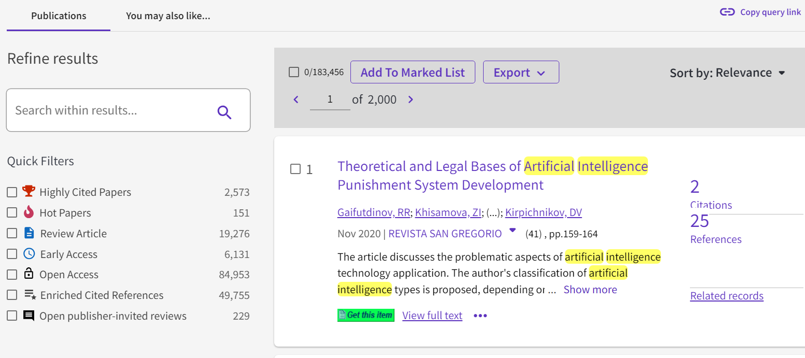
#1: Honnold mudd library
Your student tech fees pay for this – use it!!
Honnold Mudd Library: https://library.claremont.edu/
Many, many databases: https://libguides.libraries.claremont.edu/az/databases
Web of Science: https://www-webofscience-com.ccl.idm.oclc.org/wos/woscc/basic-search

Slide 8
OTHER SOURCES
Coursework – assigned readings have citations
Google Scholar (also available as a database @ Honnold-Mudd library)
Arxiv (pre-print) - https://arxiv.org/
Alpha arxiv (separate site to comment on arxiv articles/interact with authors) - https://www.alphaxiv.org/explore
Professional groups (ACM, IEEE, AIS, etc.)
Most are accessible only to members, but ACM digital library from 1951-2000 is free: https://dl.acm.org/

Slide 9
WEBSITE Aggregators
HackerNews: https://news.ycombinator.com/
Lobste.rs (geared towards Rust programming language, but has much more): https://lobste.rs/
Reddit programming thread (covers more than programming): https://old.reddit.com/r/programming/
Devurls: https://devurls.com/

Slide 10
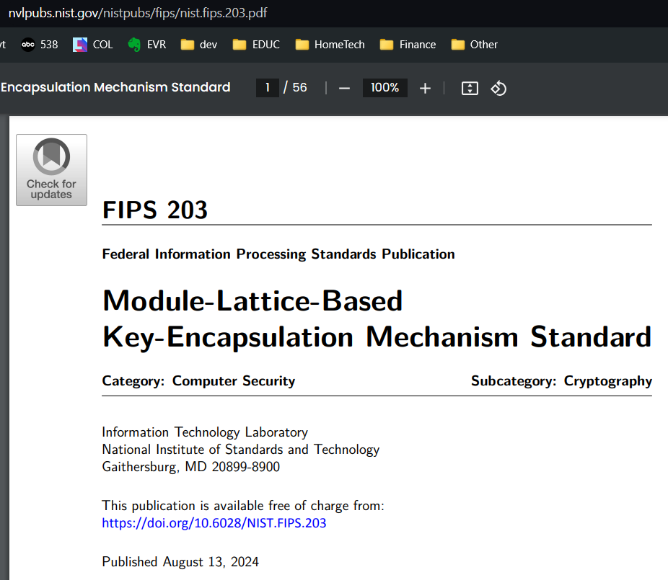

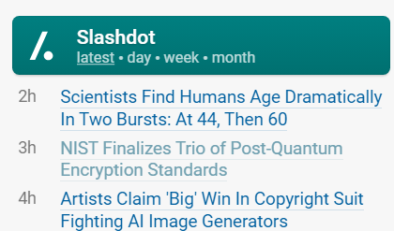
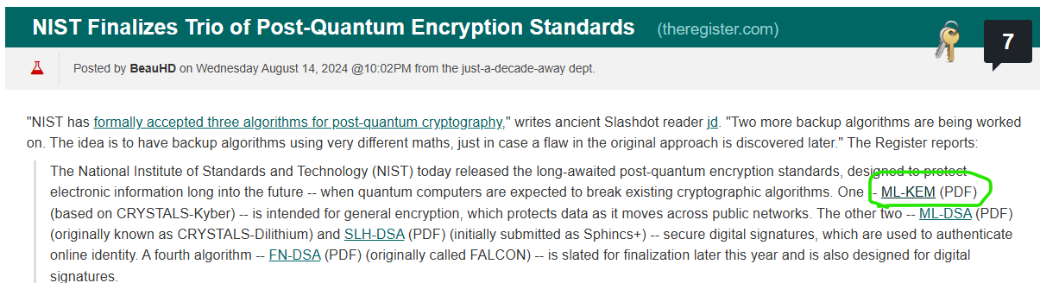
From aggregator -> article
Hmm…
sounds interesting
They mention
Specific algorithms,
ML-KEM…

Slide 11
Reading groups
Papers we love (computer science): https://github.com/papers-we-love/papers-we-love
The CISAT Paper Collective!

Slide 12

Engaging with the cpc community

Slide 13

How can you get involved?
Sign up to share a paper you enjoy!
https://forms.gle/sBKBRFaR55ZxL6B66
Visit the Github Repo
github.com/cisat-paper-collective
Sign up for the email list
Email to join the listserv, can share ideas/opportunities with other members

Slide 14

discussion

Slide 15
“I would rather have questions that can't be answered than answers that can't be questioned.”
-Richard P. Feynman

Slide 16
“The importance of stupidity in scientific research”
Martin A. Schwarz
Journal of Cell Science, Vol 121 Issue 11, June 2008, pp. 1771
https://doi.org/10.1242/jcs.033340

Slide 17
Key points
Good research is very hard
Research problems are problems because no one has the answer
Don’t know if you are asking the right question or approaching it in the right way until the end
If you don’t feel stupid, you’re not trying
Success = failing at a sufficiently high level
Be comfortable with being stupid (stupid = a state of not knowing)

Slide 18
“are ideas getting harder to find?”
Bloom, Nicholas, Charles I. Jones, John Van Reenen, and Michael Webb. 2020.
American Economic Review, 110 (4): 1104–44.
https://doi.org/10.1257/aer.20180338

Slide 19
Key points
Central equation:
economic growth = research productivity * number of researchers
Research productivity is falling (across all levels studied – industry, product, firm)
Research effort is increasing
Economics paper, less focused on the why than establishing empirical observations

Slide 20
Explanations for research productivity declines
Two of the most cited:
As the amount of research increases, so does the amount that needs to be understood prior to making meaningful contributions
Low hanging fruit has mostly been harvested
Others?

Slide 21
Why might ideas be easier to find?
Exposure to more ideas as more research is conducted
more papers to have questions about/spark ideas
Wider distribution in our networked world (open access, etc.)
Others?

Slide 22
“papers and patents are becoming less disruptive over time”
Park, M., Leahey, E. & Funk, R.J.
Nature 613, 138–144 (2023).
https://doi.org/10.1038/s41586-022-05543-x

Slide 23
summary
We have experienced exponential growth in scientific and technological knowledge yet progress in many fields is slowing
Created a disruption index that analyzes citation patterns
More disruptive if newer papers cite the focal paper only
Less disruptive if newer papers cite focal paper and many predecessor papers
Papers and patents less likely to break with the past in ways that push in new directions
Factors negatively associated with disruption: use of less diverse work, more of one’s own work, reliance on older work

Slide 24
Why focus on apparent declines in research productivity?
Relieve you of the burden of thinking you have to be up on all the latest research all the time ☺
Critically examine your own research
Be comfortable in “stupidity” – it is OK to not have all the answers, and in fact that is the point
Some questions don’t have a readily apparent answer – you have to work hard to (possibly) find one

Slide 25
Bonus paper

Slide 26
“The Era of 1-bit LLMs: All Large Language Models are in 1.58 Bits”
Shuming Ma, Hongyu Wang, Lingxiao Ma, Lei Wang, Wenhui Wang, Shaohan Huang, Li Dong, Ruiping Wang, Jilong Xue, Furu Wei
https://doi.org/10.48550/arXiv.2402.17764

Slide 27
summary
Replace 16-bit floating points with 3 possible values: 1, 0, -1
Tradeoff initial training time (more) with reduced run times
Highlights there are many possible approaches to a problem

