Slide 1
ManagementServer
CMAD Program - Essentials

Slide 2
Architecture
Device
Dashboard-UI
Get Message Details and Statistics
Post Message(http)
ManagementServer (Exposes API to collect and display log Messages)

Slide 3
Technologies Used
MYSQL Database
REST API using Spring Boot Framework
React for UI Development
Protocols used:
HTTP

Slide 4
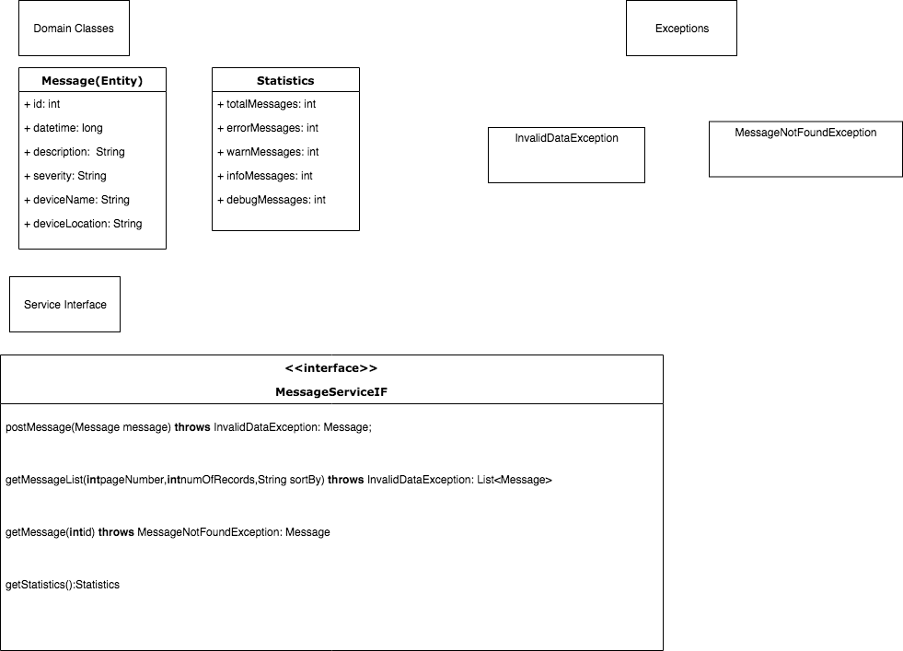
Server Design

Slide 5


API Specifications
Click Here

Slide 6
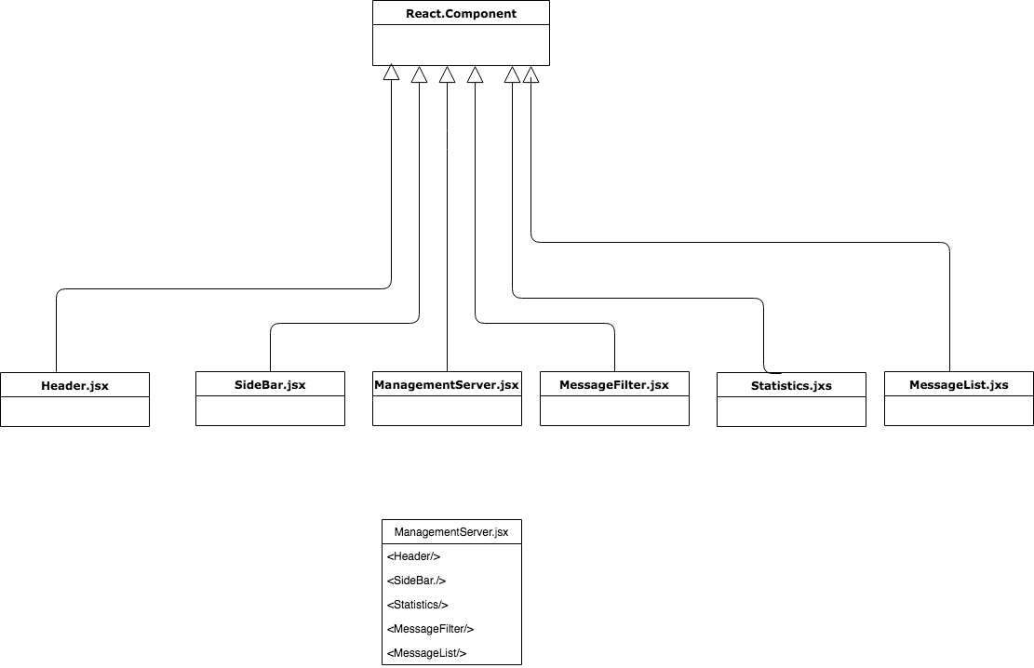
UI Design

Slide 7
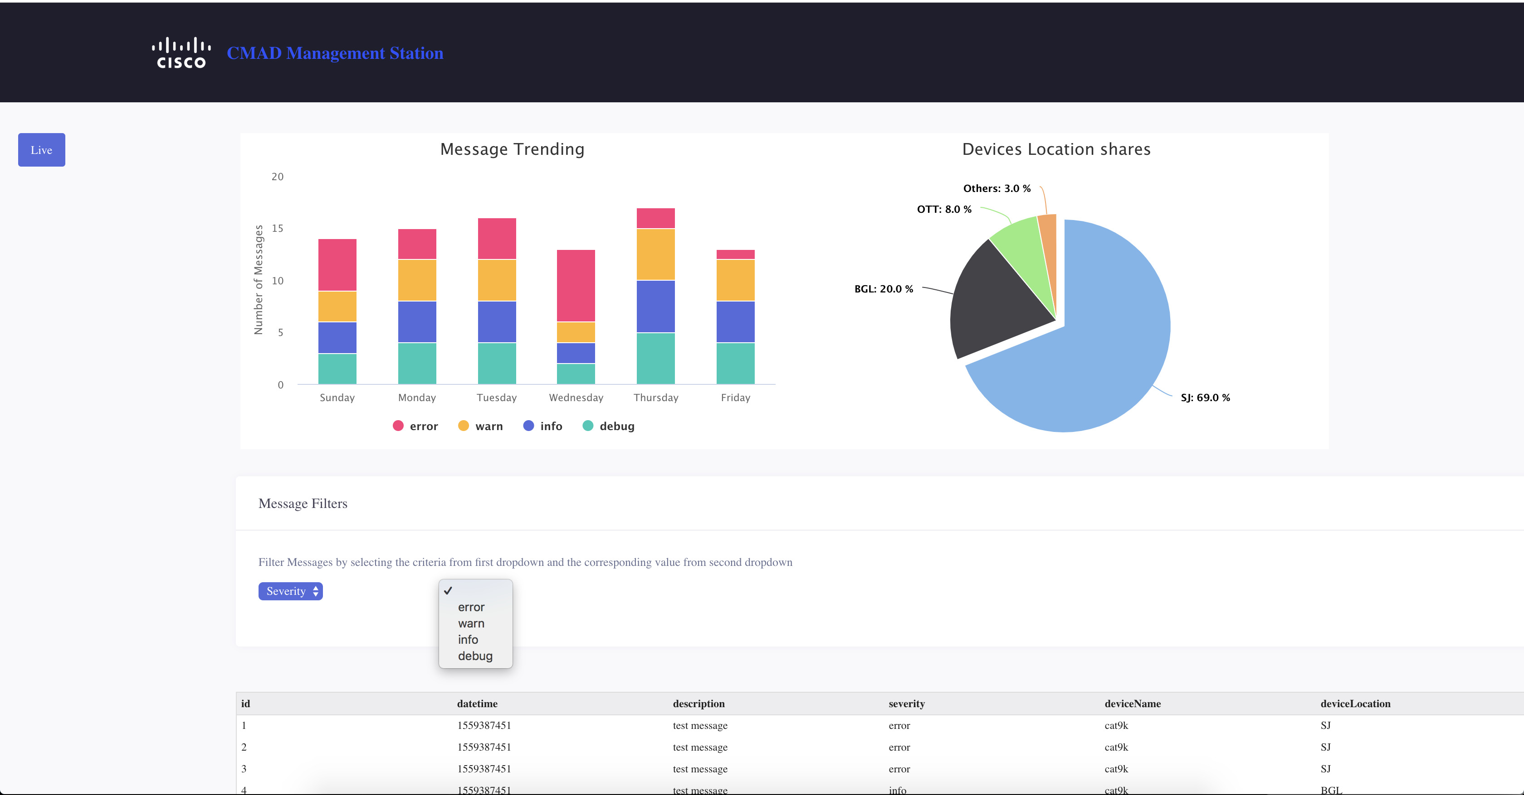
Mock UI Screen

Slide 8
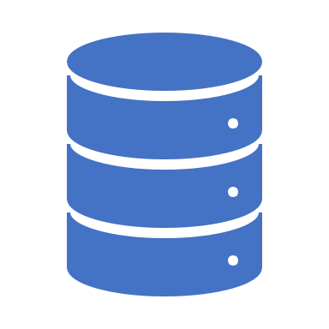
GIT URL
Backend – https://wwwin-github.cisco.com/parma/CMAD-backend
Frontend - https://wwwin-github.cisco.com/parma/CMAD-frontend

Slide 9
Thank You

