Slide 1

PYTHON CRASH COURSE
- 7th Feb, 2020

Slide 2
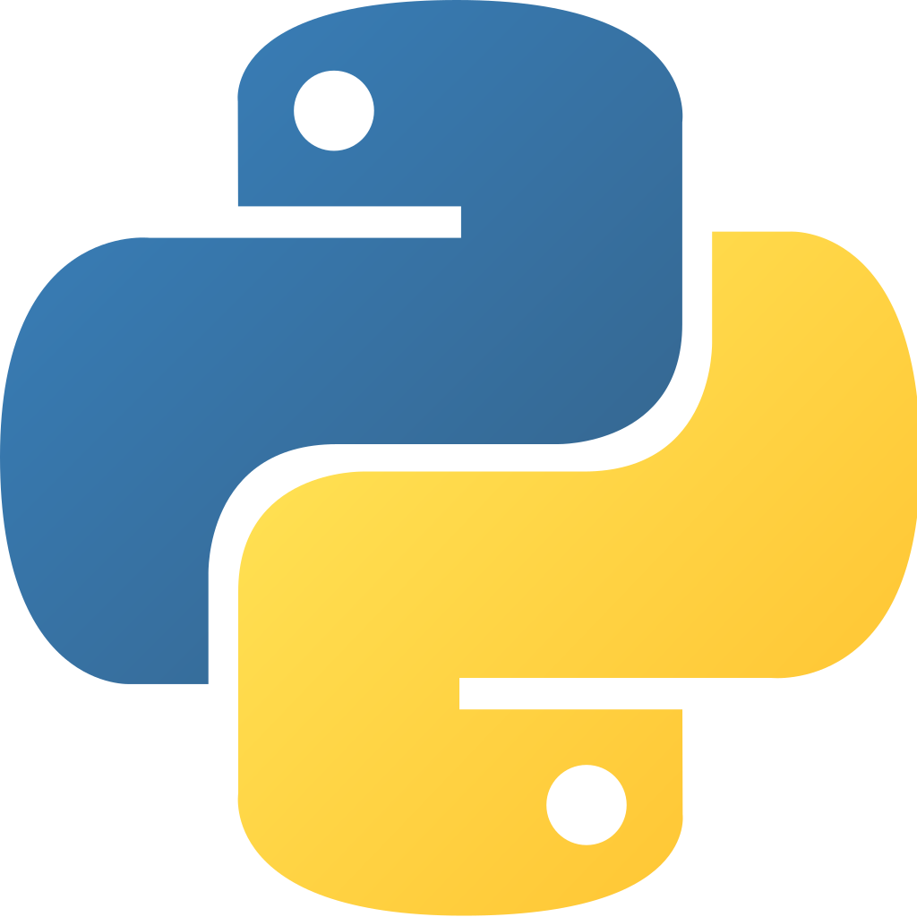
What is Python?
Python is an interpreted, object-oriented, high-level programming language with dynamic semantics.
. Created by Guido van Rossum . Released in 1991 . Latest Stable release is 3.8

Slide 3
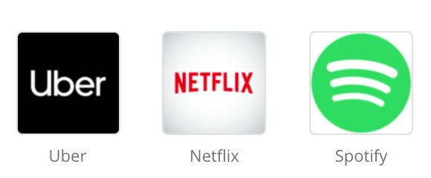


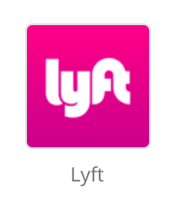
Why learn Python?
. Backend & Serverless . Bots & Conversational UI (Alexa, Dialog Flow) . IOT & Automations . Machine Learning, Data Science & AI . Quick Prototyping Stats: https://insights.stackoverflow.com/survey/2019

Slide 4

init
$ brew install python3
$ pip3 --version
$ python3
help(str) / help(str.count) & dir(str)
Install PyCharm
Virtual Environment

Slide 5
Lets begin! Chapters: https://github.com/cyberinsane/python-crash-course

Slide 6
- Get expenses - Add expense
- Update expense (Exercise)
- Delete expense (Exercise) - Scripts to consume API

Slide 7

$ pip3 install fastapi $ pip3 install uvicorn $ uvicorn expense:app --host 0.0.0.0 --port 8000

Slide 8
- Get expenses by month - Month Validation - Throw Exception

Slide 9
Use Requests to consume API
Export data in CSS, Excel
Visualize using Graphs
Use Jinja2 library to generate simple HTML

Slide 10
$ Exercises - Update Expense - Delete Expense - Create your own Solution

Slide 11
🐍 THE END 🐍

