Slide 1

Media Streaming Mesh
Giles Heron
Principal Engineer

Slide 2

A (Fuzzy) Application Taxonomy
 | Non Real-Time | Real-Time
Interactive (request/response) | Web Applications | Online Games
Streaming (publish/subscribe) | Message Buses | Live Video

Slide 3
Kubernetes Media Connectivity Options
 | TCP | HTTP | UDP | Real-Time Media (RTSP, SIP, etc.)
Service Mesh & Load Balancers
kube-proxy & NodePort
Host Networking
Media Streaming Mesh
One Pod Per Node!!!

Slide 4
Benefits of Media Streaming Mesh
Observability Media Streaming Mesh monitors jitter and packet loss across the mesh, enabling DevOps teams to quickly locate and resolve connectivity issues.
Security Media Streaming Mesh authenticates traffic senders using SPIFFE/SPIRE and can encrypt traffic using SRTP. Proxies reduce attack surface and ensure protocol conformance.
Low-Latency The Media Streaming Mesh RTP data plane proxy adds minimal latency, in contrast to web proxies that terminate TCP connections at each hop.
Deployability Lightweight per-node data plane proxy, and per-cluster control plane proxy ensures a much lower footprint than per-pod web proxies, making it suitable for deployment at the edge.

Slide 5

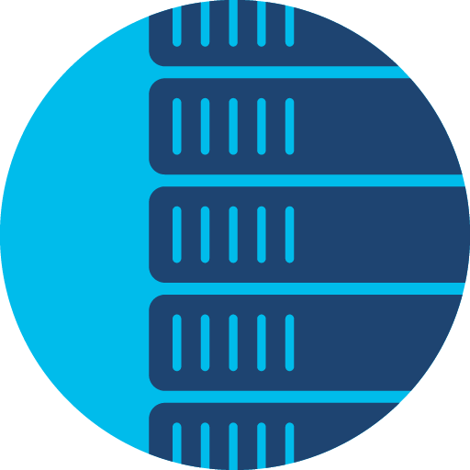

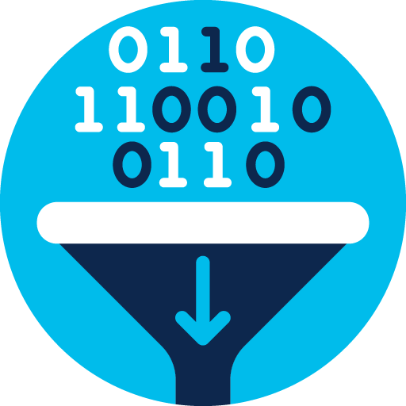


Live Video Use-Cases for MSM
Contribution Video (camera to studio and in-studio mixing)
Longer-term goal perhaps as cameras/switches/consoles are dedicated hardware platforms
Interconnection of cloud-based encoders
Most likely an intra-cluster Kubernetes use-case
Distributing live streams from encoders to caches
Fan out from encoders via MSM proxies
Proxies can add FEC, send dual streams over diverse paths etc.
Streaming RTP to clients
Potential RTP over QUIC use-case (browser-based model)
Cache
Camera
Mixer
Encoder
ISP1
WAN
WAN
Internet
ISP2

Slide 6
Video Surveillance Use-Cases for MSM
Large number of cameras
few per site in many small sites (e.g. retail)
large numbers in a few big sites (airports, factories etc.)
Multiple viewers – probably remote from the camera locations
One or more proxies per camera site and a proxy at each viewer site
Today’s approach is typically RTP over UDP multicast
WAN
MSM Proxy
MSM Proxy
MSM Proxy
MSM Proxy

Slide 7
MSM Software Architecture
Kubernetes Cluster
Worker Nodes
Services
DaemonSets
Pods
MSM
Admission Webhook
MSM CNI Plugin
eBPF/iptables Rules
MSM Stub
MSM Stub
Control Plane
RTP Proxy
App
Notes:
Services are the existing MSM admission webhook and the new MSM control plane. So these run one instance per cluster – probably on the master node(s).
DaemonSets are the existing CNI plugin plus an RTP proxy – with co-located MSM stub to enable North/South traffic. Co-located stub communicates with external apps and the MSM control plane.
Application pods have a local stub to terminate CP traffic and send to the control plane. IPtables rule currently used to intercept RTSP CP traffic – and we’re relying on TCP interleaving to intercept the DP using that same rule. Longer term will need eBPF to intercept both CP and DP traffic.

Slide 8
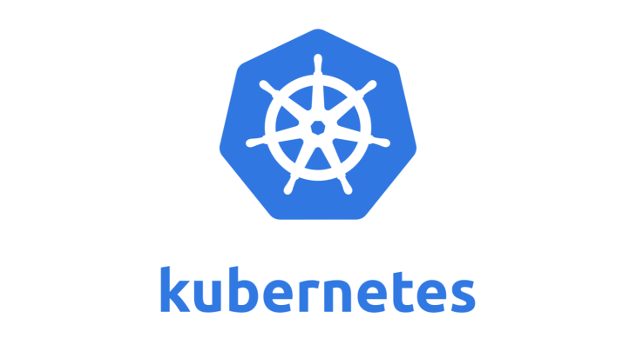
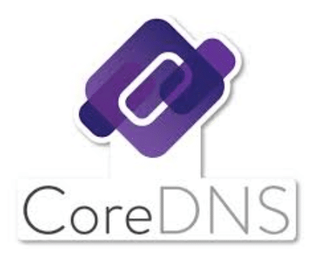
Per-Cluster Control Plane
Deploys as a Kubernetes Service
Likely 3 replicas with RAFT etc.
Uses gRPC Southbound:
To send/receive commands to/from the MSM Stubs
To program the RTP Proxies (and potentially punt/inject, stats etc.)
Uses K8s API and DNS Northbound
In future use xDS interface here
Written in Golang
Leverage existing libraries (e.g. gortsplib)
L7 protocols implemented as plug-ins:
RTSP
WebRTC
RIST
SIP
Others?
Control Plane
gRPC
gRPC
MSM Stub
CP
RTP Proxy
DP
App
RTP Proxy
Nodes
Pods
Notes:
Key is to have a CP framework such that the actual protocol is plugged into an overall framework.
“API helper” (calls to the K8s API and to DNS) currently integrated with CP. Longer term may separate it out again, and/or use xDS API NB. xDS offers possibility to implement virtual services and/o integrate with Istio (if we can get changes upstreamed).

Slide 9
The MSM Stub
Deployed:
In each pod that uses MSM
With RTP Proxy as “gateway”
Terminates Control Plane
Punts to per-cluster CP over gRPC
May intercept the Data Plane
RTSP interleaved data case
Memif towards VPP-based proxy
Monitoring at pod
“Live-Live” replication/de-duplication
Potentially uses SPIFFE/SPIRE
RTP Proxy does RTP/SRTP, will need end-to-end authentication
“Stub” because footprint is minimal
Complexity is in the CP and the RTP Proxy
Written in async Rust to keep memory footprint low, and to avoid data-plane latency spikes due to garbage collection
Kubernetes Cluster
Service
Control Plane
Node
gRPC
Pod
MSM Stub
CP
DP
App
RTP Proxy
App
Notes:
RIST would also have data-plane as a single UDP socket does RTP, RTCP and CP.
For most other protocols the stub will be CP only.
For web-based protocols one option is to replace the stub with an Envoy proxy (possibly just one per node)

Slide 10


Envoy Proxy hosting MSM Stub as a WASM filter
MSM Control Plane
Worker Node
Istio
Gateway
(Envoy)
MSM filter
External
NMOS
Node
Media App
Media App
RTP Proxy
Notes:
This could apply to any web based protocol (AMWA NMOS, WebRTC etc).
Envoy proxy could be a sidecar, or one per node. Control Plane is pretty limited traffic so one proxy per node seems better than a sidecar.

Slide 11
The RTP Proxy
Kubernetes Cluster
Deployed as a per-node DaemonSet
supports North/South and East/West flows
Probably an RTP “Translator” (RFC3550)
Unicast to multicast, IPv4 to IPv6, RFC1918 to public IP, tunnelling, MTU conversion etc.
RTP/UDP, RTP/TCP and RTP/QUIC support
Also acts as a UDP, TCP and QUIC proxy
Minimises attack surface
Implemented in async Rust
Proxy with a Filter chain
Validation, replication, encryption, protection, congestion control etc.
Key is to drive a filter ecosystem
Can work with multiple CPs
Spawn an instance per CP in golang case
CP programs proxy using gRPC
Proactive or reactive programming
Service
Control Plane
Node
Pods
gRPC
MSM Stub
DP
CP
RTP Proxy
App
Notes:
Most likely we’ll use eBPF to interface to pods (either directly or via Calico-eBPF or Cilium) and DPDK to interface to the network (either directly or via Calico-VPP).

Slide 12

RTP Proxy – Internal Architecture
RTP/RTCP Packets to
UDP, TCP, QUIC
Add Forward Error Correction to Media
Fan Out
Encrypt Data
UDP, TCP, QUIC to RTP/RTCP Packets
Client
Egress Processing
Server
Ingress
Processing
FEC
Stream
Replication
SRTP
SRTCP
clients
Filter Chain (example)
Server
Egress
Processing
SRTP
SSRC Validate
Client
Ingress Processing
media
servers
SDES
Validate
SRTCP
Monitoring
Notes:
Ingress processing will verify that the source IP/protocol/port is as expected. This is also where TCP, UDP and QUIC proxying occurs.
Filter chains are pluggable/configurable and are most likely WASM-based (will need WASI to enable us to have a packet in/packet(s) out – or possible packet vector in / packet vector out - interface).
Will look different for e.g. RTSP proxy (so all traffic is server to client) vs WebRTC (more peer to peer) and for intra-cluster vs inter-cluster use-cases.
Stream replication may well be a special case as it is programmed by the CP. Might be we have separate pre/post replication chains.

Slide 13
MSM Demo
Kubernetes Cluster
Control Plane Service
Worker Node
gRPC
MSM RTSP Stub
MSM RTSP Stub
RTP
RTSP
RTSP
RTP
MSM RTP Proxy
RTSP Server
MSM Gateway Pod
RTSP Server Pod
Notes:
This is an example of external VLC clients connecting to a video stream.
MSM CP is deployed into the cluster
When a worker node is deployed the MSM control plane updates it’s pod->node IP map and the MSM data plane (a gateway pod consisting of the RTP proxy and a co-located stub) is deployed as a daemon-set. The stub registers the pod with the control plane
When an application pod is deployed its co-located stub (injected by the MSM admission webhook) registers with the MSM Control Plane and is given the IP address/port of its local data plane
When an RTSP client connects the gateway stub adds the RTSP endpoint to the control plane and forwards its OPTIONS message to the control plane, which looks up the URL in the K8s API to find a matching K8s service, and forwards the OPTIONS message to the stub co-located with the application pod. The application pod stub connects out to the local application, adds that RTSP endpoint to the control plane and then forwards the OPTIONS to the application, which responds with its supported OPTIONS, which are then returned to the client via control plane.
(have omitted the DESCRIBE message processing)
When the client sends SETUP messages these also flow to the remote application via the control plane. This time as the message flows back the MSM RTP proxy is updated with the port values for the UDP flow from the application stub to the proxy and from the proxy to the client.
When the client sends a PLAY message this also flows to the remote application via the control plane. This time as the message flows back the MSM RTP proxy is informed that the client is now enabled for the stream.
The media will now flow from the RTSP server to its local stub as interleaved data, then to the RTP Proxy over UDP, and finally to the client over UDP
When an additional client joins the MSM Control Plane simply adds it to the stream – there’s no need to send messages to the RTSP server.

